Slide 1
Formal Methods in Software Engineering
Lecture # 27
1
Notes:
1
1

Slide 2
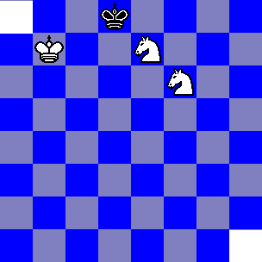

Classical Problem
  Can you completely cover the chessboard with these dominoes without partially using a domino? If so how. If not prove that you cannot.
2
Notes:
2
2
2

Slide 3
Classical Problem
  Key of invariant condition i.e. Shape of the tiles which we are using to cover the chessboard ( some information store in color)
  Given piece will cover one light and one blue tile because on a cheeseboard we do not have two white or black tiles adjusnt to each other
  We have equal number of blue and white squares on chessboard
  If do not have equal number of squares then we will not cover the whole chessboard
  Condition: We have removed two squares of the same color i.e. We are left with more blue then white i.e. 32 blue and 30 whites
3
Notes:
3
3
3

Slide 4
Conditional statements
  If ( i <= j ) then
  m : = i;
  else
  m :=j
  (m <= i and m <= j) and ( m = i or m =j)
  Possible: when “m” is smaller than i and j
  Current program assign smallest value to “m”
  Question: what is the wp? i.e. What is the condition to impose on input i and j such that we get our objective
4
Notes:
4
4
4

Slide 5
Conditional statements
  Else Part
  (i >j)
  m :=j ;
  (m = i or m = j) and ( m <= i and m <=j)
  (i > j) and ( j =i or j = j ) and ( j <=i and j <= j)
  ( i>j ) and (true) and ( j<= i and true)
  ( i >j) and ( j <= i )
  (i>j)
5
Notes:
5
5
5
- (i > j) is a subset of (j<=i)

Slide 6
Conditional statements
  If ( i <= j ) then
  m : = i;
  (m = i or m =j) and ( m <= i and m <= j)
  ( i < = j ) and ( i= i or i = j) and ( i < = i and i <= j)
  ( i <=j ) and ( true) and ( true and i <=j)
  ( i < = j) and ( i < = j)
  ( i< = j)
6
Notes:
6
6
6

Slide 7
Conditional statements
  ( i< = j) or ( i >j)
  Universal set
7
Notes:
7
7
7

Slide 8
Tower of Hanoi
8
Notes:
8
8
8

Slide 9
Tower of Hanoi
9
Notes:
9
9
9

Slide 10
Tower of Hanoi
10
Notes:
10
10
10

Slide 11
Invariant condition in Iteration
  Recursive solution is given in every book
  But we need to find iterative solution
  Odd number moves involved smallest disk
  Smallest disk move in clock-wise or anti-clock wise depending on the number of disks
  If you started with even number of disks it would be clock wise, if started with odd number then anti-clock
  Your having only one move after moving small disk
  Finding the weakest pre-condition in loops are not simple as compared to conditional statements
11
Notes:
11
11
11

Slide 12
Loop invariants
  s = 0;
  for i: = 1 to n do
  s = s + a [i];
  What is the “loop invariant” ?
  Post condition: In “s” we want to have the sum of all the elements of an array.
  I got many answers in front of me: value of “i” between 1 and “n”. But that does not help us. Remember loop invariant definition.
12
Notes:
12
12
12

Slide 13
Loop invariants
  How step in the loop should take us closer to achieve our objectives.
  How ?
  s = 0;
  for i: = 1 to n do
  s = s + a [i];
  Values of “s” will be stated in terms of formula.
  What is the value of “s” before start of the loop : S=0
  Value of “s” after first iteration : First element in it
  After two: “s” has the sum of first and second element.
  After three: Sum of first three elements
  After K iteration: S has the value which is the sum of 1 to k
13
Notes:
13
13
13

Slide 14
Loop invariants
  “s” is the sum of elements from a[1] to a [i] immediately before i is incremented
  Think about While loop ( compare it with IF statement)
14
Notes:
14
14
14

Slide 15
Weakest pre-condition for While statement
  { P} while B do S {Q}
  Let W be while B do S
  Condition for termination of the loop
  Po = ( not B)
  P1 = B and wp (S, Po) = wp ( S , not B) ( once true)
  Pk = B and wp ( S, P k-1)
15
Notes:
15
15
15

Slide 16
Weakest pre-condition for While statement
  The invariant condition
  {I} while B do S { I and not B}
16
Notes:
16
16
16

Slide 17

Weakest pre-condition for While statement
  a =0;
  i=0;
  while ( i<N)
  a = a + i++;
  Do we ever come out of this loop?
  Objective of this program is to add the first “n” numbers
  Loop invariant :
  Constraints on the input?
17
Notes:
17
17
17

Slide 18
Weakest pre-condition for While statement
  What would happen when “N” is zero or negative number
  When “N” is -1 then we have zero in a.
18
Notes:
18
18
18

Slide 19
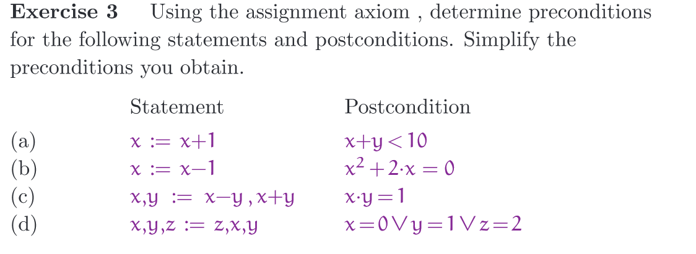
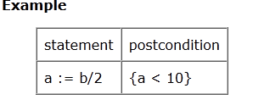
19
Notes:
19
19
19

