Slide 1
Formal Methods in Software Engineering
Lecture # 25
1
Notes:
1
1

Slide 2
Problem with Truth Table
Any problem with the truth table?
Perform good when the number of proposition is small but if the number of proposition is large then?
In truth table number of rows depends on the number of variables: If we have two variables then …
Another method is to built logical argument using deduction rules.
2
Notes:
2
2
2

Slide 3
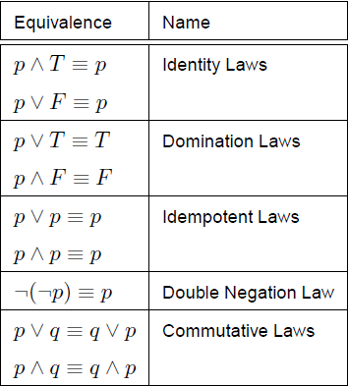
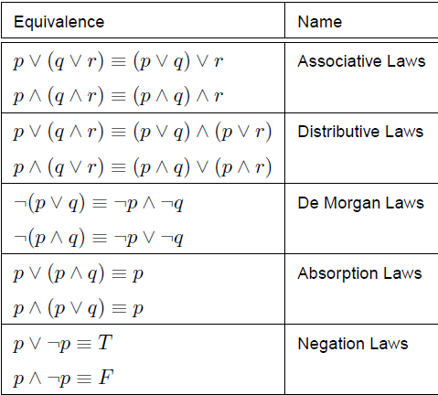
Some useful Equivalences
3
Notes:
3
3
3

Slide 4
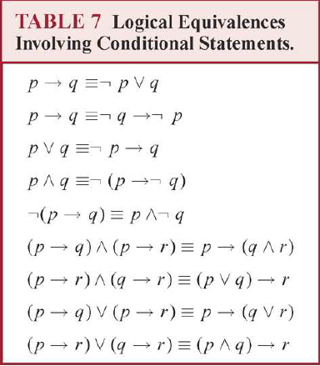
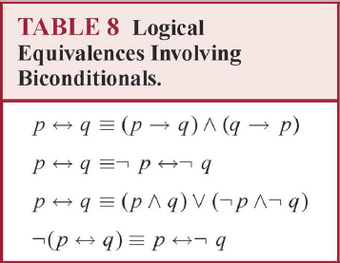
Some useful Equivalences
4
Notes:
4
4
4

Slide 5


Proof using Equivalences
A ⬄ ( A => H )
  A ⬄ ( not A or H)
  (A and ( not A or H )) or (not A and not (not A or H))
A and ( not A or H)
  (A and not A ) or ( A and H) – Distributive law
  False or (A and H)
  A and H
not A and not ( not A or H) Demorgans law
  not A and (A and not H) Associative
  (not A and A ) and not H (Negation Law)
  False and not H
  false
5
Notes:
5
5
5

Slide 6
Proof using Equivalences
Hence proved
  A ⬄ ( not A or H)
  (A and H ) or false
  A and H
6
Notes:
6
6
6

Slide 7
Rules for Inference & Logical Deduction
Introduction Rules
If two proposition is given then;
  p q (given)
  p and q (conclude)
If one proposition is given then;
  p q if p is true then p and q is true
  p and q p and q
Another;
  q if q is true then p=> will always true; p(not matter)
  p => q
7
Notes:
7
7
7

Slide 8
Rules for Inference & Logical Deduction
Elimination Rules
  p and q p and q if p and q is true then p is true
  p q
  if p is true and p=>q is also true so q has to be true
  p p => q
  q
  if your assumption is false then you can concluded anything
  p not p false
  false p
8
Notes:
8
8
8

Slide 9
Rules for Inference & Logical Deduction
Rules Importance
  Plays important role in logic e.g. Contradiction
  If your assumption is false than no matter what ever you concluded e.g. Implication (Pre-condition)
9
Notes:
9
9
9

Slide 10
Rules for Inference & Logical Deduction
Does the superman exist?
  If superman were able and willing to prevent evil , he would do so. If superman were unable to prevent evil, he would be incapable; if he were unwilling to prevent evil, he would be malevolent. Superman does not prevent evil. If superman exists he is neither incapable nor malevolent. There for superman does not exits.
10
Notes:
10
10
10

Slide 11
Rules for Inference & Logical Deduction
Superman Exits X
  Superman is willing to prevent evil W
  Superman is able to prevent evil A
  Superman is malevolent M
  Superman is incapable I
  Superman prevent evil E
11
Notes:
11
11
11

Slide 12
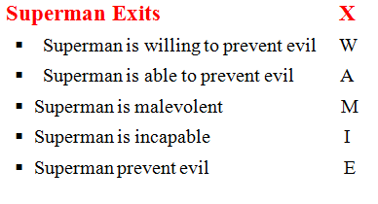
Rules for Inference & Logical Deduction
1: Assume
  (( W and A) => E)
  and ( ( not A ) => I )
  and ((not W) => M)
  and ( not E )
  and ( X => not ( I or M ))
  Prove that not X
  Logical conclusion is : Superman does not exits
12
Notes:
12
12
12

Slide 13
Rules for Inference & Logical Deduction
2: Assume X
  Use elimination rule to break No.1 down into 5 premises
3: ( W and A ) => E
4: ( not A ) => I
5: ( not W ) => M
6: not E
7: X => not ( I or M)
13
Notes:
13
13
13

Slide 14

Now application of elimination on 2 and 7 derives another simple proposition
2: Assume X 7: X => not ( I or M )
8: not ( I or M )
Now Proving I or M will result in a contradiction
14
Notes:
14
14
14

Slide 15


Now we will analyze W
9: Assume not W
10: M (from 5 & 9)
11: I or M ( from 10: introduction)
but Contradiction
15
Notes:
15
15
15

Slide 16
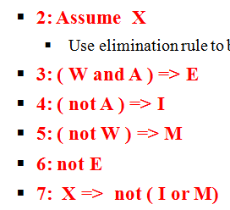

12: Assume W (Now to check in W true case)
Two possibilities for A (true or false)
13: Assume A (true)
14: W and A (12 and 13)
15: E (from 3 and 14)
16: false (from 6 & 15)
17: I or M (from 16) -> again contradiction
16
Notes:
16
16
16

Slide 17

18: Assume not A
19: I (4 and 18)
20: I or M (from 19)
21: I or M (from 17 & 20)
22: I or M (from 11 and 21)
23: false (Contradiction 8 and 22)
24: not X (from 2 and 23)
17
Notes:
17
17
17

Slide 18
Logical problem for the day
  On the island of knight and knaves, it is rumoured that there is gold buried on the island. You ask one of the native, A, whether there is a gold on the island. He makes the following responses: “There is gold on this island if and only if I am a knight.”
  The problem is as follows:
  a) Can it be determined whether A is a knight or a knave?
  b) Can it determined whether there is gold on the island?
18
Notes:
18
18
18

Slide 19
Logical problem for the day
  There is gold on the island G
  A is a knight A
  Therefore we have A ( A ⬄ G)
A | G | A <=> G | A (A <=> H)
T | T | T | T
F | T | F | T
T | F | F | F
F | F | T | F
19
Notes:
19
19
19

Slide 20
Quiz # 1
  (1) Translate the following expression into logical expression:
  “Ali is either smart or honest, but Ali is not honest if he is smart.”
  (2) Solve the puzzle using propositional logic:
  There are two types of people on an island:
  Knight: Always tell truth.
  Knave: Always lie
  A says: “B is a knight.”
  B says: “Two of us are opposite types.”
  Determine the types of A and B..
  Island Rule: Ahmad is a knight if what he said is true and Ali is a knight if what he said is true.
20
Notes:
20
20
20

Slide 21
Associativity of Equivalence
  A B C
  Can be evaluated as;
  (A B) C
  Or
  A ( B C)
  If we have two numbers : x and y. Add them (x + y) and find weather the ans is even or odd?
21
Notes:
21
21
21

Slide 22
Even and Odd numbers
  If we have two numbers : x and y. Add them and find weather the ans is even or odd?
  When the two numbers are odd then ans -> Even
  i.e. m + n is even m is even n is even
  m + n is even (m is even n is even)
22
Notes:
22
22
22

Slide 23
A B C
A | B | C | A B | (A B) c
F | F | F | T | F
F | F | T | T | T
F | T | F | F | T
F | T | T | F | F
T | F | F | F | T
T | F | T | F | F
T | T | F | T | F
T | T | T | T | T
23
Notes:
23
23
23

Slide 24
Full Adder
  b a
C out FA C
  d
a=1 A
b = 1 B
c= 1 C
c= 1 D
D = ( A B C)
24
Notes:
24
24
24

Slide 25
Island Gold Problem
  There is gold on the island G
  A is a knight A
  Therefore we have A ( A ⬄ G)
  A ( A G)
  ( A A ) G)
  true G
  G
25
Notes:
25
25
25

Slide 26
Properties of equivalence
  constant true
  true p p
  true = ( p p)
  ( true p) = p
  Symmetry
  ( p q ) = ( q p)
  e.g. p p q p r q
  p p p q q r
  true p true r
  p r
26
Notes:
26
26
26

Slide 27
  Replace the term which is repeated odd number of times by a single occurrence of the term and any term which is repeated an even number of times by removing all occurrences.
  A is a knight A
  A says “ I am a knight “ A
  A A
  Since this is always true, no meaning-full conclusion can be made.
27
Notes:
27
27
27

Slide 28
  A is a knight A
  B is a knight B
  A says “ I am the same type as B “ A B
  A A B
  B
  Person is equivalent to the statement
  Think about this problem logically
  A Says “ I am the same type as B “
28
Notes:
28
28
28

Slide 29
Island of knights and Knaves
  Suppose A is the proposition “ Person A is a knight” and suppose A makes a statement S. Then A is true is the same as S is true. That is:
  A S
29
Notes:
29
29
29

Slide 30
Logical problem for the day
  A tourist comes to a fork in the road, where one branch leads to a restaurant and one does not. A native of the island is standing at the fork. Formulate a single yes/no question that the tourist can ask such that the answerer will be yes if the left fork leads to the restaurant, and otherwise the answerer will be no.
30
Notes:
30
30
30

Slide 31
Logical problem for the day
  Let Q be the question
  Let A be “the native is a knight”
  Let L be “the left fork leads to the restaurant”
  The response to the question Q is yes is equivalent to Q A
  So we require that: L Q A or
  Q ( L A)
  Is the statement that “the left fork leads to the restaurant” equivalent to “your being a knight”?
31
Notes:
31
31
31

Slide 32
Logical problem for the day
  There are two natives A and B. A says, “ B is a knight is the same as I am a knave”.
  What can you determine about A and B ?
  A’s statement is : B ┐ not A
  So, we have: A B not A
  A not A B
  false B
  not B
  A ?
32
Notes:
32
32
32

Slide 33
Golden Rule
  p Λ q p q p v q
33
Notes:
33
33
33

Slide 34
Implication
  p => q p p Λ q
  p => q q p v q
34
Notes:
34
34
34

Slide 35
Problem
  A says: “ If I am a knight, B is a knight”.
  A => B
  A A => B
  A A A Λ B
  A Λ B
35
Notes:
35
35
35

Slide 36
Logical problem for the day
  Three of the inhabitants – A, B, and C – were standing together in a garden. A stranger passed by and asked A, “ Are you a knight or a knave?” A answered but the stranger could no understand. The stranger then asked B, “ What did A say?”. B replied, “ A said that he is a knave”. At this point, C said, “Don’t believe B; he is lying!”
  What are A, B and C.
36
Notes:
36
36
36

Slide 37
Problem
  B’s statement is: A ┐A
  C’s statement is: ┐B
  So we have:
  ( B A ┐A ) ٨ ( C ┐B)
  ┐B ٨ ( C ┐B )
  (┐B ٨ C ) (┐B ٨ ┐B)
  (┐B ٨ C ) ┐B
  ┐B ٨ C
37
Notes:
37
37
37

Slide 38
Problem
  A says, either I am a knave or B is a knight.
  A ┐A ۷ B
  A ( A false ) ۷ B
  A ( A v B false ۷ B
  A A v B B
  A ٨ B
38
Notes:
38
38
38

Slide 39
Conditional Correctness
  { P} S {Q}
  (initial state) (set of instruction) (Final State)
  Expresses the conditional correctness of S
  Binary search (pre-condition) - > Array must be in sorted form
  Which means that, in-order to work this program properly we need to start with a given condition.
  Post Condition: If the key is present then you will get the index, if the key is not present then you will get some value which will tell you that the key is not present (desired output).
  If we start with “P” and ended with “Q” then our program is conditional corret.
39
Notes:
39
39
39

