Slide 1
Formal Methods in SE
Lecture 20

Slide 2
Agenda
Relations in Z Specification

Slide 3


Domain and Range Restriction
A new relation may be created by restricting the domain or range of a relation to a set
The resulting relation only has pairs where the first (domain restriction) or second (range restriction) element is a member of the restricting set.

Slide 4

Domain and Range Restriction

Slide 5



Domain and Range Subtraction
Similarly, elements may be subtracted from the domain or range to yield a new relation
= ?

Slide 6
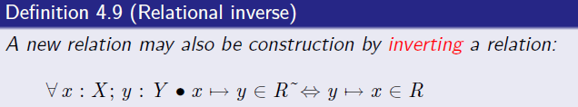
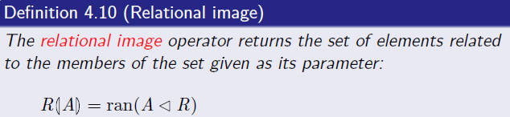
Relation Inverse and Relation Image

Slide 7
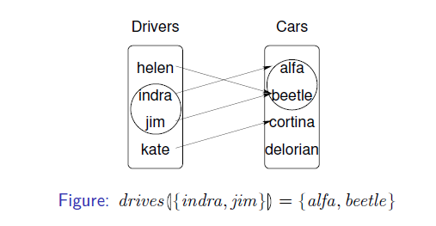

Contd…

Slide 8
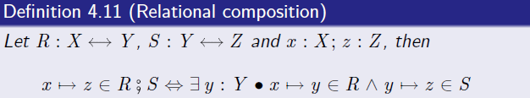
Relation Composition
If the target of one relation matches the source of another, it may be useful to consider their relational composition
The composition of two relations relates objects in the source of the first to objects in the target of the second, provided that some intermediate point exists.

Slide 9
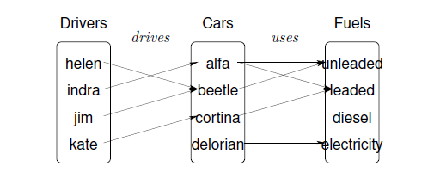
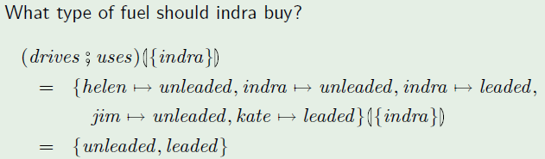
Relation Composition

Slide 10
Relation Example
A project must be located in a city, but any city may have many projects located within it. Many workers can work on a project, and a worker can work on many projects. A worker can have many skills (e.g. preparing material requisitions, checking drawings, etc.), but he/she may only use a given skill on a particular project if that skill is required.

Slide 11


Relation Example
Sets Required
  Project a set of projects
  City a set of cities
  Worker a set of workers
  Skill a set of skills
Building Relations
A project must be located in a city, but any city may have many projects located within it.
Many workers can work on a project, and a worker can workon many projects.

Slide 12

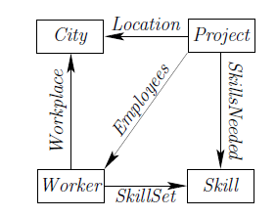
Relation Example
A worker can have many skills (e.g. preparing material requisitions, checking drawings, etc.), but he/she may only use a given skill on a particular project if that skill is required.
Model can be visualized as

Slide 13
VDM
Formal Methods in SE
Qaisar Javaid, Assistant Professor
Notes:
1

Slide 14
Formal Specification Languages
A formal specification language is a formal language used for expressing models of computing systems. Such languages typically provide support for abstraction and rigour.
General Purpose
VDM-SL
Z
RSL
Act One
Clear
Special Purpose
CCS
CSP
Real-Time Logic
Deontic Logics
Notes:
14

Slide 15
Formal Specification Languages: VDM-SL
Vienna Development Method (VDM)
Spec Language is VDM-SL
ISO Standardised: fully formal
Support Tools are available
Good record of industrial use
Support for abstraction of data and functionality
Notes:
15

Slide 16
Basic logical operators
We build more complex logical expressions out of simple ones using logical connectives:
  not negation
  and conjunction
  or disjunction
  => implication (if … then …)
  <=> biimplication (if and only if)

Slide 17
Basic logical operators Negation
Negation allows us to state that the opposite of some logical expression is true, e.g.
  The temperature in the monitor mon is not rising:
    not Rising(mon)
Truth table for negation:
A
true
false
not A
false
true

Slide 18
Basic logical operators Disjunction
Disjunction allows us to express alternatives that are not necessarily exclusive:
OverLimit: Monitor -> bool
A
true
true
false
false
B
true
false
true
false
A or B
true
true
true
false

Slide 19
Basic logical operators Conjunction
Conjunction allows us to express the fact that all of a collection of facts are true.
Continually over limit: all the readings in the sample exceed 400 C
COverLimit: Monitor -> bool
COverLimit(m) == m.temps(1) > 400 and
m.temps(2) > 400 and
m.temps(3) > 400 and
m.temps(4) > 400 and
m.temps(5) > 400
A
true
true
false
false
B
true
false
true
false
A and B
true
false
false
false

Slide 20
Basic logical operators Implication
Implication allows us to express facts which are only true under certain conditions (“if … then …”):
Safe: If readings do not exceed 400 C by the middle of the sample, the reactor is safe. If readings exceed 400 C by the middle of the sample, the reactor is still safe provided that the reading at the end of the sample is less than 400 C.
Safe: Monitor -> bool
A
true
true
false
false
B
true
false
true
false
A => B
true
false
true
true

Slide 21
Basic logical operators Biimplication
Biimplication allows us to express equivalence (“if and only if”).
Alarm: The alarm is to be raised if and only if the reactor is not safe
This can be recorded as an invariant property:
Monitor :: temps : seq of int
alarm : bool
inv m == len m.temps = 5 and
A
true
true
false
false
B
true
false
true
false
A <=> B
true
false
false
true

Slide 22
Quantifiers
For large collections of values, using a variable makes more sense than dealing with each case separately.
inds m.temps represents indices (1-5) of the sample
The “over limit” condition can then be expressed more economically as:
  exists i in set inds m.temps & temps(i) > 400
The “continually over limit” condition can then be expressed using “forall”:

Slide 23
Quantifiers
Syntax:
  forall binding & predicate
  exists binding & predicate
There are two types of binding:
  Type Binding, e.g.
  x:nat
  n: seq of char
  Set Binding, e.g.
  i in set inds m
  x in set {1,…,20}
A type binding lets the bound variable range over a type (a possibly infinite collection of values).
A set binding lets the bound variable range over a finite set of values.

Slide 24
Quantifiers
Several variables may be bound at once by a single quantifier, e.g.
  forall x,y in set {1,…,5} &
      not m.temp(x) = m.temp(y)
Would this predicate be true for the following value of m.temp ?
  [320, 220, 105, 119, 150]

Slide 25
coping with undefinedness
Suppose sensors can fail in such a way that they generate the value Error instead of a valid temperature.
In this case we can not make comparisons like
  Error < 400
The logic in VDM is equipped with facilities for handling undefined applications of operators (e.g. if division by zero could occur).
Truth tables are extended to deal with the possibility that undefined values can occur, e.g.
A
true
false
*
not A
false
true
*
* represents the undefined value

Slide 26
Disjunction in LPF
A
true
true
true
false
false
false
*
*
*
B
true
false
*
true
false
*
true
false
*
A or B
true
true
true
true
false
*
true
*
*
If one disjunct is true, we know that the whole disjunction is true, regardless of whether the other disjunct is true, false or undefined.

Slide 27
Conjunction in LPF
A
true
true
true
false
false
false
*
*
*
B
true
false
*
true
false
*
true
false
*
A and B
true
false
*
false
false
false
*
false
*
If one conjunct is false, we know that the whole conjunction is false, regardless of whether the other disjunct is true, false or undefined.

