Slide 1
Software Quality Engineering
Lecture No. 32

Slide 2
Revision of the course

Slide 3
Test Planning and Preparation
• Major testing activities:
. test planning and preparation
. execution (testing)
. analysis and follow-up
• Test planning:
. goal setting
. overall strategy
• Test preparation:
. preparing test cases & test suite(s) (systematic: model-based; our focus)
. preparing test procedure

Slide 4
Applications of Testing Techniques
• Major testing techniques covered so far:
    . Ad hoc (non-systematic) testing.
    . Checklist-based testing.
    . Partition-based coverage testing.
    . Musa’s OP for UBST.
    . Boundary testing (BT).
    . Control flow testing (CFT).
    . Data flow testing (DFT)
    • Application and adaptation issues:
    . For different purposes/goals.
    . In different environments/sub-phases.
    . Existing techniques: select/adapt.
    . May need new or specialized techniques.

Slide 5
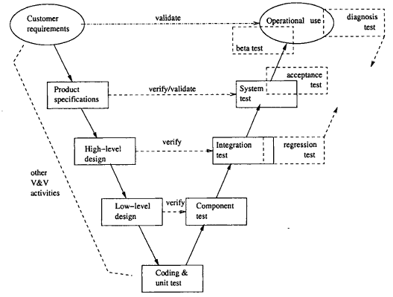
Testing Sub-Phases: V-Model
Testing sub-phases associated with the V-Model

Slide 6
Testing Levels
Unit Testing
Programs will be tested at unit level
The same developer will do the test
Integration Testing
When all the individual program units are tested in the unit testing phase and all units are clear of any known bugs, the interfaces between those modules will be tested
Ensure that data flows from one piece to another piece
System Testing
After all the interfaces are tested between multiple modules, the whole set of software is tested to establish that all modules work together correctly as an application.
Put all pieces together and test
Acceptance Testing
The client will test it, in their place, in a near-real-time or simulated environment.

Slide 7
Testing Vs Debugging
Testing is focused on identifying the problems in the product
Done by Tester
Need not know the source code
Debugging is to make sure that the bugs are removed or fixed
Done by Developer
Need to know the source Code

Slide 8
QA Alternatives
• Defect and QA:
    . Defect: error/fault/failure.
    . Defect prevention/removal/containment.
    . Map to major QA activities
• Defect prevention:
    – Error source removal & error blocking
• Defect removal: Inspection/testing/etc.
• Defect containment: Fault tolerance and failure containment (safety assurance).

Slide 9
Generic Ways for Defect Prevention
• Error blocking
    . Error: missing/incorrect actions
    . Direct intervention
    . Error blocked ⇒ fault injections prevented (or errors tolerated)
    . Rely on technology/tools/etc.
• Error source removal
    . Root cause analysis ⇒ identify error sources
    . Removal through education/training/etc.

Slide 10
Inspection as Part of QA
• Throughout the software process
    . Coding phase: code inspection
    . Design phase: design inspection
    . Inspection in other phases and at transitions from one phase to another
• Many different software artifacts:
    . program code, typically
    . requirement/design/other documents
    . charts/models/diagrams/tables/etc.
• Other characteristics:
    . People focus.
    . Not waiting for implemented system.
    . Complementary to other QA activities.

Slide 11

Generic Inspection Process
1. Planning and preparation (individual)
2. Collection (group/meeting)
3. Repair (follow-up)

Slide 12
Inspection Process Variations
• Overall planning:
    . who? team organization/size/roles/etc. .
    what? inspection objects
    . objectives?
    . number/coordination of multiple sessions?
• Technique
    . for preparation (individual inspection)
    . for collection
• What to do with defects?
    . always: detect and confirm defects
    . classify/analyze defects for feedback?
• Use of post-collection feedback?

Slide 13
Fagan Inspection
• General description
    . Earliest, Fagan at IBM
    . Lead to other variations
    . Generic process and steps
• Six steps of Fagan inspection:
    1. Planning
    2. Overview (1-to-n meeting)
    3. Preparation (individual inspection)
    4. Inspection (n-to-n meeting)
    5. Rework
    6. Follow-up.

Slide 14
Other Inspection Methods
Variations to Fagan inspection: size/scope and formality variations.
Alternative inspection techniques/processes:
    . Two-person inspection
    . Meeting-less inspections
    . Gilb inspection
    . Phased inspections
    . N-fold inspections
    . Informal check/review/walkthrough
    . Active design reviews
    . Inspection for program correctness
    . Code reading
    . Code reading with stepwise abstraction

Slide 15
QA and Formal Verification
• Formal methods = formal specification + formal verification
• Formal specification (FS):
    . As part of defect prevention
    . Formal ⇒ prevent/reduce defect injection due to imprecision, ambiguity, etc.
    . Briefly covered as related to FV.
• Formal verification (FV):
    . As part of QA, but focus on positive: “Prove absence of fault”
    . People intensive
    . Several commonly used approaches

Slide 16
Formal Specification: Ideas
Formal specification:
    . Correctness focus
    . Different levels of details
    . 3Cs: complete, clear, consistent
    . Two types: descriptive & behavioral
Descriptive formal specifications:
    . Logic: pre-/post-conditions.
    . Math functions
    . Notations and language support: Z, VDM, etc.
Behavioral formal specifications: FSM, Petri-Net, etc.

Slide 17
Formal Specification: Ideas
• “Testing shows the presence of errors, not their absence.” — Dijkstra
• Formal verification: proof of correctness
    . Formal specs: as pre/post-conditions
    . Axioms for components or functional units
    . Composition (bottom-up, chaining)
    . Development and verification together
• Other related approaches:
    . Semi-formal verification
    . Model checking
    . Inspection for correctness

Slide 18
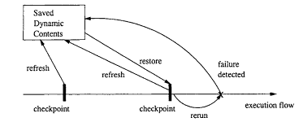
FT: Recovery Blocks (RB)
General idea:
    . Periodic check-pointing
    . Problem detection/acceptance test
    . Rollback (recovery)

Slide 19
FT: Recovery Blocks (RB)
• Periodic check-pointing
    . too often: expensive check-pointing
    . too rare: expensive recovery
    . smart/incremental check-pointing
• Problem detection/acceptance test
    . exceptions due to in/external causes
    . periodic vs event-triggered
• Recovery (rollback) from problems:
    . external disturbance: environment?
    . internal faults: tolerate/correct?

Slide 20
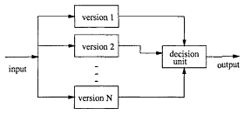
Fault Tolerance: N- Version Programming
• FT with NVP:
    . NVP: N-Version Programming
    . Multiple independent versions
    . Dynamic voting/decision ⇒ FT.

Slide 21
Hazard Elimination
• Hazard sources identification ⇒ elimination (Some specific faults prevented or removed.)
• Traditional QA (but with hazard focus):
    . Fault prevention activities:
        education/process/technology/etc
        formal specification & verification
    . Fault removal activities:
        rigorous testing/inspection/analyses
• “Safe” design: More specialized techniques:
    . Substitution, simplification, decoupling.
    . Human error elimination.
    . Hazardous material/conditions↓

Slide 22
Hazard Reduction
• Hazard identification ⇒ reduction (Some specific system failures prevented or tolerated.)
• Traditional QA (but with hazard focus):
    . Fault tolerance
    . Other redundancy
• “Safe” design: More specialized techniques:
    . Creating hazard barriers
    . Safety margins and safety constraints
    . Locking devices
    . Reducing hazard likelihood
    . Minimizing failure probability
    . Mostly “passive” or “reactive”

Slide 23
Hazard Control
• Hazard identification ⇒ control
    . Key: failure severity reduction.
    . Post-failure actions.
    . Failure-accident link weakened.
    . Traditional QA: not much, but good design principles may help.
• “Safe” design: More specialized techniques:
    . Isolation and containment
    . Fail-safe design & hazard scope↓
    . Protection system . More “active” than “passive”
    . Similar techniques to hazard reduction,
        but focus on post-failure severity↓ vs. pre-failure hazard likelihood↓.

Slide 24
Software Safety Program (SSP)
• Leveson’s approach (Leveson, 1995) — Software safety program (SSP)
• Process and technology integration
    . Limited goals
    . Formal verification/inspection based
    . But restricted to safety risks
    . Based on hazard analyses results
    . Safety analysis and hazard resolution
    . Safety verification:
        few things carried over

Slide 25
Software Safety Program (SSP)
• In overall development process:
    . Safety as part of the requirement
    . Safety constraints at different levels/phases
    . Verification/refinement activities
    . Distribution over the whole process

Slide 26
TFM: Two-Frame-Model
• TFM: Two-Frame-Model
    . Physical frame
    . Logical frame
    . Sensors: physical ⇒ logical
    . Actuators: logical ⇒ physical
• TFM characteristics and comparison:
    . Interaction between the two frames
    . Nondeterministic state transitions and encoding/decoding functions
    . Focuses on symmetry/consistency between the two frames.

Slide 27
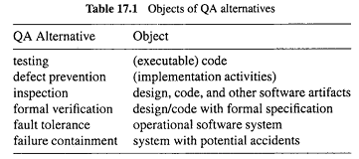
Comparison of the QA Alternatives: Applicability
• Objects QA activities applied on:
    . Mostly on specific objects, e.g., testing executable code
    . Exception: defect prevention on (implementation related) dev. activities

Slide 28
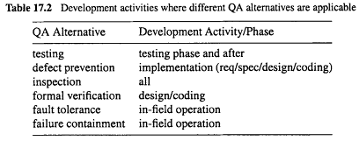
Comparison: Applicability
• Applicability to development phases:
    . In waterfall or V-model: implementation (req/design/coding) & testing/later.
    . Inspection in all phases.
    . Other QA in specific sets of phases.

Slide 29
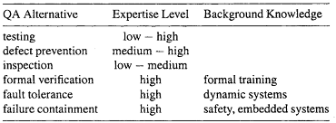
Comparison: Applicability/Expertise
• General expertise levels: mostly in ranges, depending on specific techniques used.
• Specific background knowledge
Required expertise and background knowledge for people to perform different QA Alternatives

Slide 30
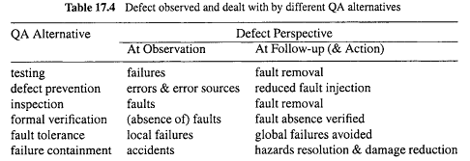
Comparison: Effectiveness
• Defect specifics or perspectives:
    . Dealing with errors/faults/failures?
    . Direct action vs follow-up action: may deal with different defect perspectives.
    . Example: failures detected in testing but (failure-causing) faults fixed in follow-up.

Slide 31
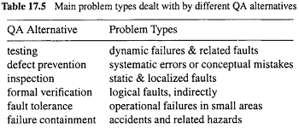
Comparison: Effectiveness
Problem or defect types:
    errors/faults/failures of different types or characteristics

Slide 32
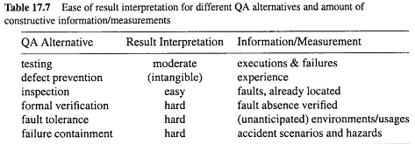
Comparison: Effectiveness
Ease of result interpretation
Specific info/measurement

Slide 33
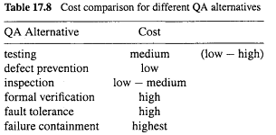
Comparison: Cost
• Overall cost comparison:
    . rough values and ranges
    . multiple factors but focus on performing the specific QA activities

Slide 34
Importance of Feedback Loop
All QA activities covered in Part II and Part III need additional support:
    . Planning and goal setting
    . Management via feedback loop:
        When to stop?
        Adjustment and improvement, etc.
        All based on assessments/predictions

Slide 35
Importance of Feedback Loop
Feedback loop for quantification/improvement:
    . Focus of Part IV chapters .
        mechanism and implementation.
        models and measurements.
        defect analyses and techniques.
        risk identification techniques.
        software reliability engineering

Slide 36
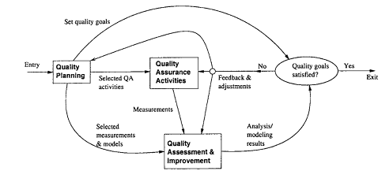
QE Activities and Process Review
• Major activities:
    . Pre-QA planning (earlier lectures).
    . QA (Part II and Part III).
    . Post-QA analysis & feedback
        Part IV (maybe parallel instead of “post-”)
• Overall process:– Software quality engineering (SQE)
Quality Engg. Process

Slide 37
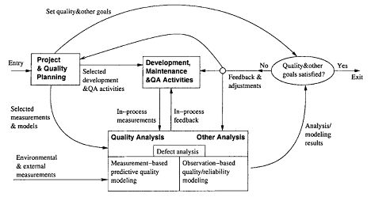
QE Activities and Process Review
Feedback loop zoom-in:
    . Multiple measurement sources.
    . Many types of analysis performed.
    . Multiple feedback paths.
    Refined Quality Engineering Process: Management, Analysis and feedback for Quantifiable improvement

Slide 38
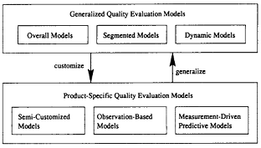
Quality Models
• Model taxonomy:
    . Generalized:
        – overall, segmented, and dynamic
    . Product-specific:
        – semi-customized: product history
        – observation-based: observations
        – measurement-driven: predictive
Classification of quality assessment models

Slide 39
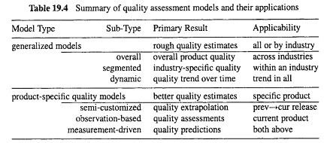
Quality Model Summary

Slide 40
Defect Analysis
Goal: (actual/potential) defect↓ or quality↑ in current and future products.
General defect analyses:
    . Questions: what/where/when/how/why?
    . Distribution/trend/causal analyses.
Analyses of classified defect data:
    . Prior: defect classification.
    . Use of historical baselines.
    . Attribute focusing in 1-way and 2-way analyses.
    . Tree-based defect analysis (Lecture 29)

Slide 41
Risk Identification Techniques
• New statistical techniques:
    . PCA: principal component analysis
    . DA: discriminant analysis
    . TBM: tree-based modeling
• AI-based new techniques:
    . NN: artificial neural networks.
    . OSR: optimal set reduction.
    . Abductive-reasoning, etc.

Slide 42
What Is SRE
• Reliability: Probability of failure-free operation for a specific time period or input set under a specific environment
    . Failure: behavioral deviations
    . Time: how to measure?
    . Input state characterization and Environment: OP
• Software reliability engineering:
    . Engineering (applied science) discipline
    . Measure, predict, manage reliability
    . Statistical modeling
    . Customer perspective:
        – failures vs. faults
        – meaningful time vs. development days
        – customer operational profile

Slide 43
The End of the Course

