Slide 1
Software Quality Engineering
Lecture No. 30

Slide 2
Part- 4:
Quantifiable Quality Improvement

Slide 3
Summary of the previous lecture
In our previous lecture, we talked about different techniques that are available for Risk Identification such as NN, PCA and OSR etc. Some of them are classified as statistical-based while other are Artificial Intelligence based
Each technique has some merits and limitations.
These techniques could be compared amongst each other using some parameters such as accuracy and usability etc.

Slide 4
Outlines of today’s lecture
In today’s lecture, we will talk about the last topic of the course, i.e., Software Reliability Engineering (SRE)
    Concepts and Approaches
    Existing Approaches: SRGMs & IDRMs
    Assessment & Improvement with TBRMs

Slide 5
Objectives
To understand and distinguish between different concepts and approaches used for Software Reliability Engineering (SRE)

Slide 6
What Is SRE
• Reliability: Probability of failure-free operation for a specific time period or input set under a specific environment
    . Failure: behavioral deviations
    . Time: how to measure?
    . Input state characterization and Environment: OP
• Software reliability engineering:
    . Engineering (applied science) discipline
    . Measure, predict, manage reliability
    . Statistical modeling
    . Customer perspective:
        – failures vs. faults
        – meaningful time vs. development days
        – customer operational profile

Slide 7
Assumption: SRE and OP
• Assumption 1: OP, to ensure software reliability from a user’s perspective.
• OP: Operational Profile
    . Quantitative characterization of the way a (software) system will be used.
    . Test case generation/selection/execution
    . Realistic assessment
    . Predictions (minimize discontinuity)

Slide 8
Other Assumptions in Context
• Assumption 2: Randomized testing
    . Independent failure intervals/observations
    . Approximation in large software systems
    . Adjustment for non-random testing
    ⇒ new models or data treatments
• Assumption 3: Failure-fault relation
    . Failure probability ∼ # faults
    . Exposure through OP-based testing
    . Possible adjustment?
    . Statistical validity for large s/w systems

Slide 9
Other Assumptions and Context
• Assumption 4: time-reliability relation
    . time measurement in SRGMs
    . usage-dependent vs. usage-independent
    . proper choice under specific environment.
• Usage-independent time measurement:
    . calendar/wall-clock time
    . only if stable or constant workload
• Usage-dependent time measurement:
    . for systems with uneven workload
    . execution time – Musa’s models
    . alternatives: runs, transactions, etc.

Slide 10
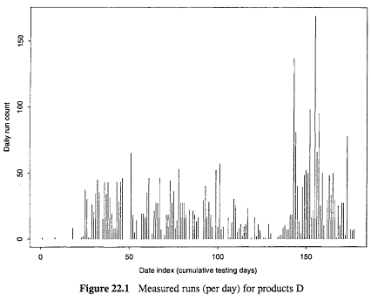
Workload for Products: An example of IBM
IBM product D workload
    . number of test runs for each day
    . wide variability
    . need usage-dependent time measurement (# of runs used)

Slide 11
Input Domain Reliability Models (IDRMs)
• IDRMs: Current reliability snapshot based on observed testing data of n samples.
• Assessment of current reliability.
• Prediction of future reliability (limited prediction due to snapshot)
• Management and improvement
    . As acceptance criteria.
    . Risk identification and follow-ups:
        reliability for input subsets
        remedies for problematic areas
        preventive actions for other areas

Slide 12

Nelson’s IDRM
• Nelson Model:
    . Running for a sample of n inputs.
    . Randomly selected from set E:
    E = {Ei : i = 1, 2, . . . , N}
    . Sampling probability vector:
    {Pi : i = 1, 2, . . . , N} .
    .{Pi}: Operational profile.
    . Number of failures: f.
    . Estimated reliability:

Slide 13
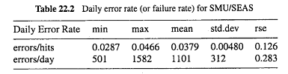
IDRM Applications
• Nelson model for web applications
    daily error rates:

Slide 14

Other IDRMs
• Brown-Lipow model:
    . explicit input state distribution.
    . known probability for sub-domains Ei
    . fi failures for ni runs from subdomain Ei
    would be the same as Nelson model for representative sampling

Slide 15
IDRM Applications
• IDRM applications
    . overall reliability at acceptance testing
    . reliability snapshots over time: in Nelson model examples earlier
    . reliability for input subsets: in TBRMs

Slide 16
Time Domain Measures and Models
• Reliability measurement
    . Reliability: time & probability
    . Result: failure vs. success
    . Time/input measurement
    . Failure intensity (rate): alternative
    . Mean Time Between/To Failures (MTBF/MTTF): summary measure

Slide 17
S/w reliability growth models (SRGMs)
• S/w reliability growth models (SRGMs):
    . Reliability growth due to defect removal based on observed testing data.
    . Reliability-fault relations
    . Exposure assumptions
    . Data: time-between-failure (TBF) vs. period-failure-count (PFC) models

Slide 18
SRGM Applications
• Assessment of current reliability
• Prediction of future reliability and resource to reach reliability goals
• Management and improvement
    . Reliability goals as exit criteria
    . Resource allocation (time/distribution)
    . Risk identification and followups:
        – reliability (growth) of different areas
        – remedies for problematic areas
        – preventive actions for other areas

Slide 19
Assessing Existing Approaches
• Time domain reliability analysis:
    . Customer perspective.
    . Overall assessment and prediction.
    . Ability to track reliability change.
    . Issues: assumption validity.
    . Problem: how to improve reliability?
• Input domain reliability analysis:
    . Explicit operational profile.
    . Better input state definition.
    . Hard to handle change/evolution.
    . Issues: sampling and practicality.
    . Problem: realistic reliability assessment?

Slide 20
TBRMs: An Integrated Approach
• Combine strengths of the two.
• TBRM for reliability modeling:
    . Input state: categorical information.
    . Each run as a data point.
    . Time cutoff for partitions.
    . Data sensitive partitioning ⇒ Nelson models for subsets.
• Using TBRMs:
    . Reliability for partitioned subsets.
    . Use both input and timing information.
    . Monitoring changes in trees.
    . Enhanced exit criteria.
    . Integrate into the testing process.

Slide 21
TBRMs: Interpretation & Usage
• Interpretation of trees:
    . Predicted response: success rate. (Nelson reliability estimate.)
    . Time predictor: reliability change.
    . State predictor: risk identification.
• Change monitoring and risk identification:
    . Change in predicted response.
    . Through tree structural change.
    . Identify high risk input state.
    . Additional analyses often necessary.
    . Enhanced test cases or components.

Slide 22
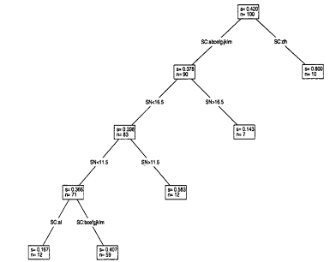
TBRMs at Different Times
An early TBRM.
    high-risk areas identified by input
    early actions to improve reliability

Slide 23
TBRMs at Different Times
An early/late TBRM.
    high-risk areas identified by input
    early actions to improve reliability
    high-risk areas ≈ early runs
    . uniformly reliable ⇒ ready for release

Slide 24
TBRM Impact
• Evaluation/validation with SRGMs:
    . Trend of reliability growth.
    . Stability of failure arrivals.
    . Estimated reliability:
    Important: deployment at all successor products at IBM

Slide 25
Integrated Approach: Implementation
• Modified testing process:
    . Additional link for data analysis.
    . Process change and remedial actions.
• Activities and Responsibilities:
    . Evolutionary, stepwise refinement.
    . Collaboration: project & quality orgs.
    . Experience factory prototype.
• Implementation:
    . Passive tracking and active guidance.
    . Periodic and event-triggered.
    . S/W tool support

Slide 26
Tool Support
• Types of tool support:
    . Data capturing
        mostly existing logging tools
        modified to capture new data
    . Analysis and modeling
        SMERFS modeling tool
        S-PLUS and related programs
    . Presentation/visualization and feedback
        S-PLUS and Tree-Browser

Slide 27
Implementation Support
Implementation of tool support:
    . Existing tools: minimize cost
        internal as well as external tools
    . New tools and utility programs
    . Tool integration
        loosely coupled suite of tools
        connectors/utility programs

Slide 28
SRE Perspectives
• New models and applications
    . Expand from “medium-reliable” systems.
    New models for new application domains.
    Data selection/treatment
• Reliability improvement
    . Followup to TBRMs
    Predictive (early!) modeling for risk identification and management
• Other SRE frontiers:
    . Coverage/testing and reliability
    . Reliability composition and maximization

Slide 29
Summary of Today’s Lecture
In today’s lecture, we talked about the Software Reliability Engineering (SRE)
    Concepts and Approaches
    Existing Approaches: SRGMs & IDRMs
    Assessment & Improvement with TBRMs

Slide 30
Overview of the next lecture
The last two lectures of the course, i.e., Lecture No. 21 & 32 are going to be the revision of the whole course.

Slide 31
The End

