Slide 1
Software Quality Engineering
Lecture No. 29

Slide 2
Part- 4:
Quantifiable Quality Improvement

Slide 3
Summary of the previous lecture
In our previous lecture, we talked about Defect Classification and Analysis. We also focused on:
    General Types of Defect Analyses,
    ODC: Orthogonal Defect Classification.
    Analysis of ODC Data.
    We also discussed an examples of most common defects that occur in a web based project.

Slide 4
Outlines of today’s lecture
In today’s lecture, we will talk about Risk Identification for Quantifiable Quality Improvement
    Basic Ideas and Concepts
    Traditional Statistical Techniques
    Newer/More Effective Techniques
      NN, TBM, OSR etc.
    Tree-Based Analysis of ODC Data

Slide 5
Objectives
To understand and distinguish between different techniques that are available for risk identification in a software
To apply the knowledge learnt in the real life software.

Slide 6
Risk Identification: Why?
• Observations and empirical evidences:
    . 80:20 rule: non-uniform distribution:
        20% of the modules/parts/etc. contribute to
        80% of the defects/effort/etc.
    . implication: non-uniform attention – risk identification – risk management/resolution
• Risk Identification in SQE:
    . 80:20 rule as implicit hypothesis
    . focus: techniques and applications

Slide 7
Risk Identification: How?
• Qualitative and subjective techniques:
    . Causal analysis
    . Delphi and other subjective methods
• Traditional statistical techniques:
    . Correlation analysis
    . Regression models:
        linear, non-linear, logistic, etc.
• Newer (more effective) techniques:
    . Statistical: PCA, DA, TBM
    . AI-based: NN, OSR
    . Focus of our Lecture.

Slide 8
Risk Identification: Where?
• 80% or target:
    . Mostly quality or defect (most of our examples also)
    . Effort and other external metrics
    . Typically directly related to goal
    . Resultant improvement
• 20% or contributor:
    . 20%: risk identification!
    . Understand the link
    . Control the contributor:
          corrections/defect removal/etc.
          future planning/improvement
          remedial vs preventive actions

Slide 9
New Techniques
• New statistical techniques:
    . PCA: principal component analysis
    . DA: discriminant analysis
    . TBM: tree-based modeling
• AI-based new techniques:
    . NN: artificial neural networks.
    . OSR: optimal set reduction.
    . Abductive-reasoning, etc.

Slide 10
New Techniques: PCA & DA
• Not really new techniques, but rather new applications in SE.
• PCA: principal component analysis
    . Idea of linear transformation.
    . PCA to reduce dimensionality.
    . Effectively combined with DA and other techniques.
• DA: discriminant analysis
    . Discriminant function
    . Risk id as a classification problem
    . Combine with other techniques

Slide 11
New Techniques: PCA & DA
• DA: how?
    Other/similar definitions possible.
    . Minimize misclassification rate in model fitting and in prediction.
    . Good results (Khoshgoftaar et al., 1996).
• PCA&DA: Summary and Observations:
    . Positive/encouraging results, but,
    . Much processing/transformation needed.
    . Much statistics knowledge.
    . Difficulty in data/result interpretation.

Slide 12
New Technique: NN
• NN or ANN: artificial neural networks
    . Inspired by biological computation
    . Neuron: basic computational unit
        different functions
    . Connection: neural network
    . Input/output/hidden layers
• NN applications:
    . AI and AI problem solving
    . In SQE: defect/risk identification

Slide 13
New Technique: TBM
• TBM: tree-based modeling
    . Similar to decision trees
    . But data-based (derived from data)
    . Preserves tree advantages:
        – easy to understand/interpret
        – both numerical and categorical data
        – partition ⇒ non-uniform treatment
• TBM applications:
    . Main: defect analysis TBDMs (tree-based defect models)
    Reliability: TBRMs (next lecture)
• Risk identification and characterization.

Slide 14
New Technique: TBM
• TBM for risk identification:
    . Assumption in traditional techniques: – linear relation – uniformly valid result
    . Reality of defect distribution: – isolated pocket – different types of metrics – correlation/dependency in metrics – qualitative differences
    . Need new risk id. techniques.
• TBM for risk characterization:
    . Identified, then what? . Result interpretation.
    . Remedial/corrective actions.
    . Extrapolation to new product/release.
    . TBDMs appropriate.

Slide 15
New Technique: TBM
• TBDMs: tree-based defect models using tree-based modeling (TBM) technique
• Decision trees:
    . multiple/multi-stage decisions
    . may be context-sensitive
    . natural to the decision process
    . applications in many problems – decision making & problem solving – decision analysis/optimization
• Tree-based models:
    . reverse process of decision trees
    . data ⇒ tree . idea of decision extraction
    . generalization of “decision”

Slide 16
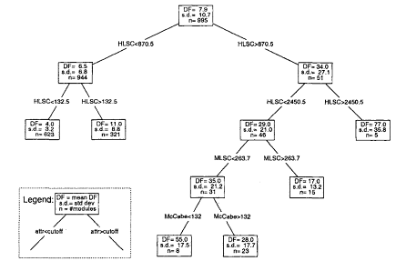
TBM Example
• TBDM example:
    defect prediction for IBM-NS
    . 11 design/size/complexity metrics

Slide 17
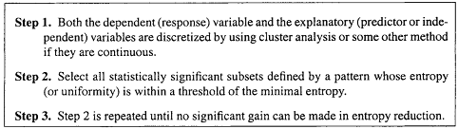
New Technique: OSR
• OSR: optimal set reduction
    . pattern matching idea
    . clusters and cluster analysis
    . similar to TBM but different in: pattern extraction vs. partition
    Following are the steps for OST algorithm

Slide 18
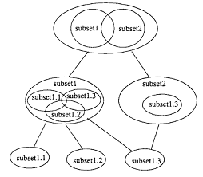
New Technique: OSR
• Organization/modeling results:
    . no longer a tree, see example above
    . general subsets, may overlap
    . details and some positive results:

Slide 19
Risk Identification: Comparison
• Comparison: cost-benefit analysis ≈ comparing QA alternatives (Last lecture of Part III).
• Comparison area: benefit-related
    . accuracy
    . early availability and stability
    . constructive information and guidance for (quality) improvement
• Comparison area: cost-related
    . simplicity
    . ease of result interpretation
    . availability of tool support

Slide 20
Comparison: Accuracy
• Accuracy in assessment:
    . model fits data well
        use various goodness-of-fit measures
    . avoid over-fitting
    . cross validation by review etc.
• Accuracy in prediction:
    . over-fitting ⇒ bad predictions
    . prediction: training and testing sets
        within project: jackknife
        across projects: extrapolate
    . minimize prediction errors

Slide 21
Comparison: Usefulness
• Early availability and stability
    . to be useful must be available early
    . focus on control/improvement
    . apply remedial/preventive actions early
    . track progress: stability
• Constructive information and guidance
    . what: assessment/prediction
    . how to improve?
        constructive information
        guidance on what to do
    . example of TBRMs

Slide 22
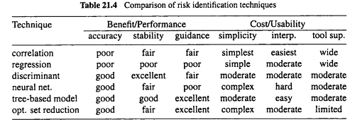
Comparison Summary

Slide 23
Summary of Today’s Lecture
There are different techniques available for Risk Identification.
Each technique has some merits and limitations.
These techniques could be compared amongst each other using some parameters such as accuracy and usability etc.

Slide 24
Overview of the next lecture
Last Topic of the course, i.e., Software Reliability Engineering
    Concepts and Approaches
    Existing Approaches: SRGMs & IDRMs
    Assessment & Improvement with TBRMs

Slide 25
The End

