Slide 1
Software Quality Engineering
Lecture No. 28

Slide 2
Part- 4:
Quantifiable Quality Improvement

Slide 3
Summary of the previous lecture
In our previous lecture, we talked about quality models. We discussed different types of quality models
    . Generalized: averages or trends
    . Product-specific: more customized
We also discussed Model/Measurement Selection

Slide 4
Outlines of today’s lecture
In today’s lecture, we will talk about Defect Classification and Analysis
    General Types of Defect Analyses.
    ODC: Orthogonal Defect Classification.
    Analysis of ODC Data.

Slide 5
Objectives
To understand and distinguish defect analysis and defect distribution analysis.
To apply the knowledge learnt of the ODC to real life software.

Slide 6
Defect Analysis
Goal: (actual/potential) defect↓ or quality↑ in current and future products.
General defect analyses:
    . Questions: what/where/when/how/why?
    . Distribution/trend/causal analyses.
Analyses of classified defect data:
    . Prior: defect classification.
    . Use of historical baselines.
    . Attribute focusing in 1-way and 2-way analyses.
    . Tree-based defect analysis (Lecture 29)

Slide 7
Defect in Quality Data/Models
• Defect data ⊂ quality measurement data:
    . As part of direct Q data.
    . Extracted from defect tracking tools.
    . Additional (defect classification) data may be available.
• Defect data in quality models:
    . As results in generalized models (GMs).
    . As (response/independent variable) in product specific models (PSMs).
        semi-customized models ≈ GMs,
        observation-based: in SRGMs,
        predictive: in TBDMs

Slide 8
General Defect Analysis
• General defect analyses: Questions
    . What? identification (and classification).
        type, severity, etc.,
        even without formal classification.
    . Where? distribution across location.
    . When? discovery/observation
          – what about when injection? harder
          – pre-release: more data
          – post-release: more meaningful/sensitive
    . How/why? related to injection
    ⇒ use in future defect prevention.

Slide 9
General defect analyses
General defect analyses: Types
    . Distribution by type or area.
    . Trend over time.
    . Causal analysis.
    . Other analysis for classified data.

Slide 10
Defect Analysis: Data Treatment
• Variations of defect data:
    . Error/fault/failure perspective.
    . Pre-/post-release. . Unique defect?
    . Focus here: defect fixes.
• Why defect fixes (DF):
    . Propagation information.
    . Close ties to effort (defect fixing).
    . Pre-release: more meaningful. (post release: each failure occurrence.)

Slide 11
Defect Distribution Analysis
• Distribution: what, where, etc.
• What: Distribution over defect types.
    . Ties to quality views/attributes.
    . Within specific view: types/sub-types.
    . Defect types ⇐ product’s “domain”.
• Important observation:
    ⇒ importance of risk identification for effective quality improvement
    . Early indicators needed! (Cannot wait after defect discoveries.)

Slide 12
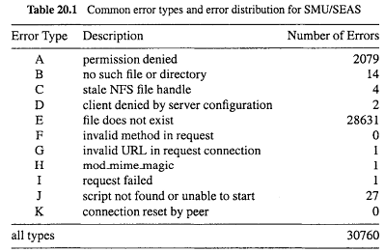
Defect Distribution Analysis
Web example:
    . defect = “error” in web community.
    . dominance of type E “missing files”.
    . type A: further information needed.
    . all other types: negligible.

Slide 13
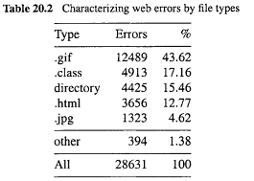
Defect Distribution Analysis
• Further analysis of web example above:
    . for dominant type E “missing files”
    . web error distribution by file type
    . again, skewed distribution!

Slide 14
Defect Trend Analysis
• Trend as a continuous function:
    Customized with local data
    Other analysis related to SRE
        defect/effort/reliability curves
        more in Lecture 30.
    . Sometimes discrete analysis may be more meaningful (see below).
• Defect dynamics model:
    . Important variation to trend analysis.
    . Defect categorized by phase.
    . Discovery (already done).
    . Analysis to identify injection phase.

Slide 15
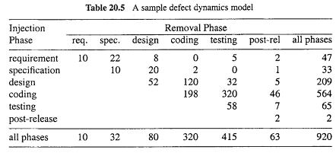
Defect Trend Analysis
• Defect dynamics model:
    . row: where (phase) injected
    . column: where (phase) removed/discovered
    . focus out-of-phase/off-diagonal ones!

Slide 16
Defect Causal Analysis
• Defect causal analyses: Types
    . Causal relation identified:
        error-fault vs fault-failure
        works backwards
    . Techniques: statistical or logical.
• Root cause analysis (logical):
    . Human intensive.
    . Good domain knowledge.
    . Fault-failure: individual and common.
    . Error-fault: project-wide effort focused on pervasive problems.
• Statistical causal analysis: ≈ risk identification techniques in Lecture 29

Slide 17
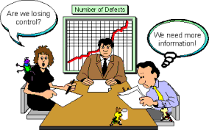
Orthogonal Defect Classification ODC: Overview
• Development . Chillarege et al. at IBM
    . Applications in IBM Labs and several other companies
    . Recent development and tools
• Key elements of ODC
    . Aim: tracking/analysis/improve
    . Approach: classification and analysis
    . Key attributes of defects
    . Views: both failure and fault
    . Applicability: inspection and testing
    . Analysis: attribute focusing
    . Need for historical data

Slide 18
ODC: Why?
• Statistical defect models:
    Quantitative and objective analyses.
    Problems: accuracy & timeliness.
• Causal (root cause) analyses:
    Qualitative but subjective analyses.
    Use in defect prevention.
• Gap and ODC solution:
    Bridge the gap between the two.
    Systematic scheme used.
    Wide applicability

Slide 19
ODC: Ideas
• Cause-effect relation by type:
    Different types of faults.
    Causing different failures.
    Need defect classification.
    Multiple attributes for defects.
• Good measurement:
    Orthogonality (independent view).
    Consistency across phases.
    Uniformity across products.
• ODC process/implementation:
    Human classification.
    Analysis method and tools.
    Feedback results (and follow-up)

Slide 20
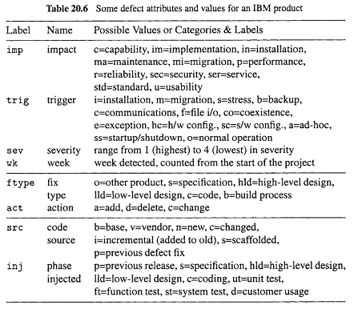
ODC Example

Slide 21
ODC Attributes: Failure-View
• Defect trigger:
    . Associated with verification process
        similar to test case measurement
        collected by testers
    . Trigger classes
        – product specific
        – black box in nature
        – pre/post-release triggers
• Other attributes:
    . Impact
    . Severity: low-high
    . Detection time, etc.

Slide 22
ODC Attributes: Cause/Fault-View
• Defect type:
    . Associated with development process.
    . Missing or incorrect.
    . Collected by developers.
    . May be adapted for other products.
• Other attributes:
    . Action: add, delete, change.
    . Number of lines changed, etc.

Slide 23
ODC Attributes: Cause/Error-View
• Key attributes:
    . Defect source: vendor/base/new code.
    . Where injected.
    . When injected.
• Characteristics:
    . Associated to additional causal analysis.
    . (May not be performed.)
    . Many subjective judgment involved (evolution of ODC philosophy)
• Phase injected: rough “when”.

Slide 24
Adapting ODC for Web Error Analysis
• Continuation of web testing/QA study.
• Web error = observed failures, with causes already recorded in access/error logs.
• Key attributes mapped to ODC:
    . Error type = defect impact.
        response code (4xx) in access logs
    . Referring page = defect trigger.
        individual pages with embedded links
        classified: internal/external/empty
        focus on internal problems
    . Missing file type = defect source – different fixing actions to follow.
• May include other attributes for different kinds of web sites.

Slide 25
ODC Analysis: Attribute Focusing
• General characteristics
    . Graphical in nature
    . 1-way or 2-way distribution
    . Phases and progression
    . Historical data necessary
    . Focusing on big deviations
• Representation and analysis
    . 1-way: histograms
    . 2-way: stack-up vs. multiple graphics
    . Support with analysis tools

Slide 26
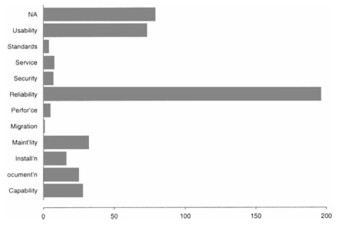
ODC Analysis Examples
• 1-way analysis:
    . Defect impact distribution for an IBM product.
    . Uneven distribution of impact areas!
    ⇒ risk identification and focus.

Slide 27
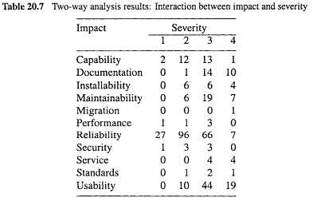
ODC Analysis Examples
• 2-way analysis:
    . Defect impact-severity analysis.
    . IBM product study continued.
    . Huge contrast: severity of reliability and usability problems!

Slide 28
ODC Process and Implementation
• ODC process:
    . Human classification
        defect type: developers,
        defect trigger and effect: testers,
        other information: coordinator/other.
    . Tie to inspection/testing processes.
    . Analysis: attribute focusing.
    . Feedback results: graphical.
• Implementation and deployment:
    . Training of participants.
    . Data capturing tools.
    . Centralized analysis.
    . Usage of analysis results.

Slide 29
Linkage to Other Topics
• Development process
    . Defect prevention process/techniques.
    . Inspection and testing.
• Testing and reliability:
    . Expanded testing measurement
        Defects and other information:
        Environmental (impact)
        Test case (trigger)
        Causal (fault)
    . Reliability modeling for ODC classes

Slide 30
Summary of Today’s Lecture
In today’s lecture, we talked about Defect Classification and Analysis. We also focused on:
    General Types of Defect Analyses.
    ODC: Orthogonal Defect Classification.
    Analysis of ODC Data.

Slide 31
Overview of the next lecture
Risk Identification for Quantifiable Quality Improvement
    Basic Ideas and Concepts
    Traditional Statistical Techniques
    Newer/More Effective Techniques
    Tree-Based Analysis of ODC Data

Slide 32
The End

