Slide 1
Software Quality Engineering
Lecture No. 27

Slide 2
Part- 4:
Quantifiable Quality Improvement

Slide 3
Summary of the previous lecture
In last lecture, we talked about Quality Models and Measurements
Post-QA analysis & feedback
    Part IV (maybe parallel instead of “post-)
Analysis => Feedback loops => Follow-ups

Slide 4
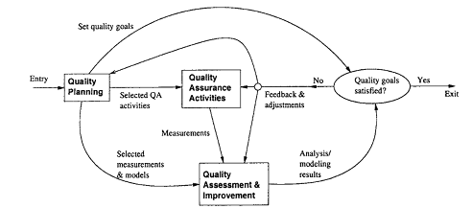
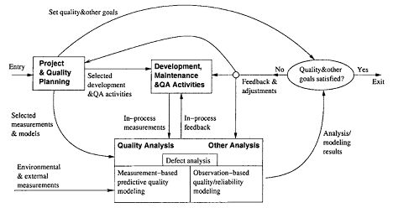
QE Activities and Process Review
Quality Engg. Process
    Refined Quality Engineering Process: Management, Analysis and feedback for Quantifiable improvement

Slide 5
Outlines
Quality Models and Measurements
• Types of Quality Assessment Models.
• Comparing Quality Assessment Models.
• Data Requirements and Measurement
• Measurement and Model Selection.

Slide 6
Objectives
To understand and distinguish different types of quality models such as Generalized and Product-specific
To apply and use different types of product specific models to solve real life software challenges

Slide 7
QA Data and Analysis
• Generic testing process:
    . Test planning and preparation.
    . Execution and measurement.
    . Test data analysis and follow-up.
    . Related data ⇒ quality ⇒ decisions
• Other QA activities:
    . Similar general process.
    . Data from QA/other sources (previous lecture).
    . Models used in analysis and follow-up:
        – provide timely feedback/assessment
        – prediction, anticipating/planning
        – corrective actions ⇒ improvement

Slide 8
QA Models and Measures
• General approach
    . Adapt GQM-paradigm.
    . Quality: basic concept and ideas.
    . Compare models ⇒ taxonomy.
    . Data requirements ⇒ measurements.
    . Practical selection steps.
    . Illustrative examples.
• Quality attributes and definitions:
    . Q models: data ⇒ quality
    . Correctness vs. other attributes
    . Our definition/restriction: being defect-free or of low-defect
    . Examples: reliability, safety, defect count/density/distribution/etc.

Slide 9
Quality Analysis
• Analysis and modeling:
    . Quality models: data ⇒ quality
        Also known as quality assessment models or quality evaluation models
    . Various models needed
    . Assessment, prediction, control
    . Management decisions
    . Problematic areas for actions
    . Process improvement
• Measurement data needed
    . Direct quality measurements: success/failure (defect info)
    . Indirect quality measurements:
        activities/internal/environmental.
    Indirect but early quality indicators. All described in Lecture26.

Slide 10
Quality Models
• Practical issues:
    . Applicability vs. appl. environment
    . Goal/Usefulness: information/results?
    . Data: measurement data required
    . Cost of models and related data
• Type of quality models
    . Generalized: averages or trends
    . Product-specific: more customized
    . Relating to issues above

Slide 11
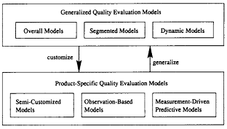
Generalized Models: Overall
• Model taxonomy:
    . Generalized:
        – overall, segmented, and dynamic
    . Product-specific:
        – semi-customized: product history
        – observation-based: observations
        – measurement-driven: predictive
Classification of quality assessment models

Slide 12
Generalized Models: Overall
• Key characteristics
    . Industrial averages/patterns ⇒ (single) rough estimate.
    . Most widely applicable.
    . Low cost of use.
• Examples: Defect density.
    . Estimate total defect with sizing model.
    . Variation: QI in IBM (counting in-field unique defect only)
• Non-quantitative overall models:
    . As extension to quantitative models.
    . Examples: 80:20 rule, and other general observations.

Slide 13
Product-Specific Models (PSM)
• Product-specific models (PSMs):
    . Product-specific info. used (vs. none used in generalized models)
    . Better accuracy/usefulness at cost ↑
    . Three types:
        semi-customized
        observation-based
        measurement-driven predictive
• Connection to generalized models (GMs):
    . Customize GMs to PSMs with new/refined models and additional data.
    . Generalize PSMs to GMs with empirical evidence and general patterns.

Slide 14

PSM: Semi-Customized
• Semi-customized models:
    . Project level model based on history.
    . Data captured by phase.
    . Both projections and actual.
    . Linear extrapolation.
Related extensions to Defect Removal Model (DRM):
    . Defect dynamics model in Lecture 28,
    . Orthogonal Defect Classification (ODC) defect analyses in Lecture 28:
        1-way distribution/trend analysis
        2-way analysis of interaction.

Slide 15
PSM: Observation-Based
• Observation-based models:
    . Detailed observations and modeling
    . Software reliability growth models
    . Other reliability/safety models
• Model characteristics
    . Focus on the effect/observations
    . Assumptions about the causes
    . Assessment-centric

Slide 16
PSM: Predictive
• Measurement-driven predictive models
    . Establish predictive relations
    . Modeling techniques: regression, TBM, NN, OSR etc.
    . Risk assessment and management
• Model characteristics:
    . Response: chief concern
    . Predictors: observable/controllable
    . Linkage quantification

Slide 17
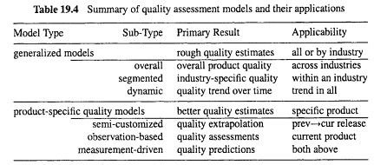
Model Summary

Slide 18
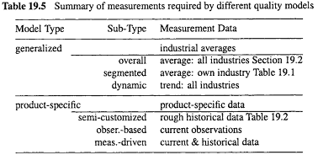
Relating Models to Measurements
Data required by quality models (Lecture 26):
    . Direct quality measurements
        to be assessed/predicted/controlled
    . Indirect quality measurements
        – means to achieve the goal
        – environmental, activity, product-internal
    . Data requirement by models summarized below

Slide 19
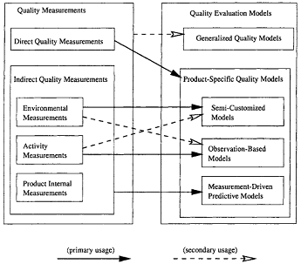
Relating Models to Measurements

Slide 20
Model/Measurement Selection
• Customize Goal-Question-Metric (GQM) into 3-steps
• Step 1: Quality goals
    . Restricted, not general goals
• Step 2: Quality models
    . Model characteristics/taxonomy
    . Model applicability/usefulness
    . Data requirement/affordability
• Step 3: Quality measurements
    . Model-measurements relations
    . Detailed model information

Slide 21
Selection Example A
• Goal: rough quality estimates
• Situation 1:
    . No product specific data
    . Industrial averages/patterns
    . Commercial tools: SLIM etc.
    . Product planning stage
    . Defect profile in lifecycle
    . Use generalized models
• Situation 2: . Data from related products
    . DRM for legacy products
    . ODC profile for IBM products
    . Semi-customized models

Slide 22
Summary of Today’s Lecture
In today’s lecture, we talked about quality models. We discussed some generalized models and their characteristics and we also discussed PSMs.
Certain models can be appropriate for specific type of softwares.

Slide 23
Overview of the next lecture
In next lecture, we will talk about Defect Classification and Analysis
    General Types of Defect Analyses.
    ODC: Orthogonal Defect Classification.
    Analysis of ODC Data.

Slide 24
The End

