Slide 1
Software Quality Engineering
Lecture No. 26

Slide 2
Summary of the previous lecture
In last lecture, we compared different QA Alternatives (including Testing, Inspection, Validation) More specifically, we will talk about
General Areas
Questions for Comparison
Applicability, Effectiveness, and Cost
Summary and Recommendations.
We have seen different comparison tables to identify which QA alternative is appropriate for what type of software.

Slide 3
Part- 4:
Quantifiable Quality Improvement

Slide 4
Outlines
Feedback Loop and Activities for Quantifiable Quality Improvement
• Feedback Loop and Overall Mechanism
• Monitoring and Measurement
• Analysis and Feedback
• Tool and Implementation Support

Slide 5
Objectives
To understand and distinguish between Pre-QA activities and Post-QA activities.
To be able to apply the knowledge of quantifiable quality improvement in real life software.

Slide 6
Importance of Feedback Loop
All QA activities covered in Part II and Part III need additional support:
    . Planning and goal setting
    . Management via feedback loop:
        When to stop?
        Adjustment and improvement, etc.
        All based on assessments/predictions

Slide 7
Importance of Feedback Loop
Feedback loop for quantification/improvement:
    . Focus of Part IV chapters .
        mechanism and implementation.
        models and measurements.
        defect analyses and techniques.
        risk identification techniques.
        software reliability engineering

Slide 8
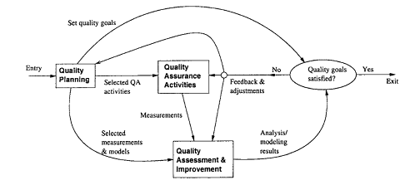
QE Activities and Process Review
• Major activities:
    . Pre-QA planning (earlier lectures).
    . QA (Part II and Part III).
    . Post-QA analysis & feedback
        Part IV (maybe parallel instead of “post-”)
• Overall process:– Software quality engineering (SQE)
Quality Engg. Process

Slide 9
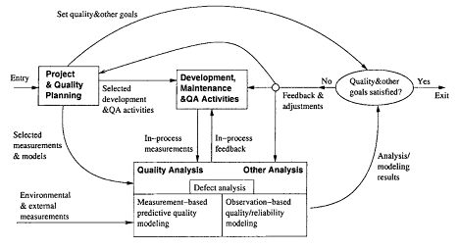
QE Activities and Process Review
Feedback loop zoom-in: Fig 18.1 (p.304)
    . Multiple measurement sources.
    . Many types of analysis performed.
    . Multiple feedback paths.
    Refined Quality Engineering Process: Management, Analysis and feedback for Quantifiable improvement

Slide 10
Feedback Loop Related Activities
Monitoring and measurement:
    defect monitoring ∈ process management.
    defect measurement ∈ defect handling.
    many other related measurements.
Analysis modeling:
    Historical baselines and experience.
    Choosing models and analysis techniques.
    Focus on defect/risk/reliability analyses.
    Goal: assessment/prediction/improvement.
Feedback and followup:
    Frequent feedback: assessment/prediction.
    Possible improvement areas identified.
    Overall management and improvement.

Slide 11
Quality Monitoring and Measurements
Quality monitoring needs:
    Quality as a quantified entity over time.
    Able to assess, predict, and control.
    Various measurement data needed.
    Some directly in quality monitoring.
    Others via analyses to provide feedback.
Direct quality measurements:
    Result, impact and related info. – e.g., success vs. failure
    Defect information: directly monitored. – additional defect analysis
    Mostly used in quality monitoring.

Slide 12
Indirect Quality Measurements
• Indirect quality measurements: Why?
    . Other quality measurements (reliability) need additional analyses/data.
    Unavailability of direct quality measurements early in the development cycle ⇒ early (indirect) indicators.
    Used to assess/predict/control quality. (to link to or affect various direct quality measurements)
• Types of indirect quality measurements:
    Environmental measurements.
    Product internal measurements.
    Activity measurements.

Slide 13
Indirect Measurements: Environment
• Process characteristics
    . Entities and relationships
    . Preparation, execution and followup
    . Techniques used
• People characteristics
    . Skills and experience
    . Roles: planners/developers/testers
    . Process management and teams
• Product characteristics
    . Product/market environment
    . Hardware/software environment

Slide 14
Indirect Measurements: Internal
• Product internal measurements: most studied/understood in SE
• Software artifacts being measured:
    . Mostly code-related
    . Sometimes SRS, design, docs etc.
• Product attributes being measured:
    . Control: e.g., McCabe complexity
    . Data: e.g., Halstead metrics
    . Presentation: e.g., indentation rules
• Structures:

Slide 15
Indirect Measurements: Activity
• Execution/activity measurements:
    Overall: e.g., cycle time, total effort.
    Phased: profiles/histograms.
    Detailed: transactions in SRGMs.
• Testing activity examples:
    Timing during testing/usage
    Path verification (white-box)
    Usage-component mapping (black-box)
    Measurement along the path
• Usage of observations/measurements: observation-based and predictive models

Slide 16
Immediate Followup and Feedback
• Immediate (without analyses): Why?
    . Immediate action needed right away: – critical problems ⇒ immediate fixing – most other problems: no need to wait
    . Some feedback as built-in features in various QA alternatives and techniques.
    . Activities related to immediate actions.
• Testing activity examples:
    . Shifting focus from failed runs/areas.
    . Re-test to verify defect fixing.
    . Other defect-related adjustments.
• Defect and activity measurements used.

Slide 17
Analyses, Feedback, and Followup
• Most feedback/follow-up relies on analyses.
Types of analyses:
    . Product release decision related.
    . For other project management decisions, at the phase or overall project level.
    . Longer-term or wider-scope analyses.
• Types of feedback paths:
    . Shorter vs. longer feedback loops.
    . Frequency and time duration variations.
    . Overall scope of the feedback.
    . Data source refinement.
    . Feedback destinations.

Slide 18
Analysis for Product Release Decisions
• Most important usage of analysis results
    “when to stop testing?”
• Basis for decision making:
    . Without explicit quality assessment:
        – implicit: planned activities,
        – indirect: coverage goals,
        – other factors: time/$-based.
    . With explicit quality assessment:
        – failure-based: reliability,
        – fault-based: defect count & density.
• Criteria preference: reliability – defect – coverage – activity.

Slide 19
Analyses for Other Decisions
• Transition from one (sub-)phase to another:
    . Later ones: similar to product release.
    . Earlier ones: reliability undefined
        – defects – coverage – activity,
        – inspection and other early QA
• Other decisions/management-activities:
    . Schedule adjustment.
    . Resource allocation and adjustment.
    . Planning for post-release support.
    . Planning for future products or updates.
• These are product-level or sub-product-level decisions and activities.

Slide 20
Other Feedback and Followup
• Other (less frequent) feedback/followup:
    . Goal adjustment (justified/approved).
    . Self-feedback (measurement & analysis)
        – unsuitable measurements and models?
        – SRE measurement example in IBM.
    . Longer term, project-level feedback.
    . May even carry over to followup projects.
• Beyond a single-project duration/scope:
    . Future product quality improvement
        – overall goal/strategy/model/data,
        – especially for defect prevention.
    . Process improvement.
    . More experienced people.

Slide 21
Feedback Loop Implementation
• Key question: sources and destinations. (Analysis and modeling activity at center.)
• Sources of feedback loop = data sources:
    . Result and defect data:
        – the QA activities themselves.
    . Activity data:
        – both QA and development activities.
    . Product internal data: product. (produced by development activities)
    . Environmental data: environment.
• Additional sources of feedback loop:
    . From project/QA planning.
    . Extended environment: measurement data and models beyond project scope.

Slide 22
Feedback Loop Implementation
• Feedback loop at different duration/scope levels.
• Immediate feedback to current development activities (locally).
• Short-term or sub-project-level feedback:
    . transition, schedule, resource,
    . destination: development activities.
• Medium-term or project-level feedback:
    . overall project adjustment and release
• Longer-term or multi-project feedback: – to external destinations

Slide 23
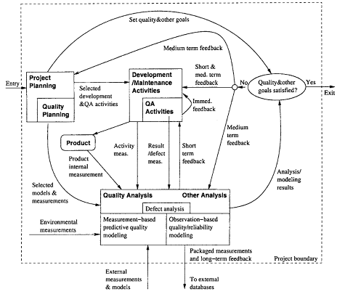
Feedback Loop Implementation

Slide 24
Implementation Support Tools
• Type of tools:
    . Data gathering tools.
    . Analysis and modeling tools.
    . Presentation tools.
• Data gathering tools:
    . Defects/direct quality measurements:
        – from defect tracking tools.
    . Environmental data: project db.
    . Activity measurements: logs.
    . Product internal measurements:
        – commercial/home-build tools.
    . New tools/APIs might be needed.

Slide 25
Implementation Support Tools
• Analysis and modeling tools:
    . Dedicated modeling tools: – e.g., SMERFS and CASRE for SRE
    . General modeling tools/packages: – e.g., multi-purpose S-Plus, SAS.
    . Utility programs often needed for data screening and processing.
• Presentation tools:
    . Aim: easy interpretation of feedback ⇒ more likely to act on.
    . Graphical presentation preferred.
    . Some “what-if”/exploration capability.

Slide 26
Strategy for Tool Support
• Using existing tools ⇒ cost↓:
    . Functionality and availability/cost.
    . Usability.
    . Flexibility and programmability.
    . Integration with other tools.
• Tool integration issues:
    . Assumption: multiple tools used. (All-purpose tools not feasible/practical.)
    . External rules for inter-operability, – common data format and repository.
    . Multi-purpose tools.
    . Utilities for inter-operability.

Slide 27
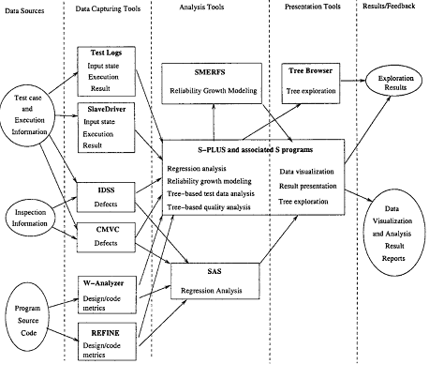
Tool Support Example (IBM)

Slide 28
Summary of Today’s Lecture
In today’s lecture, we talked about Feedback Loop and Activities for Quantifiable Quality Improvement. We discussed the Feedback Loop and Overall Mechanism, Monitoring and Measurement, Analysis and Feedback and lastly, we talked about Tool and Implementation Support
.

Slide 29
Overview of the next lecture
We will talk about Quality Models and Measurements
    Types of Quality Assessment Models.
    Comparing Quality Assessment Models.
    Data Requirements and Measurement
    Measurement and Model Selection.

Slide 30
The End

