Slide 1
Software Quality Engineering
Lecture No. 25

Slide 2
Part- 3:
Quality Assurance Techniques

Slide 3
Summary of the previous lecture
In last lecture, our discussion on fault Tolerance and failure containment continued. We talked about :
Hazard Elimination and Hazard Reduction.
Hazard Control and Damage Control.
Software Safety Program (SSP)
TFM: Two-Frame-Model
Frame Inconsistencies
Prescriptive Specifications (PS)

Slide 4
Outlines
We will Compare QA Alternatives, More specifically, we will talk about\
General Areas
Questions for Comparison
Applicability, Effectiveness, and Cost
Summary and Recommendations.

Slide 5
Objectives
To understand and distinguish between QA alternatives.
To be able to apply the knowledge learnt on real life QA in software.

Slide 6
QA Alternatives
• Defect and QA:
    Defect: error/fault/failure.
    Defect prevention/removal/containment.
    Map to major QA activities
• Defect prevention
    Error source removal & error blocking
• Defect removal: Inspection/testing/etc.
• Defect containment: Fault tolerance and failure containment (safety assurance).
• Comparison: This Lecture

Slide 7
Comparison
• Cost-benefit under given environments:
    . Environments: applicable or not?
    . Cost to perform.
    . Benefit: quality, directly or indirectly.
• Testing as the comparison baseline:
    . Most commonly performed QA activity.
    . Empirical and internal data for testing.
    . QA alternatives compared to testing:
        defect prevention (DP),
        Inspection and formal verification (FV),
        fault tolerance (FT),
        failure containment (FC).
    . FT & FC: separate items in comparison.

Slide 8
Comparison: Applicability
• Applicability questions:
    . High-level questions: development vs. field usage (and support/maintenance)
    . Low level questions: development phases/activities.
• Applicability to maintenance:
    . Not applicable: Defect prevention. (although lessons applied to future)
    . Applicable to a limited degree: Inspection, testing, formal verification, as related to reported field failures.
    . Applicable: fault tolerance and failure containment, but designed/implemented during development.
• Our focus: applicability to development

Slide 9
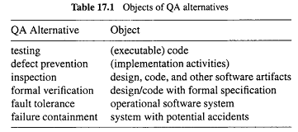
Comparison: Applicability
• Objects QA activities applied on:
    . Mostly on specific objects, e.g., testing executable code
    . Exception: defect prevention on (implementation related) dev. activities

Slide 10
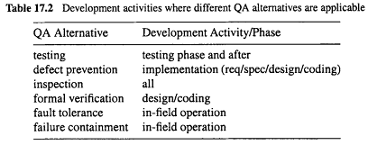
Comparison: Applicability
• Applicability to development phases:
    . In waterfall or V-model: implementation (req/design/coding) & testing/later.
    . Inspection in all phases.
    . Other QA in specific sets of phases.

Slide 11
Comparison: Applicability
• Applicability to product domain/segment:
    . All QA alternatives can be applied to all domains/segments.
    . Other factors: cost-benefit ratio.
    . Higher cost needs to be justified by higher payoff/returns.
    . Further comparison in connect to cost and effectiveness comparisons.

Slide 12
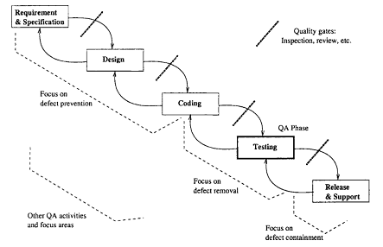
Comparison: Applicability
• Also relate to general context of QA
    . QA distribution
    . Related activities in other phases, e.g., design/implementation for FT/SSE.
• Other process variations: similar to smaller cycles of waterfall

Slide 13
Comparison: Applicability/Expertise
• Pre-condition to performing specific QA activities:
    . specific expertise required
    . also related to cost
• Expertise areas:
    . Specifics about the QA alternative.
    . Background/domain-specific knowledge.
    . FV: formal training.
    . FT: dynamic system behavior.
    . FC: embedded system safety.
    . Other QA: general CS/SE knowledge.

Slide 14
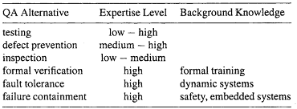
Comparison: Applicability/Expertise
• General expertise levels: mostly in ranges, depending on specific techniques used.
• Specific background knowledge
Required expertise and background knowledge for people to perform different QA Alternatives

Slide 15
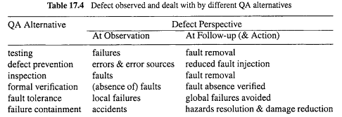
Comparison: Effectiveness
• Defect specifics or perspectives:
    . Dealing with errors/faults/failures?
    . Direct action vs follow-up action: may deal with different defect perspectives.
    . Example: failures detected in testing but (failure-causing) faults fixed in follow-up.

Slide 16
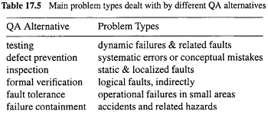
Comparison: Effectiveness
Problem or defect types:
    errors/faults/failures of different types or characteristics

Slide 17
Comparison: Effectiveness
• Defect types: Inspection vs. testing:
    . Static analysis vs. dynamic execution ⇒ static vs dynamic problems and conceptual/logical problems vs. timing problems.
    . Localized defects easily detected by inspection vs. interface/interaction problems detected by testing.
• Defect types: Other QA:
    . defect prevention: negating causes or pre-conditions to pervasive problems.
    . fault tolerance: rare conditions
    . safety assurance: accidents
    . FV: logical problems, but indirectly.

Slide 18
Comparison: Effectiveness
Information for defect↓ and quality↑
Result interpretation:
    specific pieces of info.
    interpret the info./result
    link to quality, impact, meaning, etc.?
Using information/measurement:
    to provide feedback
    to guide followup activities
    to help decision making/improvement
    goal: defect↓ and quality↑ (usually via analysis/modeling)
Part IV. Quantifiable Improvement: measure-analyze-feedback-improve steps.

Slide 19
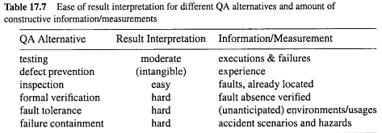
Comparison: Effectiveness
Ease of result interpretation
Specific info/measurement

Slide 20
Comparison: Cost
• Cost measurement/characterization:
    Direct cost: $$$
    Indirect cost: time, effort, etc.
    Things affecting cost: simplicity, expertise (already addressed), tools, etc.
    Cost to perform specific QA activities.
• Factors beyond cost to perform QA:
    Cost of failures and related damage.
    Other cost, particularly for defect containment (FT and FC)
    Operational cost, e.g., FT mechanisms slow down normal operations
    Implementation cost of FT mechanisms.

Slide 21
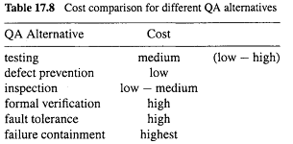
Comparison: Cost
• Overall cost comparison:
    . rough values and ranges
    . multiple factors but focus on performing the specific QA activities

Slide 22
Comparison: Summary
• Testing:
    . Important link in dev. process
    . Activities spilt over to other phases
        OP development, test preparation, etc.
        (partial) code exist before testing
    Dynamic/run-time/interaction problems
    . Medium/low defect situations
    . Techniques and tools
    . Coverage vs. reliability focus
    . Cost: moderate
• Defect prevention: . Most effective if causes known. . Good at pervasive problems. . Low cost, due to downstream damage↓. . Issue: “if causes”, and up-front cost

Slide 23
Comparison: Summary
• Defect prevention:
    . Most effective if causes known.
    . Good at general/universal problems.
    . Low cost, due to downstream damage↓.
    . Issue: “if causes”, and up-front cost

Slide 24
Comparison: Summary
• Inspection:
    . Good throughout dev. process
    . Works on many software artifacts
    . Conceptual/static faults
    . High fault density situations:
        non-blocking
        experience ⇒ efficiency↑
    . Human intensive, varied cost

Slide 25
Comparison: Summary
Formal verification:
    . Positive confirmation/correctness.
    . On design/code with formal spec.
    . Low/no defect situations
    . Practicality: high cost → benefit?
    . Human intensive, rigorous training (therefore, high up-front cost)

Slide 26
Comparison: Summary
• Fault tolerance:
    . Dynamic problems (must be rare)
    . High cost & reliability (low defect)
    . Technique problems (independent NVP?) . Process/technology intensive
• Failure containment:
    . Similar to FT above, but even more so.
    . Rare conditions related to accidents
    . Extremely high cost ⇒ apply only when safety matters
    . Many specialized techniques
    . Process/technology intensive

Slide 27
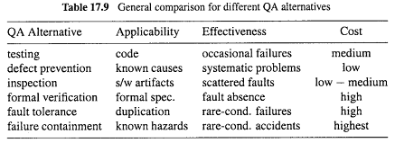
Comparison: Grand Summary
Pairwise comparison, if needed.
Different strength/weakness ⇒ hybrid/integrated strategies

Slide 28
Pairwise Comparison
• Inspection vs. preventive actions:
    . Inspection coupled with causal analysis.
    . Together drive preventive actions.
    . Key difference: error vs fault focus
• Inspection vs. formal verification
    . FV ≈ formalized inspection
    . Focus: people vs. mathematical/logical
    . Applicability to design/code only?
    . Existence of formal specifications?
    . Tradeoff: formality vs. cost
    . Training and acceptability issues

Slide 29
Pairwise Comparison
• Inspection vs. testing:
    . Existence of the implemented product
    . Levels of quality/defects
    . Static vs. dynamic defects
    . Localized vs. interconnected defects
    . Combined approaches:
        phases and transitions
        inspection of testing entities/processes
• Inspection vs. fault tolerance
    . Complementary instead of competing (e.g., inspect individual versions)
    . Static vs. dynamic
    . Inspection of FT techniques/mechanisms

Slide 30
Recommendation: Integration
• Different QA alternatives often complementary instead of competing to one another:
    . Dealing with different problems.
    . Work in different phases/environments.
    . Combined effect ⇒ use multiple QA alternatives together.
    . Shared resource and expertise.

Slide 31
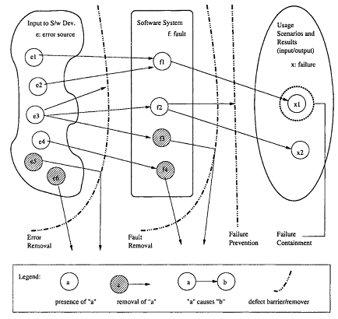
Recommendation: Integration
Integration: Concerted QA effort
    . As a series of defense (Fig 3.1, p.30).
    . Satisfy specific product/segment needs.
    . Fit into process and overall environment.
    . Adaptation/customization often needed.
    . Match to organizational culture.

Slide 32
Summary of Today’s Lecture
In today’s lecture, we talked about comparing QA alternatives. We highlighted its General Areas and we did comparison using different tables. Lastly, we have seen the summary and recommendations.

Slide 33
Overview of the next lecture
We will proceed to the Part- 4 of the course, i.e., Quantifiable Quality Improvement:
We will talk about Feedback Loop and Activities for Quantifiable Quality Improvement.

Slide 34
The End

