Slide 1
Software Quality Engineering
Lecture No. 23

Slide 2
Part- 3:
Quality Assurance Techniques

Slide 3
Summary of the previous lecture
We continued our discussion on Formal Verification of a software. The General idea and approaches for formal verification were discussed. We also highlight Axiomatic verification and other approaches for software verification.

Slide 4
Outlines
In today’s lecture, we will talk about Fault Tolerance and Safety Assurance.
The basic concepts and safety assurance techniques will be discussed.
We will also talk about Fault Tolerance recovery blocks and Event Tree Analysis (ETA)

Slide 5
Objectives
To be able to understand the concepts of Safety for Software development.
To understand and distinguish between Fault Tolerance Analysis (FTA) and Event Tree Analysis (ETA)

Slide 6
QA Alternatives
Defect and QA:
    . Defect: error/fault/failure.
    . Defect prevention/removal/containment.
    . Map to major QA activities
Defect prevention:
    Error source removal & error blocking
Defect removal: Inspection (Lecture No. 21)
Special case (this lecture): Formal verification (Lecture 22)
Defect containment: Fault tolerance and failure containment (safety assurance) This Lecture.

Slide 7
QA and Fault Tolerance (FT)
• Fault tolerance as part of QA:
    . Duplication: over time or components
    . High cost, high reliability
    . Run-time/dynamic focus
    . FT design and implementation
    . Complementary to other QA activities
• General idea
    . Local faults not lead to system failures
    . Duplication/redundancy used
    . redo ⇒ recovery block (RB)
    . parallel redundancy
      ⇒ N version programming (NVP)

Slide 8
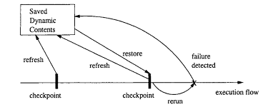
FT: Recovery Blocks (RB)
General idea:
    . Periodic check-pointing
    . Problem detection/acceptance test
    . Rollback (recovery)

Slide 9
FT: Recovery Blocks (RB)
• Periodic check-pointing
    . too often: expensive check-pointing
    . too rare: expensive recovery
    . smart/incremental check-pointing
• Problem detection/acceptance test
    . exceptions due to in/external causes
    . periodic vs event-triggered
• Recovery (rollback) from problems:
    . external disturbance: environment?
    . internal faults: tolerate/correct?

Slide 10
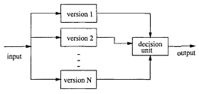
Fault Tolerance: N- Version Programming
• FT with NVP:
    . NVP: N-Version Programming
    . Multiple independent versions
    . Dynamic voting/decision ⇒ FT.

Slide 11
Fault Tolerance: N- Version Programming
Multiple independent versions
    . Multiple: parallel vs backup?
    . How to ensure independence?
Support environment:
    . concurrent execution
    . switching
    . voting/decision algorithms
Correction/recovery?
    . p-out-of-n reliability
    . in conjunction with RB
    . dynamic vs. off-line correction

Slide 12
FT and Safety
• Extending FT idea for safety:
    . FT: tolerate fault
    . Extend: tolerate failure
    . Safety: accident free
    . Weaken error-fault-failure-accident link
• FT in SSE (software safety engineering):
    . Too expensive for regular systems
    . As hazard reduction technique in SSE
    . Other related SSE techniques:
        general redundancy
        substitution/choice of modules
        barriers and locks
        analysis of FT

Slide 13
What Is Safety?
• Safety: The property of being accident-free for (embedded) software systems.
    . Accident: failures with severe consequences
    . Hazard: condition for accident
    . Special case of reliability
    . Specialized techniques
• Software safety engineering (SSE): .
    Hazard identification/analysis techniques
    . Hazard resolution alternatives
    . Safety and risk assessment
    . Qualitative focus
    . Safety and process improvement

Slide 14
Safety Analysis & Improvement
• Hazard analysis:
    . Hazard: condition for accident
    . Fault trees: (static) logical conditions
    . Event trees: dynamic sequences
    . Combined and other analyses
    . Generally qualitative
    . Related: accident analysis and risk assessment
• Hazard resolution
    . Hazard elimination
    . Hazard reduction
    . Hazard control
    . Related: damage reduction

Slide 15
Hazard Analysis: Fault Tolerance Analysis
• Fault tree idea:
    . Top event (accident)
    . Intermediate events/conditions
    . Basic or primary events/conditions
    . Logical connections
    . Form a tree structure
• Elements of a fault tree:
    . Nodes: conditions and sub-conditions – terminal vs. no terminal
    . Logical relations among sub-conditions – AND, OR, NOT
    . Other types/extensions possible

Slide 16
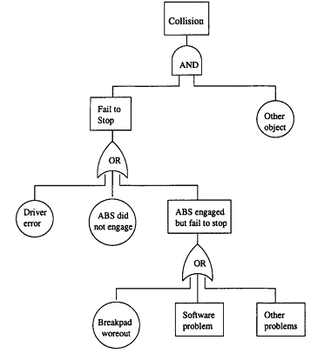
Hazard Analysis: FTA Example
    Example FTA for an automobile accident

Slide 17
Hazard Analysis: FTA
• FTA construction:
    . Starts with top event/accident
    . Decomposition of events or conditions
    . Stop when further development not required or not possible (atomic)
    . Focus on controllable events/elements
• Using FTA:
    . Hazard identification – logical composition – (vs. temporal composition in Event Tree Analysis (ETA) .
    . Hazard resolution (more later)
        component replacement etc.
        focused safety verification
        negate logical relation

Slide 18
Hazard Analysis: Event Tree Analysis (ETA)
• ETA: Why?
    . FTA: focus on static analysis
        (static) logical conditions
    . Dynamic aspect of accidents
    . Timing and temporal relations
    . Real-time control systems
• Search space/strategy concerns:
    . Contrast ETA with FTA:
        FTA: backward search
        ETA: forward search
    . May yield different path/info.
    . ETA provide additional info.

Slide 19
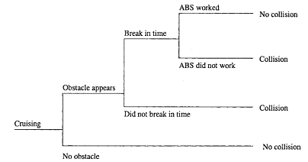
Hazard Analysis: ETA Example
Example ETA for an automobile accident

Slide 20
Hazard Analysis: ETA
• Event trees:
    . Temporal/cause-effect diagram
    . (Primary) event and consequences
    . Stages and (simple) propagation
        not exact time interval
        logical stages and decisions
• Event tree analysis (ETA):
    Recreate accident sequence/scenario
    Critical path analysis
    Used in hazard resolution (more later)
        esp. in hazard reduction/control
        e.g. creating barriers
        isolation and containment

Slide 21
Summary of Today’s Lecture
In today’s lecture, we talked about Fault Tolerance and Safety Assurance. We have seen some basic concepts and safety assurance techniques. We also talked about Fault Tolerance recovery blocks. Our discussion ended on Fault Tolerance Analysis (FTA) and Event Tree Analysis (ETA)

Slide 22
Overview of the next lecture
We will talk about Hazard Elimination and Hazard Reduction.
We will also talk about Hazard Control and Damage Control.

Slide 23
The End

