Slide 1
Software Quality Engineering
Lecture No. 21

Slide 2
Part- 3:
Quality Assurance Techniques

Slide 3
Summary of the previous lecture
We discussed Software Inspection
    Basic Concept and Generic Process
    Inspection Process Variations
    Fagan Inspection

Slide 4
Outlines
Software Inspection
    Scope Inspection
    Gilb Inspection (Expanded Fagan)
    Other Inspection and Related Activities
    Other Issues

Slide 5
Objectives
To understand and distinguish between informal software inspection and formal software inspection
To be able to inspect the software for program correctness.

Slide 6
Reduced Size/Scope Inspection
Two-person inspection
    Fagan inspection simplified
    Author-inspector pair which is mutually beneficial
    Smaller scale program
Meeting-less inspections
    Importance of preparation (individual insp.) (most defects found during preparation)
    Empirical (observed) evidence
    1-on-1 instead of team meetings (or other feedback mechanisms)

Slide 7
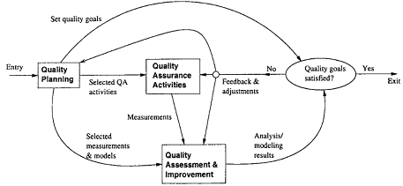
Gilb Inspection (Expanded Fagan)
Key: A “process brainstorming” meeting
    root cause analysis
    right after inspection meeting
    parallel to edit (rework)
    aim at preventive actions/improvement
Other characteristics
    Clearly identified input, checklists/rules extensively used
    Output include change request and suggested process improvement, in addition to inspected documents.
    Team size: 4-6 people.
    . More emphasis on
    feedback loop: resemble To SQE process

Slide 8
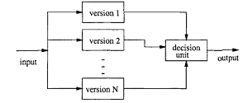
Other Expanded Fagan Inspections
Phased inspections
    Expand Fagan inspection
    Multiple phases/meetings
    Each on a specific area/problem-type
    Dynamic team make-up
N-fold inspections
    Idea similar to NVP (N-Version Programming)
    N parallel inspections, 1 moderator
    Duplications ⇒ cost↑

Slide 9
Informal Inspection
Desk check (self-conducted):
    Should focus on conceptual problems
    Use tools for problems with syntax / spelling / format etc.
Informal review (by others):
    Similar to desk check, but by others
    Benefit from independent/orthogonal views
    Group reviews for phase transitions
Walkthroughs:
    More organized, but still informal
    Leading role of author/moderator
    Less preparation by other participants than in inspection

Slide 10
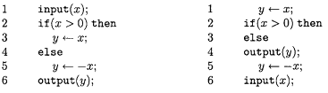
Formal Inspection: Code Reading
A program segment (left) and its permutation (right)
Program comprehension (understanding):
    a program (left) and its permutation (its change) (right)
    different effort in comprehension
    different recall accuracy
    experience factor (expert vs beginner)
Related to top-down design and code reading/abstraction (bottom-up)

Slide 11
Formal Inspection: Code Reading
Code reading
    . focus on code
    . optional meetings
Code reading by stepwise abstraction
    . basis: program comprehension studies
    . variation to code reading
      formalized code reading technique
    . top-down decomposition and bottom-up abstraction
    . recent evidence of effectiveness

Slide 12
Formal Inspection: ADR & Correctness
Active design reviews (ADR)
    . Another formal inspection, for designs
    . Inspector active vs. passive
    . Author prepares questionnaires
    . More than one meeting
    . Scenario based (questionnaires)
    . Overall ADR divided into small ones
    . 2-4 persons (for each smaller ADR)
Inspection for program correctness
    . Correctness (vs. questionnaire) of:
      – topology (decomposition, hierarchy)
      – algebra (equivalence of refinements)
      – invariance (variable relations)
      – robustness (error handling)
    . Close to formal verification

Slide 13
Extending Inspection: Analysis
Inspection as analysis
    . Program/document/etc. analysis
    . Inspection as statics analysis
    . Testing as dynamic analysis
Other analyses
    . Static: algorithm, decision table, boundary value, control flow, data flow, etc.
    . Dynamic: symbolic execution, simulation, prototyping, timing, in-field execution, etc.

Slide 14
Defect Detection Techniques
• Ad-hoc vs. systematic ones below:
    checklist-/scenario-/abstraction-based.
• Checklist-based inspection:
    . Similar to testing checklists
    . Basic types: artifact-/property-based.
• Scenario-based inspection:
    . Similar to usage-based testing.
    . Scenarios ties multiple components.
    . More a usage/external view.
    . Suitable for OOS.
• Abstraction-based inspection: Similar to code reading with stepwise abstraction.

Slide 15
Implementation and Effectiveness
• Implementation support:
    . Process and communication support
    . Repository management tools
    . Defect tracking and analysis as followup
    . Still human intensive
• Effectiveness studies
    . Measurement: defect or effort
    . Defect detection technique important
    . Inspector skills/expertise also important
    . Many individual variations

Slide 16
Conclusions
• Key advantages:
    . Wide applicability and early availability
    . Complementary to testing/other QA
    . Many techniques/process to follow/adapt
    . Effective under many circumstances
• Key limitations:
    . Human intensive
    . Dynamic/complex problems and interactions: Hard to track/analyze.
    . Hard to automate.

Slide 17
Summary of Today’s Lecture
We continued our discussion on Software Inspection. We explored Scope Inspection and Gilb Inspection which is an Expanded version of Fagan inspection.
We also highlighted Active design reviews (ADR)

Slide 18
Overview of the next lecture
We will talk about QA and Formal Verification. The General idea and approaches and Axiomatic verification will form part of our next lecture discussion.

Slide 19
The End

