Slide 1
Software Quality Engineering
Lecture No. 15

Slide 2
Part- 2 (b):
Other Models & Techniques of Testing

Slide 3
Summary of the previous lecture
Data Dependency and Sequencing
Data Dependency Analysis
Data Dependency Graph (DDG)
  we need DDG; Its characteristics and construction with example was discussed
CFT Vs DDT

Slide 4
Outlines
Testing Techniques: Adaptation, Specialization, and Integration.
Adaptation to Test Sub-phases
Specialized Testing Techniques

Slide 5
Objectives
To understand and distinguish between different Application and adaptation issues of testing
To understand the needs of Testing Sub-Phases.

Slide 6
Applications of Testing Techniques
• Major testing techniques covered so far:
    . Ad hoc (non-systematic) testing.
    . Checklist-based testing.
    . Partition-based coverage testing.
    . Musa’s OP for UBST.
    . Boundary testing (BT).
    . Control flow testing (CFT).
    . Data flow testing (DFT)
    • Application and adaptation issues:
    . For different purposes/goals.
    . In different environments/sub-phases.
    . Existing techniques: select/adapt.
    . May need new or specialized techniques.

Slide 7
V-Model
Solid box: original sub-phase
Dashed box: added sub-phase or specialized testing

Slide 8
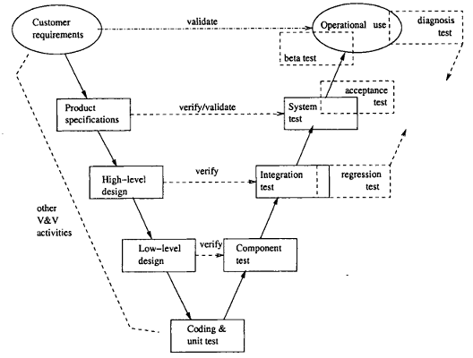
Testing Sub-Phases: V-Model
Testing sub-phases associated with the V-Model

Slide 9
Testing Sub-Phases: V-Model
Original sub-phases in V-model:
    . Operational use (not testing, strictly).
    . System test for product specification.
    . Integration test for high-level design.
    . Component test for low-level design.
    . Unit test for program code.
Additional sub-phases/specialized testing:
    . Diagnosis test through all sub-phases.
    . Beta test for limited product release.
    . Acceptance test for product release.
    . Regression test for legacy products.

Slide 10
Unit Testing
Key characteristics:
    . Object: unit (implemented code)
      function/procedure/subroutine in C, FORTRAN, etc.
      method in OO languages
    . Implementation detail ⇒ WBT. (BBT could be used, but less often.)
    . Exit: coverage (reliability undefined).
Commonly used testing techniques:
    . Ad hoc testing.
    . Informal debugging.
    . Input domain partition testing and BT.
    . CFT and DFT.

Slide 11
Component Testing
Key characteristics:
    . Object: component (⊃ unit), 2 types.
    1. collection of units in C/FORTRAN/etc.
      implementation detail ⇒ WBT. .
    2. class in OO languages
      reusable component ⇒ BBT.
    . Exit: coverage (sometimes reliability).
Commonly used testing techniques:
    . for traditional systems (component I) ≈ unit testing, but at larger scale
    . for OO systems (component II) ≈ system testing, but at smaller scale
      see system testing techniques later in the slides

Slide 12
Summary of Today’s Lecture
We explored what type of testing is suitable in which type of environment.
Not all types of testing are suitable universally

Slide 13
Overview of Next lecture
System Testing, Acceptance Testing, Beta Testing
Integration and Web Testing Case Study
Defect Diagnose Testing
Regression Testing

Slide 14
The End

