Slide 1
Software Quality Engineering
Lecture No. 13

Slide 2
Summary of the previous lecture
Usage Based Statistical Testing
Checklist-Based Testing
Partitions and Partition Testing
OP case study

Slide 3
Part- 2 (b):
Other Models & Techniques of Testing

Slide 4
Outlines
Control Flow Testing (CFT)
Data Dependency Analysis
Control Flow Graph (CFG)
  Steps
  Construction
  Issues
  Methods

Slide 5
Objectives
To understand and distinguish Control Flow Testing and Data Dependency Analysis
To be able to understand Control Flow Graphs

Slide 6
Interactions in program execution
. Interaction along the execution paths:
– path: involving multiple elements/stages
– later execution affected by earlier stages
– tested via control flow testing (CFT)
– control flow graph (CFG) ⊂ FSM
. Computational results affected too:
– data dependency through execution
– analysis: data dependency graph (DDG)
– tested via data flow testing (DFT)

Slide 7
CFGs and FSMs
• CFG (control flow graph):
. Basis for control flow testing (CFT).
. CFG as specialized FSMs:
– type II: processing & I/O in nodes,
– links: “is-followed-by” relation, some annotated with conditions.
• CFG elements as FSM elements:
      . nodes = states = unit of processing.
      . links = transitions = “is-followed-by”.
      . link types: unconditional and conditional,
      latter marked by branching condition

Slide 8
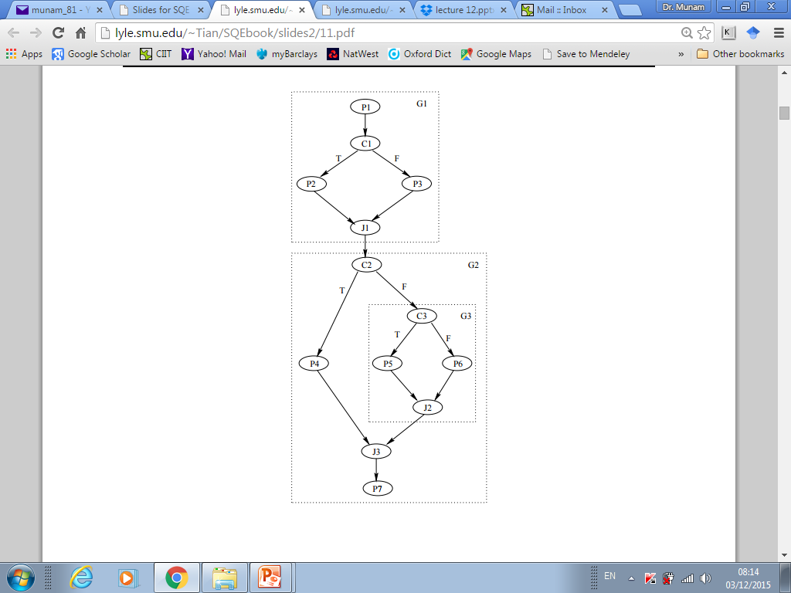
CFG Example
Example: CFG for a proper structured program (seq. concatenation. + nesting, no GOTOs)

Slide 9
CFG: Nodes and Links
• Inlink and outlink defined w.r.t a node.
• Entry/exit/processing nodes:
    . Entry (source/initial) nodes.
    . Exit (sink/final) nodes.
    . Processing nodes.
• Branching & junction nodes & links:
. Branching/decision/condition nodes:
      – multiple outlinks,
      – each marked by a specific condition,
      – only 1 outlink taken in execution.
. Junction nodes:
      – opposite to branching nodes,
      – but no need to mark these inlinks,
– only 1 inlink taken in execution.
. 2-way and N-way branching/junction.

Slide 10
CFG for CFT
• CFGs for our CFT:
. Separate processing/branching/junction
nodes for clarity
. Sequential nodes: mostly processing
⇒ collapsing into one node (larger unit)
. No parallelism allow
(single point of control in all executions).
. Mostly single-entry/single-exit CFGs
. Focus: structured programs, ¬ GOTO.
– GOTOs ⇒ ad hoc testing.
• Notational conventions:
. “Pi” for processing node “i”
. “Ji” for junction node “i”
. “Ci” for condition/branching node “i”

Slide 11
CFT Technique
• Test preparation:
. Build and verify the model (CFG)
. Test cases: CFG ⇒ path to follow
. Outcome checking: what to expect and how to check it
• Other steps: Standard
    . Test planning & procedure preparation.
    . Execution: normal/failure case handling.
    . Analysis and Follow-up
• Some specific attention in standard steps: Confirmation of outcome and route in analysis and follow-up.

Slide 12
CFT: Constructing CFG
• Sources for CFG:
. White box: design/code
– traditional white-box technique
. Black box: specification
– structure and relations in specs
• Program-derived (white-box) CFGs:
. Processing: assignment and calls
. Branch statements:
– binary: if-then-else, if-then
– multi-way: switch-case, cascading if’s.
. Loop statements (later)
. composition: concatenating/nesting.
. structured programming: no GOTOs
– hierarchical decomposition possible.
. explicit/implicit entry/exit

Slide 13
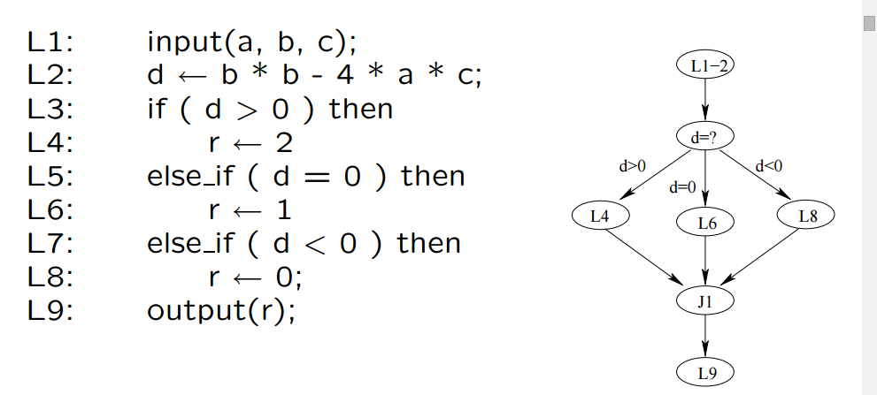
CFT: Constructing WB/CFG
. Analyse program code on left
. derive CFG on right
. focus on decision and branches

Slide 14
CFT: Constructing CFG
• Specification-derived (black-box) CFGs:
  . Node: “do” (enter, calculate, etc.)
  . Branch: “goto/if/when/while/...”
  . Loop: “repeat” (for all, until, etc.)
  . Entry: usually implicit
  . Exit: explicit and implicit
  . External reference as process unit
  . General sequence: “do”...(then)...“do”.
• Comparison to white-box CFGs:
  . Implementation independent.
  . Generally assume structured programs.
  . Other info sources: user-related items
  – usage-scenarios/traces/user-manuals,
  – high-level req. and market analyses.

Slide 15
CFT: Path Definition
• Test cases: CFG ⇒ path to follow
  . Connecting CFG elements together in paths.
  . Define and select paths to cover
  . Sensitize (decide input for) the paths
• Path related concepts/definitions:
  . Path: entry to exit via n intermediate links and nodes.
  . Path segment or sub-path: proper subset of a path.
  . Loop: path or sub-path with 1+ nodes visited 1+ times.
  . Testing based on sub-path combinations. . Loop testing: specialized techniques.

Slide 16
CFT: Path Selection
• Path selection (divide & conquer)
  . Path segment definition
  . Sequential concatenation
  . Nesting of segments
  . Unstructured construction: difficult
  . Eliminate unachievable/dead paths
  (contradictions and correlations)
• “Divide”: hierarchical decomposition for
structured programs.
• “Conquer”: Bottom-up path definition one
segment at a time via basic cases for nesting
and sequential concatenation.

Slide 17
CFT: Other Steps
• CFT: Sensitization: Path sensitization/realization
• CFT: Algebraic Sensitization
Complexity due to dynamic values . Symbolic execution
• CFT: Logic Sensitization:
• Segment and combination . Divide into segments (entry-exit).
• Segment and combination . Divide into segments
• Execution and follow-up: . Path/statement- oriented execution – debugger and other tools helpful . Follow-up: coverage and analysis

Slide 18
Loops: What and Why
• Loop: What is it?
  . Repetitive or iterative process.
  . Graph: a path with one or more nodes visited more than once.
  . Appear in many testing models.
  . Recursion.
• Why is it important?
  . Intrinsic complexity:
  – coverage: how much?
  – effectiveness concerns (above)
  . Practical evidence: loop defects
  . Usage in other testing.

Slide 19
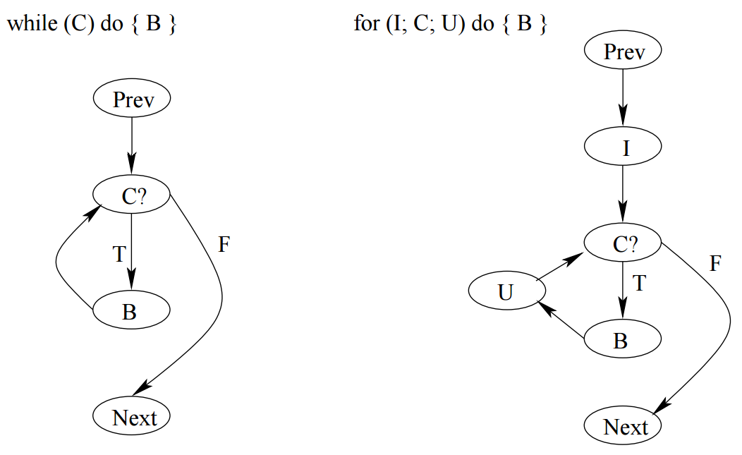
Loop Examples
• Common loop examples:
  . left: “while” loops
  . right: “for” loops
  . other (structured) loops can be converted to these loops

Slide 20
Loop Specification
• Deterministic vs. nondeterministic
– determining #iterations ahead of time?
• Individual loops:
  . Loop control: node, predicate, and control variable.
  . Loop entry/exit.
  . Processing and looping: pre-test, post-test, mixed-test.
• Combining loops: structured (nesting & concat.) vs. non-structured (goto).

Slide 21
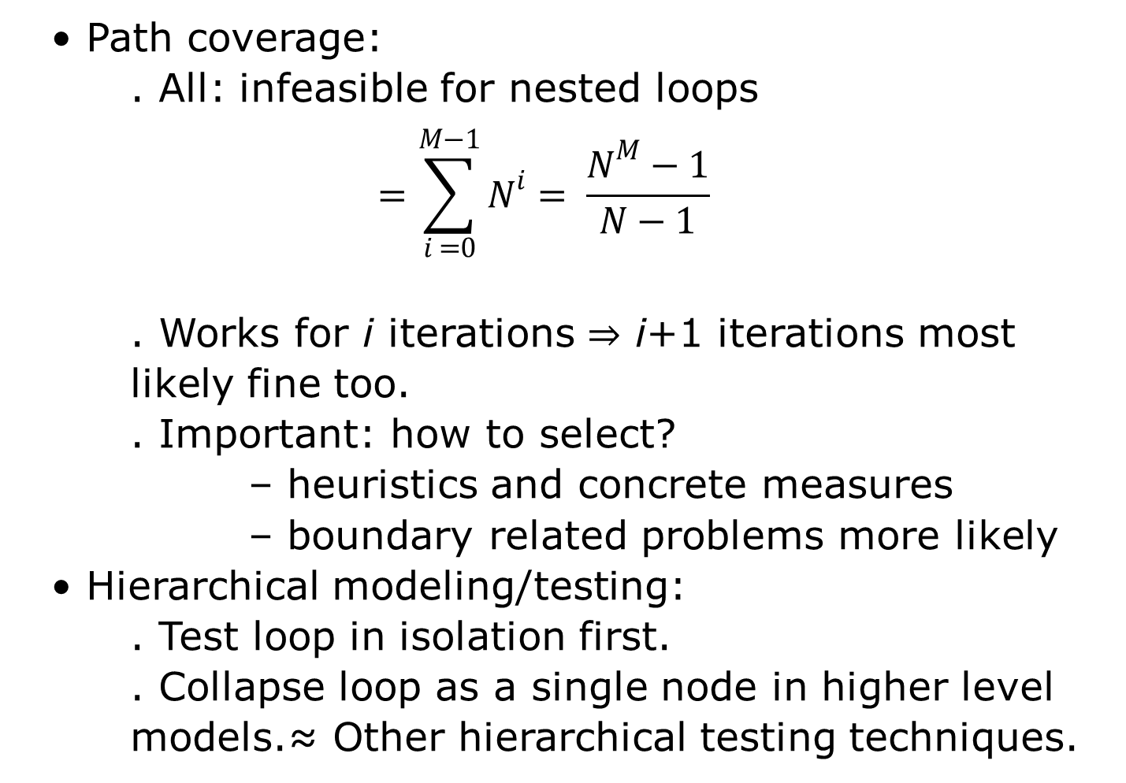
Loop Testing
• Path coverage:
. All: infeasible for nested loops
$$=\sum_{i =0}^{M−1}{N^{i}}= \frac{N^{M}−1}{N−1}$$
. Works for i iterations ⇒ i+1 iterations most likely fine too.
. Important: how to select?
– heuristics and concrete measures
– boundary related problems more likely
• Hierarchical modeling/testing:
. Test loop in isolation first.
. Collapse loop as a single node in higher level models.≈ Other hierarchical testing techniques.

Slide 22
Critical Values for Loop Testing
• General boundary problems:
. Under/over defined problems and closure problems.
. Boundary shift, ±1 problem.
• Lower bound problems:
. Initialization problem.
. Loop execution problem.
. Other boundary problems.
• Lower bound test values:
. Bypass, once, twice.
. Min, min + 1, min − 1.

Slide 23
CFT Usage
• As white box testing (more often):
    . Small programs during unit testing.
    . Coarse-grain system level model.
• As black box testing (less often):
    . Model built on specification
    – higher level constraints as specs.
    . Overall coverage of functionality.
    . Can be used for UBST.
• Application environment:
    . Control flow errors (& decision errors).
    . In combination with other techniques.

Slide 24
CFT: Other Issues
• Limit control flow complexity
  . Proper granularity
  . Hierarchical modeling ideas:
  – external units/internal blocks
  . Combination with other strategies:
  – CFT for frequently-used/critical parts
  . Language/programming methodology
  . Complexity measurement as guidelines
• Need automated support:
  . Models from specifications/programs
  . Sensitization support — debugging
  . Path verification — tracing

Slide 25
Summary of Today’s Lecture
We discussed Control Flow Testing (CFT) and Control Flow Graph (CFG).
We explored details of CFG such as:
  Steps
  Construction
  Issues
  Methods

Slide 26
Overview of Next lecture
Interaction Testing
General Types of Interaction in Execution

Slide 27
The End

