Slide 1
Software Quality Engineering
Lecture No. 9

Slide 2
Part- 2 (a):
Software Testing

Slide 3
Summary of the previous lecture
We discussed basics of software testing. We highlighted why testing is important and how it plays role in SQE
W examined different types of testing such as black box and white box testing.

Slide 4
Outlines
Software Testing Activities
Software Testing Scope
Software Testing Principles
Software Testing Process
Software Testing Myths
Software Testing Limits
Different Types of Software Testing

Slide 5
Objectives
To further understand the basics of Testing
To be able to distinguish between unit, integration and system testing

Slide 6
What is Software Testing
Several definitions:
“Testing is the process of establishing confidence that a program or system does what it is supposed to.” by Hetzel 1973
“Testing is the process of executing a program or system with the intent of finding errors.”
by Myers 1979
“Testing is any activity aimed at evaluating an attribute or capability of a program or system and determining that it meets its required results.”
by Hetzel 1983

Slide 7
What is Software Testing
- One of very important software development phases
- A software process based on well-defined software quality control and testing standards, testing methods, strategy, test criteria, and tools.
- Engineers perform all types of software testing activities to perform a software
test process.
- The last quality checking point for software on its production line

Slide 8
Testing Objectives
The Major Objectives of Software Testing:
- Uncover as many as errors (or bugs) as possible in a given timeline.
- Demonstrate a given software product matching its requirement specifications.
- Validate the quality of a software testing using the minimum cost and efforts.
- Generate high quality test cases, perform effective tests, and issue correct and helpful problem reports.
Major goals:
uncover the errors (defects) in the software, including errors in:
- requirements from requirement analysis
- design documented in design specifications
- coding (implementation)
- system resources and system environment
- hardware problems and their interfaces to software

Slide 9
Who does Software Testing
- Test manager
- manage and control a software test project
- supervise test engineers
- define and specify a test plan
- Software Test Engineers and Testers
- define test cases, write test specifications, run tests
- Independent Test Group
- Development Engineers
- Only perform unit tests and integration tests
- Quality Assurance Group and Engineers
- Perform system testing
- Define software testing standards and quality control process

Slide 10
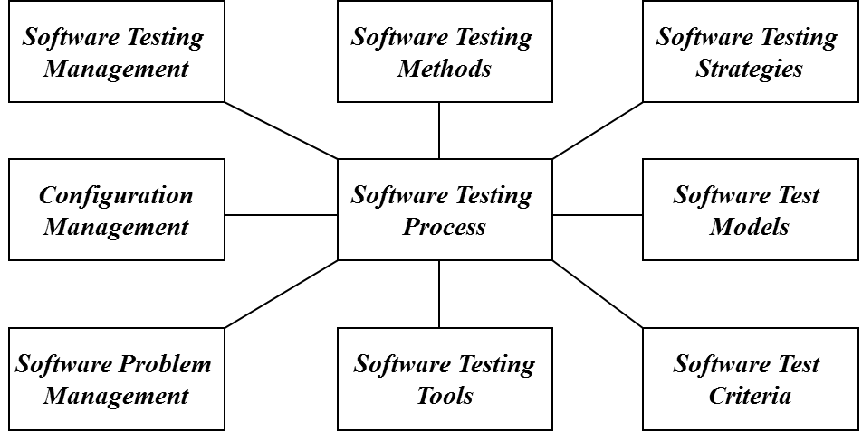
Software Testing Scope

Slide 11
Software Testing Activities
- Test Planning
Define a software test plan by specifying:
- a test schedule for a test process and its activities, as well as assignments
- test requirements and items
- test strategy and supporting tools
- Test Design and Specification
- Conduct software design based well-defined test generation methods.
- Specify test cases to achieve a targeted test coverage.
- Test Set up:
- Testing Tools and Environment Set-up
- Test Suite Set-up
- Test Operation and Execution
- Run test cases manually or automatically

Slide 12
Software Testing Activities
- Test Result Analysis and Reporting
Report software testing results and conduct test result analysis
- Problem Reporting
Report program errors using a systematic solution.
- Test Management and Measurement
Manage software testing activities, control testing schedule, measure testing complexity and cost
- Test Automation
- Define and develop software test tools
- Adopt and use software test tools
- Write software test scripts and facility
- Test Configuration Management
- Manage and maintain different versions of software test suites, test environment and tools, and documents for various product versions.

Slide 13
Verification and Validation
Software testing is one element of a broader topic that is often referred to as
===> Verification and Validation (V&V)
Verification --> refers to the set of activities that ensure that software correctly implements a specific function.
Validation -> refers to a different set of activities that ensure that the software that has been built is traceable to customer requirements.
Boehm [BOE81]:
Verification: “Are we building the product right?”
Validation: “Are we building the right product?”
The definition of V&V encompasses many of SQA activities, including
formal technical reviews, quality and configuration audits
performance monitoring, different types of software testing
feasibility study and simulation

Slide 14
Software Quality Factors
Functionality (exterior quality)
- Correctness, reliability, usability, and integrity
Engineering (interior quality)
- Efficiency, testability, documentation, structure
Adaptability (future qualities)
- Flexibility, reusability, maintainability

Slide 15
Software Testing Principles
Principle #1: Complete testing is impossible.
Principle #2: Software testing is not simple.
  Reasons:
    Quality testing requires testers to understand a system/product completely
    Quality testing needs adequate test set, and efficient testing methods
    A very tight schedule and lack of test tools.
Principle #3: Testing is risk-based.
Principle #4: Testing must be planned.
Principle #5: Testing requires independence.
Principle #6: Quality software testing depends on:
    Good understanding of software products and related domain application
    Cost-effective testing methodology, coverage, test methods, and tools.
    Good engineers with creativity, and solid software testing experience

Slide 16
Software Testing Myths
We can test a program completely. In other words, we test a program exhaustively.
We can find all program errors as long as test engineers do a good job.
We can test a program by trying all possible inputs and states of a program.
A good test suite must include a great number of test cases.
Good test cases always are complicated ones.
Software test automation can replace test engineers to perform good software testing.
Software testing is simple and easy. Anyone can do it. No training is needed.

Slide 17
Software Testing Limits
- Due to the testing time limit, it is impossible to achieve total confidence.
- We can never be sure the specifications are 100% correct.
- We can never be certain that a testing system (or tool) is correct.
- No testing tools can copy with every software program.
- Tester engineers never be sure that they completely understand a software product.
- We never have enough resources to perform software testing.
- We can never be certain that we achieve 100% adequate software testing.

Slide 18
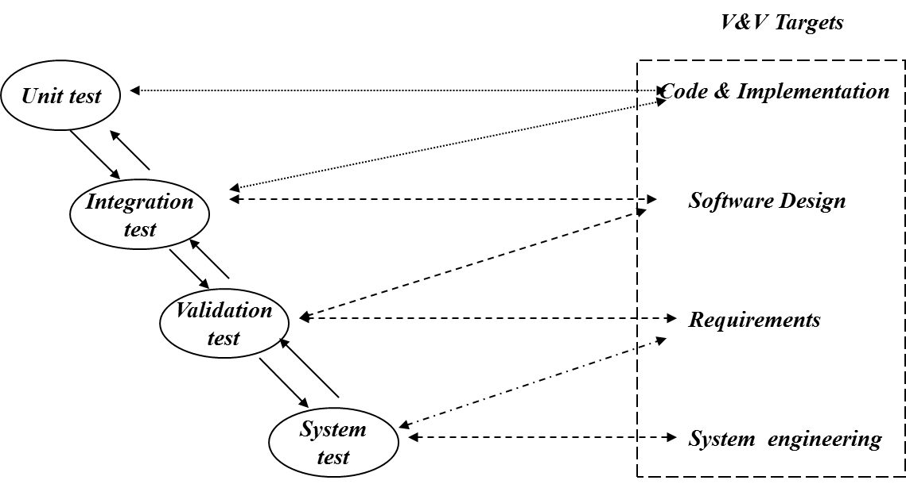
Software Testing Process

Slide 19
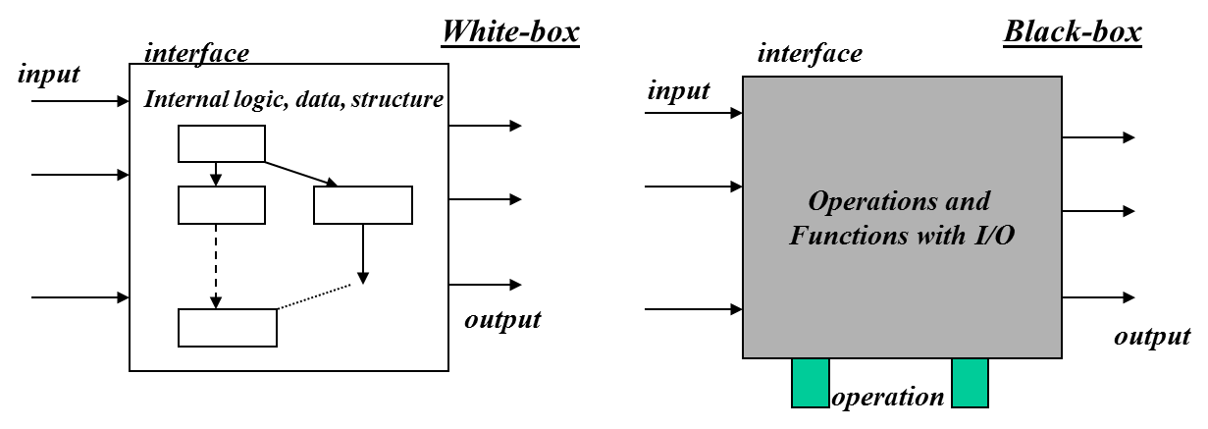
Unit Test (Component Level Test)
Unit testing: Individual components are tested independently to ensure their quality. The focus is to uncover errors in design
and implementation, including:
- data structure in a component
- program logic and program structure in a component
- component interface
- functions and operations of a component
Unit testers: developers of the components.

Slide 20
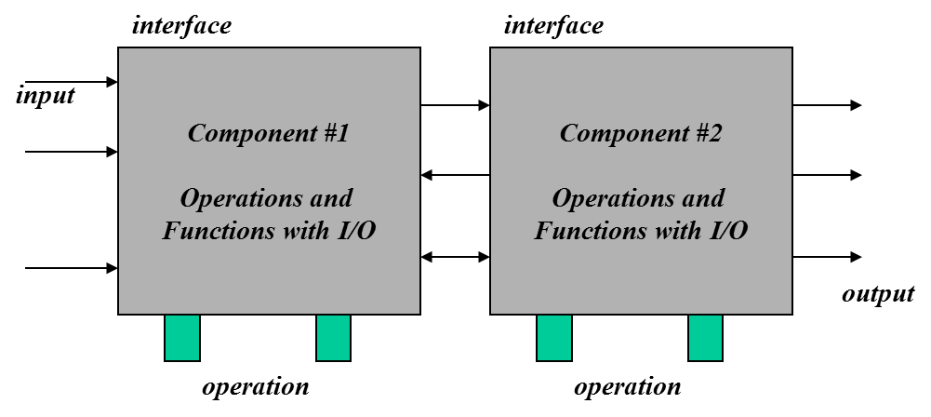
Integration Testing
Integration test: A group of dependent components are tested together to ensure their the quality of their integration unit.
The focus is to uncover errors in:
- Design and construction of software architecture
- Integrated functions or operations at sub-system level
- Interfaces and interactions between them
- Resource integration and/or environment integration
Integration testers: either developers and/or test engineers.

Slide 21
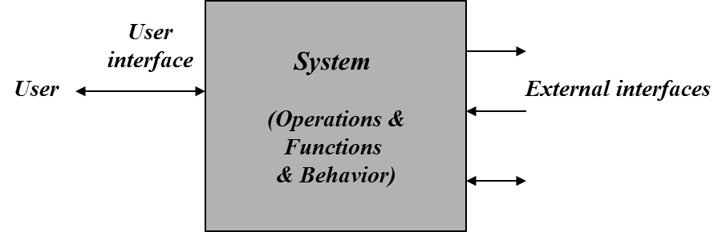
Function Validation Testing
Validation test: The integrated software is tested based on requirements to ensure that we have a right product.
The focus is to uncover errors in:
- System input/output
- System functions and information data
- System interfaces with external parts
- User interfaces
- System behavior and performance
Validation testers: test engineers in ITG or SQA people.

Slide 22
System Testing
System test: The system software is tested as a whole. It verifies all
elements mesh properly to make sure that all system functions and performance are achieved in the target environment.
The focus areas are:
- System functions and performance
- System reliability and recoverability (recovery test)
- System installation (installation test)
- System behavior in the special conditions
(stress and load test)
- System user operations (acceptance test/alpha test)
- Hardware and software integration and collaboration
- Integration of external software and the system
System testers: test engineers in ITG or SQA people.
When a system is to be marketed as a software product, a testing process called
beta testing is often used.

Slide 23
Test Issues in Real World
Software testing is very expensive.
How to achieve test automation?????
When should we stop software testing?
Test criteria, test coverage, adequate testing.
Other software testing:
GUI Testing
Object-Oriented Software Testing
Component Testing and Component-based Software Testing
Domain-specific Feature Testing
Testing Web-based Systems

Slide 24
Summary of Today’s Lecture
In today’s lecture, we explored different definitions of software.
We have also seen different roles which perform software testing such as test managers, testers, SQA people etc.
And lastly, we talked about unit, integration, validation and system testing.

Slide 25
Overview of Next lecture
Our discussion on testing will continue. We will see more details about software testing and how it achieves software quality.

Slide 26
The End

