Slide 1
Software Quality Engineering
Lecture No. 8

Slide 2
Summary of the previous lecture
More on:
    Quality concepts
    Quality control
    Cost of Quality
Statistical Quality Assurance
The SQA Plan

Slide 3
Part- 2 (a):
Software Testing

Slide 4
Outlines
What is testing
Why testing is needed
History of testing
White box testing
Black box testing

Slide 5
Objectives
To understand the basics of Testing
To be able to distinguish between black box testing and white box testing

Slide 6
Software Testing
“Testing is the process of executing a program with the intention of finding errors.”
“Testing can show the presence of bugs but never their absence.”

Slide 7
Objective Testing
Uncover as many as error(or bug) as possible in a given produce.
Demonstrate a given software product matching its requirement specification.
Validate the quality of a software testing using the minimum cost and effort.
Generate high quality test case, perform effective test and issue correct and helpful problem report.

Slide 8
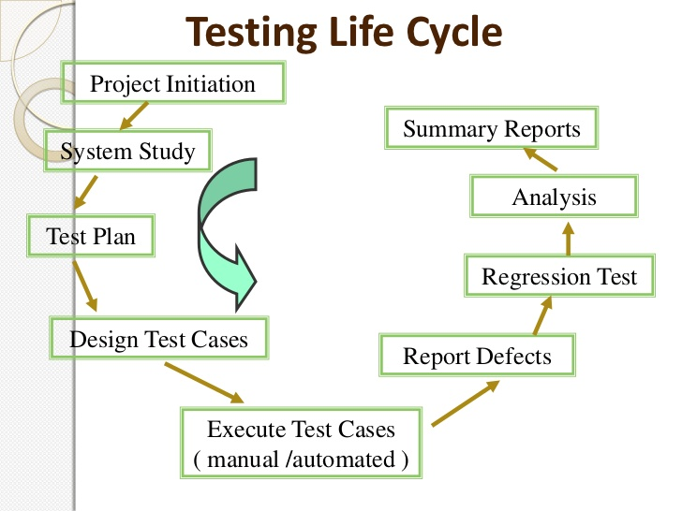

Slide 9
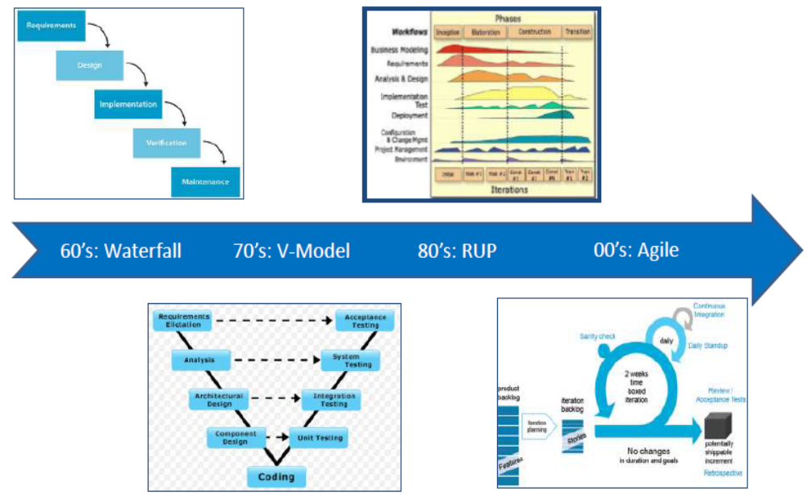
DEVELOPMENT PROCESS EVOLUTION

Slide 10
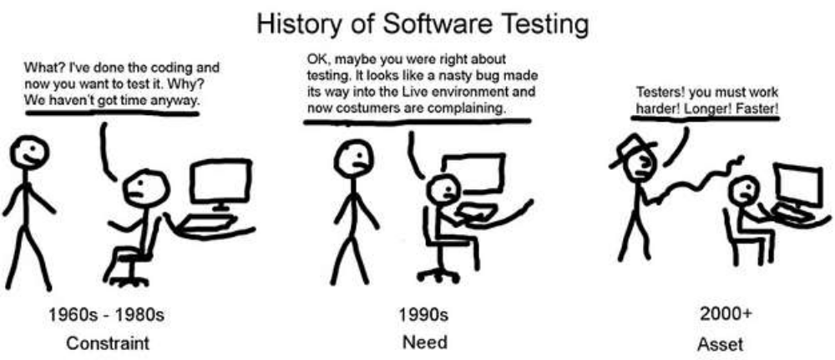
How Testing Has Changed
What? I have done the coding and now you want to test it? Why? We have not got time anyway
OK. May be you were right about testing. It looks like a nasty bug made its way into Live environment and now customers are complaining
Testers! You must work harder! Longer! Fasters!

Slide 11
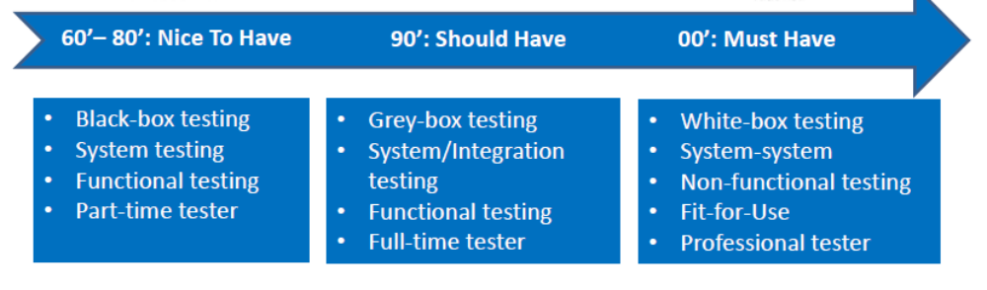
History of Software Testing

Slide 12
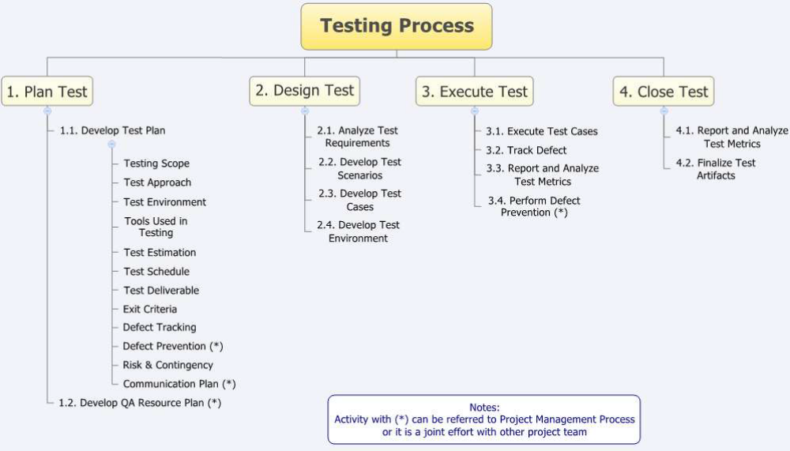
Phases in Testing

Slide 13
Testing Methology
BLACK BOX TESTING
WHITE BOX TESTING

Slide 14
Black Box Testing
No knowledge of internal program design or code required
Testing are based on requirement and functionality

Slide 15
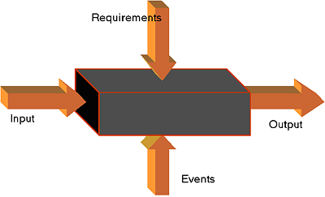
Software is considered as a Black Box

Slide 16
WHITE BOX TESTING
Knowledge of the internal program design and code required.
Test are based on coverage of code statement,branches,path,condition.

Slide 17
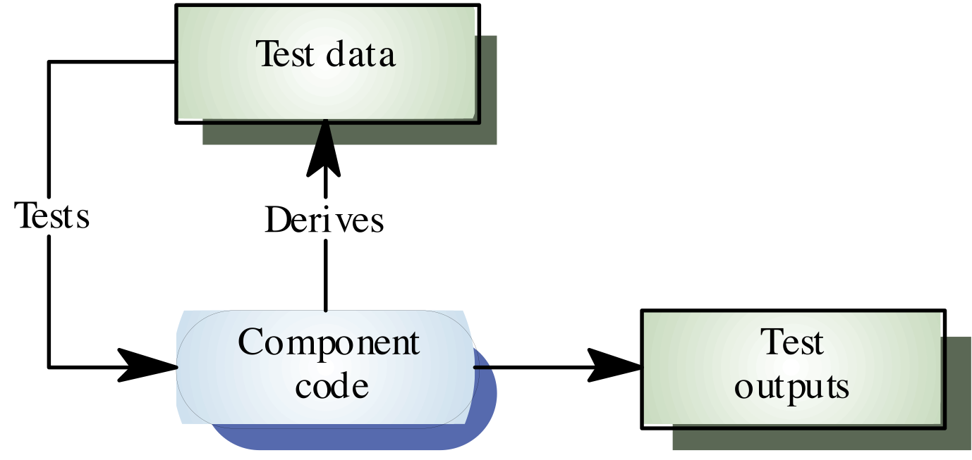

Slide 18
LEVEL OF TESTING
Unit testing
Integration testing
System testing

Slide 19
UNIT TESTING
Test each module individually.
Follows a white box testing.

Slide 20
INTEGRATION TESTING
Once all modules have been tested, integration testing is perform.
It is systematic testing
Produce test to identify errors associated with interfacing.
TYPES:-
  Big bang integration testing
  Top down integration testing
  Bottom up integration testing
  Mixed integration testing

Slide 21
System Testing
This system as a whole is tested to uncover requirement errors.
verifies that all system element work properly and that overall system function and performance has been achieved.
TYPES:-
  Alfa testing
  Beta testing
  Acceptance testing
  Performance testing

Slide 22
Summary of Today’s Lecture
In today’s lecture, we explored what quality is and why it is important in the life cycle of a software.
We explored different types of testing such as white box, black box, unit, integration and system testing.

Slide 23
Overview of Next lecture
Our discussion on Testing will continue and we will explore some challenges associated with testing in real life
We will explore further unit, integration and system testing in details

Slide 24
The End

