Slide 1
Software Quality Engineering
Lecture No. 7

Slide 2
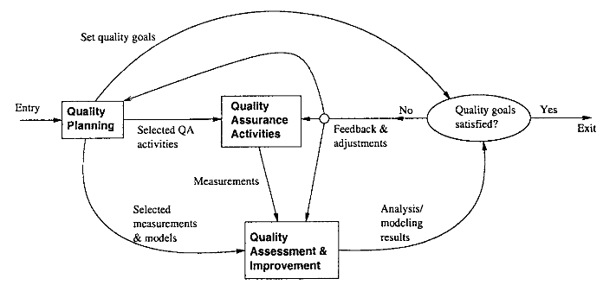
Summary of the previous lecture
QA to SQE
Key SQE Activities
SQE in Software Process
SQE and QIP (quality improvement paradigm)

Slide 3
Last Lecture of Part- 1:
Overview and Basics

Slide 4
Outlines
More on:
    Quality concepts
    Quality control
    Cost of Quality
Statistical Quality Assurance
The SQA Plan

Slide 5
Objectives
To further understand the concept of quality in the life cycle of a software
To be able to distinguish between quality control, quality concept and cost of quality.

Slide 6
Quality Concepts
Software quality assurance is an umbrella activity that is applied throughout the software process.
SQA encompasses:
    (1) a quality management approach
    (2) effective software engineering technology
    (3) formal technical reviews
    (4) a multi-tiered testing strategy
    (5) document change control
    (6) software development standard and its control procedure
    (7) measurement and reporting mechanism)

Slide 7
Quality Concepts
Quality --> refers to measurable characteristics of a software. These items can be compared based on a given standard
Two types of quality control:
Quality design -> the characteristics that designers specify for an item. --> includes: requirements, specifications, and the design of the system.
Quality of conformance -> the degree to which the design specification are followed. It focuses on implementation based on the design.

Slide 8
Quality Control
What is quality control -- the series of inspections, reviews, and test used throughout the develop cycle of a software product
Quality control includes a feedback loop to the process.
Objective ---> minimize the produced defects, increase the product quality. Implementation approaches:
    - Fully automated
    - Entirely manual
    - Combination of automated tools and human interactions

Slide 9
Quality Control
Key concept of quality control:
--> compare the work products with the specified and measurable standards
Quality assurance consists of:
    the auditing and reporting function of management
Goal --> provide management with the necessary data about product quality. --> gain the insight and confidence of product quality

Slide 10
Cost of Quality
Cost of quality --> includes all costs incurred in the pursuit of quality or perform quality related work
Quality cost includes:
    Prevention cost:
    Appraisal cost
    Failure Cost

Slide 11
Cost of Quality
- prevention cost:
    - quality planning
    - formal technical reviews
    - testing equipment
    - training
- appraisal cost:
    - in-process and inter-process inspection
    - equipment calibration and maintenance
    - testing
- failure cost:
    internal failure cost:
    Repair, and failure mode analysis, external failure cost: complaint resolution, product return and replacement, help line support , warranty work

Slide 12
Software Quality Assurance
Three import points for quality measurement:
    - Use requirements as the foundation
    - Use specified standards as the criteria
    - Considering implicit requirements

Slide 13
Software Quality Assurance Group
Who is involved in quality assurance activities?
Software engineers, project managers, customers, sale people, SQA group
Engineers involved the quality assurance work do following:
    - apply technical methods and measures
    - conduct formal technical review
    - perform well-planned software testing

Slide 14
Causes of Errors
Causes of errors:
    - incomplete or erroneous specification (IES)
    - misinterpretation of customer communication (MCC)
    - intentional deviation from specification (IDS)
    - violation of programming standards (VPS)
    - error in data representation (EDR)
    - inconsistent module interface (IMI)
    - error in design logic (EDL)
    - incomplete or erroneous testing (IET)
    - inaccurate or incomplete documentation (IID)
    - error in programming language translation of design (PLT)
    - ambiguous or inconsistent human-computer interface (HCI)
    - miscellaneous (MIS)

Slide 15
The SQA Plan
The SQA plan provides a road map for instituting software quality assurance.
Basic items:
    - purpose of plan and its scope
    - management : organization structure, SQA tasks, their placement in the process - roles and responsibilities related to product quality
    - documentation: Project documents, model, technical documents, user document - standards, practices, and conventions
    - reviews and audits; test - test plan and procedure
    - problem reporting, and correction actions
    - tools; code control; media control; supplier control
    - records collection, maintenance, and retention
    - training; risk management

Slide 16
Summary of Today’s Lecture
In today’s lecture, we explored quality and other related terminologies for SQE and SQA.
We explored different types of Costs, errors and constraints associated with SQE

Slide 17
Overview of Next lecture
We will move to the second part of the course. Here we will discuss :
  Different Software Testing Techniques. Specification Based Testing Techniques, Black-box and Grey-Box Testing, Other Comprehensive Software Testing techniques for SDLC.

Slide 18
The End

