Slide 1
Software Quality Engineering
Lecture No. 6

Slide 2
Part- 1
Overview and Basics

Slide 3
Summary of the previous lecture
QA to SQE
Key SQE Activities
V & V model
SQE in Software Process

Slide 4
Outlines
SQE: Software Quality Engineering
Key SQE Activities
SQE in Software Process

Slide 5
Objectives
To understand SQE in software process
To understand and distinguish between SQE activities

Slide 6
QA to SQE
QA activities need additional support:
    Planning and goal setting
    Management:
      – when to stop?
      – adjustment and improvement, etc.
      – all based on assessments/predictions
Assessment of quality/reliability/etc.:
    Data collection needed
    Analysis and modeling
    Providing feedback for management
QA + above ⇒ software quality engineering (SQE)

Slide 7
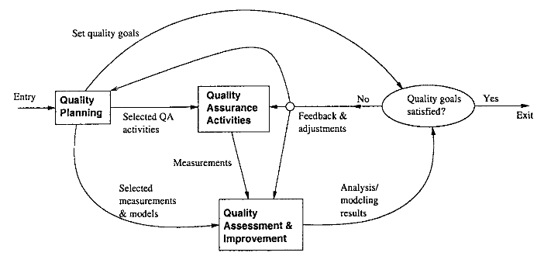
SQE Process
  Quality Engineering Process

Slide 8
SQE Process
  SQE process to link major SQE activities:
  Pre-QA planning;
  QA: covered previously (Lecture 4 and 5);
  Post-QA analysis and feedback
  (maybe parallel instead of “post-”)
  Quality Engineering Process

Slide 9
SQE and QIP
QIP (quality improvement paradigm):
    Step 1: understand baseline
    Step 2: change then assess impact
    Step 3: package for improvement

Slide 10
SQE and QIP
QIP support:
    overall support: experience factory
    measurement/analysis: GQM (goal-question-metric paradigm)
SQE as expanding QA to include QIP ideas

Slide 11
Pre-QA Planning
Pre-QA planning:
    Quality goal
    Overall QA strategy:
    QA activities to perform?
    measurement/feedback planning
Setting quality goal(s):
    Identify quality views/attributes
    Select direct quality measurements
    Assess quality expectations vs. cost

Slide 12
Setting Quality Goals
Identify quality views/attributes
    customer/user expectations,
    market condition,
    product type, etc.
Select direct quality measurements
    direct: reliability
    defect-based measurement
    other measurements
Assess quality expectations vs. cost
    cost-of-quality/defect studies
    economic models: COCOMO etc

Slide 13
Forming QA Strategy
QA activity planning
    evaluate individual QA alternatives
    strength/weakness/cost/applicability/etc.
    match against goals
    integration/cost considerations
Measurement/feedback planning:
    define measurements (defect & others)
    planning to collect data
    preliminary choices of models/analyses
    feedback & follow-up mechanisms, etc.

Slide 14
Measurement Analysis and Feedback
Measurement:
    defect measurement as part of defect handling process
    other data and historical baselines
Analyses: quality/other models
    input: above data
    output/goal: feedback and follow-up
    focus on defect/risk/reliability analyses
Feedback and follow-up:
    frequent feedback: assessments/predictions
    possible improvement areas
    project management and improvement

Slide 15
SQE in Software Processes
SQE activities ⊂ development activities:
    quality planning ⊂ product planning
    QA activities ⊂ development activities
    analysis/feedback ⊂ project management
Fitting SQE in software processes:
    different start/end time
    different sets of activities, sub-activities, and focuses
    In waterfall process: more staged (planning, execution, analysis/feedback)
    In other processes: more iterative or other variations

Slide 16
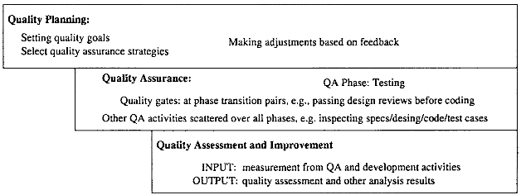
Quality engineering in the waterfall process

Slide 17
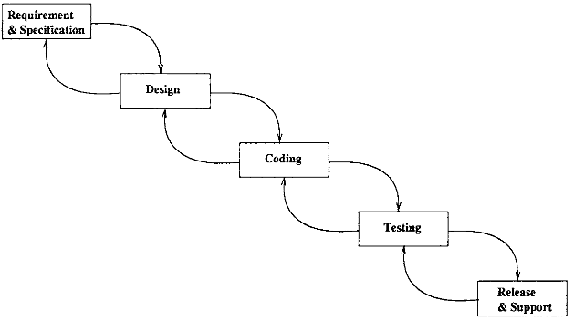
Quality engineering in the waterfall process

Slide 18
SQE Effort Profile
QE activity/effort distribution/dynamics:
    different focus in different phases
    different levels (qualitatively)
    different build-up/wind-down patterns
    impact of product release deadline (deadline-driven activities)
planning: front heavy
QA: activity mix (early vs. late; peak variability? deadline?)
analysis/feedback: tail heavy (often deadline-driven or decision-driven)

Slide 19
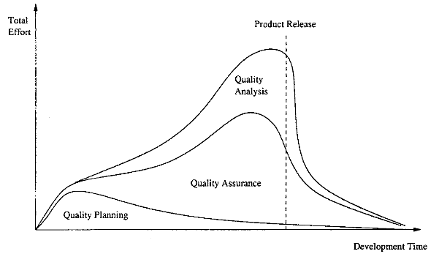
SQE Effort in Waterfall Process
Quality engineering effort profile: The share of different activities as part of the total effort

Slide 20
SQE Effort in Waterfall Process
Effort profile
planning/QA/analysis of total effort
general shape/pattern only (actually data would not be as smooth)
in other processes: – similar but more evenly distributed

Slide 21
Summary of Today’s Lecture
In today’s lecture, we explored Key SQE Activities
We also discussed SQE in Software Process such as waterfall

Slide 22
Overview of Next lecture
We will move to the last lecture of Part-I
We will explore some more expects that leads to or are helpful in SQE

Slide 23
The End

