Slide 1
Software Quality Engineering
Lecture No. 5

Slide 2
Part- 1
Overview and Basics

Slide 3
Summary of the previous lecture
QA Classification
Overview
    Defect prevention
    Testing
    Fault
    Safety

Slide 4
Outlines
QA Context
Quality in software processes
V & V View
DC View
QA: Defect View vs V&V View

Slide 5
Objectives
To understand and distinguish between V&V-view and DC-view of SQE

Slide 6
Quality Assurance in Context
QA and the overall development context
    defect handling/resolution
    activities in process
    alternative perspectives: verification/validation (V&V) view
Defect handling/resolution
    status and tracking
    causal (root-cause) analysis
    resolution: defect removal/etc.
    improvement: break causal chain

Slide 7
Defect Measurement and Analysis
Defect measurement: .
    parallel to defect handling
    where injected/found?
    type/severity/impact?
    more detailed classification possible?
    consistent interpretation
    timely defect reporting
Defect analyses/quality models
    as follow-up to defect handling
    data and historical baselines
    goal: assessment/prediction/improvement
    causal/risk/reliability/etc. analyses

Slide 8
QA in Software Processes
Mega-process:
    initiation, development, maintenance, termination.
Development process components:
    requirement, specification, design, coding, testing, release.

Slide 9
QA in software Process
Process variations:
    waterfall development process
    iterative development process
    spiral development process
    lightweight/agile development processes and XP (extreme programming)
    maintenance process too
    mixed/synthesized/customized processes
QA important in all processes

Slide 10
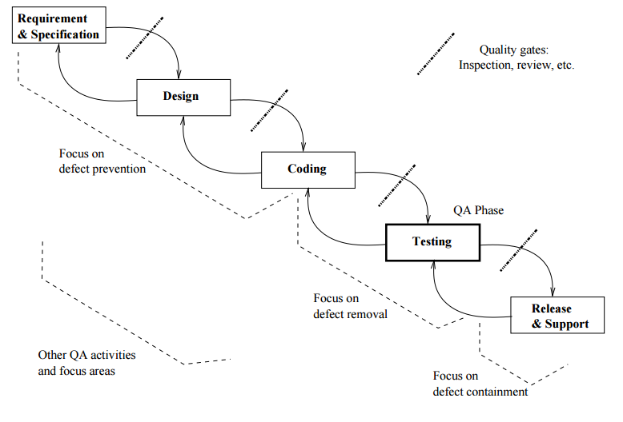
QA in Waterfall Process
defect prevention in early phases . focused defect removal in testing phase . defect containment in late phases . phase transitions: inspection/review/etc

Slide 11
QA in software Processes
Process variations (¬ waterfall) and QA:
    iterative: QA in iterations/increments
    spiral: QA and risk management
    XP: test-driven development
    mixed/synthesized: case specific
    more evenly distributed QA activities
QA in maintenance processes:
    focus on defect handling;
    some defect containment activities for critical or highly-dependable systems;
    data for future QA activities •
QA scattered throughout all processes

Slide 12
V & V
Core QA activities grouped into V&V
Validation: w.r.t. requirement (what?)
    appropriate/fit-for-use/“right thing”?
    scenario and usage inspection/testing;
    system/integration/acceptance testing;
    beta testing and operational support.
Verification: w.r.t. specification/design (how?)
    correct/“doing things right”?
    design as specification for components;
    structural and functional testing;
    inspections and formal verification.

Slide 13
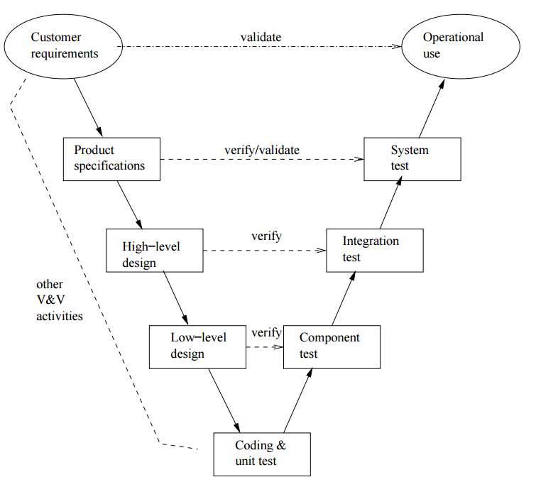
V&V in Software Process
V & V
V-model

Slide 14
V&V in Software Process
V-model as bent-over waterfall .
left-arm: implementation (& V&V)
right-arm: testing (& V&V)
user@top vs. developer@bottom
V&V vs DC View
  Two views of QA:
    V&V view
    DC (defect-centered)
    Interconnected: mapping possible?

Slide 15
V&V vs DC View
Mapping between V&V and DC view:
    V&V after commitment (defect injected already) ⇒ defect removal & containment focus
    Verification: more internal focus
    Validation: more external focus
    In V-model: closer to user (near top) or developer (near bottom)?

Slide 16
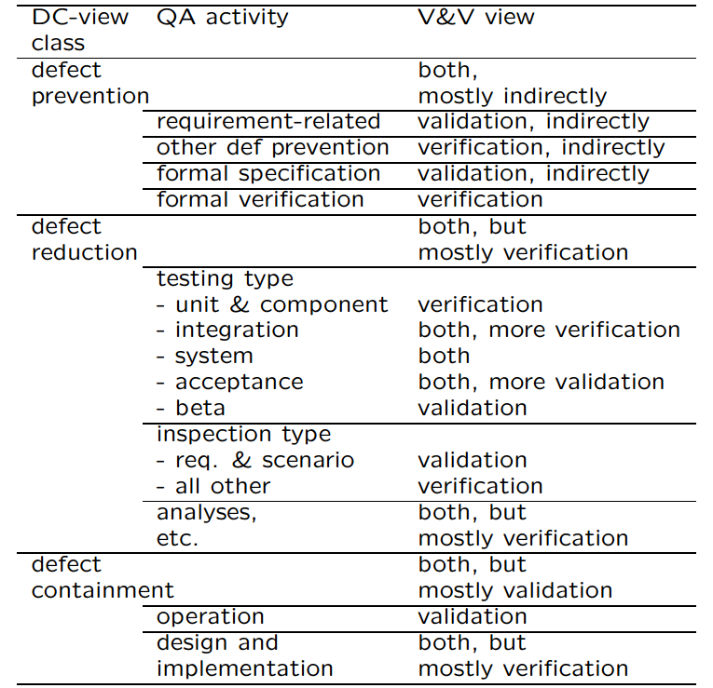
DC-V&V Mapping

Slide 17
Summary of Today’s Lecture
QA in Software Processes
We explored some V & V model
We compared and contrasted V & V and DC views

Slide 18
Overview of Next lecture
QA to SQE
Key SQE Activities
SQE in Software Process
SQE and QIP (quality improvement paradigm)

Slide 19
The End

