Slide 1
Software Quality Engineering
Lecture No. 4

Slide 2
Part- 1
Overview and Basics

Slide 3
Summary of the previous lecture
ISO-9126 Quality Framework
Other Quality Frameworks
Correctness, Defects and Quality
    Failure, Fault, error, bug, defect
Quality, as a Historical Perspective

Slide 4
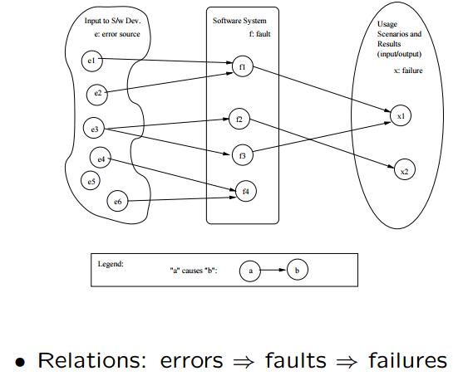
Summary of the previous lecture

Slide 5
Outlines
QA Classification
Overview
    Defect prevention
    Testing
    Fault
    Safety

Slide 6
Objectives
To describe how to prevent and stop defects
To briefly overview some concepts related to SQE

Slide 7
Quality Assurance
Quality Assurance mainly deals in
    Dealing with Defect
    Defect Prevention
    Defect Detection and Removal
QA focus on correctness aspect of Q
QA as dealing with defects
  – post-release: impact on consumers
  – pre-release: what producer can do .
what: testing & many others
when: earlier ones desirable (lower cost) but may not be feasible
how ⇒ classification below

Slide 8
How to deal with defects
Quality Assurance mainly deals in
    Prevention
    Removal (but detect them first)
    Containment (control)

Slide 9
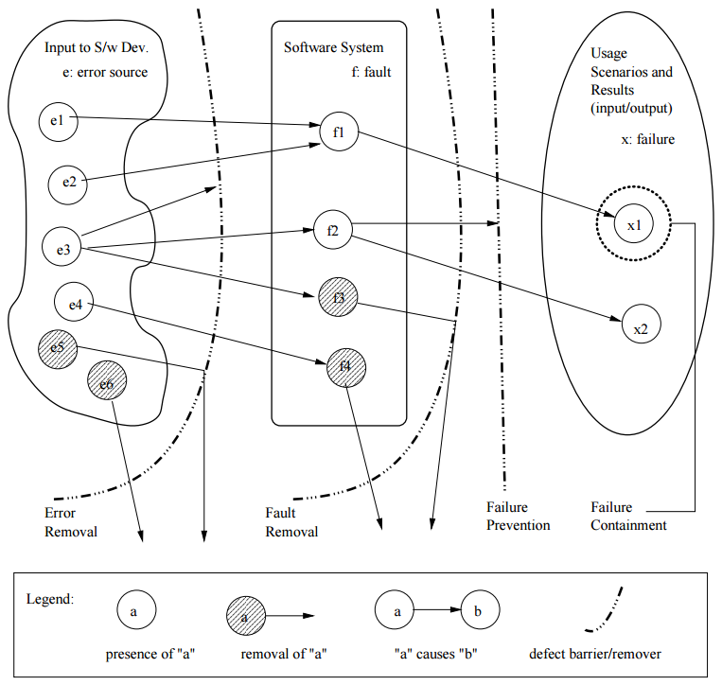
QA Classification
Dealing with errors, faults, or failures
Removing or blocking defect sources
Preventing undesirable consequences

Slide 10
Error/Fault/Failure & QA
Preventing fault injection
    error blocking (errors 6⇒ faults)
    error source removal
Removal of faults (pre: detection)
    inspection: faults discovered/removed
    testing: failures trace back to faults
Failure prevention and containment:
    local failure 6⇒ global failure – via dynamic measures to tolerate faults
    failure impact↓ ⇒ safety assurance

Slide 11
Overview of some topics related to SQE
We will briefly overview the following
    Detect Prevention Overview
    Testing Overview
    Fault Tolerance Overview
    Safety Assurance Overview
    Formal Method Overview
    Inspection Overview

Slide 12
Defect Prevention Overview
Error blocking
    error: missing/incorrect actions .
    direct intervention to block errors ⇒ fault injections prevented
    rely on technology/tools/etc.
Error source removal .
    root cause analysis ⇒ identify error sources
    removal through education/training/etc.
Systematic defect prevention via process improvement.

Slide 13
Formal Method Overview
Motivation .
    fault present: – revealed through testing/inspection/etc.
    fault absent: formally verify. (formal methods ⇒ fault absent)
Basic ideas .
    behavior formally specified:
      – pre/post conditions, or
      – as mathematical functions. .
    verify “correctness”: – intermediate states/steps, – axioms and compositional rules. .
    Approaches: axiomatic/functional/etc.

Slide 14
Inspection Overview
Artifacts (code/design/test-cases/etc.) from req./design/coding/testing/etc. phases.
Informal reviews:
    self-conducted reviews.
    independent reviews.
    orthogonality of views desirable.
Formal inspections:
    Fagan inspection and variations.
    process and structure.
    individual vs. group inspections.
    what/how to check: techniques

Slide 15
Testing Overview
Product/Process characteristics: .
    object: product type, language, etc.
    scale/order: unit, component, system, who: self, independent, 3rd party
What to check:
    verification vs. validation
    external specifications (black-box) .
    internal implementation (white/clear-box)
Criteria: when to stop?
    coverage of specs/structures. .
    reliability ⇒ usage-based testing

Slide 16
Fault Tolerance Overview
Motivation .
    fault present but removal infeasible/impractical
    fault tolerance ⇒ contain defects
FT techniques: break fault-failure link
    recovery: rollback and redo
    NVP: N-version programming – fault blocked/out-voted

Slide 17
Safety Assurance Overview
Extending FT idea for safety:
    – fault tolerance to failure “tolerance”
Safety related concepts: .
    safety: accident free .
    accident: failure w/ severe consequences
    hazard: precondition to accident
Safety assurance:.
    hazard analysis
    hazard elimination/reduction/control
    damage control

Slide 18
Summary of Today’s Lecture
We explored some standards of Quality Engineering
Furthermore, we briefly overviewed following
    Detect Prevention Overview
    Testing Overview
    Fault Tolerance Overview
    Safety Assurance Overview
    Formal Method Overview
    Inspection Overview

Slide 19
Overview of Next lecture
Defect Handling
QA in Software Processes
V&V Perspective
QA: Defect View vs V&V View

Slide 20
The End

