Slide 1
Software Quality Engineering
Lecture No. 3

Slide 2
Part- 1
Overview and Basics

Slide 3
Summary of the previous lecture
Meeting People’s Quality Expectations
General Expectations
Meeting Quality Expectations
    Internal Expectations / Consumer Expectations
    External Expectations / Producer Expectations
Software Quality Engineering (SQE) activities
    Testing => Quality Assurance Alternatives => SQE
Software Quality Framework

Slide 4
Outlines
ISO-9126 Quality Framework
Other Quality Frameworks
Correctness, Defects and Quality
Quality, as a Historical Perspective
How to prevent defect

Slide 5
Objectives
To describe the standards for quality engineering
To understand and distinguish between correctness defect and quality and detection, prevention and removal

Slide 6
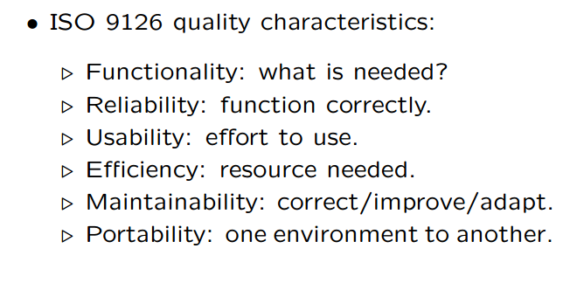
ISO-9126 Quality Framework

Slide 7
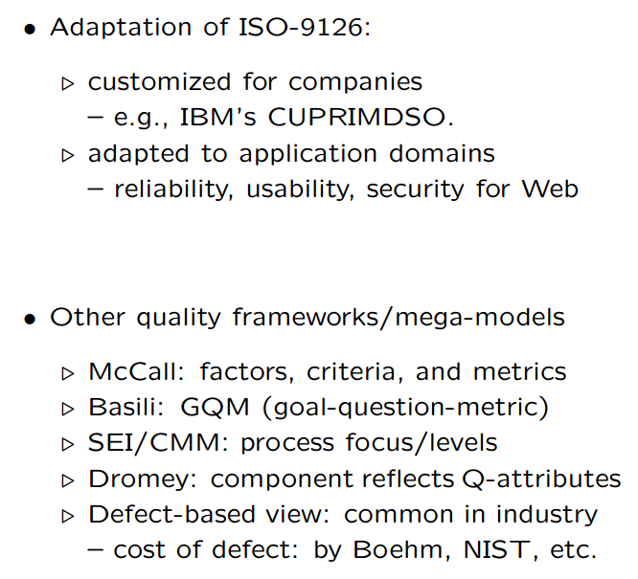
Other Quality Frameworks

Slide 8
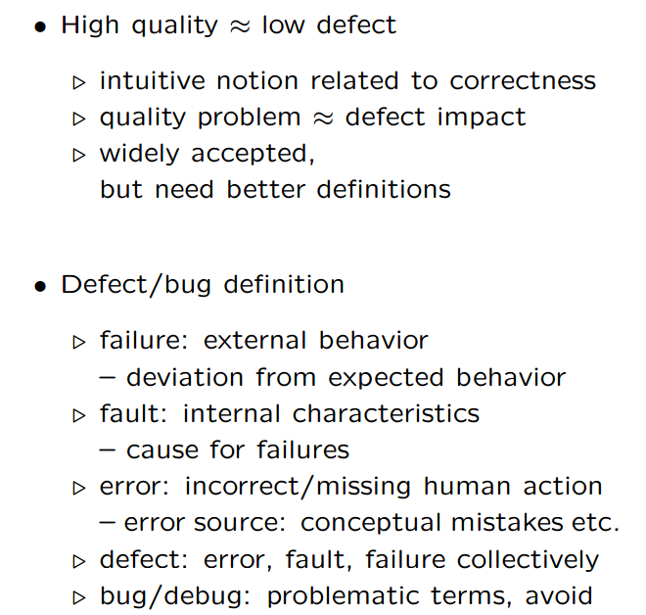
Correctness, Defect and Quality

Slide 9
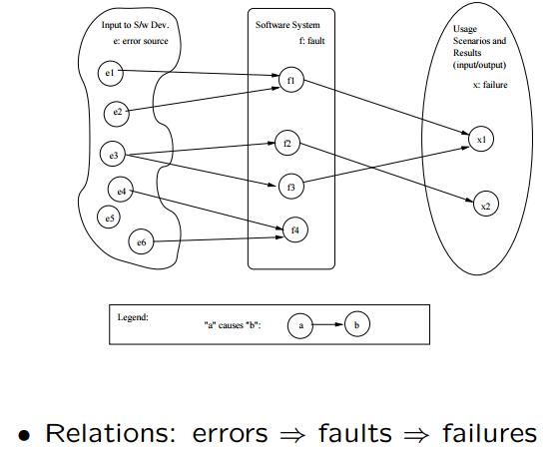
Correctness, Defect and Quality

Slide 10
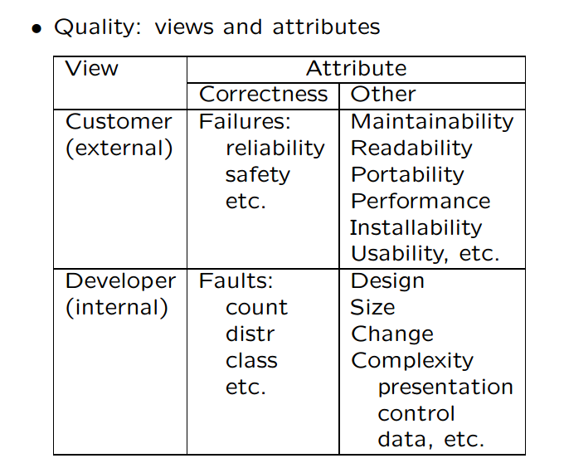
Defining Quality in SQE

Slide 11
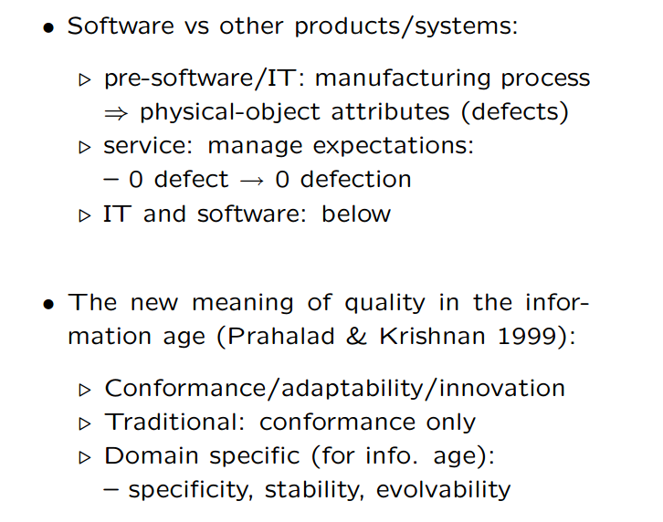
Quality: Historical Perspective

Slide 12
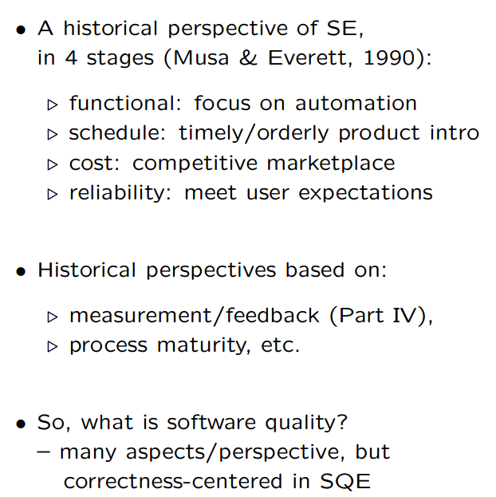
Quality: Historical Perspective (conti..)

Slide 13
Quality Assurance
Quality Assurance mainly deals in
    Dealing with Defect
    Defect Prevention
    Defect Detection and Removal
QA focus on correctness aspect of Q
QA as dealing with defects
  – post-release: impact on consumers
  – pre-release: what producer can do .
what: testing & many others
when: earlier ones desirable (lower cost) but may not be feasible
how ⇒ classification below

Slide 14
Summary of Today’s Lecture
We explored some standards of Quality Engineering
Furthermore, we briefly overviewed following
    Fault, error , bug
    Detect Prevention Overview

Slide 15
Overview of Next lecture
    Testing Overview
    Fault Tolerance Overview
    Safety Assurance Overview
    Formal Method Overview
    Inspection Overview

Slide 16
The End

