Slide 1
Software Quality Engineering
CSE302

Slide 2
Part - 1: Overview and Basics.
The main concepts that are discussed in this part are:
Overview. What is Quality? Quality Assurance, QA in Context, Quality Engineering and the Quality Challenge.

Slide 3
Part- 1
Overview and Basics

Slide 4
Summary of the previous lecture
What is a software?
    Characteristics of a Software
What is Engineering?
    What is difference between engineering, manufacturing and construction
What is Quality?

Slide 5
Outlines
Meeting People’s Quality Expectations
General Expectations
Quality Expectations
Meeting Quality Expectations
Software Quality Engineering (SQE) activities

Slide 6
Objectives
To describe the basics of what is expected as quality
To understand and distinguish between people expectations and software quality expectations.

Slide 7
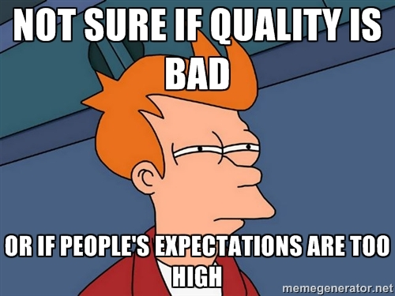
Meeting People’s Quality Expectations
As we previously discussed, if people’s expectations are met in any product, then the product is supposed to have quality in it.
Must perform expected behavior.

Slide 8
General Expectations
General expectation: “good” software quality
• Objects of our study: software
    software products, systems, and services
    stand-alone to embedded
    software-intensive systems
    wide variety, but focus on software
• Quality (and how “good”) formally defined in Ch.2

Slide 9
Quality Expectations
People: Consumers vs producers .
    quality expectations by consumers
    to be satisfied by producers through software quality engineering (SQE)
Deliver software system that... .
    does what it is supposed to do –
      needs to be “validated” .
    does the things correctly
    – needs to be “verified” .
      show/demonstrate/prove it (“does”) – modeling/analysis needed

Slide 10
Meeting Quality Expectations
Difficulties in achieving good quality:
    size: MLOC products common
    Complexity
    environmental stress/constraints
    flexibility/adaptability expected
Other difficulties/factors:
    product type
    cost and market conditions

Slide 11
Major SQE Activities
Major SQE Activities:
    Testing: MLOC products common
    Other quality assurance alternatives to testing
    How do you know: analysis & modeling
Scope and content hierarchy:
Software Quality Engineering
Quality Assurance
Testing

Slide 12
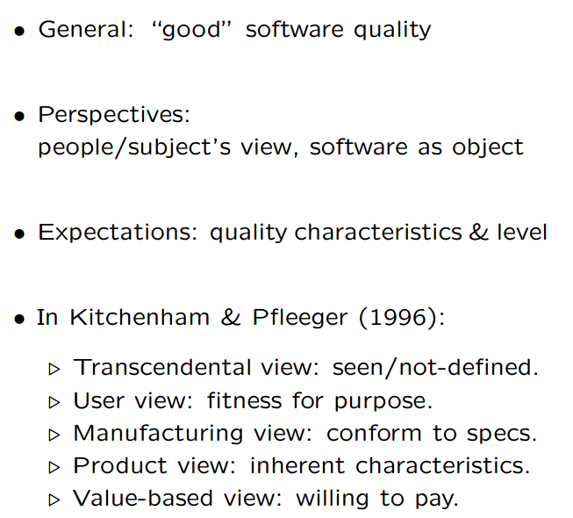
Perspectives and Expectations

Slide 13
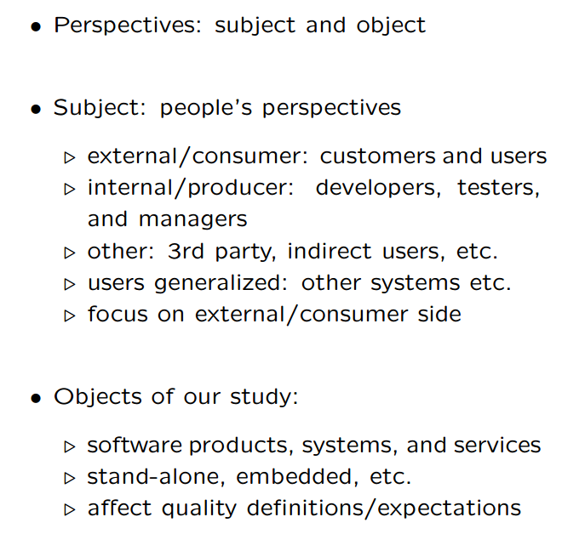
Quality Perspective

Slide 14
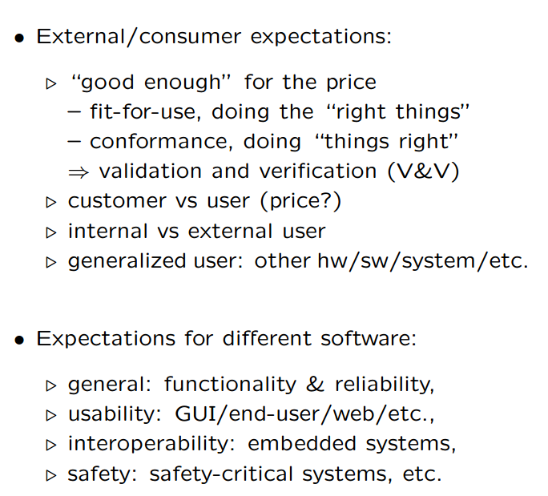
Quality Expectations

Slide 15
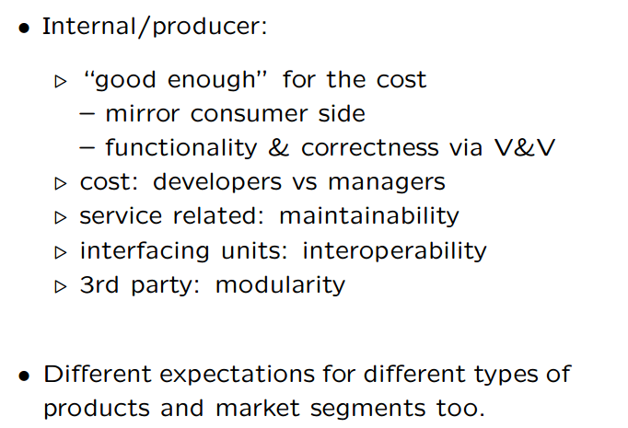
Quality Expectations (conti..)

Slide 16
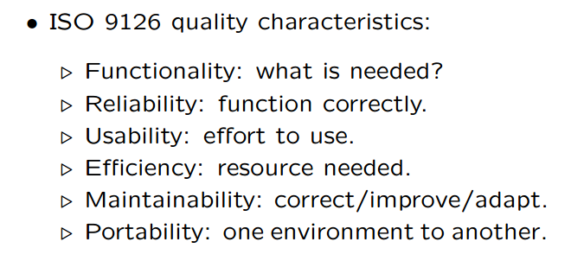
ISO-9126 Quality Framework

Slide 17
Summary of Today’s Lecture
We explored the concept of quality from different aspects.
We have also seen what is a defect or failure to the quality.
Lastly, we talked about the history of the Quality

Slide 18
Overview of Next lecture
QA as Dealing with Defect
Defect Prevention
Defect Detection and Removal
Defect Containment

Slide 19
The End

