Slide 1
Artificial Intelligence
Lecture No. 6
Dr. Asad Ali Safi
​
Assistant Professor,
Department of Computer Science,
COMSATS Institute of Information Technology (CIIT) Islamabad, Pakistan.

Slide 2
Summary of Previous Lecture
Different types of Environments
IA examples based on Environment
Agent types
  Simple reflex agents
  Reflex agents with state/model
  Goal-based agents
  Utility-based agents

Slide 3
Today’s Lecture
Problem solving by searching
What is Search?
Problem formulation
Search Space Definitions
Goal-formulation
Searching for Solutions Visualize Search Space as a Graphs

Slide 4
Problem-Solving Agent
In which we look at how an agent can decide what to do by systematically considering the outcomes of various sequences of actions that it might take.
- Stuart Russell & Peter Norvig

Slide 5
Problem solving agent
A kind of Goal-based agent.
Decide what to do by searching sequences of actions that lead to desirable states.

Slide 6
Problem Definition
Initial state : starting point
Operator: description of an action
State space: all states reachable from the initial state by any sequence action
Path: sequence of actions leading from one state to another
Goal test: which the agent can apply to a single state description to determine if it is a goal state
Path cost function: assign a cost to a path which the sum of the costs of the individual actions along the path.

Slide 7
What is Search?
Search is the systematic examination of states to find path from the start/root state to the goal state.
The set of possible states, together with operators defining their connectivity the search space.
The output of a search algorithm is a solution, that is, a path from the initial state to a state that satisfies the goal test.
In real life search usually results from a lack of knowledge. In AI too search is merely a offensive instrument with which to attack problems that we can't seem to solve any better way.

Slide 8
Search groups
Search techniques fall into three groups:
Methods which find any start - goal path,
Methods which find the best path,
Search methods in the face of opponent.

Slide 9
Search
An agent with several immediate options of unknown value can decide what to do by first examining different possible sequences of actions that lead to states of known value, and then choosing the best one. This process is called search.
A search-algorithm takes a problem as input and returns a solution in the form of an action sequence.

Slide 10
Problem formulation
What are the possible states of the world relevant for solving the problem?
What information is accessible to the agent?
How can the agent progress from state to state?
Follows goal-formulation.
Courtesy: Dr. Franz J. Kurfess

Slide 11
Well-defined problems and solutions
A problem is a collection of information that the agent will use to decide what to do.
Information needed to define a problem:
  The initial state that the agent knows itself to be in.
  The set of possible actions available to the agent.
    Operator denotes the description of an action in terms of which state will be reached by carrying out the action in a particular state.
    Also called Successor function S. Given a particular
    state x, S (x) returns the set of states reachable from x by any single action.

Slide 12
State space and a path
State space is the set of all states reachable from the initial state by any sequence of actions.
Path in the state space is simply any sequence of actions leading from one state to another.

Slide 13
Search Space Definitions
Problem formulation
  Describe a general problem as a search problem
Solution
  Sequence of actions that transitions the world from the initial state to a goal state
Solution cost (additive)
  Sum of the cost of operators
  Alternative: sum of distances, number of steps, etc.
Search
  Process of looking for a solution
  Search algorithm takes problem as input and returns solution
  We are searching through a space of possible states
Execution
  Process of executing sequence of actions (solution)

Slide 14
Goal-formulation
What is the goal state?
What are important characteristics of the goal state?
How does the agent know that it has reached the goal?
Are there several possible goal states?
  Are they equal or are some more preferable?
Courtesy: Dr. Franz J. Kurfess

Slide 15
Goal
We will consider a goal to be a set of world states – just those states in which the goal is satisfied.
Actions can be viewed as causing transitions between world states.

Slide 16
Looking for Parking
Going home; need to find street parking
Formulate Goal:
  Car is parked
Formulate Problem:
  States: street with parking and car at that street
  Actions: drive between street segments
Find solution:
  Sequence of street segments, ending with a street with parking

Slide 17
Example Problem
Start Street
Street with
Parking

Slide 18
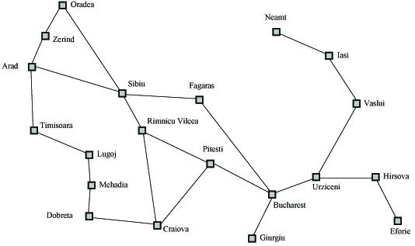
Search Example
Formulate goal: Be in Bucharest.
Formulate problem: states are cities, operators drive between pairs of cities
Find solution: Find a sequence of cities (e.g., Arad, Sibiu, Fagaras, Bucharest) that leads from the current state to a state meeting the goal condition

Slide 19
Problem Formulation
A search problem is defined by the
Initial state (e.g., Arad)
Operators (e.g., Arad -> Zerind, Arad -> Sibiu, etc.)
Goal test (e.g., at Bucharest)
Solution cost (e.g., path cost)

Slide 20
Examples (2) Vacuum World
8 possible world states
3 possible actions: Left/Right/ Suck
Goal: clean up all the dirt= state(7) or state(8)

Slide 21
Vacuum World
S₁
S₂
S₃
S₆
S₅
S₄
S₇
S₈
States: S₁ , S₂ , S₃ , S₄ , S₅ , S₆ , S₇ , S₈
Operators: Go Left , Go Right , Suck
Goal test: no dirt left in both squares
Path Cost: each action costs 1.

Slide 22
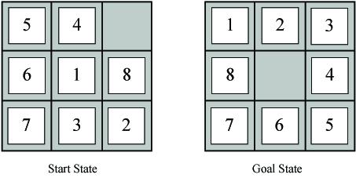
Example Problems – Eight Puzzle
States: tile locations
Initial state: one specific tile configuration
Operators: move blank tile left, right, up, or down
Goal: tiles are numbered from one to eight around the square
Path cost: cost of 1 per move (solution cost same as number of most or path length)
Eight Puzzle
http://mypuzzle.org/sliding

Slide 23
Single-State problem and
Multiple-States problem
World is accessible ➔ agent’s sensors give enough information about which state it is in (so, it knows what each of its action does), then it calculate exactly which state it will be after any sequence of actions. Single-State problem
world is inaccessible ➔ agent has limited access to the world state, so it may have no sensors at all. It knows only that initial state is one of the set {1,2,3,4,5,6,7,8}. Multiple-States problem

Slide 24
Think of the graph defined as follows:
  the nodes denote descriptions of a state of the world, e.g., which blocks are on top of what in a blocks scene, and where the links represent actions that change from one state to the other.
  A path through such a graph (from a start node to a goal node) is a "plan of action" to achieve some desired goal state from some known starting state. It is this type of graph that is of more general interest in AI.

Slide 25
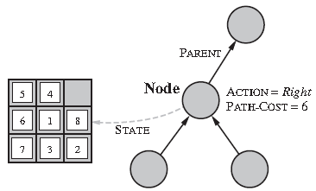
Searching for Solutions
Visualize Search Space as a Tree
States are nodes
Actions are edges
Initial state is root
Solution is path from root to goal node
Edges sometimes have associated costs
States resulting from operator are children

Slide 26
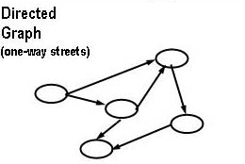
Directed graphs
A graph is also a set of nodes connected by links but where loops are allowed and a node can have multiple parents.
We have two kinds of graphs to deal with: directed graphs, where the links have direction (one-way streets).

Slide 27
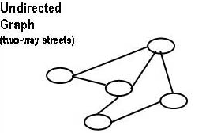
Undirected graphs
undirected graphs where the links go both ways. You can think of an undirected graph as shorthand for a graph with directed links going each way between connected nodes.

Slide 28
Searching for solutions:
Graphs or trees
The map of all paths within a state-space is a graph of nodes which are connected by links.
Now if we trace out all possible paths through the graph, and terminate paths before they return to nodes already visited on that path, we produce a search tree.
Like graphs, trees have nodes, but they are linked by branches.
The start node is called the root and nodes at the other ends are leaves.
Nodes have generations of descendents.
The aim of search is not to produce complete physical trees in memory, but rather explore as little of the virtual tree looking for root-goal paths.

Slide 29
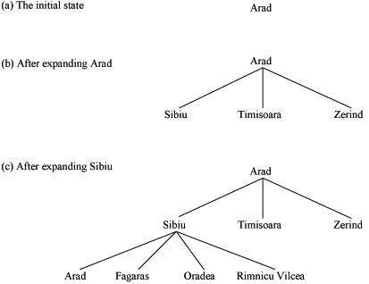
Search Problem Example (as a tree)
(start: Arad, goal: Bucharest.)

Slide 30
Summery of Today’s Lecture
Problem solving by searching
What is Search?
Problem formulation
Search Space Definitions
Goal-formulation
Examples
Searching for Solutions Visualize Search Space as a Graphs
Directed graphs and Undirected graphs

