Slide 1
Artificial Intelligence
Lecture No. 30
Dr. Asad Ali Safi
​
Assistant Professor,
Department of Computer Science,
COMSATS Institute of Information Technology (CIIT) Islamabad, Pakistan.

Slide 2
Summary of Previous Lecture
Single Layer Perceptron
Multi-Layer Networks
Example
Training Multilayer Perceptron

Slide 3
Today’s Lecture
Unsupervised learning
Unsupervised learning Approaches
Self Organizing Map (SOM)

Slide 4
Unsupervised learning
By applying unsupervised learning trying to find hidden structure in unlabeled data.
Since the examples given to the learner are unlabeled, there is no error or reward signal to evaluate a potential solution. This distinguishes unsupervised learning fromsupervised learning and reinforcement learning.

Slide 5
Unsupervised learning Approaches
Approaches to unsupervised learning include:
  clustering
blind signal separation using feature extraction techniques for dimensionality reduction
Among neural network models, the self-organizing map (SOM) and adaptive resonance theory(ART) are commonly used unsupervised learning algorithms.

Slide 6
Self-Organizing Map (SOM)

Slide 7
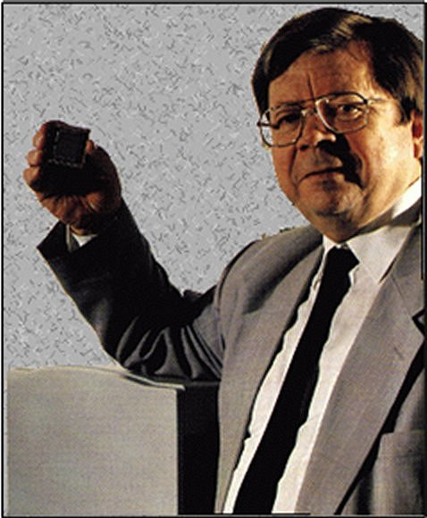
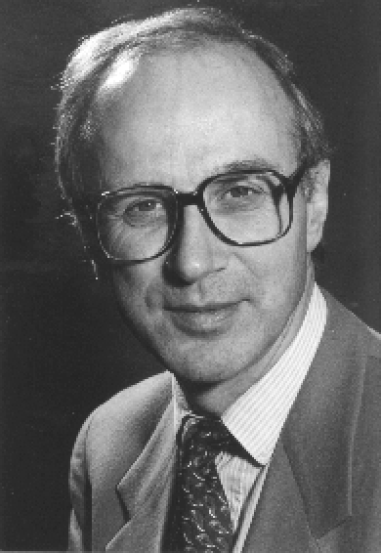
Kohonen Self Organizing Map
Developed by this guy (Teuvo Kohonen) at U of Helsinki in the early 1980s.
Based on work by this guy (Christoph von der Malsburg) at Ruhr-Universität Bochum in the mid-1970s.

Slide 8
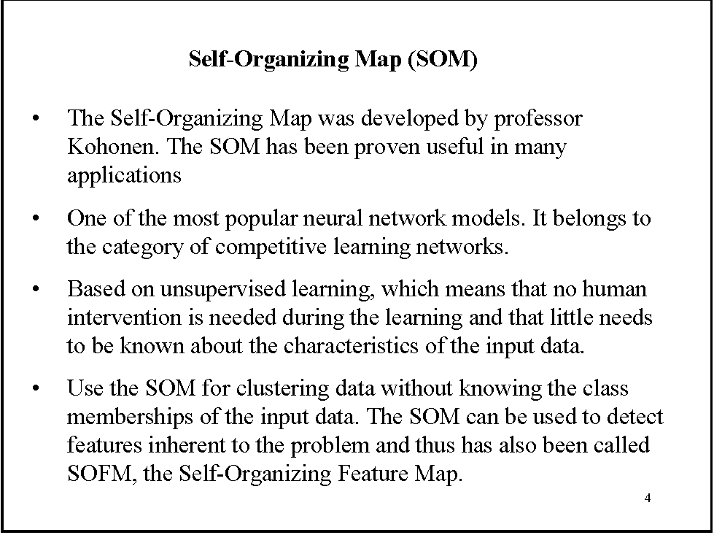

Slide 9
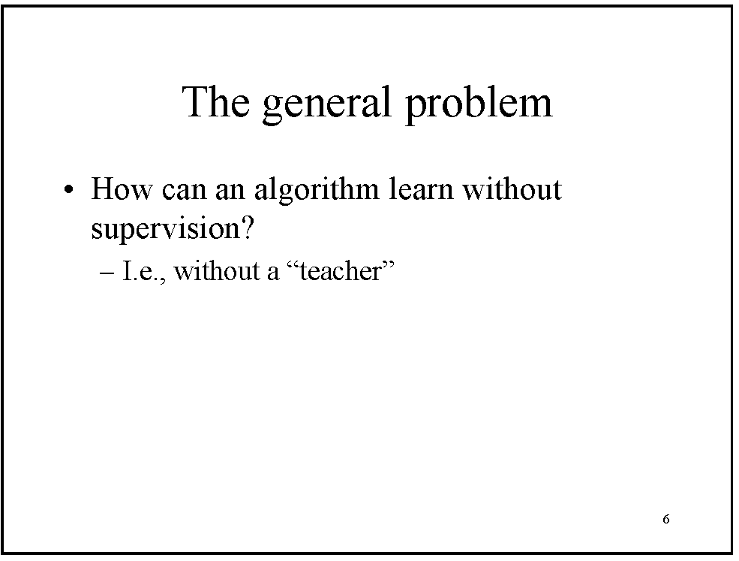

Slide 10


































































Items

Slide 11
sometimes you need a way to group stuff.

Slide 13


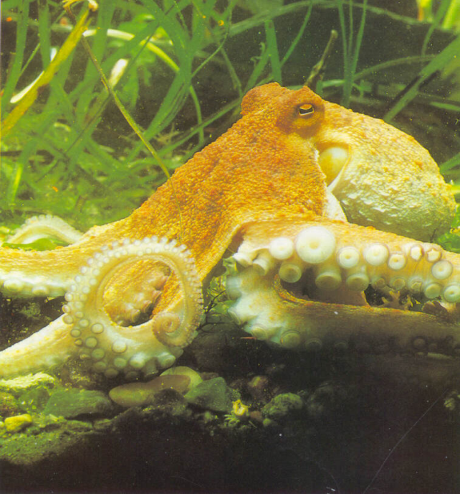
When we use unsupervised learning
How do you learn without any language skills?

Slide 14
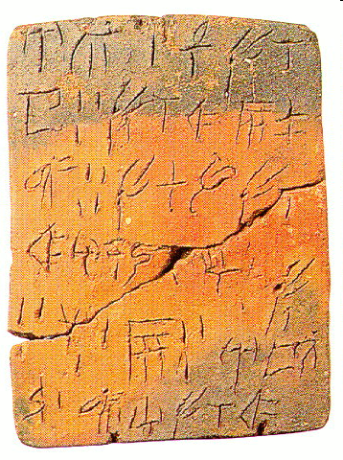
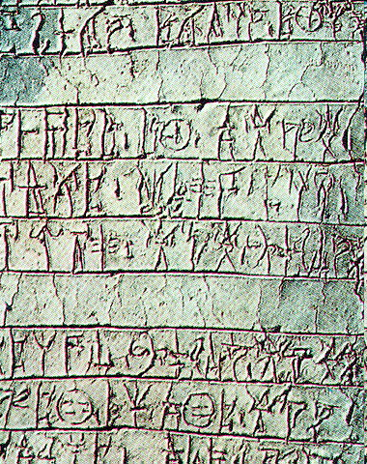
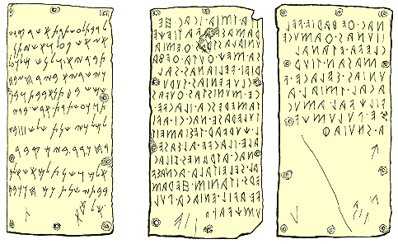
When we use unsupervised learning
Linear A (proto-Greek)
Linear B (Greek)
Etruscan
How do you crack a dead language?

Slide 15
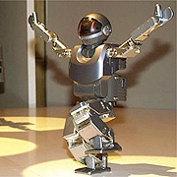
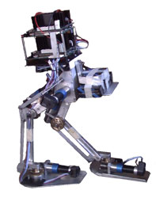
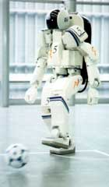
More Importantly….
How would you teach these guys to do the same things?

Slide 16
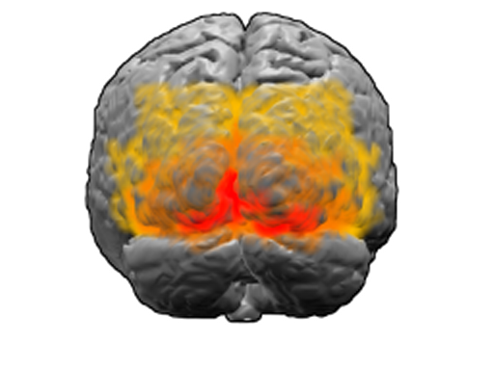
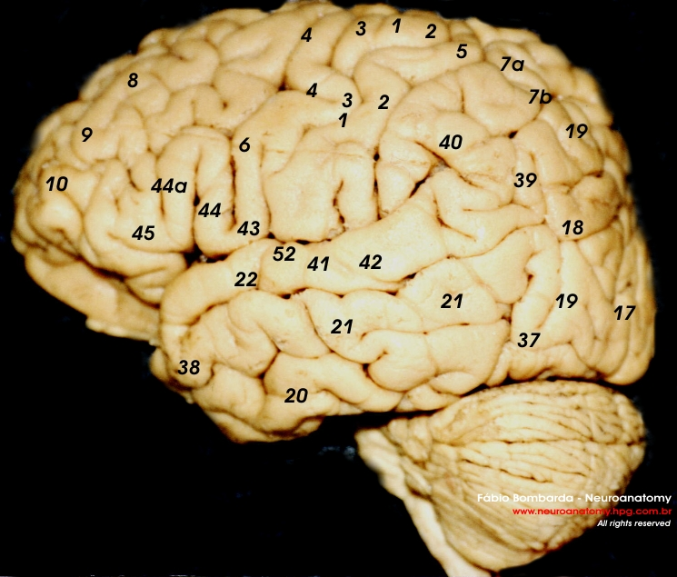
Biological Justification for the SOM
The SOM models are based on studies of learning in the V1, V2, V4, and MT areas of the brain. These are also called “Broadman areas”, specifically areas 17 through 19.

Slide 17
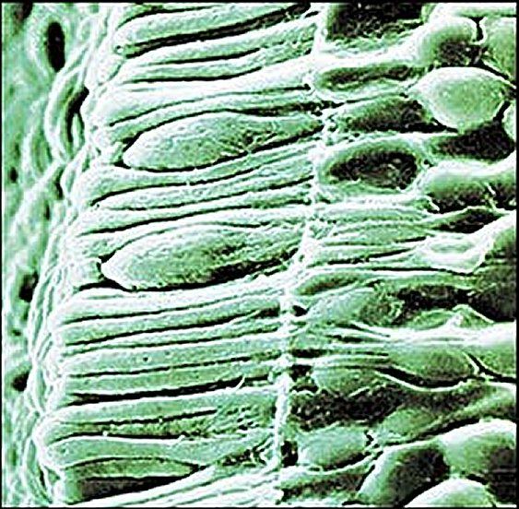
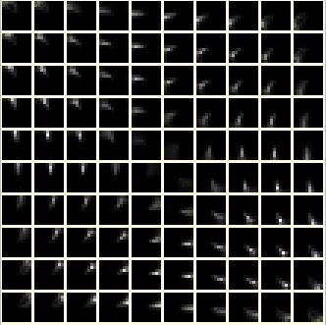
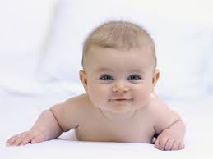
Biological Justification:Vision and Learning
Input Stimulus
Goes to the rods and
cones of the eye
And gets converted
for processing

Slide 18
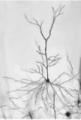
Vision and Learning
Input Layer
And then it hits the cortex.
Unsensitized pyramidal cells

Slide 19
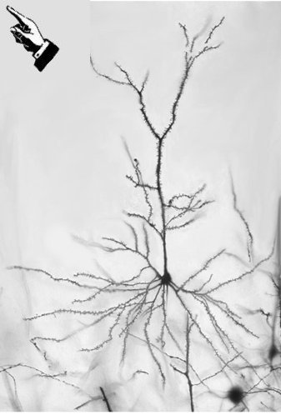
Vision and Learning
Input Layer
A cell in cortical sheet is stimulated!

Slide 20
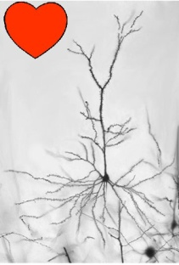
Vision and Learning
Input Layer
!
And responds accordingly.

Slide 21

Vision and Learning
Input Layer
As do others in the immediate area or “neighborhood”

Slide 22

Vision and Learning
Input Layer
Different inputs ….

Slide 23
Vision and Learning
Input Layer
….impact different areas of the cortex.

Slide 24
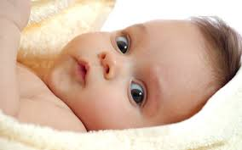
Vision and Learning
Resulting in a map in which clusters of neurons which respond to the respective stimuli

Slide 25
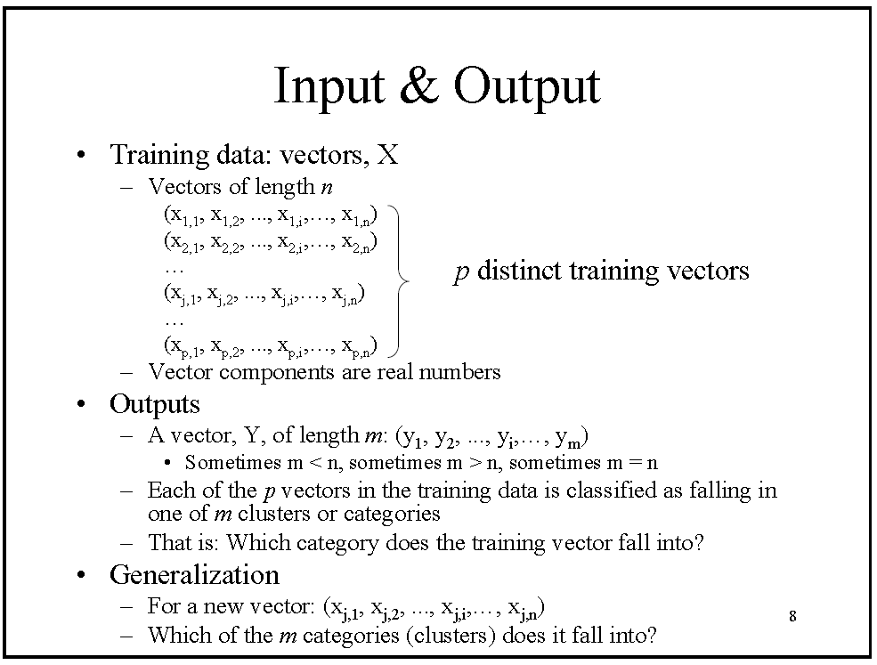

Slide 26
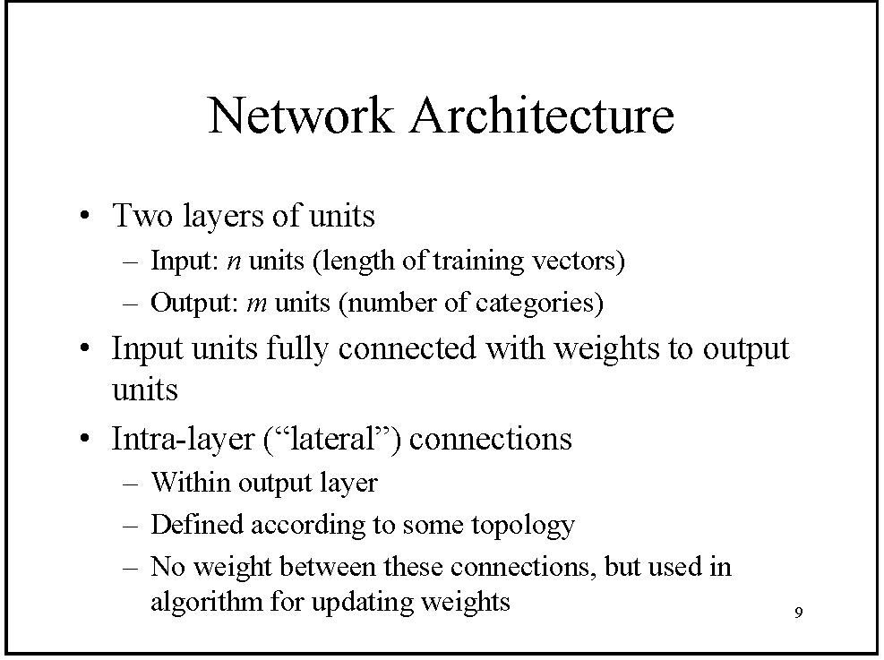

Slide 27
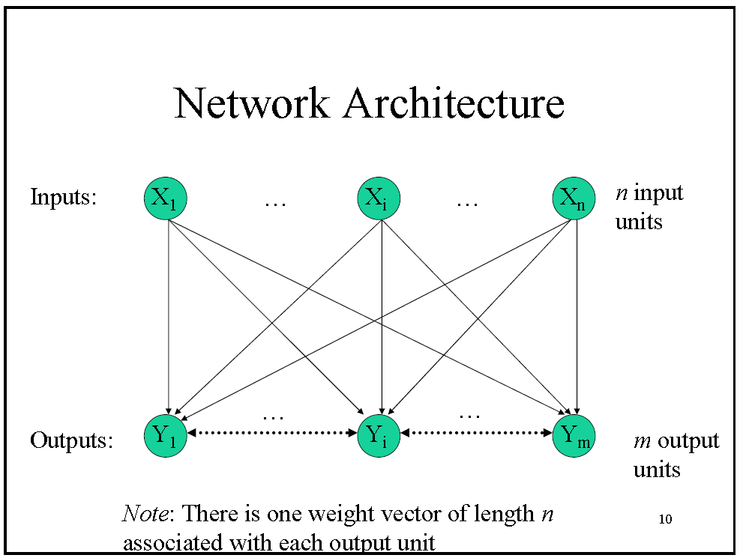

Slide 28
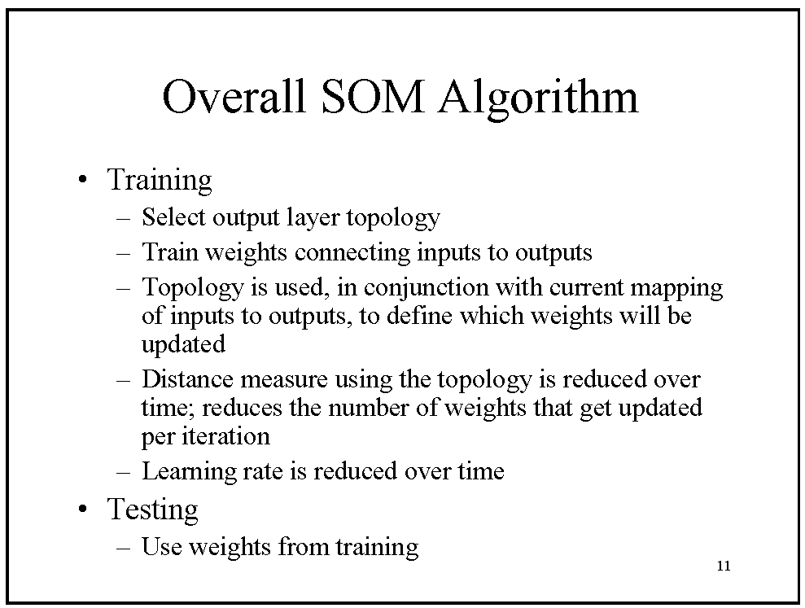

Slide 29
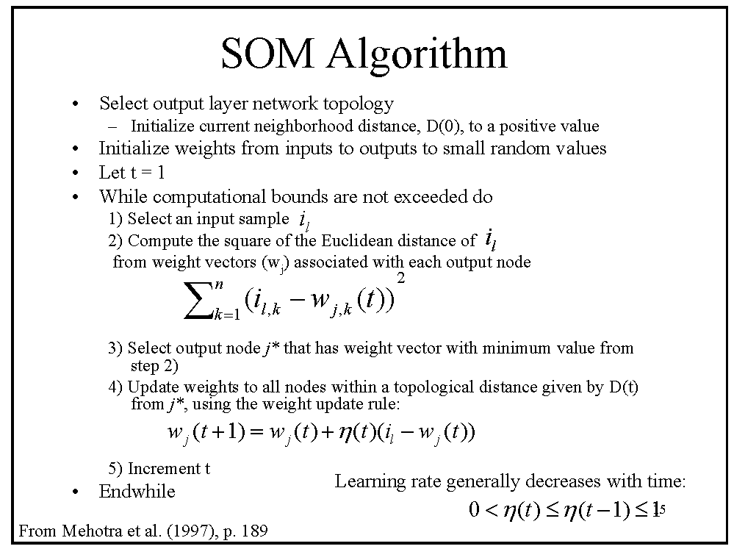

Slide 30
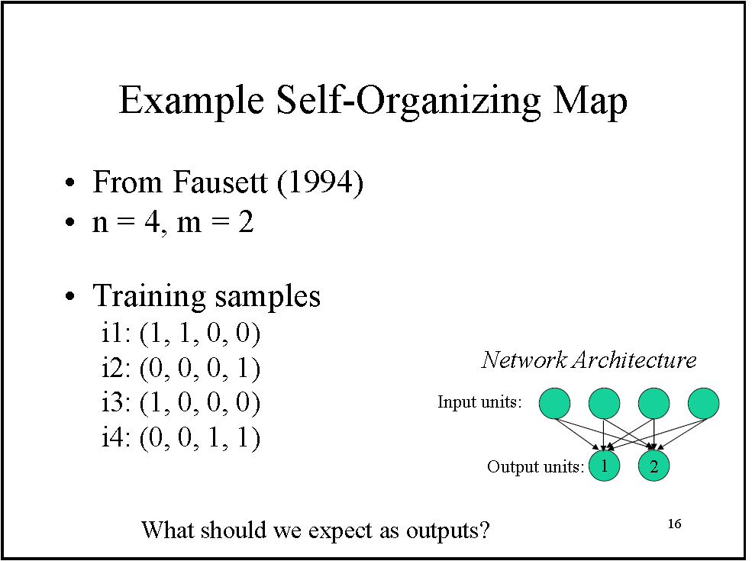

Slide 31
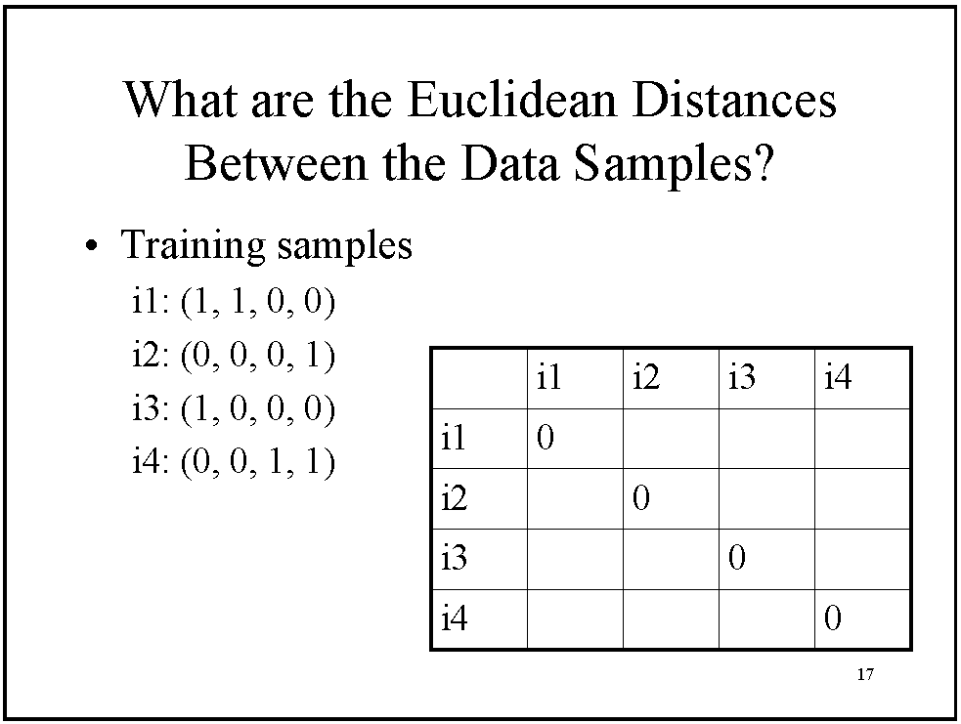

Slide 32
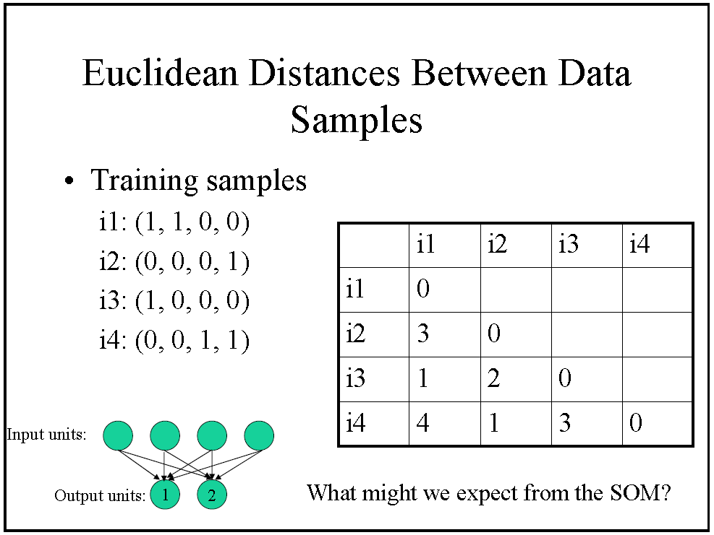

Slide 33
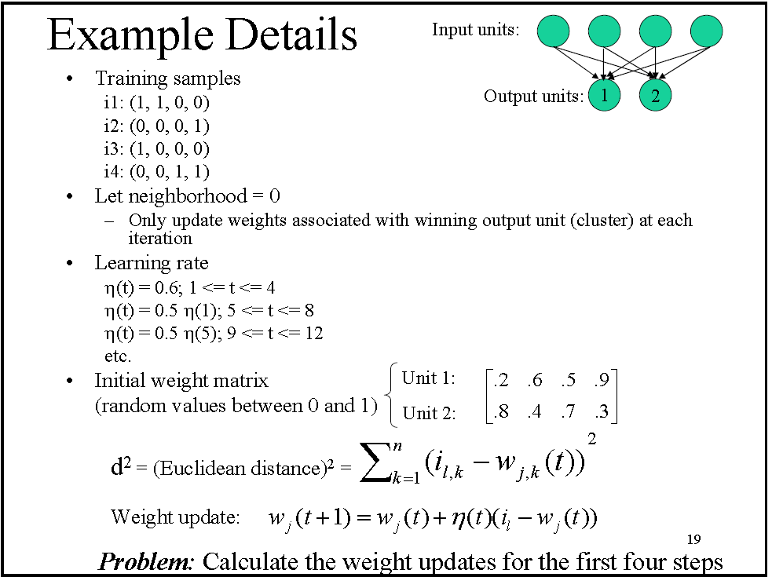

Slide 34
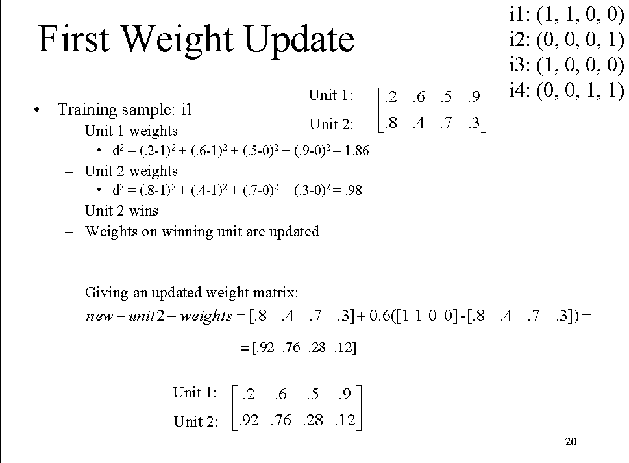

Slide 35
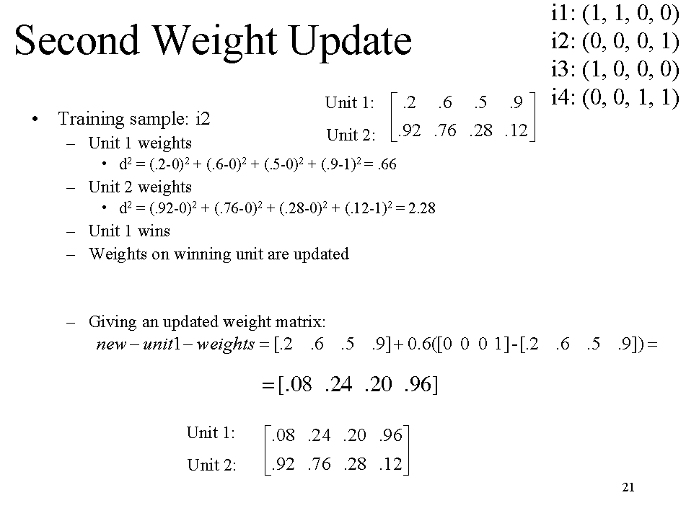

Slide 36
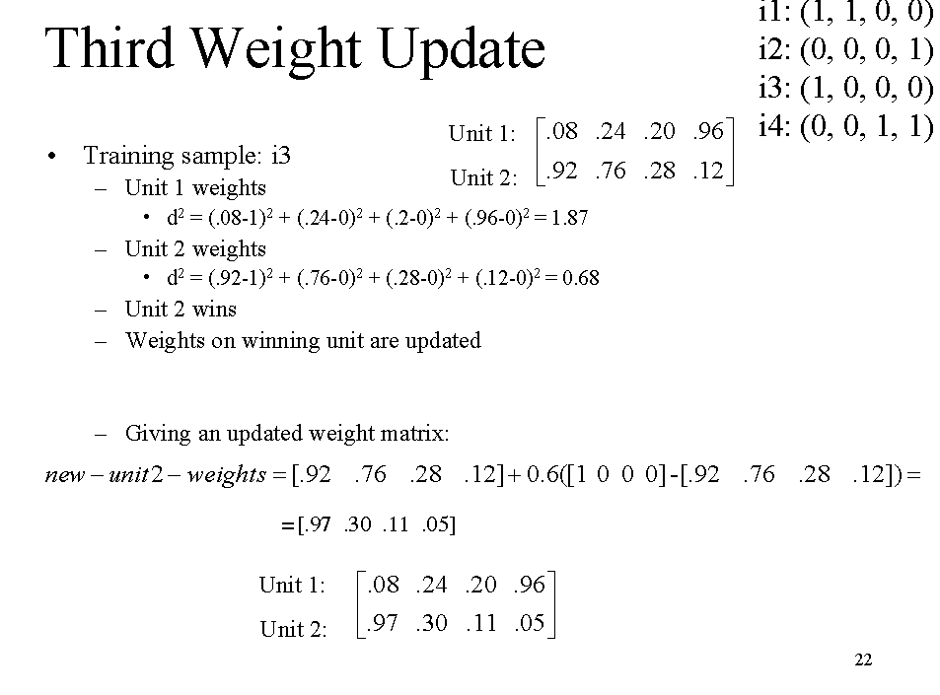

Slide 37
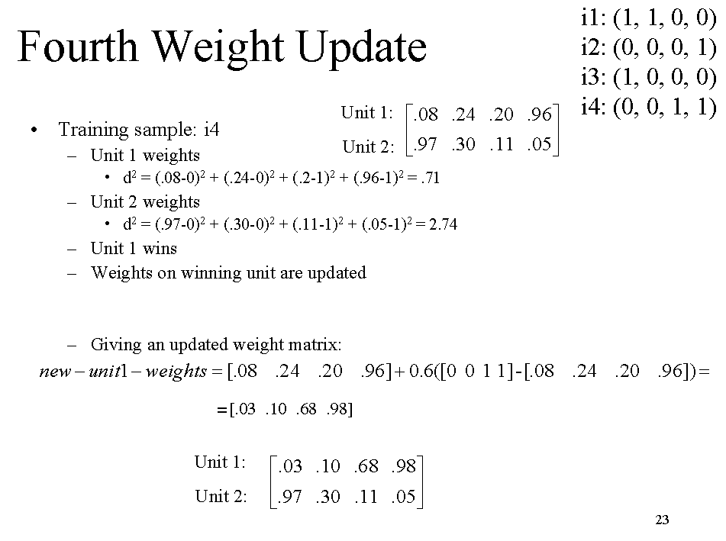

Slide 38
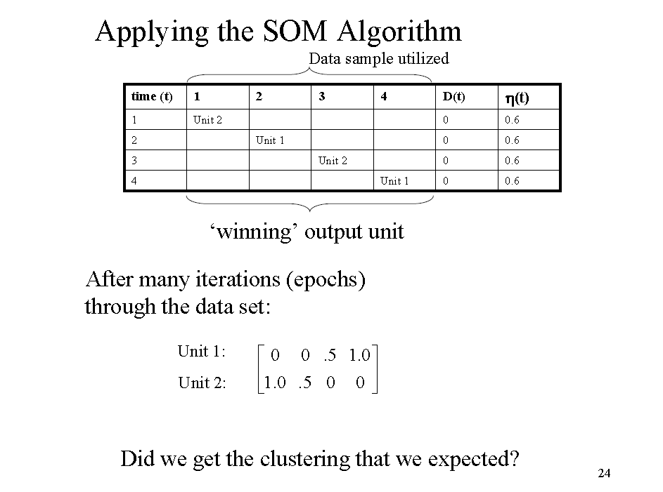

Slide 39
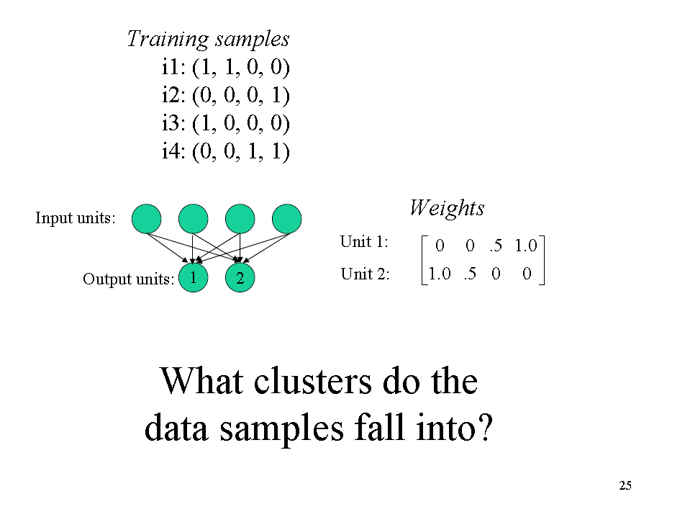

Slide 40
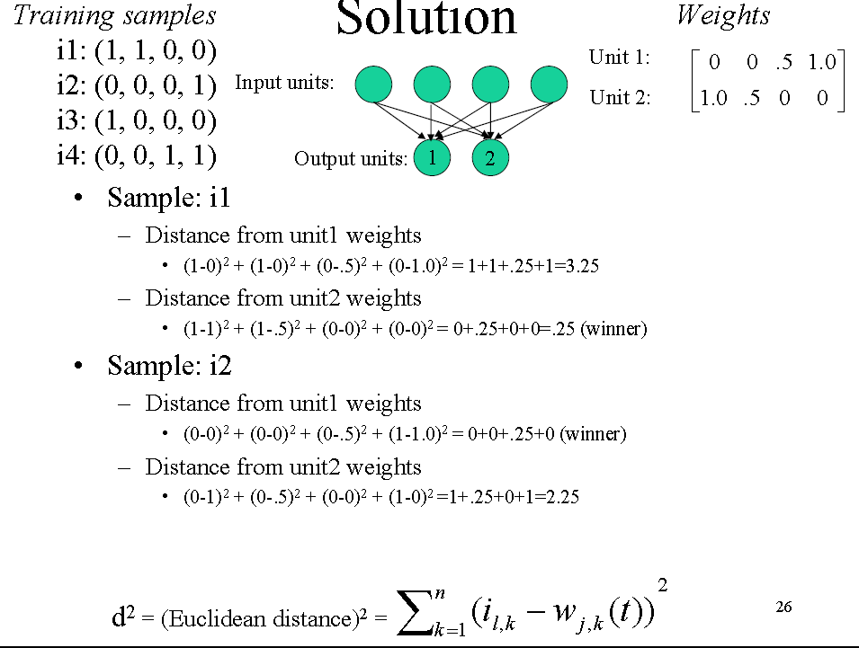

Slide 41
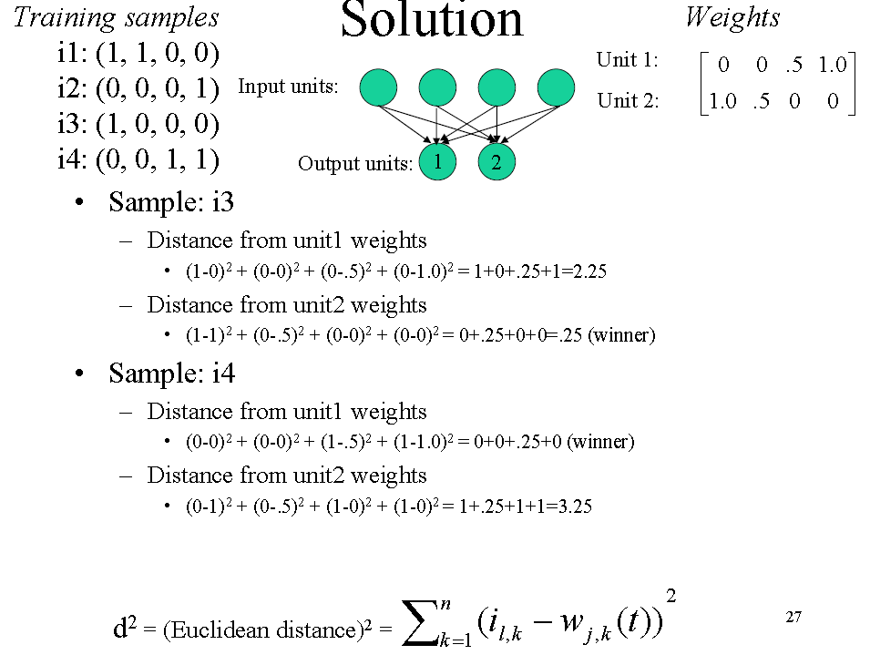

Slide 42
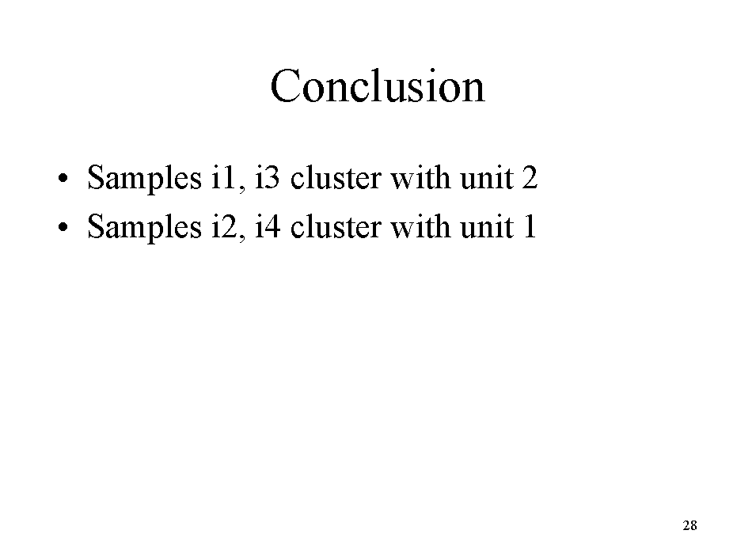

Slide 43
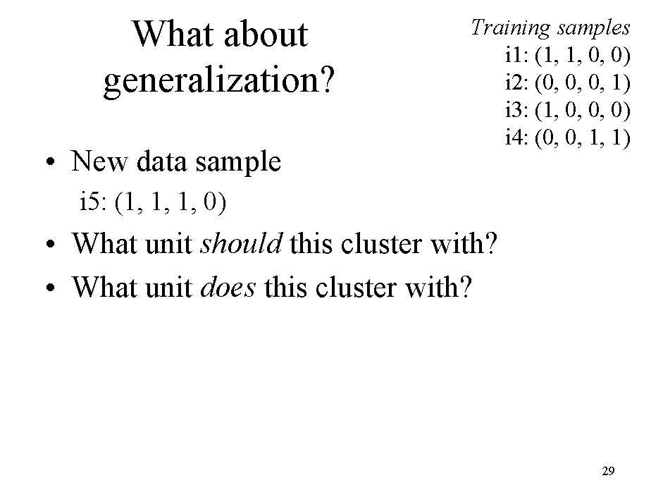

Slide 44
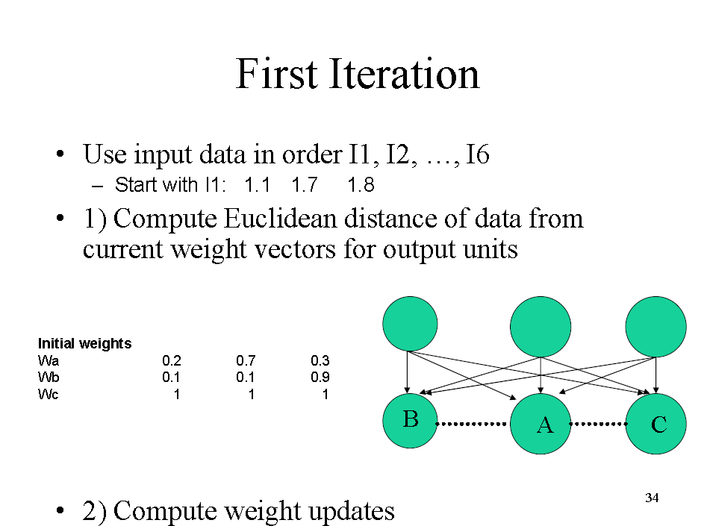

Slide 45
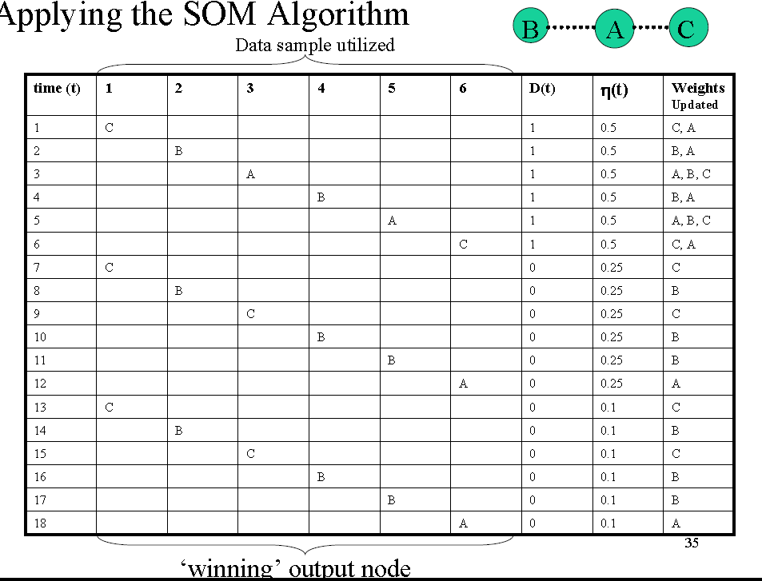

Slide 46
Summery of Today’s Lecture
Unsupervised learning
Unsupervised learning Approaches
Self Organizing Map (SOM)

