Slide 1
Artificial Intelligence
Lecture No. 3
Dr. Asad Safi
​
Assistant Professor,
Department of Computer Science,
COMSATS Institute of Information Technology (CIIT) Islamabad, Pakistan.

Slide 2
Summary of Previous Lecture
AI Applications
  improvements in hardware and algorithms
  AI applications in industry, finance, medicine, and science.
Human Intelligence VS Artificial Intelligence
  Artificial Intelligence VS Conventional Computing
Is AI dangerous?
  Sentient AI

Slide 3
Today’s Lecture
Weak and Strong AI
Acting humanly
Think like humans
think rationally
Acting rationally
Turing Test
Chinese Room Argument

Slide 4

What is AI?
The exciting new effort to make computers thinks … machine with minds, in the full and literal sense”
(Haugeland 1985)
The automation of activities that we associate with human thinking, activities such as decision-making, problem solving, learning ...'' (Bellman, 1978)
“The study of mental faculties through the use of computational models”
(Charniak et al. 1985)
The study of the computations that make it possible to perceive, reason, and act'' (Winston, 1992)
“The art of creating machines that perform functions that require intelligence when performed by people” (Kurzweil, 1990)
The study of how to make computers do things at which, at the moment, people are better'' (Rich and Knight, 1991)
A field of study that seeks to explain and emulate intelligent behavior in terms of computational processes” (Schalkol, 1990)
The branch of computer science that is concerned with the automation of intelligent behavior'' (Luger and Stubblefield, 1993)

Slide 5
What is AI?
Systems that think like humans
Systems that think rationally
The exciting new effort to make computers thinks … machine with minds, in the full and literal sense”
(Haugeland 1985)
“The study of mental faculties through the use of computational models”
(Charniak et al. 1985)
Systems that act like humans
Systems that act rationally
“The art of creating machines that perform functions that require intelligence when performed by people” (Kurzweil, 1990)
A field of study that seeks to explain and emulate intelligent behavior in terms of computational processes” (Schalkol, 1990)

Slide 6
Weak and Strong AI
Weak AI
  Computers can be programmed to act as if they were intelligent (as if they were thinking)
Strong AI
  Computers can be programmed to think (i.e. they really are thinking)

Slide 7
Weak and Strong AI
Weak AI is AI that can not 'think', i.e. a computer chess playing AI does not think about its next move, it is based on the programming it was given, and its moves depend on the moves of the human opponent.
Strong AI is the idea/concept that we will one day create AI that can 'think' i.e. be able to play a chess game that is not based on the moves of the human opponent or programming, but based on the AI's own 'thoughts' and feelings and such, which are all supposed to be exactly like a real humans thoughts and emotions and stuff.

Slide 8
What is AI?
Systems that think like humans
Systems that think rationally
The exciting new effort to make computers thinks … machine with minds, in the full and literal sense”
(Haugeland 1985)
“The study of mental faculties through the use of computational models”
(Charniak et al. 1985)
Systems that act like humans
Systems that act rationally
“The art of creating machines that perform functions that require intelligence when performed by people” (Kurzweil, 1990)
A field of study that seeks to explain and emulate intelligent behavior in terms of computational processes” (Schalkol, 1990)

Slide 9
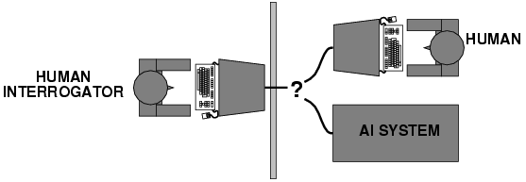
Acting humanly
The Turing Test approach
Turing (1950) "Computing machinery and intelligence"
The Turing Test

Slide 10
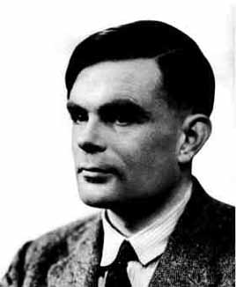
Alan Turing
Alan Turing, born at 23rd of june, 1912

Slide 11
“I believe that in about fifty years’ time it will
be possible to programme computers, with a
storage capacity of about 10⁹, to make them play
the imitation game so well that an average
interrogator will not have more than 70 per cent
chance of making the right identification after
5 minutes of questioning”
-Alan Turing (1950)

Slide 12
Turing Test
“Turing was convinced that if a computer could do all mathematical operations, it could also do anything a person can do“
Computing Machinery and Intelligence, written by Alan Turing and published in 1950 in Mind, is a paper on the topic of artificial intelligence in which the concept of what is now known as the Turing test was introduced to a wide audience.

Slide 13
The Turing Test
Today the Game is usually referred to as the Turing Test.
If a computer can play the game just as well as a human, then the computer is said to ‘pass’ the ‘test’, and shall be declared intelligent.

Slide 14
Turing Test
How can we evaluate intelligence?
  Turing [1950]: a machine can be deemed intelligent when its responses to interrogation by a human are indistinguishable from those of a human being.

Slide 15



Turing Test
Interrogator

Slide 16
Turing Test
Interrogator

Slide 17
total Turing Test
includes a video signal so that the interrogator can test the subject's perceptual abilities, as well as the opportunity for the interrogator to pass physical objects ``through the hatch.''
To pass the total Turing Test, the computer will need
  computer vision to perceive objects, and
  robotics to move them about.

Slide 18
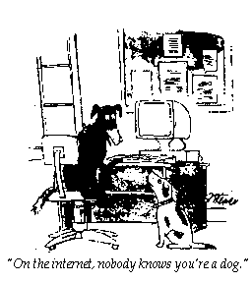
Turing Test

Slide 19
How effective is this test?
Agent must:
  Have command of language
  Have wide range of knowledge
  Demonstrate human behavior (humor, emotion)
  Be able to reason
  Be able to learn
Loebner prize competition is modern version of Turing Test
  (The Loebner Prize is an annual competition in artificial intelligence that awards prizes to the chatterbot considered by the judges to be the most human-like.)
  Example: Alice, Loebner prize winner for 2000 and 2001

Slide 20
Turing Test: Criticism
What are some potential problems with the Turing Test?
  Some human behavior is not intelligent
    the temptation to lie, a high frequency of typing mistakes
  Some intelligent behavior may not be human
    If it were to solve a computational problem that is practically impossible for a human to solve
  Human observers may be easy to fool
    A lot depends on expectations
    Chatbots, e.g., ELIZA, ALICE
  Chinese room argument
Is passing the Turing test a good scientific/engineering goal?

Slide 21
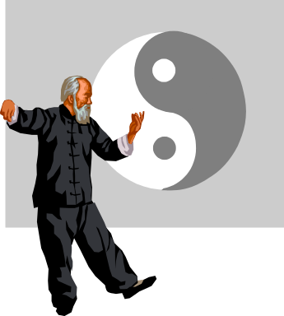

Chinese Room Argument
Devised by John Searle
An argument against the possibility of true artificial intelligence.

Slide 22
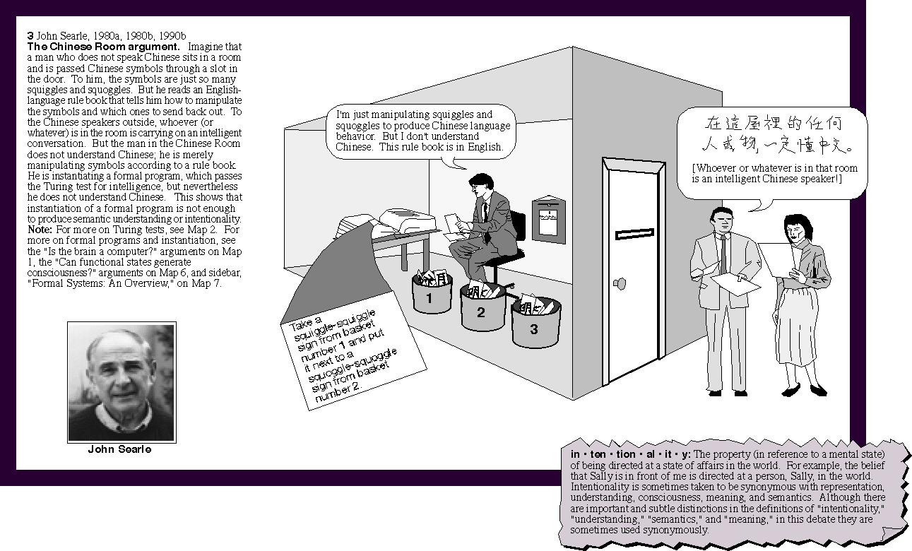
Chinese Room Argument

Slide 23
Chinese Room Argument
“The reason that no computer program can ever be a mind is simply that a computer program is only syntactical, and minds are more than syntactical. Minds are semantical, they have content.” - John Searle

Slide 24
What is AI?
Systems that think like humans
Systems that think rationally
The exciting new effort to make computers thinks … machine with minds, in the full and literal sense”
(Haugeland 1985)
“The study of mental faculties through the use of computational models”
(Charniak et al. 1985)
Systems that act like humans
Systems that act rationally
“The art of creating machines that perform functions that require intelligence when performed by people” (Kurzweil, 1990)
A field of study that seeks to explain and emulate intelligent behavior in terms of computational processes” (Schalkol, 1990)

Slide 25
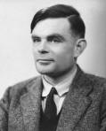
Acting humanly
The Turing Test approach
Turing (1950) "Computing machinery and intelligence"
The Turing Test
What capabilities would a computer need to have to pass the Turing Test?
  Natural language processing
  Knowledge representation
  Automated reasoning
  Machine learning
Turing predicted that by the year 2000, machines would be able to fool 30% of human judges for five minutes

Slide 26
Thinking humanly
The cognitive modeling approach
Goal: Develop precise theories of human thinking
Cognitive Architecture
  Software Architecture for modeling human performance
  Describe task, required knowledge, major sub-goals
  Architecture follows human-like reasoning
  Makes testable predictions: Time delays during problem solving, kinds of mistakes, eye movements, verbal protocols, learning rates, strategy shifts over time, etc.
Problems:
  It may be impossible to identify the detailed structure of human problem solving using only externally-available data.
Notes:
Cognitive :o pertaining to the mental processes of perception, memory, judgment, and reasoning, as contrasted with emotional and volitional processes.
the act or faculty of perceiving, or apprehending by means of the senses or of the mind; understanding.

Slide 27
Thinking humanly
The cognitive modelling approach
We need to get inside the actual workings of human minds.
There are two ways to do this: through
  trying to catch our own thoughts as they go by
  or through psychological experiments.
Cognitive science: the brain as an information processing machine
  Requires scientific theories of how the brain works
How to understand cognition as a computational process?
  try to think about how we think
  Predict and test behavior of human subjects
  Image the brain, record neurons
The latter two methodologies are the domains of cognitive science and cognitive neuroscience

Slide 28
Thinking rationally
The laws of thought approach
Idealized or “right” way of thinking
Logic: patterns of argument that always yield correct conclusions when supplied with correct premises
  “Tom is a man; all men are mortal; therefore Tom is mortal.”
Beginning with Aristotle, philosophers and mathematicians have attempted to formalize the rules of logical thought
Logicist approach to AI: describe problem in formal logical notation and apply general deduction procedures to solve it
Problems with the logicist approach
  Computational complexity of finding the solution
  Describing real-world problems and knowledge in logical notation
  Dealing with uncertainty
  A lot of intelligent or “rational” behavior has nothing to do with logic
Notes:
A rational decision is one that is not just reasoned, but is also optimal for achieving a goal or solving a problem.
uncertainty::doubt

Slide 29
Thinking Rationally:
The Logical Approach
Ensure that all actions performed by computer are justifiable (“rational”)
Rational = Conclusions are provable from inputs and prior knowledge
Problems:
  Representation of informal knowledge is difficulty
  Hard to define “provable” reasoning
Facts and Rules in Formal Logic
Theorem Prover

Slide 30
Acting rationally
Rational agent
A rational agent is one that acts to achieve the best expected outcome
  Goals are application-dependent and are expressed in terms of the utility of outcomes
  Being rational means maximizing your expected utility
  In practice, utility optimization is subject to the agent’s computational constraints

Slide 31
Acting Rationally
Rational Agents
Claim: “Rational” means more than just logically justified. It also means “doing the right thing”
Rational agents do the best they can given their resources

Slide 32
Weak and Strong AI
Systems that think like humans
Systems that think rationally
The exciting new effort to make computers thinks … machine with minds, in the full and literal sense”
(Haugeland 1985)
“The study of mental faculties through the use of computational models”
(Charniak et al. 1985)
Strong AI
Weak AI
Systems that act like humans
Systems that act rationally
“The art of creating machines that perform functions that require intelligence when performed by people” (Kurzweil, 1990)
A field of study that seeks to explain and emulate intelligent behavior in terms of computational processes” (Schalkol, 1990)

Slide 33
Summery of Today’s Lecture
Weak and Strong AI
Acting humanly
Think like humans
think rationally
Acting rationally
Turing Test
Chinese Room Argument

