Slide 1
Artificial Intelligence
Lecture No. 29
Dr. Asad Ali Safi
​
Assistant Professor,
Department of Computer Science,
COMSATS Institute of Information Technology (CIIT) Islamabad, Pakistan.

Slide 2
Summary of Previous Lecture
Supervised
Artificial Neural Networks
Perceptrons

Slide 3
Today’s Lecture
Single Layer Perceptron
Multi-Layer Networks
Example
Training Multilayer Perceptron

Slide 4
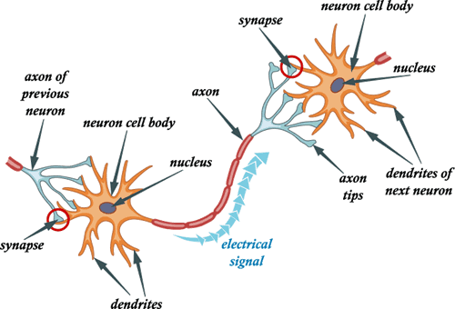
The Parts of a Neuron

Slide 5
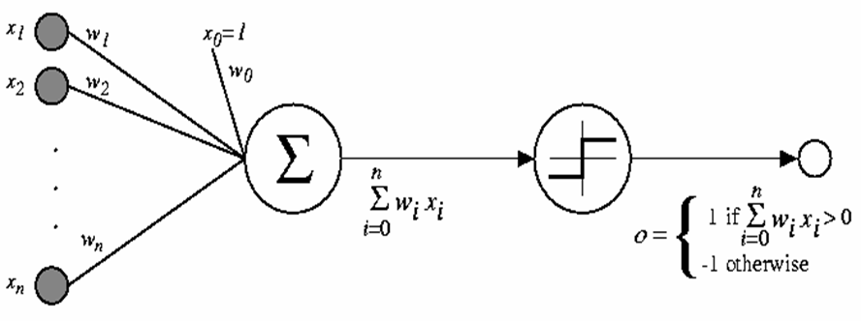
Perceptrons

Slide 6
Representational Power of Perceptrons
Perceptrons can represent the logical AND, OR, and NOT functions as above.
we consider 1 to represent True and –1 to represent False.

Slide 7
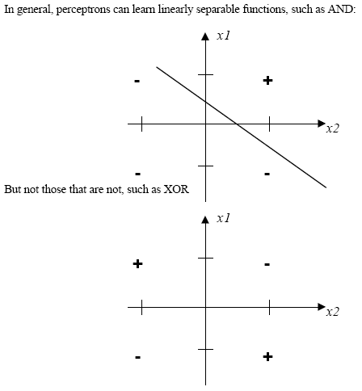
Here there is no way to draw a single line that separates the "+" (true) values from the "-"
(false) values.

Slide 8
Train a perceptron
At start of the experimenter the W random values
Than the train begin with objective of teaching it to differentiate two classes of inputs I and II
The goal is to have the nodes output o = 1 if the input is of class I , and to have
o= -1 if the input is of class II
You can free to choose any inputs (Xi) and to designate them as being of class I or II

Slide 9
Train a perceptron
If the node happened to output 1 signal when given a class II input or output -1 signal when given a class I input the weight Wi no change
Then the training is complete

Slide 10
Single Layer Perceptron
For a problem which calls for more then 2 classes, several perceptrons can be combined into a network.
Can distinguish only linear separable functions

Slide 11
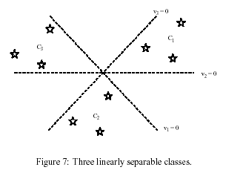
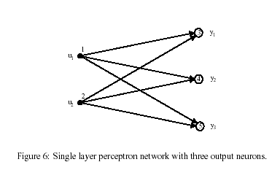
Single Layer Perceptron
Single layer, five nodes. 2 inputs and 3 outputs
Recognizes 3 linear separate classes, by means of 2 features

Slide 12
Multi-Layer Networks

Slide 13
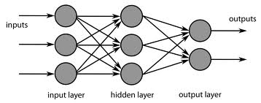
Multi-Layer Networks
A Multi layer perceptron can classify non linear separable problems.
A Multilayer network has one or more hidden layers.

Slide 14
Multi-layer networks
x₁
x₂
Input
(visual input)
Output
(Motor output)
x_{n}
Hidden layers

Slide 15
EXAMPLE
1,0
1,1
Logical XOR
Function
X Y output
0 0 0
0 1 1
0 1
1 1 0
X
0,0
0,1
Y

Slide 16
XOR
XOR
0
0
Activation Function:
if (input >= threshold), fire
else, don’t fire
1
w₁₃
w₂₁
1
0
0
0
0
1
2
1
0
0
0
All weights are 1, unless otherwise labeled.
-2
1
0

Slide 17
XOR
XOR
1
0
Activation Function:
if (input >= threshold), fire
else, don’t fire
1
w₁₃
w₂₁
1
0
0
1
0
1
2
1
1
0
0
All weights are 1, unless otherwise labeled.
-2
1
1

Slide 18
XOR
XOR
0
1
Activation Function:
if (input >= threshold), fire
else, don’t fire
1
w₁₃
w₂₁
1
0
0
0
1
1
2
1
0
0
1
All weights are 1, unless otherwise labeled.
-2
1
1

Slide 19
XOR
XOR
1
1
Activation Function:
if (input >= threshold), fire
else, don’t fire
1
w₁₃
w₂₁
1
0
0
1
1
1
2
1
1
1
1
All weights are 1, unless otherwise labeled.
-2
1
0

Slide 20
Training Multilayer Perceptron
The training of multilayer networks raises some important issues:
How many layers ?, how many neurons per layer ?
Too few neurons makes the network unable to learn the desired behavior.
Too many neurons increases the complexity of the learning algorithm.

Slide 21
Training Multilayer Perceptron
A desired property of a neural network is its ability to generalize from the training set.
If there are too many neurons, there is the danger of over fitting.

Slide 22
Problems with training:
Nets get stuck
  Not enough degrees of freedom
  Hidden layer is too small
Training becomes unstable
  too many degrees of freedom
  Hidden layer is too big / too
  many hidden layers
Over-fitting
  Can find every pattern, not all are significant. If neural net is “over-fit” it will not generalize well to the testing dataset

Slide 23
Summery of Today’s Lecture
Single Layer Perceptron
Multi-Layer Networks
Example
Training Multilayer Perceptron

