Slide 1
Artificial Intelligence
Lecture No. 27
Dr. Asad Ali Safi
​
Assistant Professor,
Department of Computer Science,
COMSATS Institute of Information Technology (CIIT) Islamabad, Pakistan.

Slide 2
Summary of Previous Lecture
CLIPS

Slide 3
Today’s Lecture
Machine learning
Machine learning / Data mining
Algorithm types

Slide 4
Machine learning
A branch of artificial intelligence, concerns the construction and study of systems that can learn from data.
  A machine learning system could be trained on email messages to learn to distinguish between spam and non-spam messages.
  After learning, it can then be used to classify new email messages into spam and non-spam folders.
Notes:
The core of machine learning deals with representation and generalization.
Representation of data instances and functions evaluated on these instances are part of all machine learning systems. Generalization is the property that the system will perform well on unseen data instances; the conditions under which this can be guaranteed are a key object of study in the subfield of computational learning theory.

Slide 5
Machine learning
Machine learning deals with representation and generalization.
  Representation of data instances and functions evaluated on these instances are part of all machine learning systems.
  Generalization is the property that the system will perform well on unseen data instances; the conditions under which this can be guaranteed are a key object of study in the subfield of Computational Learning Theory.

Slide 6
Machine learning / Data mining
These two terms are commonly confused, as they often employ the same methods and overlap significantly.
They can be roughly defined as follows:
  Machine learning focuses on prediction, based on known properties learned from the training data.
  Data mining (which is the analysis step of Knowledge Discovery in Databases) focuses on the discovery of (previously) unknown properties on the data.

Slide 7
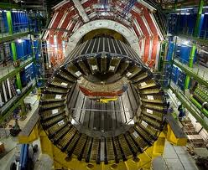

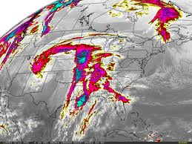
Learning from Data
The world is driven by data.
Germany’s climate research centre generates 10 petabytes per year
Google processes 24 petabytes per day
The Large Hadron Collider produces 60 gigabytes per minute (~12 DVDs)
There are over 50m credit card transactions a day in the US alone.

Slide 8
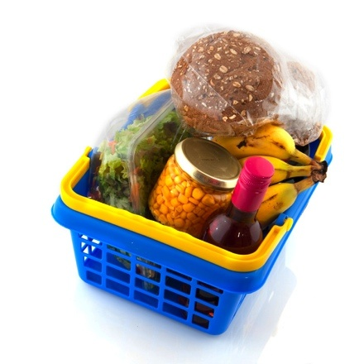

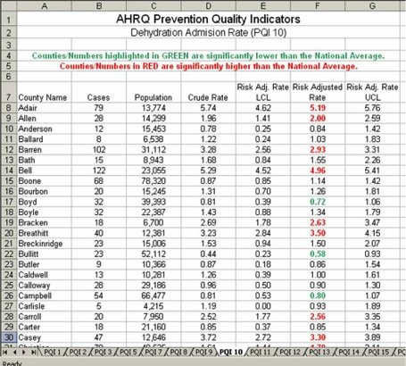
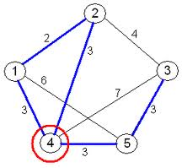
Learning from Data
Data is recorded from some real-world phenomenon.
What might we want to do with that data?
Prediction
- what can we predict about this phenomenon?
Description
- how can we describe/understand this phenomenon in a new way?

Slide 9


Learning from Data
How can we extract knowledge from data to help humans take decisions?
How can we automate decisions from data?
How can we adapt systems dynamically to enable better user experiences?
Write code to explicitly
do the above tasks
Write code to make the computer
learn how to do the tasks

Slide 10
Machine Learning
Where does it fit? What is it not?
Artificial Intelligence
Statistics / Mathematics
Data Mining
Machine Learning
Computer Vision
Robotics

Slide 11
Coding Skills
Maths/Statistics
Knowledge
Machine Learning
Data Science
£££
Software Engineer
Statistician
Specialist Domain Knowledge

Slide 12
Human interaction
Some machine learning systems attempt to eliminate the need for human intuition in data analysis, while others adopt a collaborative approach between human and machine.
Human intuition cannot, however, be entirely eliminated, since the system's designer must specify how the data is to be represented and what mechanisms will be used to search for a characterization of the data

Slide 13
What is Learning?
Many different answers, depending on the field you’re considering and whom you ask
  AI vs. psychology vs. education vs. neurobiology vs. …

Slide 14






Does Memorization = Learning?
Test #1: Thomas learns his mother’s face
Memorizes:
But will he recognize:

Slide 15

Thus he can generalize beyond what he’s seen!

Slide 16

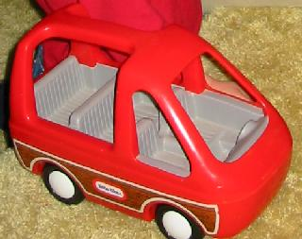
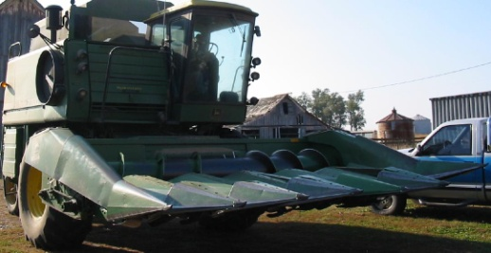
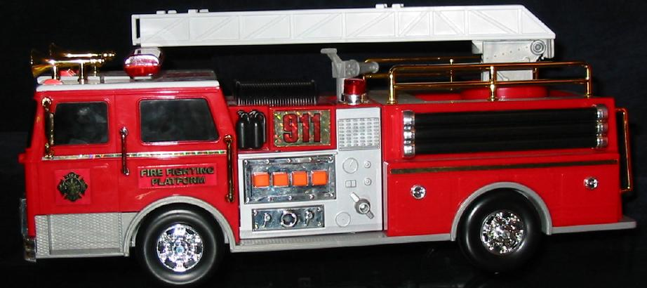
Does Memorization = Learning? (cont’d)
Test #2: Nicholas learns about trucks
Memorizes:
But will he recognize others?

Slide 17
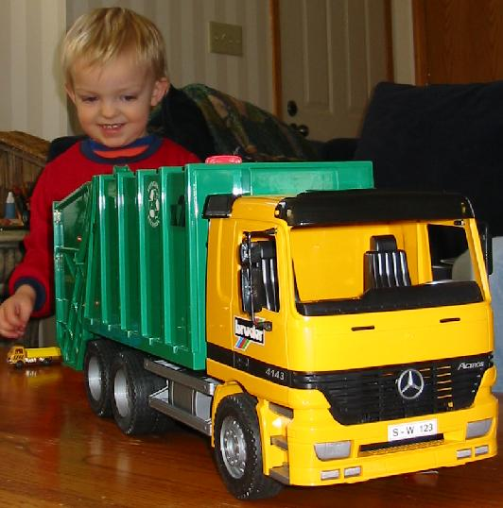
So learning involves ability to generalize from labeled examples
(in contrast, memorization is trivial, especially for a computer)

Slide 18
Again, what is Machine Learning?
Given several labeled examples of a concept
  E.g. trucks vs. non-trucks
Examples are described by features
  E.g. number-of-wheels (integer), relative-height (height divided by width), hauls-cargo (yes/no)
A machine learning algorithm uses these examples to create a hypothesis that will predict the label of new (previously unseen) examples
Similar to a very simplified form of human learning

Slide 19
Why Machine Learning?
(Relatively) new kind of capability for computers
  Data mining: extracting new information from medical records, maintenance records, etc.
  Self-customizing programs: Web browser that learns what you like and seeks it out
  Applications we can’t program by hand: E.g. speech recognition, autonomous driving

Slide 20
Why Machine Learning?
(cont’d)
Many old real-world applications of AI were expert systems
  Essentially a set of if-then rules to emulate a human expert
  E.g. “If medical test A is positive and test B is negative and if patient is chronically thirsty, then diagnosis = diabetes with confidence 0.85”
  Rules were extracted via interviews of human experts

Slide 21
Machine Learning vs. Expert Systems
ES: Expertise extraction done ML: Automatic
ES: Rules might not incorporate intuition, which might mask true reasons for answer
  E.g. in medicine, the reasons given for diagnosis x might not be the objectively correct ones, and the expert might be unconsciously picking up on other info
  ML: More “objective”

Slide 22
Machine Learning vs. Expert Systems (cont’d)
ES: Expertise might not be comprehensive, e.g. physician might not have seen some types of cases
ML: Automatic, objective, and data-driven
  Though it is only as good as the available data

Slide 23
More Detailed Example: Content-Based Image Retrieval
Given database of hundreds of thousands of images
How can users easily find what they want?
One idea: Users query database by image content
  E.g. “give me images with a waterfall”

Slide 24
Content-Based Image Retrieval (cont’d)
One approach: Someone explain each image with text on its content
  Tedious, terminology ambiguous, maybe subjective
Better approach: Query by example
  Users give examples of images they want
  Program determines what’s common among them and finds more like them

Slide 25
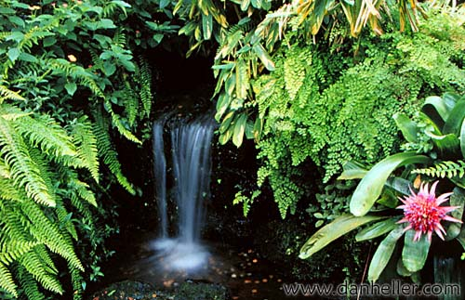
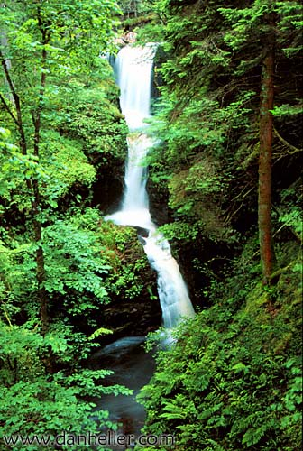
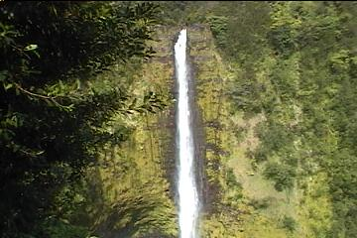



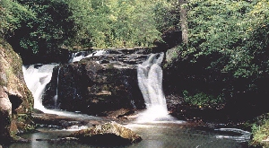
Content-Based Image Retrieval (cont’d)
User’s Query:
System’s Response:
User Feedback:
Yes
Yes
Yes
NO!

Slide 26
Content-Based Image Retrieval (cont’d)
User’s feedback then labels the new images, which are used as more training examples, yielding a new hypothesis, and more images are retrieved

Slide 27

How Does the System Work?
For each pixel in the image, extract its color + the colors of its neighbors
These colors (and their relative positions in the image) are the features the learner uses (replacing e.g. number-of-wheels)
A learning algorithm takes examples of what the user wants, produces a hypothesis of what’s common among them, and uses it to label new images

Slide 28
Other Applications of ML
The Google search engine uses numerous machine learning techniques
  Spelling corrector: “spehl korector”, “phonitick spewling”, “Brytney Spears”, “Brithney Spears”, …
  Grouping together top news stories from numerous sources (news.google.com)
  Analyzing data from over 3 billion web pages to improve search results
  Analyzing which search results are most often followed, i.e. which results are most relevant

Slide 29
Algorithm types
Machine learning algorithms can be organized into a taxonomy based on the desired outcome of the algorithm or the type of input available during training the machine.

Slide 30
Supervised learning
Algorithms are trained on labeled examples, i.e., input where the desired output is known.
The supervised learning algorithm attempts to generalize a function or mapping from inputs to outputs which can then be used to speculatively generate an output for previously unseen inputs.

Slide 31
Unsupervised learning
Algorithms operate on unlabelled examples, i.e., input where the desired output is unknown.
Here the objective is to discover structure in the data (e.g. through a cluster analysis), not to generalize a mapping from inputs to outputs.

Slide 32
Semi-supervised learning
Combines both labeled and unlabelled examples to generate an appropriate function or classifier.

Slide 33
Reinforcement learning
Concerned with how intelligent agents have to to act in an environment to maximize some notion of reward.
The agent executes actions which cause the observable state of the environment to change. Through a sequence of actions, the agent attempts to gather knowledge about how the environment responds to its actions, and attempts to synthesizes a sequence of actions that maximizes a cumulative reward.

Slide 34
Summery of Today’s Lecture
Machine learning
Machine learning / Data mining
Algorithm types

