Slide 1
Artificial Intelligence
Lecture No. 24
Dr. Asad Ali Safi
​
Assistant Professor,
Department of Computer Science,
COMSATS Institute of Information Technology (CIIT) Islamabad, Pakistan.

Slide 2
Summary of Previous Lecture
Functional
~ | &
Basic arithmetic
Read

Slide 3
Today’s Lecture
readline function
(assert-string)
Functions

Slide 4
(read) function
The (read) function is not a general-purpose function that will read anything you type on the keyboard. One limitation is that (read) will read only one field. So if you try to read
  primary color is red
only the first field, "primary", will be read. To (read) all the input, you must enclose the input within double quotes.
Of course, once the input is within double quotes, it is a single literal field. You can then access the substrings "primary", "color", "is", and "red“ with the str-explode or sub-string functions.

Slide 5
(read) function
The second limitation of (read) is that you can't input parentheses unless they are within double quotes. Just as you can't assert a fact containing parentheses, you can't (read) parentheses directly except as literals.

Slide 6
readline function
The readline function is used to read multiple values until terminated by a carriage return. This function reads in data as a string.
In order to assert the (readline) data, an (assert-string) function is used to assert the nonstring fact, just as input by (readline).

Slide 7
CLIPS> (clear)
CLIPS> (assert-string "(primary color is red)")
<Fact-1>
Notice that the argument of (assert-string) must be a string The following shows how to assert a fact of multiple fields from (readline).

Slide 8
  CLIPS> (clear)
  CLIPS> (defrule test-readline
  =>
  (printout t "Enter input" crlf)
  (bind ?string (readline))
  (assert-string (str-cat "(" ?string ")")))
  CLIPS> (reset)
  CLIPS> (run)

Slide 9
(assert-string)
Since (assert-string) requires parentheses around the string to be asserted, the (str-cat) function is used to put them around ?string.
Both (read) and (readline) also can be used to read information from a file by specifying the logical name of the file as the argument. For more information, see the CLIPS Reference Manual.

Slide 10
Test conditional element
The test conditional element provides a very powerful way by which to compare numbers, variables, and strings on the LHS. The (test) is used as a pattern on the LHS.
A rule will only be triggered if the (test) is satisfied together with other patterns.
Many predefined functions are provided by CLIPS as shown in the following table.

Slide 11
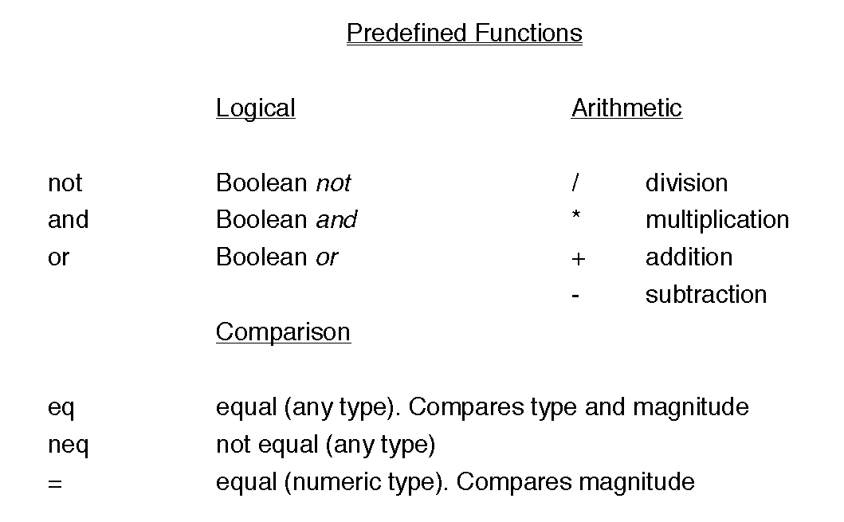

Slide 12
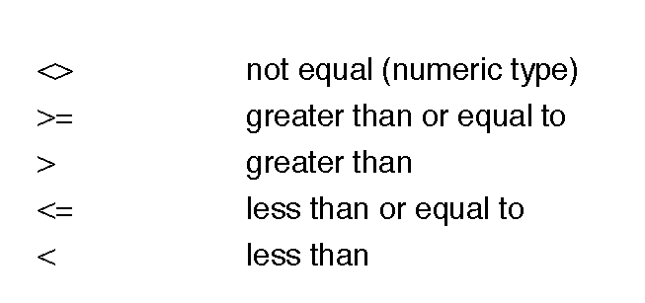
All the comparison functions except "eq" and "neq" will give an error message if they are used to compare a number and non-number.
If the type is not known in advance, the "eq" and "neq" functions should be used.
The eq function checks for the same magnitude and type of its arguments
while the "=" function only checks the magnitude of its (numeric) arguments and doesn't care if they're integer or floating-point.

Slide 13
logical values
The logical functions of CLIPS are and, or, and not. They can be used in expressions as Boolean functions. In CLIPS, true and false are represented by the symbols TRUE and FALSE.
Note that upper-case must be used for logical values in CLIPS.

Slide 14
Functions
The eq function returns the symbol TRUE if its first argument is equal in value to all its subsequent arguments, otherwise it returns the symbol FALSE. Note that eq compares types as well as values. Thus, (eq 3 3.0) is FALSE since 3 is an integer and 3.0 is a float.
The neq function returns the symbol TRUE if its first argument is not equal in value to all its subsequent arguments, otherwise it returns the symbol FALSE. Note that neq compares types as well as values. Thus, (neq 3 3.0) is TRUE since 3 is an integer and 3.0 is a float.

Slide 15
Functions ..
The = function returns the symbol TRUE if its first argument is equal in value to all its subsequent arguments, otherwise it returns the symbol FALSE. Note that = compares only numeric values and will convert integers to floats when necessary for comparison.
The <> function returns the symbol TRUE if its first argument is not equal in value to all its subsequent arguments, otherwise it returns the symbol FALSE. Note that <> compares only numeric values and will convert integers to floats when necessary for comparison.

Slide 16
Functions ….
The >= function returns the symbol TRUE if for all its arguments, argument n‑1 is greater than or equal to argument n, otherwise it returns the symbol FALSE. Note that >= compares only numeric values and will convert integers to floats when necessary for comparison.
The < function returns the symbol TRUE if for all its arguments, argument n‑1 is less than argument n, otherwise it returns the symbol FALSE. Note that < compares only numeric values and will convert integers to floats when necessary for comparison.
The <= function returns the symbol TRUE if for all its arguments, argument n‑1 is less than or equal to argument n, otherwise it returns the symbol FALSE. Note that <= compares only numeric values and will convert integers to floats when necessary for comparison.

Slide 17
Functions
The numberp function returns the symbol TRUE if its argument is a float or integer, otherwise it returns the symbol FALSE.
The floatp function returns the symbol TRUE if its argument is a float, otherwise it returns the symbol FALSE.
The integerp function returns the symbol TRUE if its argument is an integer, otherwise it returns the symbol FALSE.
The stringp function returns the symbol TRUE if its argument is a string, otherwise it returns the symbol FALSE.

Slide 18
Functions ..
The evenp function returns the symbol TRUE if its argument is an even number, otherwise it returns the symbol FALSE.
The oddp function returns the symbol TRUE if its argument is an odd number, otherwise it returns the symbol FALSE.

Slide 19
Functions……
The and function returns the symbol TRUE if each of its arguments evaluates to TRUE, otherwise it returns the symbol FALSE. Each argument of the function is evaluated from left to right. If any argument evaluates to FALSE, then the symbol FALSE is immediately returned by the function.
he or function returns the symbol TRUE if any of its arguments evaluates to TRUE, otherwise it returns the symbol FALSE. Each argument of the function is evaluated from left to right. If any argument evaluates to TRUE, then the symbol TRUE is immediately returned by the function.
The not function returns the symbol TRUE if its argument evaluates to FALSE, otherwise it returns the symbol FALSE.

Slide 20
CLIPS> (= 3 3.0)
TRUE
CLIPS> (= 4 4.1)
FALSE
CLIPS>
CLIPS> (neq foo bar yak bar)
TRUE
CLIPS> (neq foo foo yak bar)
FALSE
CLIPS> (neq 3 a)
TRUE
CLIPS>
CLIPS> (eq foo bar mumble foo)
FALSE
CLIPS> (eq foo foo foo foo)
TRUE
CLIPS> (eq 3 4)
FALSE
CLIPS>

Slide 21
Summery of Today’s Lecture
readline function
(assert-string)
Functions

