Slide 1
Artificial Intelligence
Dr. Asad Safi
​
Assistant Professor,
Department of Computer Science,
COMSATS Institute of Information Technology (CIIT) Islamabad, Pakistan.

Slide 2
Summary of Previous Lecture
Artificial Intelligence involves the study of:
  automated recognition and understanding of signals
  reasoning, planning, and decision-making
AI has made substantial progress in
  recognition and learning
  some planning and reasoning problems
  …but many open research problems
What are the components that might be useful?
  Fast hardware?
  Speech interaction?
    speech recognition/understanding
  Image recognition and understanding ?
  Learning?
  Planning and decision-making?
Reading: chapter 1 in text,

Slide 3
Today’s Lecture
AI Applications
  improvements in hardware and algorithms
  AI applications in industry, finance, medicine, and science.
Human Intelligence VS Artificial Intelligence
  Artificial Intelligence VS Conventional Computing
Is AI dangerous?
  Sentient AI

Slide 4
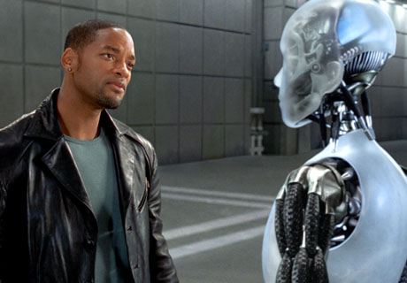
How much can be a Machine Intelligent?

Slide 5
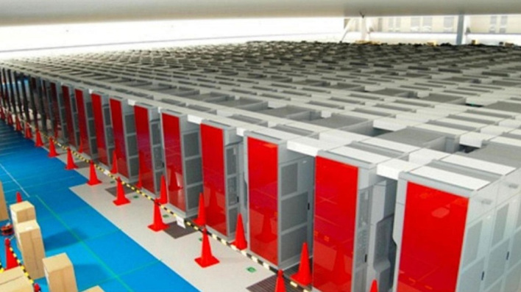
Simulating 1 second of real brain activity takes 40 minutes and 83K processors
Researchers have simulated 1 second of real brain activity, on a network equivalent to 1 percent of an actual brain’s neural network, using the world’s fourth-fastest supercomputer.
The results aren’t revolutionary just yet,
http://gigaom.com/2013/08/02/simulating-1-second-of-real-brain-activity-takes-40-minutes-83k-processors/

Slide 6
successes of AI today

Slide 7
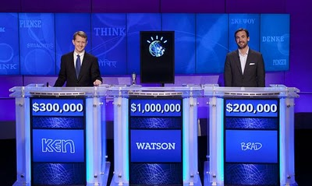
IBM Watson
Watson is an artificially intelligent computer system capable of answering questions posed in natural language, developed in IBM's DeepQA project by a research team.
The computer system was specifically developed to answer questions on the quiz show Jeopardy!.
In 2011, Watson competed on Jeopardy! against former winners Brad Rutter andKen Jennings.
Watson received the first prize of $1 million.

Slide 8
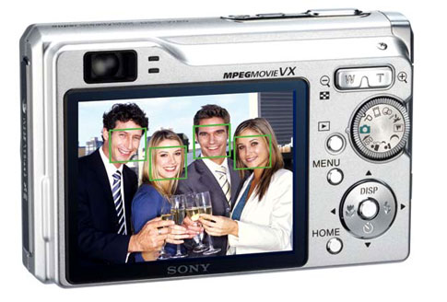
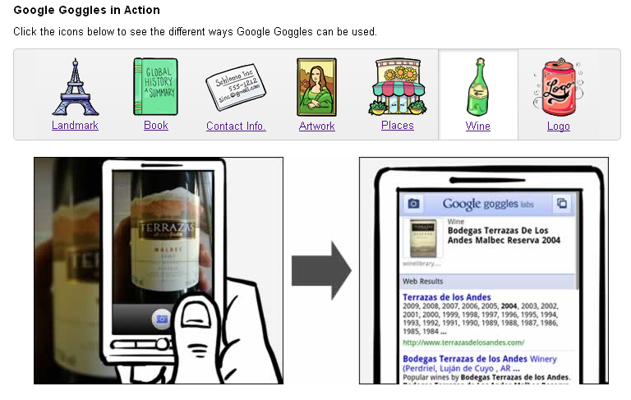
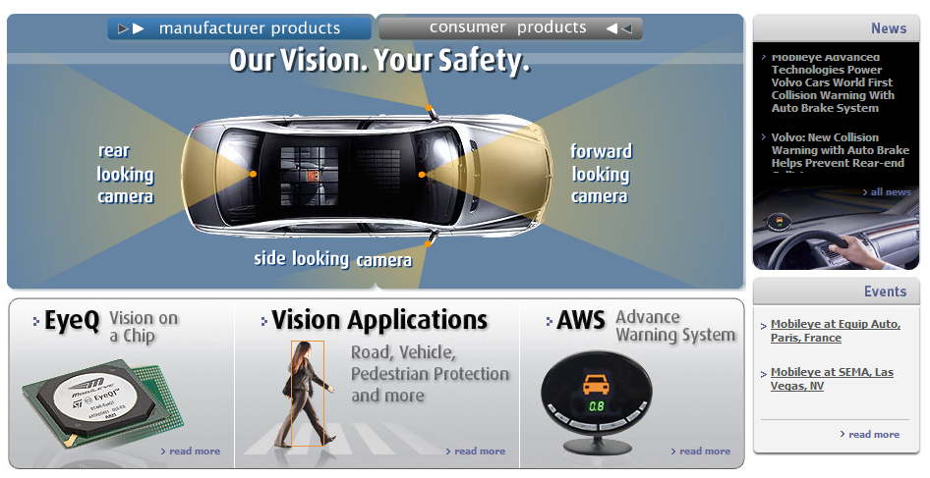

Vision
OCR, handwriting recognition
Face detection/recognition: many consumer cameras, Apple iPhoto
Visual search: Google Goggles
Vehicle safety systems: Mobileye

Slide 9
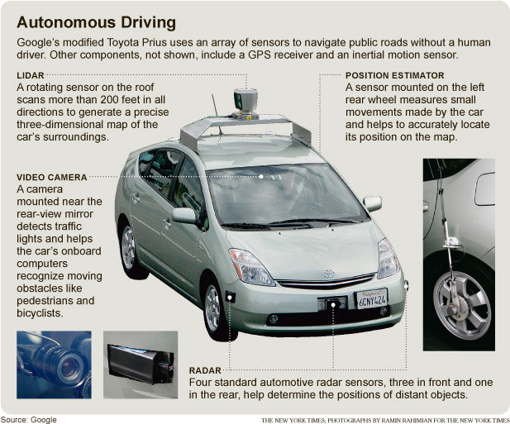
Google self-driving cars
Google’s self-driving car passes 300,000 miles ( 8/15/2012)

Slide 10
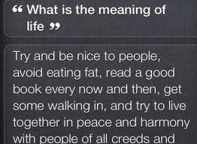
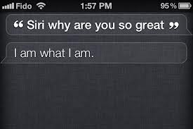
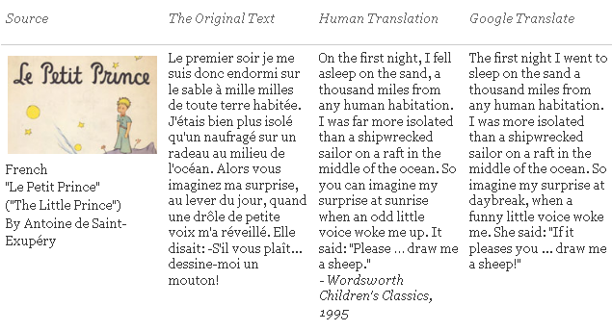
Natural Language
Speech technologies
  Google voice search
  Apple Siri
Machine translation
  translate.google.com
  Comparison of several translation systems

Slide 11
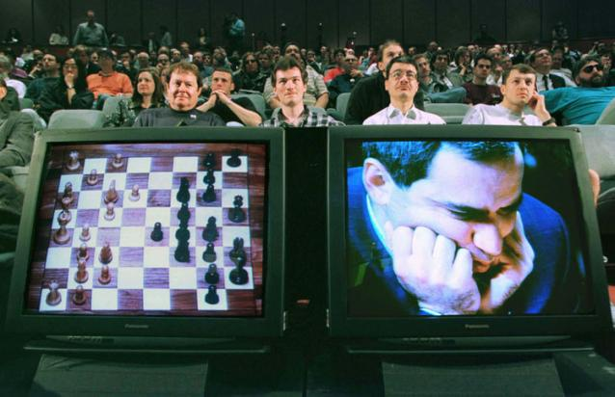
Math, games
In 1996, a computer program written by researchers at Argonne National Laboratory proved a mathematical supposition unsolved for decades
  NY Times story: The Computers have found proofs of mathematical conjectures.
  “[The proof] would have been called creative if a human had thought of it”
IBM’s Deep Blue defeated the world chess champion Garry Kasparov in 1997
  1996: Kasparov Beats Deep Blue
  “I could feel – I could smell – a new kind
  of intelligence across the table.”
  1997: Deep Blue Beats Kasparov
  “Deep Blue hasn't proven anything.”
In 2007, checkers was “solved”
  he game of checkers has roughly 500 billion billion possible positions (5 × 10^20).
  Science article

Slide 12
Logistics, scheduling, planning
During the 1991 Gulf War, US forces deployed an AI logistics planning and scheduling program that involved up to 50,000 vehicles, cargo, and people
NASA’s Remote Agent software operated the Deep Space 1 spacecraft during two experiments in May 1999
In 2004, NASA introduced the MAPGEN system to plan the daily operations for the Mars Exploration Rovers

Slide 13
Information agents
Search engines
Recommendation systems
Spam filtering
Automated helpdesks
Fraud detection
Automated trading
Medical diagnosis

Slide 14
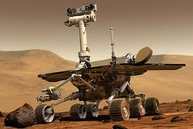
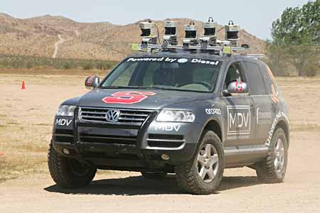

Robotics
Mars rovers
Autonomous vehicles
  DARPA Grand Challenge
  Google self-driving cars
Autonomous helicopters
Robot soccer
  RoboCup
Personal robotics
  Humanoid robots
  Robotic pets
  Personal assistants?

Slide 15
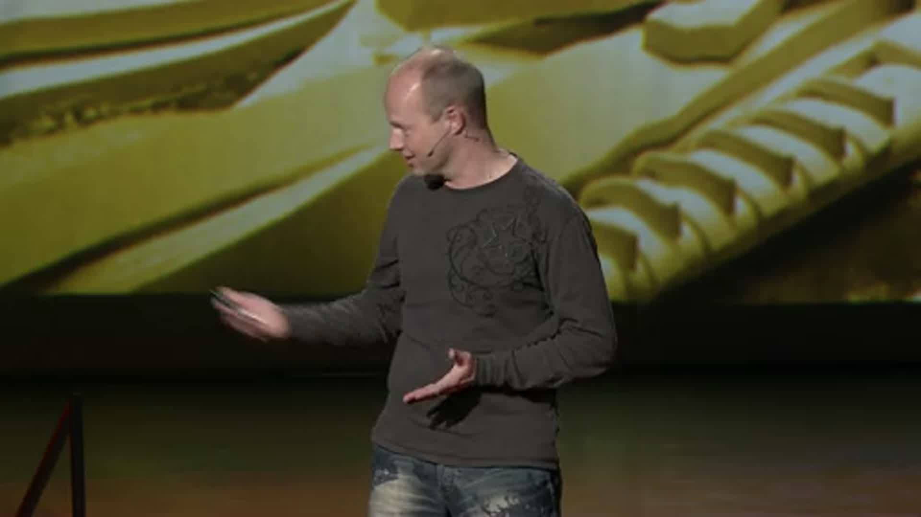
  DARPA Grand Challenge

Slide 16
ASIMO
ASIMO, an acronym for Advanced Step in Innovative MObility,
Is a humanoid robot designed and developed by Honda.
Introduced on 21 October 2000, ASIMO was designed to be a multi-functional mobile assistant. With aspirations of helping those who lack full mobility,

Slide 17

ASIMO Revolution

Slide 18
RoboCup
RoboCup is an international robotics competition founded in 1997.
The aim is to promote robotics and AI research, by offering a publicly appealing, but formidable challenge.
The name RoboCup is a contraction of the competition's full name, "Robot Soccer World Cup“.

Slide 19
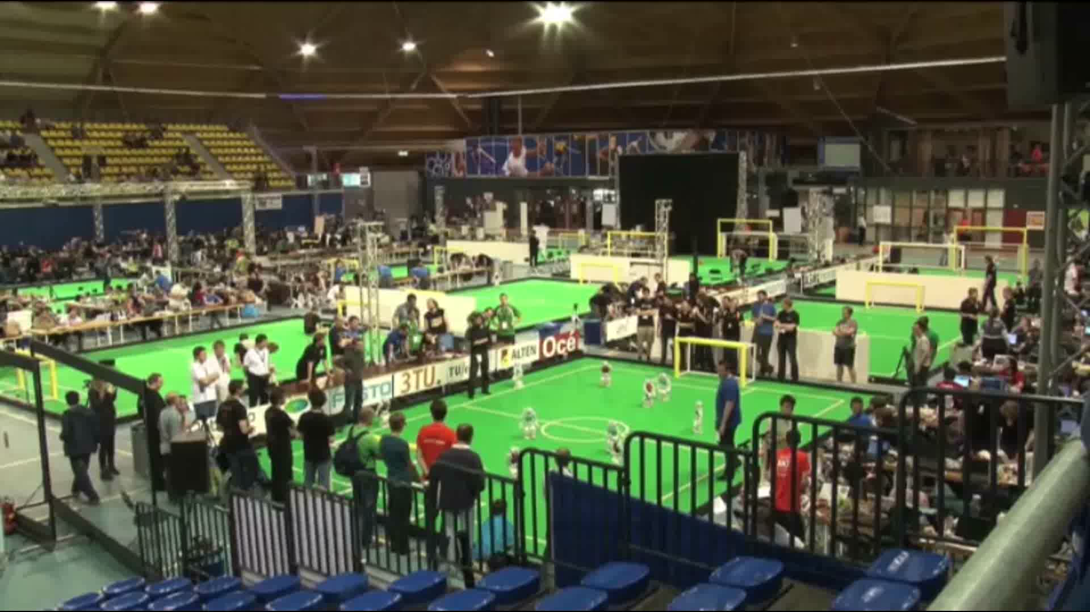
RoboCup

Slide 20
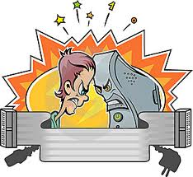
Human Intelligence VS Artificial Intelligence

Slide 21
Human Intelligence VS Artificial Intelligence
Pros
Human Intelligence
Artificial Intelligence
Intuition, Common sense, Judgement, Creativity, Beliefs etc
The ability to demonstrate their intelligence by communicating effectively
Reasoning and Critical thinking
Ability to simulate human behavior and cognitive processes
Capture and preserve human expertise
Fast Response. The ability to comprehend large amounts of data quickly.
Notes:
The important aspects of human intelligence seem to following the use of intuition, common sense, judgment, creativity, goal directedness, plausible reasoning, knowledge and beliefs.
Meaning of intelligence is not human brain’s information processing ability but the ability of humans to demonstrate their intelligence by communicating effectively.

Slide 22
Human Intelligence VS Artificial Intelligence
Cons
Human Intelligence
Artificial Intelligence
  Humans are fallible
  They have limited knowledge bases
  Information processing of serial nature proceed very slowly in the brain as compared to computers
Humans are unable to retain large amounts of data in memory.
No “common sense”
Cannot deal with “mixed” knowledge
May have high development costs
Raise legal and ethical concerns

Slide 23
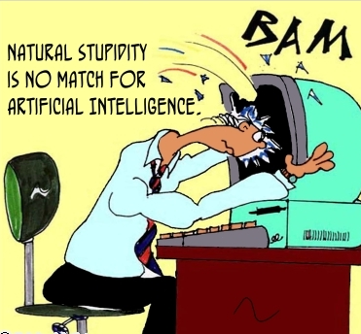
Human Intelligence VS Artificial Intelligence
We achieve more than we know.
We know more than we understand.
We understand more than we can explain
(Claude Bernard, 19th C French scientific philosopher)

Slide 24
Artificial Intelligence VS Conventional Computing
Artificial Intelligence
Conventional Computing
AI software uses the techniques of search and pattern matching
Programmers design AI software to give the computer only the problem, not the steps necessary to solve it
Conventional computer software follow a logical series of steps to reach a conclusion
Computer programmers originally designed software that accomplished tasks by completing algorithms

Slide 25
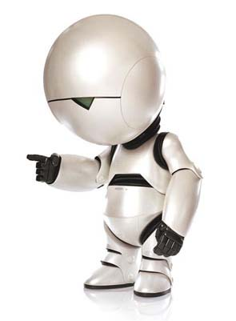
A Perspective
For Humans Intelligence is no more than TAKING a right decision at right time
And
For Machines Artificial Intelligence is no more than CHOOSING a right decision at right time

Slide 26
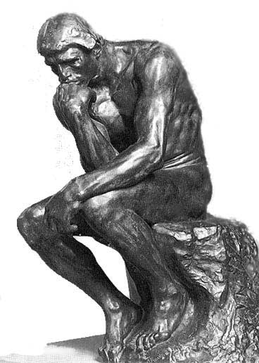
Is AI dangerous?
What is a Sentient AI?
Sentience = self-awareness
Human-level intelligence
Notes:
The Turing Test is a test devised by famed British computer scientist Alan Turing. The test involves a human judge having a conversation with one person and one machine, both of which are trying to appear human. For obvious reasons, the conversation would be text only, via written or typed messages. If the Judge cannot reliably identify the participants, then the machine is said to have passed the Turing Test. Imitation game -> how else to tell if something thinks? Can’t peek inside one’s head…
[sen-shuhns]
[sen-shuhnt]

Slide 27
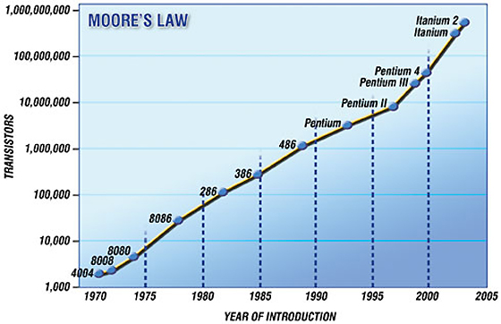
The Plausibility of Sentient AI
Moore’s Law: exponential growth!
Notes:
Moore's Law describes an important trend in the history of computer hardware: that the number of transistors that can be inexpensively placed on an integrated circuit is increasing exponentially, doubling approximately every two years.^{[1]} The observation was first made by Intel co-founder Gordon E. Moore in a 1965 paper.^{[2][3][4]} The trend has continued for more than half a century and is not expected to stop for another decade at least and perhaps much longer. Even if a wall is reached, it is likely that some other way will be found to increase computing power, such as using quantum computers or by replacing wires with laser beams/light.

Slide 28
The Plausibility of Sentient AI
The Blue Brain Project
  It could be possible to model a complete human brain within ten years – on a single machine, no less.
Ray Kurzweil:
  “… we will have both the hardware and the software to achieve human level artificial intelligence with the broad suppleness of human intelligence including our emotional intelligence by 2029”
Notes:
Blue Brain: research project conducted in Switzerland. Model of the brain built from the bottom-up, using a supercomputer to simulate individual neuron interactions. BIOLOGICALLY REALISTIC/ACCURATE
-Have accurately modeled a small slice of a rat’s brain
-Hope to model a complete rat brain within two years, download its brain into a robot rat body to test it – bump into walls = bad.
RAY KURZWEIL:
-Futurist and inventor
-Invented Kurzweil Reading Machine for the blind – scan text and read aloud.

Slide 29
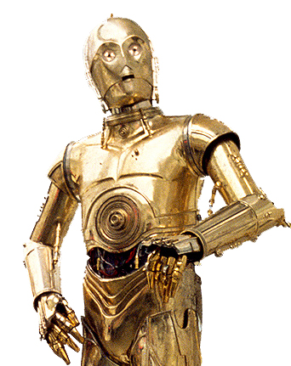
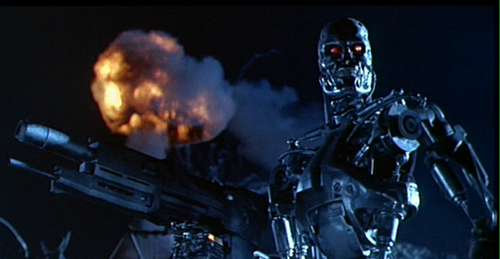
The Controversy
Should humans strive to build sentient AI?
  What are the risks? Benefits?
  Is it ethical or morally responsible?
  What rights should artificial beings have?
  Would there be any place for us?
?
Notes:
change

Slide 30
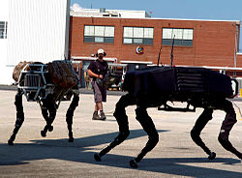
Sentient Artificial Intelligence could be dangerous
I, Robot
Thinking for one’s self
Turn skills against humans
Stephen Hawking:
  “in contrast with our intellect, computers double their performance every 18 months … the danger is real that they could develop intelligence and take over the world”

Slide 31
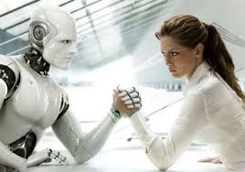
Sentient Artificial Intelligence would take jobs away from humans
Around the neighborhood
  “in the home, by the end of 2003, about 610,000 autonomous vacuum cleaners and lawn-mowers were in operation” (United Nations)
Medicine
  “computers [are] better able to distinguish signs of Alzheimer's than humans, and [prove] cheaper, faster and more accurate than current methods” so “PC beats doctor in scan tests”)
Car industry

Slide 32

Ethical Dilemma
Robot Rights
  If machines have the potential to exhibit complex behaviors such as altruism, language, and self-reproduction, “questions of ‘machine rights’ and ‘robot liberation’ will surely arise in the future” (Robert A. Freitas)
Notes:
Humans as advanced Machines:
Humans are basically very complex machines, programmed by Biology and experience. Soon, the gap between machine and man will narrow, therefore by creating sentient artificial intelligence we open a flood of moral issues.

Slide 33
Blown out of proportion
Movies such as I, Robot, Terminator, and The Matrix
    Take negative ideas and make them prominent.
    Give society a negative idea of sentience and AI.
    These movies are not an accurate idea of the potential uses of sentience.
Benefits of Sentient AI
    Benefits of AI be more important than the very small possibility of these movies becoming a reality.

Slide 34
Job loss isn’t a bad thing
Take those jobs away!
    Dangerous occupations
    Depths of space
      One-way Missions
    Biological limitations
    Purely repetitive tasks
Increase Efficiency

Slide 35
Creation- A bribe!
Still just a robot
Overall benefits to mankind
  Utilitarianism View
Exploration into the unknown

Slide 36
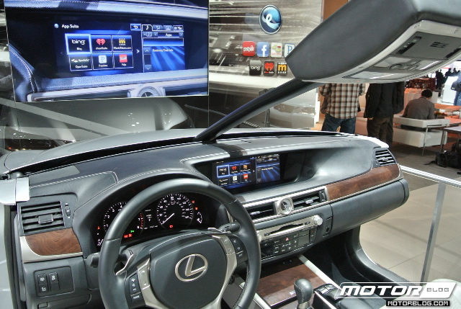
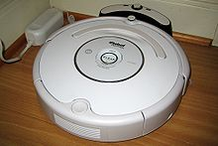
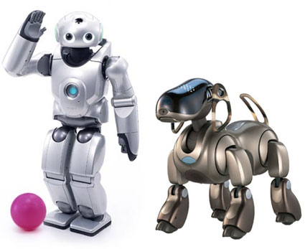
A Life of Luxury
Smart Cars
    Park itself!
Roomba!
Think QRIO

Slide 37
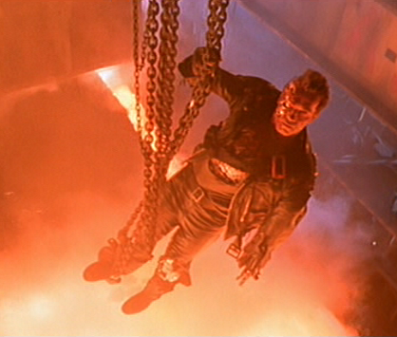
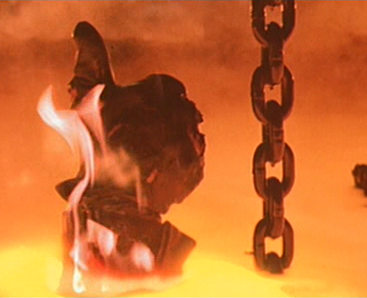
Conclusion / Compromise
Some level of artificial intelligence is capable of benefitting society
AI should be specialized in a specific task so as to not become more like humans
If these requirements are met, AI should be allowed to be developed more

Slide 38
Summary of Today’s Lecture
AI Applications
  improvements in hardware and algorithms
  AI applications in industry, finance, medicine, and science.
Human Intelligence VS Artificial Intelligence
  Artificial Intelligence VS Conventional Computing
Is AI dangerous?
  Sentient AI

