Slide 1
Artificial Intelligence
Lecture No. 16
Dr. Asad Ali Safi
​
Assistant Professor,
Department of Computer Science,
COMSATS Institute of Information Technology (CIIT) Islamabad, Pakistan.

Slide 2
Summary of Previous Lecture
Structure of a rule-based expert system
Expert Systems Shells
Characteristics of an expert system
Comparison of expert systems with conventional systems and human experts

Slide 3
Today’s Lecture
Types of inference engines
Forward chaining and backward chaining
Conflict resolution
Advantages/disadvantages of rule-based expert systems

Slide 4
Types of inference engines
As Expert Systems evolved many new techniques were incorporated into various types of inference engines. Some of the most important of these were:
  Truth Maintenance.
  Hypothetical Reasoning.
  Fuzzy Logic.
  Ontology Classification.

Slide 5
Truth Maintenance
Truth maintenance systems record the dependencies in a knowledge-base so that when facts are altered dependent knowledge can be altered accordingly.
For example, if the system learns that Jon is no longer known to be a man it will revoke the assertion that Jon is mortal.

Slide 6
Hypothetical Reasoning
In hypothetical reasoning, the knowledge base can be divided up into many possible views, aka worlds.
This allows the inference engine to explore multiple possibilities in parallel.
In this simple example, the system may want to explore the consequences of both assertions, what will be true if Jon is a Man and what will be true if he is not?

Slide 7
Fuzzy Logic
One of the first extensions of simply using rules to represent knowledge was also to associate a probability with each rule.
So, not to assert that Jon is mortal but to assert Jon may be mortal with some probability value.
Simple probabilities were extended in some systems with sophisticated mechanisms for uncertain reasoning and combination of probabilities.

Slide 8
Ontology Classification
With the addition of object classes to the knowledge base a new type of reasoning was possible. Rather than reason simply about the values of the objects the system could also reason about the structure of the objects as well.
In this simple example Man can represent an object class and R1 can be defined as a rule that defines the class of all men.
These types of special purpose inference engines are known as classifiers. Although they were not highly used in expert systems classifiers are very powerful for unstructured volatile domains and are a key technology for the Internet and the emerging

Slide 9
Forward chaining and backward chaining
In a rule-based expert system, the domain knowledge is represented by a set of IF-THEN production rules and data is represented by a set of facts about the current situation.
The inference engine compares each rule stored in the knowledge base with facts contained in the database.
When the IF (condition) part of the rule matches a fact, the rule is fired and its THEN (action) part is executed.

Slide 10
Forward chaining and backward chaining
The matching of the rule IF parts to the facts produces inference chains.
The inference chain indicates how an expert system applies the rules to reach a conclusion.

Slide 11
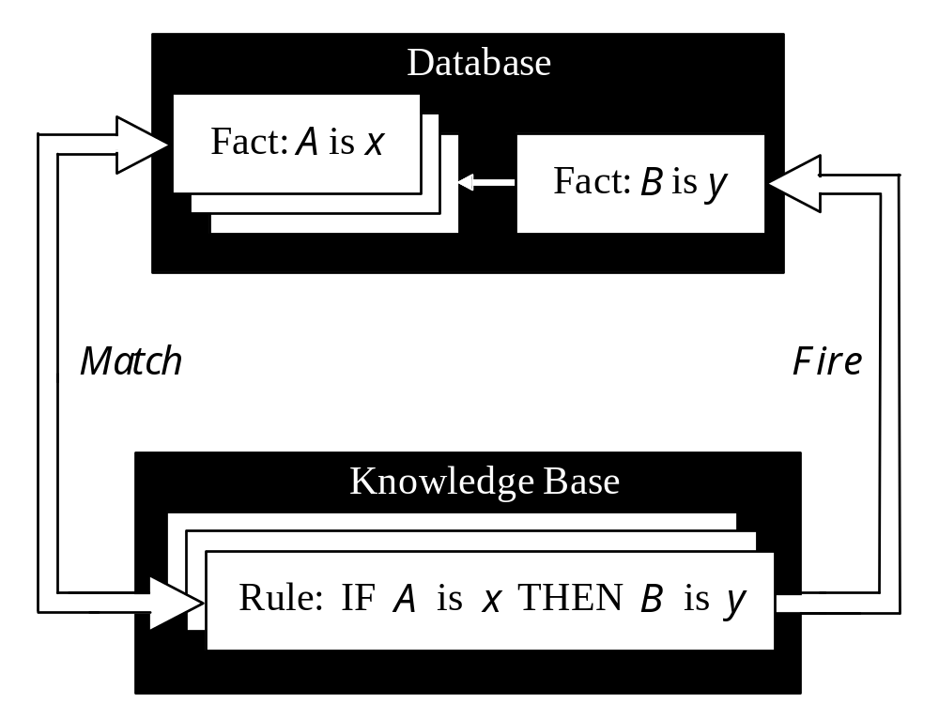
Inference engine cycles via a match-fire procedure

Slide 12
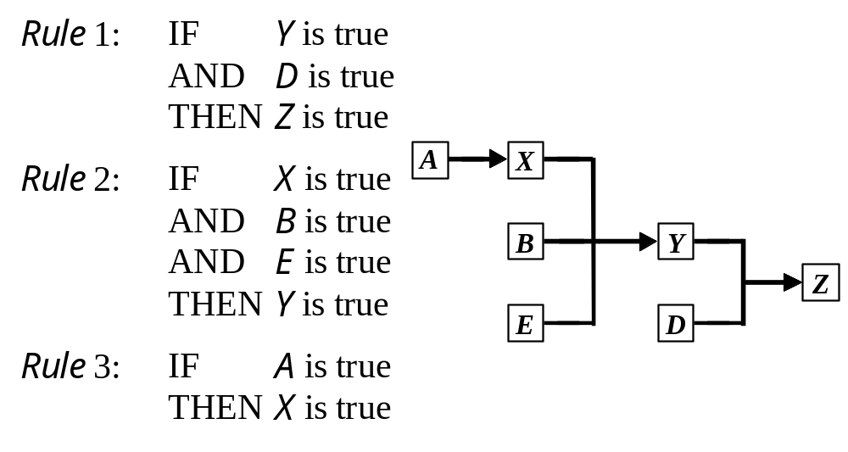
An example of an inference chain

Slide 13
Forward chaining
Forward chaining is one of the two main methods of reasoning when using inference rules.
Forward chaining is a popular implementation strategy for expert systems, business and production rule systems. .
Forward chaining starts with the available data and uses inference rules to extract more data until a goal is reached.
An inference engine using forward chaining searches the inference rules until it finds one where the If clause is known to be true.
When such a rule is found, the engine can conclude, the Then clause, resulting in the addition of new information to its data.
Inference engines will iterate through this process until a goal is reached.

Slide 14
Forward chaining…
For example, suppose that the goal is to conclude the color of a pet named Fritz, given that he croaks and eats flies, and that the rule base contains the following four rules:
If X croaks and eats flies - Then X is a frog
If X chirps and sings - Then X is a canary
If X is a frog - Then X is green
If X is a canary - Then X is yellow

Slide 15
Forward chaining…
Let us illustrate forward chaining by following the pattern of a computer as it evaluates the rules. Assume the following facts:
Fritz croaks
Fritz eats flies
Tweety eats flies
Tweety chirps
Tweety is yellow

Slide 16
Forward chaining…
With forward reasoning, the computer can derive that Fritz is green in four steps:
1. Fritz croaks and Fritz eats flies
Based on logic, the computer can derive:
2. Fritz croaks and eats flies
Based on rule 1, the computer can derive:
3. Fritz is a frog
Based on rule 3, the computer can derive:
4. Fritz is green.

Slide 17
Forward chaining…
The name "forward chaining" comes from the fact that the computer starts with the data and reasons its way to the answer, as opposed to backward chaining, which works the other way around.
In the derivation, the rules are used in the reverse order as compared to backward chaining.
Note that the computer does not use any knowledge about Tweety, when it computes that Fritz is a frog.

Slide 18
Forward chaining…
Because the data determines which rules are selected and used, this method is called data-driven.
The forward chaining approach is often employed by expert systems, such as CLIPS.
One of the advantages of forward-chaining over backward-chaining is that the reception of new data can trigger new inferences, which makes the engine better suited to dynamic situations in which conditions are likely to change.

Slide 19
Backward chaining
Backward chaining (or backward reasoning) is an inference method that can be described as working backward from the goal(s).
It is used in automated theorem provers, proof assistants and other artificial intelligence applications.
In game theory, its application to (simpler) subgames in order to find a solution to the game is called backward induction

Slide 20
Backward chaining…
Backward chaining starts with a list of goals (or a hypothesis) and works backwards from the consequent to the antecedent to see if there is data available that will support any of these consequents.
An inference engine using backward chaining would search the inference rules until it finds one which has a consequent (Then clause) that matches a desired goal.
If the antecedent (If clause) of that rule is not known to be true, then it is added to the list of goals (in order for one's goal to be confirmed one must also provide data that confirms this new rule).

Slide 21
Backward chaining…
For example, suppose that the goal is to conclude whether Tweety or Fritz is a frog, given information about each of them, and that the rule base contains the following four rules:
If X croaks and eats flies – Then X is a frog
If X chirps and sings – Then X is a canary
If X is a frog – Then X is green
If X is a canary – Then X is yellow

Slide 22
Backward chaining…
Let us illustrate backward chaining by following the pattern of a computer as it evaluates the rules. Assume the following facts:
Fritz croaks
Fritz eats flies
Tweety eats flies
Tweety chirps
Tweety is yellow

Slide 23
Backward chaining…
With backward reasoning, the computer can answer the question "Who is a frog?" in four steps: In its reasoning, the computer uses a placeholder (here: question mark) for the answer.
1. ? is a frog
Based on rule 1, the computer can derive:
2. ? croaks and eats flies
Based on logic, the computer can derive:
3. ? croaks and ? eats flies
Based on the facts, the computer can derive:
4. Fritz croaks and Fritz eats flies
This derivation will cause the computer to produce Fritz as the answer to the question "Who is a frog?".
Note that the computer has not used any knowledge about Tweety to compute that Fritz is a frog.

Slide 24
Note that the goals always match the affirmed versions of the consequents of implications and even then, their antecedents are then considered as the new goals (and not the conclusions as in affirming the consequent) which ultimately must match known facts (usually defined as consequents whose antecedents are always true
Because the list of goals determines which rules are selected and used, this method is called goal-driven, in contrast to data-driven forward-chaining inference.
The backward chaining approach is often employed by expert systems.
Programming languages such as Prolog, Knowledge Machine and ECLiPSe support backward chaining within their inference engines.

Slide 25
How do we choose between forward and backward chaining?
If an expert first needs to gather some information and then tries to infer from it whatever can be inferred, choose the forward chaining inference engine.
However, if your expert begins with a hypothetical solution and then attempts to find facts to prove it, choose the backward chaining inference engine.

Slide 26
Conflict resolution
considered rules for crossing a road.
Rule 1: IF the ‘traffic light’ is green THEN the action is go
Rule 2: IF the ‘traffic light’ is red THEN the action is stop
Let us now add third rule:
Rule 3: IF the ‘traffic light’ is red THEN the action is go

Slide 27
We have two rules, Rule 2 and Rule 3, with the same IF part. Thus both of them can be set to fire when the condition part is satisfied. These rules represent a conflict set. The inference engine must determine which rule to fire from such a set. A method for choosing a rule to fire when more than one rule can be fired in a given cycle is called conflict resolution.

Slide 28
In forward chaining, BOTH rules would be fired.
Rule 2 is fired first as the topmost one, and as a result, its THEN part is executed and linguistic object action obtains value stop.
However, Rule 3 is also fired because the condition part of this rule matches the fact ‘traffic light’ is red, which is still in the database. As a consequence, object action takes new value go.

Slide 29
Methods used for conflict resolution
Fire the rule with the highest priority. In simple applications, the priority can be established by placing the rules in an appropriate order in the knowledge base. Usually this strategy works well for expert systems with around 100 rules.
Fire the most specific rule. This method is also known as the longest matching strategy. It is based on the assumption that a specific rule processes more information than a general one.

Slide 30
Fire the rule that uses the data most recently entered in the database.
This method relies on time tags attached to each fact in the database. In the conflict set, the expert system first fires the rule whose antecedent uses the data most recently added to the database.

Slide 31
Advantages of rule-based expert systems
Natural knowledge representation. An expert usually explains the problem-solving procedure with such expressions as this: “In such-and-such situation, I do so-and-so”. These expressions can be represented quite naturally as IF-THEN production rules.
Uniform structure. Production rules have the uniform IF-THEN structure. Each rule is an independent piece of knowledge. The very syntax of production rules enables them to be self-documented.

Slide 32
Advantages of rule-based expert systems
Separation of knowledge from its processing. The structure of a rule-based expert system provides an effective separation of the knowledge base from the inference engine. This makes it possible to develop different applications using the same expert system shell.
Dealing with incomplete and uncertain knowledge. Most rule-based expert systems are capable of representing and reasoning with incomplete and uncertain knowledge.

Slide 33
Disadvantages of rule-based expert systems
Opaque relations between rules. Although the individual production rules are relatively simple and self-documented, their logical interactions within the large set of rules may be opaque. Rule-based systems make it difficult to observe how individual rules serve the overall strategy.
Ineffective search strategy. The inference engine applies an exhaustive search through all the production rules during each cycle. Expert systems with a large set of rules (over 100 rules) can be slow, and thus large rule-based systems can be unsuitable for real-time applications.

Slide 34
Disadvantages of rule-based expert systems
Inability to learn. In general, rule-based expert systems do not have an ability to learn from the experience. Unlike a human expert, who knows when to “break the rules”, an expert system cannot automatically modify its knowledge base, or adjust existing rules or add new ones. The knowledge engineer is still responsible for revising and maintaining the system.

Slide 35
Disadvantages of rule-based expert systems
The most common disadvantage cited for expert systems in the academic literature is the knowledge engineering problem.
Obtaining the time of domain experts for any software application is always difficult but for expert systems it was especially difficult because the experts were by definition highly valued and in constant demand by the organization.

Slide 36
Summery of Today’s Lecture
Types of inference engines
Forward chaining and backward chaining
Conflict resolution
Advantages/disadvantages of rule-based expert systems

