Slide 1
Artificial Intelligence
Lecture No. 15
Dr. Asad Ali Safi
​
Assistant Professor,
Department of Computer Science,
COMSATS Institute of Information Technology (CIIT) Islamabad, Pakistan.

Slide 2
Summary of Previous Lecture
Organizing the Knowledge
Propositional logic
Predicate Logic
Expert System
Transferring Expertise
The main players in the development team
Structure of a rule-based expert system

Slide 3
Today’s Lecture
Structure of a rule-based expert system
Expert Systems Shells
Characteristics of an expert system
Comparison of expert systems with conventional systems and human experts

Slide 4
Structure of a rule-based expert system
In the early seventies, Newell and Simon from Carnegie-Mellon University proposed a production system model, the foundation of the modern rule- based expert systems.
The production model is based on the idea that humans solve problems by applying their knowledge (expressed as production rules) to a given problem represented by problem-specific information.
The production rules are stored in the long-term memory and the problem-specific information or facts in the short-term memory.

Slide 5
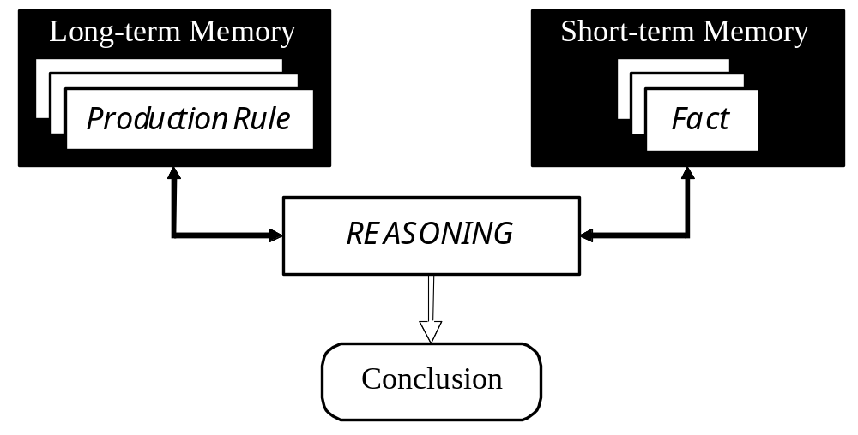
Production system model

Slide 6
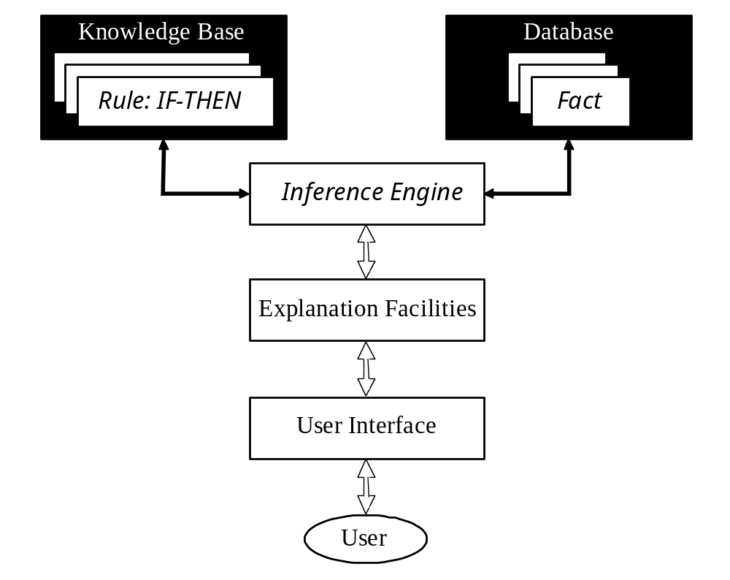
Basic structure of a rule-based expert system

Slide 7
Knowledge base
The knowledge base contains the domain knowledge useful for problem solving.
In a rule- based expert system, the knowledge is represented as a set of rules. Each rule specifies a relation, recommendation, directive, strategy or heuristic and has the IF (condition) THEN (action) structure.
When the condition part of a rule is satisfied, the rule is said to fire and the action part is executed.

Slide 8
Database
The database includes a set of facts used to match against the IF (condition) parts of rules stored in the knowledge base.

Slide 9
Inference engine
The inference engine carries out the reasoning whereby the expert system reaches a solution.
It links the rules given in the knowledge base with the facts provided in the database.

Slide 10
Explanation facilities
The explanation facilities enable the user to ask the expert system how a particular conclusion is reached and why a specific fact is needed.
An expert system must be able to explain its reasoning and justify its advice, analysis or conclusion.

Slide 11
User interface
The user interface is the means of communication between a user seeking a solution to the problem and an expert system.

Slide 12
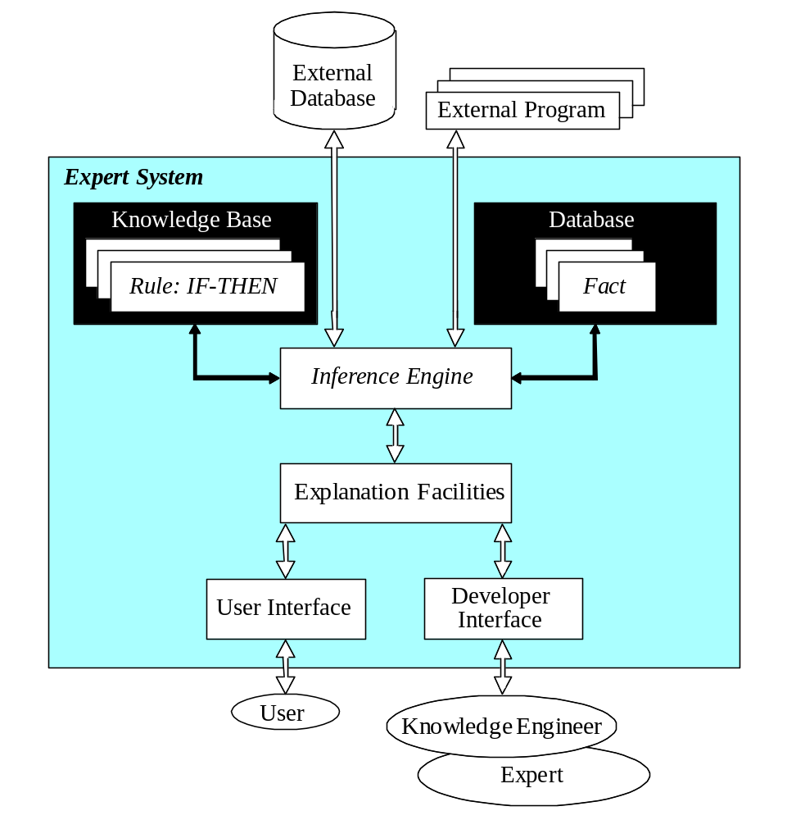
Complete structure of a rule-based expert system

Slide 13
Expert Systems Shells
The E.S shell simplifies the process of creating a knowledge base.
It is the shell that actually processes the information entered by a user relates it to the concepts contained in the knowledge base and provides an assessment or solution for a particular problem.
Thus E.S shell provides a layer between the user interface and the computer O.S to manage the input and output of the data.
It also manipulates the information provided by the user in conjunction with the knowledge base to arrive at a particular conclusion.

Slide 14
Characteristics of an expert system
An expert system is built to perform at a human expert level in a narrow, specialized domain.
Thus, the most important characteristic of an expert system is its high-quality performance. No matter how fast the system can solve a problem, the user will not be satisfied if the result is wrong.

Slide 15
Characteristics of an expert system
On the other hand, the speed of reaching a solution is very important.
Even the most accurate decision or diagnosis may not be useful if it is too late to apply, for instance, in an emergency, when a patient dies or a nuclear power plant explodes.

Slide 16
Characteristics of an expert system
Expert systems apply heuristics to guide the reasoning and thus reduce the search area for a solution.
A unique feature of an expert system is its explanation capability. It enables the expert system to review its own reasoning and explain its decisions.

Slide 17
Characteristics of an expert system
Expert systems employ symbolic reasoning when solving a problem. Symbols are used to represent different types of knowledge such as facts, concepts and rules.

Slide 18
Can expert systems make mistakes?
Even a brilliant expert is only a human and thus can make mistakes.
This suggests that an expert system built to perform at a human expert level also should be allowed to make mistakes. But we still trust experts, even we recognize that their judgments are sometimes wrong.
Likewise, at least in most cases, we can rely on solutions provided by expert systems, but mistakes are possible and we should be aware of this.

Slide 19
Characteristics of an expert system
In expert systems, knowledge is separated from its processing (the knowledge base and the inference engine are split up).
A conventional program is a mixture of knowledge and the control structure to process this knowledge.
This mixing leads to difficulties in understanding and reviewing the program code, as any change to the code affects both the knowledge and its processing.

Slide 20
When an expert system shell is used, a knowledge engineer or an expert simply enters rules in the knowledge base. Each new rule adds some new knowledge and makes the expert system smarter.

Slide 21
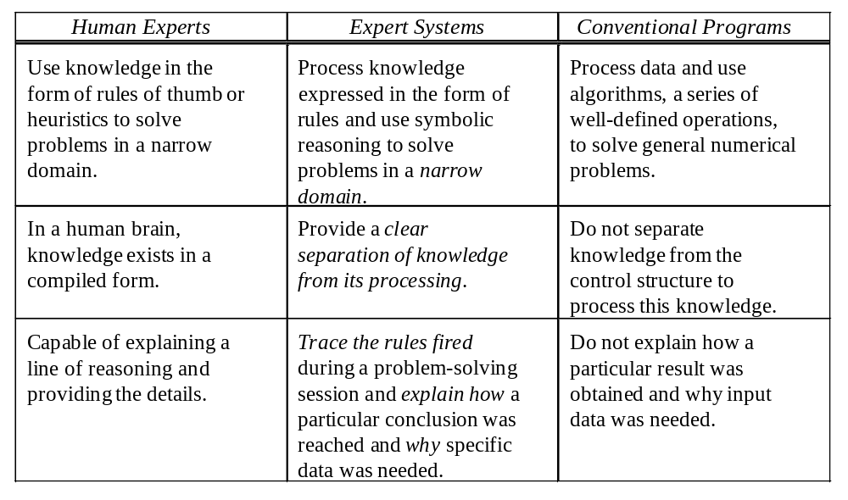
Comparison of expert systems with conventional systems and human experts

Slide 22
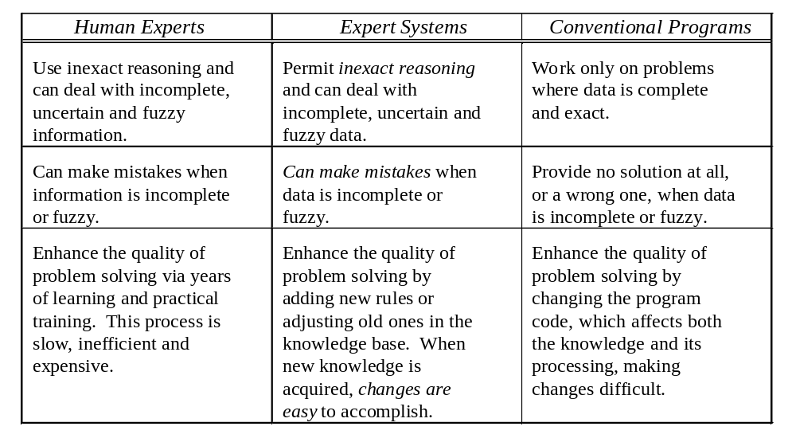
Comparison of expert systems with conventional systems and human experts (Continued)

Slide 23
Forward chaining and backward chaining
In a rule-based expert system, the domain knowledge is represented by a set of IF-THEN production rules and data is represented by a set of facts about the current situation.
The inference engine compares each rule stored in the knowledge base with facts contained in the database.
When the IF (condition) part of the rule matches a fact, the rule is fired and its THEN (action) part is executed.

Slide 24
Forward chaining and backward chaining
The matching of the rule IF parts to the facts produces inference chains.
The inference chain indicates how an expert system applies the rules to reach a conclusion.

Slide 25
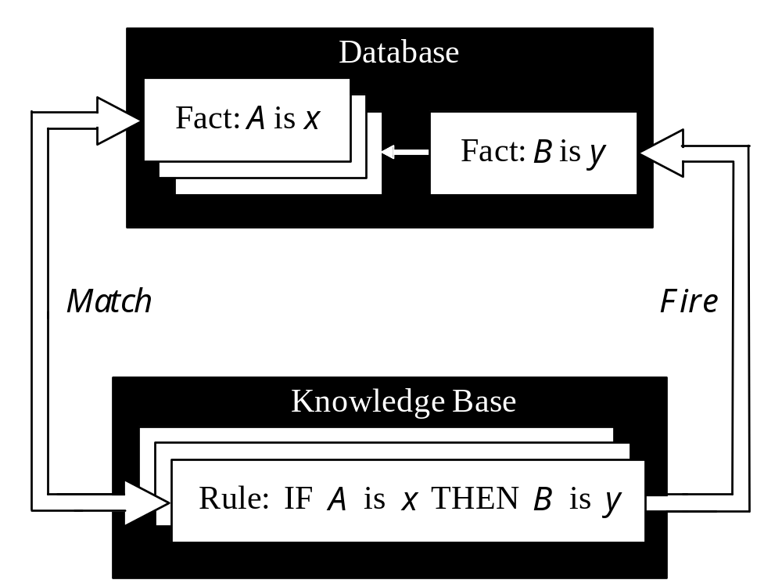
Inference engine cycles via a match-fire procedure

Slide 26
Summery of Today’s Lecture
Structure of a rule-based expert system
Expert Systems Shells
Characteristics of an expert system
Comparison of expert systems with conventional systems and human experts

