Slide 1
Artificial Intelligence
Lecture No. 14
Dr. Asad Ali Safi
​
Assistant Professor,
Department of Computer Science,
COMSATS Institute of Information Technology (CIIT) Islamabad, Pakistan.

Slide 2
Summary of Previous Lecture
Organizing the Knowledge
Rules based Organizing of the Knowledge
Rules can representation
Propositional logic

Slide 3
Today’s Lecture
Organizing the Knowledge
Propositional logic
Predicate Logic
Expert System
Transferring Expertise
The main players in the development team
Structure of a rule-based expert system

Slide 4
Propositional Logic
Propositional logic isn’t powerful enough as a general knowledge representation language.
Impossible to make general statements. E.g., “all students sit exams” or “if any student sits an exam they either pass or fail”.
So we need predicate logic.

Slide 5
Predicate Logic
Propositional logic combines atoms
  An atom contains no propositional connectives
  Have no structure (today_is_wet, john_likes_apples)
Predicates allow us to talk about objects
  Properties: is_wet(today)
  Relations: likes(john, apples)
  True or false

Slide 6
Predicte
Every complete sentence contains two partes: a “subject” and a “predicate”
The subject is what (or whom) the sentence is about
The predicate tells something about the subject
  i.e A sentence “Jon {runs} ”
Predicate is a verb phrase template that describes a property of object or a relation among objects represented by the variables.

Slide 7
  The car Tom is driving is blue;
  The sky is blue;
  The cover of this book is blue
Predicate is “is blue” describes property
Predicates are given names; let B is name for predicate “is blue”
Sentence is represented as B(x), as “x is blue”
Symble “x” represents an arbitrary object

Slide 8
Predicate logic expressions
The logical operators && ,||
Quantifiers < >
Universal quantifiers
Existential quantifiers
In predicate logic each atom is a predicate
  e.g. first order logic, higher-order logic

Slide 9
Organizing the Knowledge
Representing the knowledge
  Frames
  Semantic Networks
  Rules
  Propositional and Predicate Logic

Slide 10
Expert System

Slide 11
Expert System
Computer software that:
  Emulates human expert
  Deals with small, well defined domains of expertise
  Is able to solve real-world problems
  Is able to act as a cost-effective consultant
  Can explains reasoning behind any solutions it finds
  Should be able to learn from experience.

Slide 12
Expert System
An expert system is a system that utilizes human knowledge captured in a computer to solve problems that ordinarily require human expertise.(Turban)
A computer program that emulates the behaviour of human experts who are solving real-world problems associated with a particular domain of knowledge. (Pigford & Braur)

Slide 13
What is an Expert?
  solve simple problems easily.
  ask appropriate questions (based on external stimuli - sight, sound etc).
  reformulate questions to obtain answers.
  explain why they asked the question.
  explain why conclusion reached.
  judge the reliability of their own conclusions.
  talk easily with other experts in their field.
  learn from experience.
  reason on many levels and use a variety of tools such as heuristics, mathematical models and detailed simulations.
  transfer knowledge from one domain to another.
  use their knowledge efficiently

Slide 14
Expert System
Expert Systems manipulate knowledge while conventional programs manipulate data.
An expert system is often defined by its structure.

Slide 15
Expert Systems
Provide Direct Application of Expertise
Expert Systems Do Not Replace Experts, But They
  Make their Knowledge and Experience More Widely Available
  Permit Nonexperts to Work Better

Slide 16
Transferring Expertise
Objective of an expert system
  To transfer expertise from an expert to a computer system and
  Then on to other humans (nonexperts)
Activities
  Knowledge acquisition
  Knowledge representation
  Knowledge inferencing
  Knowledge transfer to the user
Knowledge is stored in a knowledge base
Decision Support Systems and Intelligent Systems, Efraim Turban and Jay E. Aronson
6th ed, Copyright 2001, Prentice Hall, Upper Saddle River, NJ

Slide 17
The main players in the development team
There are five members of the expert system development team: the domain expert, the knowledge engineer, the programmer, the project manager and the end-user.
The success of their expert system entirely depends on how well the members work together.

Slide 18
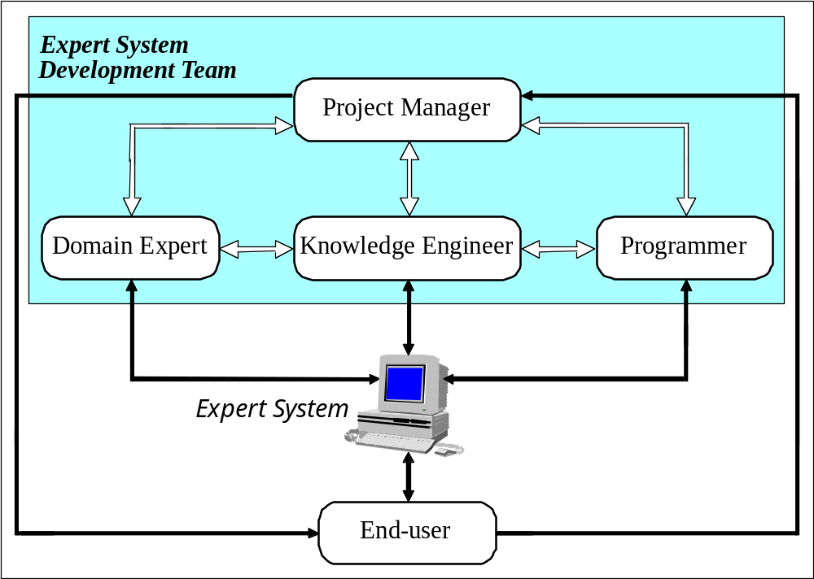
The main players in the development team

Slide 19
The domain expert
The domain expert is a knowledgeable and skilled person capable of solving problems in a specific area or domain.
This person has the greatest expertise in a given domain. This expertise is to be captured in the expert system.
Therefore, the expert must be able to communicate his or her knowledge, be willing to participate in the expert system development and commit a substantial amount of time to the project.
The domain expert is the most important player in the expert system development team.

Slide 20
The knowledge engineer
The knowledge engineer is someone who is capable of designing, building and testing an expert system.
He or she interviews the domain expert to find out how a particular problem is solved.
The knowledge engineer establishes what reasoning methods the expert uses to handle facts and rules and decides how to represent them in the expert system.
The knowledge engineer then chooses some development software or an expert system shell, or looks at programming languages for encoding the knowledge.
And finally, the knowledge engineer is responsible for testing, revising and integrating the expert system into the workplace.

Slide 21
The programmer
The programmer is the person responsible for the actual programming, describing the domain knowledge in terms that a computer can understand.
The programmer needs to have skills in symbolic programming in such AI languages as CLISP, Prolog and OPS5 and also some experience in the application of different types of expert system shells.
In addition, the programmer should know conventional programming languages like C, C++, C# and Basic.

Slide 22
The project manager
The project manager is the leader of the expert system development team, responsible for keeping the project on track.
He or she makes sure that all deliverables and milestones are met, interacts with the expert, knowledge engineer, programmer and end-user.

Slide 23
The end-user
The end-user, often called just the user, is a person who uses the expert system when it is developed.
The user must not only be confident in the expert system performance but also feel comfortable using it.
Therefore, the design of the user interface of the expert system is also vital for the project’s success; the end-user’s contribution here can be critical .

Slide 24
Structure of a rule-based expert system
In the early seventies, Newell and Simon from Carnegie-Mellon University proposed a production system model, the foundation of the modern rule- based expert systems.
The production model is based on the idea that humans solve problems by applying their knowledge (expressed as production rules) to a given problem represented by problem-specific information.
The production rules are stored in the long-term memory and the problem-specific information or facts in the short-term memory.

Slide 25
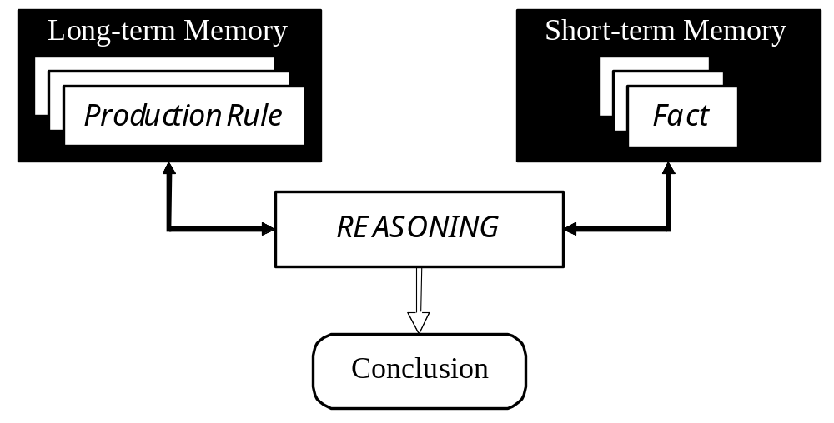
Production system model

Slide 26
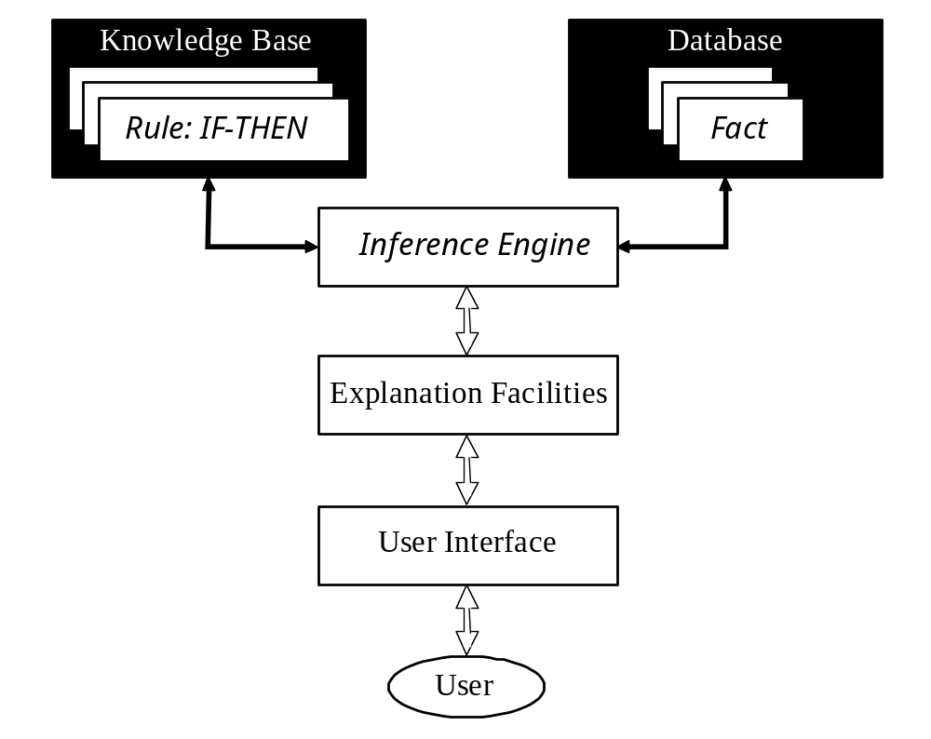
Basic structure of a rule-based expert system

Slide 27
Summery of Today’s Lecture
Organizing the Knowledge
Propositional logic
Predicate Logic
Expert System
Transferring Expertise
The main players in the development team
Structure of a rule-based expert system

