Slide 1
Artificial Intelligence
Lecture No. 12
Dr. Asad Ali Safi
​
Assistant Professor,
Department of Computer Science,
COMSATS Institute of Information Technology (CIIT) Islamabad, Pakistan.

Slide 2
Summary of Previous Lecture
Using FOL
Knowledge engineering in FOL
Knowledge
Transfer of knowledge
Types of knowledge
Organizing the Knowledge
Frames

Slide 3
Today’s Lecture
Organizing the Knowledge
Knowledge Representation using Frames
Inheritance in Frames
Semantic network
Common kinds of semantic networks
Semantic Networks Advantages/disadvantages

Slide 4
Organizing the Knowledge
Representing the knowledge
  Frames
  Semantic Networks
  Rules
  Propositional and Predicate Logic

Slide 5
Knowledge Representation using Frames
Frames are more structured form of packaging knowledge,
  used for representing objects, concepts etc.
Frames are organized into hierarchies or network of frames.
Lower level frames can inherit information from upper level frames in network.
Nodes are connected using links viz.,
  subc (links two class frames, one of which is subclass of other e.g., science_faculty class is ako of faculty class),
  is_a ( connects a particular instance of a class frame e.g., Renuka is_a science_faculty)
  a_part_of (connects two class frames one of which is contained in other e.g., faculty class is_part_of department class).
  Property link of semantic net is replaced by SLOT fields.

Slide 6
Cont…
A frame may have any number of slots needed for describing object. e.g.,
  faculty frame may have name, age, address, qualification etc as slot names.
Each frame includes two basic elements : slots and facets.
  Each slot may contain one or more facets (called fillers) which may take many forms such as:
    value (value of the slot),
    default (default value of the slot),
    range (indicates the range of integer or enumerated values, a slot can have),
    demons (procedural attachments such as if_needed, if_deleted, if_added etc.) and
    other (may contain rules, other frames, semantic net or any type of other information).

Slide 7
Frame Network - Example

Slide 8
Detailed Representation of Frame Network

Slide 9
Description of Frames
Each frame represents either a class or an instance.
Class frame represents a general concept whereas instance frame represents a specific occurrence of the class instance.
Class frame generally have default values which can be redefined at lower levels.
If class frame has actual value facet then decedent frames can not modify that value.
Value remains unchanged for subclasses and instances.

Slide 10
Inheritance in Frames
Suppose we want to know nationality or phone of an instance-frame frame13.
These information are not given in this frame.
Search will start from frame13 in upward direction till we get our answer or have reached root frame.
The frames can be easily represented in prolog by choosing predicate name as frame with two arguments.
First argument is the name of the frame and second argument is a list of slot - facet pair.

Slide 11
Features of Frame Representations
Frames can support values more naturally than semantic nets (e.g. the value 25)
Frames can be easily implemented using object-oriented programming techniques.
Demons allow for arbitrary functions to be embedded in a representation.
But a price is paid in terms of efficiency, generality, and modularity!
Inheritance can be easily controlled.

Slide 12
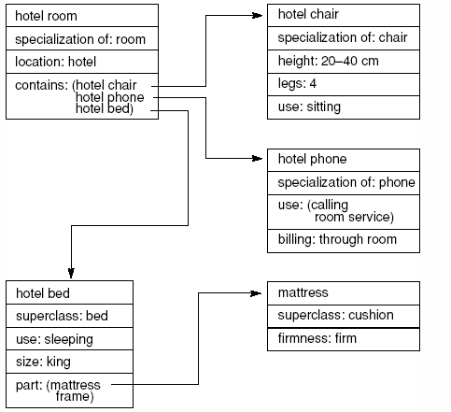
Frames Example
Fig 7.12 Part of a frame description of a hotel room. “Specialization” indicates a pointer to a superclass.(Luger: Artificial Intelligence, 6th edition. © Pearson Education Limited, 2009)

Slide 13
Frames
Advantages
Frames add power and clarity by allowing complex objects to be represented as a single frame.
Frames provide an easier framework to organize information hierarchically.
Frames allow for procedural attachment which runs a demon (piece of code) as a result of another action in the KB.
frames support class inheritance.

Slide 14
Semantic network
A semantic network or net is a graph structure for representing knowledge in patterns of interconnected nodes and arcs.
Computer implementations of semantic networks were first developed for artificial intelligence and machine translation, but earlier versions have long been used in philosophy, psychology, and linguistics.
The Giant Global Graph of the Semantic Web is a large semantic network
          (Berners-Lee et al. 2001; Hendler & van Harmelen 2008).

Slide 15
What is common to all semantic networks is a declarative graphic representation that can be used to represent knowledge and support automated systems for reasoning about the knowledge.
Some versions are highly informal, but others are formally defined systems of logic.

Slide 16
Semantic Networks
Define objects in terms of their association with other objects
  e.g. snow, white, snowman, ice, slippery.
Represent knowledge as a graph:
Concepts at lower levels inherit characteristics from their parent concepts.
Concepts
Relations

Slide 17
Six most common kinds of semantic networks:
1: Definitional networks:
Emphasize the subtype or is-a relation between a concept type and a newly defined subtype.
The resulting network, also called a generalization or subsumption hierarchy, supports the rule of inheritance for copying properties defined for a supertype to all of its subtypes.
Since definitions are true by definition, the information in these networks is often assumed to be necessarily true.

Slide 18
2: Assertional networks:
Are designed to assert propositions. Unlike definitional networks, the information in an assertional network is assumed to be contingently true, unless it is explicitly marked with a modal operator.
Some assertional netwoks have been proposed as models of the conceptual structures underlying natural language semantics.

Slide 19
3: Implicational networks:
Use implication as the primary relation for connecting nodes. They may be used to represent patterns of beliefs, causality, or inferences.
Implicational networks emphasize implication, they are capable of expressing all the Boolean connectives by allowing a conjunction of inputs to a propositional node and a disjunction of outputs.

Slide 20
4: Executable networks:
Include some mechanism, such as marker passing or attached procedures, which can perform inferences, pass messages, or search for patterns and associations.
Executable semantic networks contain mechanisms that can cause some change to the network itself.
The simplest networks with attached procedures are dataflow graphs, which contain passive nodes that hold data and active nodes that take data from input nodes and send results to output nodes.

Slide 21
5: Learning networks:
Build or extend their representations by acquiring knowledge from examples. The new knowledge may change the old network by adding and deleting nodes and arcs or by modifying numerical values, called weights, associated with the nodes and arcs.
The purpose of learning, both from a natural and an AI standpoint, is to create modifications that enable the system to respond more effectively within its environment.

Slide 22
6: Hybrid networks:
Combine two or more of the previous techniques, either in a single network or in separate, but closely interacting networks.
Systems are usually called hybrids if their component languages have different syntax. . . The most widely used hybrid of multiple network notations is the Unified Modeling Language (UML), which was by designed by three authors . . . who merged their competing notations.

Slide 23
Semantic Networks
Well designed semantic networks are a form of logic.
memberOf(femalePersons, mary)
female Persons
memberOf
mary

Slide 24
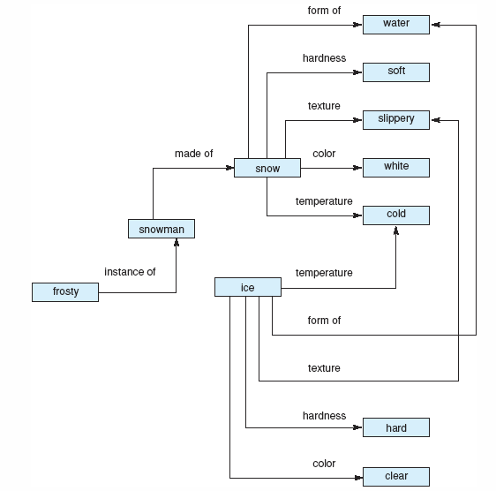
Semantic Networks
Example
Fig 7.2 Network representation of properties of snow and ice (From: Luger: Artificial Intelligence, 6th edition. © Pearson Education Limited, 2009)

Slide 25
Semantic Networks
Example
mammals
subsetOf
legs
hasMother
Persons
2
subsetOf
subsetOf
female Persons
male Persons
memberOf
memberOf
sisterOf
legs
mary
john
1

Slide 26
Semantic Networks
Inference Mechanism
Inheritance
  e.g. Persons by default have 2 legs. How many legs does Mary have? John?
Use of Inverse Links (through reification)
  e.g. hasSister(p, s) and sisterOf(s, p)
hasSister
inverseOf
sisterOf

Slide 27
Semantic Networks
Example
mammals
subsetOf
legs
hasMother
Persons
2
subsetOf
subsetOf
female Persons
male Persons
memberOf
memberOf
sisterOf
legs
mary
john
1
hasSister

Slide 28


Simple semantic nets
Nodes are labeled with names (nouns).
Arcs are labeled with relationships.
Special link label "isa" means "is a".
Show membership or subset relationships

Slide 29
In any case, we can use our high-level data abstraction, the directed graph, to make these relationships a bit more visual. For example, from the bird definitions, we can construct the following abstraction:
vertebrate
^
| is-a
has-part
| /------------- wings
/ reproduction
| /--------------- egg-laying
| / body-temp
| /----------------- warm-blooded
bird--< no. of legs
^ ^ ^ \----------------- 2
/ | \ \ covering
is-a / | \ \--------------- feathers
/ | \ \ movement
color / | \ \------------- flight
yellow ------canary
size / | is-a \ is-a
small -----/ | \ movement
| ostrich---------- run
movement | \ size
swim ----------penguin \--------- big

Slide 30
Semantic Networks
Advantages
Simple and transparent inference processes.
Ability to assign default values for categories.
Ability to include procedural attachment.

Slide 31
Semantic Networks
Disadvantages
Simple query language may be too limiting to express complex queries.
Does not represent full FOL since it does not provide means to use negation, disjunction, and existential quantification.
n-ary functions must be mapped onto binary functions.

Slide 32
Semantic Networks
Much of this work has been done in the arena of natural language.
First implementation in machine translation in the early 60s.
Quillian’s dictionary (late 1960s):
  Planes contain single word definitions.
  Words are defined in terms of other words in a semantic network format.
  Program used definitions to find relationships between pairs of words. (e.g. comfort and cry produce sad)

Slide 33
Comparative Summary
Semantic nets can easily represent inheritance and exceptions, but are not well-suited for representing negation, disjunction, preferences, conditionals, and cause/effect relationships.
Frames allow arbitrary functions (demons) and typed inheritance. Implementation is a bit more cumbersome.

Slide 34
Summery of Today’s Lecture
Organizing the Knowledge
Knowledge Representation using Frames
Inheritance in Frames
Semantic network
Common kinds of semantic networks
Semantic Networks Advantages/disadvantages

