Slide 1
Artificial Intelligence
Lecture No. 11
Dr. Asad Ali Safi
​
Assistant Professor,
Department of Computer Science,
COMSATS Institute of Information Technology (CIIT) Islamabad, Pakistan.

Slide 2
Summary of Previous Lecture
Logic
Propositional logic
Pros and cons of propositional logic
First-order logic
Syntax of FOL: Basic elements
Atomic/complex sentences
Connections between Quantifiers

Slide 3
Today’s Lecture
Using FOL
Knowledge engineering in FOL
Knowledge
Transfer of knowledge
Types of knowledge
Organizing the Knowledge
Frames

Slide 4
Using FOL
We want to TELL things to the KB, e.g.
TELL(KB, )
TELL(KB, King(John) )
These sentences are assertions
We also want to ASK things to the KB,
ASK(KB, )
these are queries or goals
The KB should return the list of x’s for which Person(x) is true: {x/John,x/Richard,...}

Slide 5
FOL Version of Wumpus World
Typical percept sentence:
Percept([Stench,Breeze,Glitter,None,None],5)
Actions:
Turn(Right), Turn(Left), Forward, Shoot, Grab, Release, Climb
To determine best action, construct query:
∀ a BestAction(a,5)
ASK solves this and returns {a/Grab}
  And TELL about the action.

Slide 6
Knowledge Base for Wumpus World
Perception
  ∀b,g,t Percept([Breeze,b,g],t) ⇒ Breeze(t)
  ∀s,b,t Percept([s,b,Glitter],t) ⇒ Glitter(t)
Reflex
  ∀t Glitter(t) ⇒ BestAction(Grab,t)

Slide 7
Knowledge engineering in FOL
Identify the task
Assemble the relevant knowledge
Decide on a vocabulary of predicates, functions, and constants
Encode general knowledge about the domain
Encode a description of the specific problem instance
Pose queries to the inference procedure and get answers
Debug the knowledge base

Slide 8
WHAT IS KNOWLEDGE?
Knowledge is the body of facts and principles.
Knowledge can be language, concepts, procedures, rules, ideas, abstractions, places, customs, and so on.
In philosophy, the study of knowledge is called epistemology.
The philosopher Plato famously defined knowledge as "justified true belief."
However, no single agreed definition of knowledge exists, though there are numerous theories to explain it.

Slide 9

Knowledge
Knowledge is a familiarity with someone or something, which can include facts, information, descriptions, or skills acquired through experience or education.
It can refer to the theoretical or practical understanding of a subject.
It can be implicit (as with practical skill or expertise)
Or
explicit (as with the theoretical understanding of a subject); it can be more or less formal or systematic.
http://oxforddictionaries.com/view/entry/m_en_

Slide 10
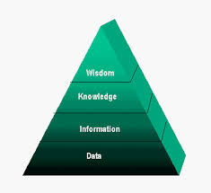
Data, Information, Knowledge and Wisdom

Slide 11
Data
The data might concern numerical quantities of process elements that could include bottle weight, data about the soft drink colour.
Only when these sets of data are put in the right order or in a more specific and more organized framework will they have a meaning.

Slide 12
Information
In this example information could be an excel data sheet that describes several production elements of a specific drink lot.
For example, the title of the sheet could be: Weight of bottles for Coke, Lot No 12445, produced on 29/11/2013.
It is obvious that this sheet with organized information has a specific purpose (to control) and it is associated to a particular production element or object (Coke) and production event (bottles filled for lot No 12445 on 29/11/2013).

Slide 13
Knowledge
When the particular knowledge associated with the above data and information is discussed it could be easily realized that:
  1. Someone, who is expert in quality statistical control, must interpret the data sheet
  2. In addition, this person, in order to make his decision, needs a framework for evaluating this information. The final decision of the quality manager could be to send the bottles back for refilling or to rank the lot as quality A or quality B and then decide to which markets the lot should be pushed to.
  3. Only this expert was able to decide how the drinks lot in question varied from the past lots and from the quality standards and why this lot should be pushed to market A (more strict customers) or to market B (not so strict customers).

Slide 14
Wisdom
In this example the corresponding wisdom could be described as the ability of the quality expert or quality department to improve the whole quality control process by reviewing the quality standards again as well as by reviewing the required control process taking into consideration previous knowledge and experience.
In any of the above-mentioned cases the company will improve the quality control process.

Slide 15

Transfer of knowledge
Symbolic representations can be used to indicate meaning and can be thought of as a dynamic process.
Other forms of communication include observation and imitation, verbal exchange, and audio and video recordings.

Slide 16

Transfer of knowledge
Philosophers of language construct and analyze theories of knowledge transfer or communication.
While many would agree that one of the most universal and significant tools for the transfer of knowledge is writing and reading, argument over the usefulness of the written word exists.

Slide 17
Types of knowledge
The types of knowledge include
  procedural knowledge,
  declarative knowledge
  and heuristic knowledge.

Slide 18
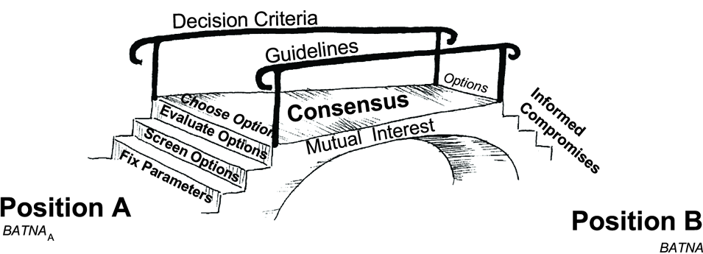
Procedural knowledge
Procedural knowledge is compiled or processed form of information.
Procedural knowledge is related to the performance of some task.
For example, sequence of steps to solve a problem is procedural knowledge.
This knowledge is formed by doing

Slide 19
Procedural knowledge
In some legal systems, such procedural knowledge has been considered the intellectual property of a company, and can be transferred when that company is purchased.
One advantage of procedural knowledge is that it can involve more senses, such as hands-on experience, practice at solving problems, understanding of the limitations of a specific solution, etc.

Slide 20

Declarative knowledge
Declarative knowledge is passive knowledge in the form of statements of facts about the world.
the type of knowledge that is, by its very nature, expressed in declarative sentences or indicative propositions.
For example, mark statement of
a student is declarative knowledge.

Slide 21

Heuristic knowledge
Heuristics knowledge are rules of thumb or tricks.
Heuristic knowledge is used to make judgments and also to simplify solution of problems.
It is acquired through experience. An expert uses his knowledge that he has gathered due to his experience and learning.

Slide 22
Heuristic knowledge
experience-based techniques for problem solving, learning, and discovery that give a solution which is not guaranteed to be optimal.
Where the exhaustive search is impractical, heuristic methods are used to speed up the process of finding a satisfactory solution via mental shortcuts to ease the cognitive load of making a decision.
Examples of this method include using a rule of thumb, an educated guess, an intuitive judgment, stereotyping, or common sense.

Slide 23
Importance of knowledge
Intelligence requires knowledge. That is, to exhibit intelligence, knowledge is required. Knowledge plays a major role in building intelligent systems.

Slide 24
Organizing the Knowledge
Representing the knowledge
  Frames
  Semantic Networks
  Rules
  Propositional and Predicate Logic

Slide 25
FRAMES
Natural language understanding requires inference i.e., assumptions about what is typically true of the objects or situations under consideration.
Such information can be coded in structures known as frames.

Slide 26
Need of frames
Frame is a type of schema used in many AI applications including vision and natural language processing.
Frames provide a convenient structure for representing objects that are typical to a stereotypical situations.
The situations to represent may be visual scenes, structure of complex physical objects, etc.
Frames are also useful for representing commonsense knowledge.
As frames allow nodes to have structures they can be regarded as three-dimensional representations of knowledge.

Slide 27
A frame is similar to a record structure and corresponding to the fields and values are slots and slot fillers.
Basically it is a group of slots and fillers that defines a conventional object.
A single frame is not much useful. Frame systems usually have collection of frames connected to each other. Value of an attribute of one frame may be another frame.

Slide 28
A frame for a book is given below.
Slots | Fillers
publisher | Thomson
title | Expert Systems
author | Giarratano
edition | Third
year | 1998
pages | 600
The above example is simple one but most of the frames are complex.
Moreover with filler slots and inheritance provided by frames powerful knowledge representation systems can be built.

Slide 29
Frames can represent either generic or frame. Following is the example for generic frame.
The fillers may values such as computer in the name slot or a range of values as in types slot. The procedures attached to the slots are called procedural attachments.
Slot | Fillers
name | computer
specialization_of | a_kind_of machine
types | (desktop, laptop,mainframe,super) if-added: Procedure ADD_COMPUTER
speed | default: faster if-needed: Procedure FIND_SPEED
location | (home,office,mobile)
under_warranty | (yes, no)

Slide 30
There are mainly three types of procedural attachments: I
  if-needed,
  default and
  if-added.
As the name implies if-needed types of procedures will be executed when a filler value is needed.
Default value is taken if no other value exists. Defaults are used to represent commonsense knowledge. Commonsense is generally used when no more situation specific knowledge is available.

Slide 31
The if-added type is required if any value is to be added to a slot. In the above example, if a new type of computer is invented ADD_COMPUTER procedure should be executed to add that information.
An if-removed type is used to remove a value from the slot.

Slide 32
Summery of Today’s Lecture
Using FOL
Knowledge engineering in FOL
Knowledge
Transfer of knowledge
Types of knowledge
Organizing the Knowledge
Frames

