Slide 1
Artificial Intelligence
Dr. Asad Safi
​
Assistant Professor,
Department of Computer Science,
COMSATS Institute of Information Technology (CIIT) Islamabad, Pakistan.

Slide 2
My Introduction
Dr. Asad Ali Safi
  Assistant Professor
  Office: 206 Admin block
  Email: asad.safi@comsats.edu.pk
  Office Phone: 051-90495311
EDUCATION
2008 - 2012 | Technical University of Munich, Germany
 | Ph.D. Major: Machine learning (Distinction)
2004 - 2007 | COMSATS Abbottabad, Pakistan
 | MS, Major: A.I. (1st division)
2002 - 2004 | COMSATS Abbottabad, Pakistan
 | MCS, Major: Computer Science (1st division)
2000 - 2002 | University of Peshawar, Pakistan
 | BSC (Honors) Major: CS Minor: Islamic & Arabic Studies. (1st division)

Slide 3
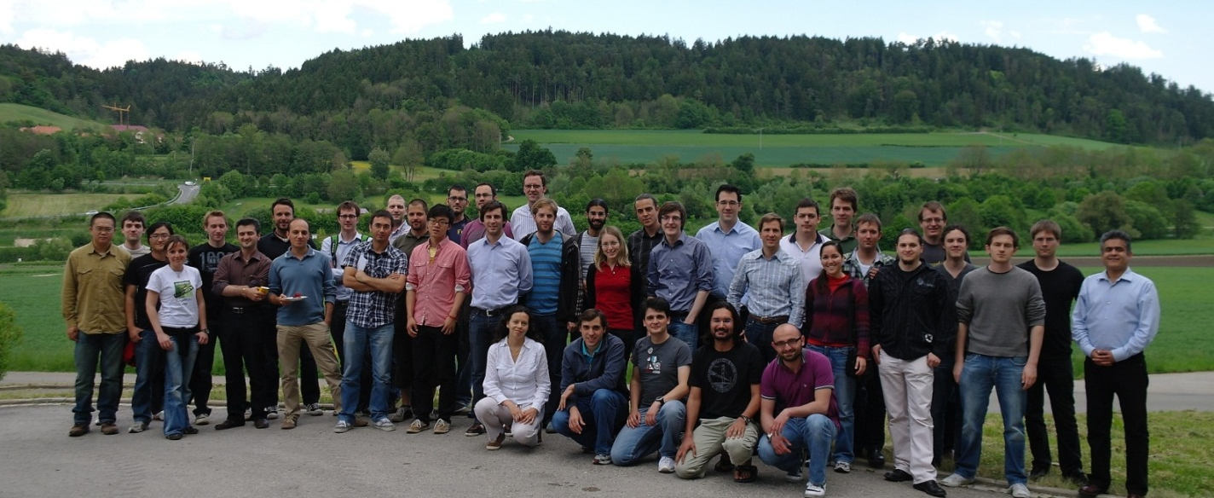
CAMP@TUM
Chair for Computer Aided Medical Procedures
Technical University of Munich, Germany

Slide 4
Course Description
Introduction to Artificial Intelligence (AI) history and applications;
Strong AI and weak AI
Knowledge representation;
Problem solving in artificial intelligence using knowledge representation, searching and reasoning;
Uninformed and heuristic search;
Machine learning;
Laws of Robotics;
CLIPS programming;
Advanced AI Topics. Natural language processing, ANN, Fuzzy logic, clustering

Slide 5
Learning Outcomes
Understand the meaning of AI, its alternative approaches and the implications of AI for cognitive science more broadly.
Expand knowledge about Inform and uniform search heuristic search, genetic algorithm, planning, and learning algorithms.
Understand the basic methods in planning and reasoning using both logic and uncertain inference.
Know a variety of ways to represent and retrieve knowledge and information [Expert systems, Agents].
Know the fundamentals of AI programming techniques and advanced machine learning in a modern programming language.

Slide 6
Required Material
Text Book:
  Artificial Intelligence: A Modern Approach, Stuart Russell and Peter Norvig, Prentice Hall.
  Programming for Artificial Intelligence, CLIPS User Guide
Reference Books:
  Artificial Intelligence: Structures and Strategies for Complex Problem Solving, George F. Luger, Addison Wesley Publisher.

Slide 7
Today’s Lecture
What is intelligence?
What is artificial intelligence?
Modern successes
Sentience AI

Slide 8
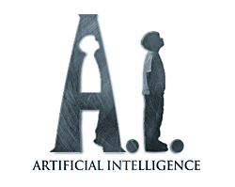
Let’s begin
Introduction Artificial Intelligence?
  AI is one of the newest disciplines
  Formally initiated in 1956
  The study of intelligence is also one of the oldest discipline.
For over 2,000 years philosophers have tried to understand how
    Seeing
    Learning
    Remembering
    And reasoning could or should be done?????

Slide 9

What is Intelligence ?
“ability to learn, understand and think”
(Oxford dictionary)

Slide 10
What is Intelligence???
Intelligence is the ability to learn about, to learn from, to understand about, and interact with one’s environment.
Intelligence is the faculty of understanding
Intelligence is not to make no mistakes but quickly to understand how to make them good
(German Poet)

Slide 11
What is Intelligence???
Capacity to learn from experience
Ability to adapt to different contexts
The use of analyses ability to enhance learning
Capacity of mind, especially to understand principles, truths, facts or meanings, acquire knowledge, and apply it to practice; the ability to learn and comprehend.

Slide 12
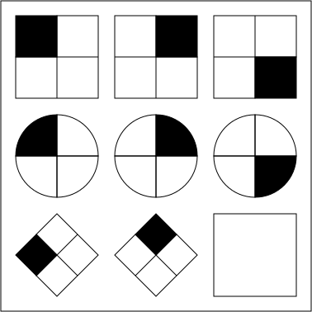
Intelligence quotient
IQ
An intelligence quotient, or IQ, is a score derived from one of several standardized tests designed to assess intelligence.

Slide 13
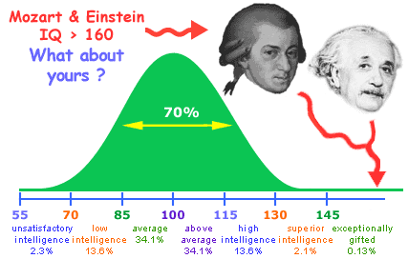

Slide 14
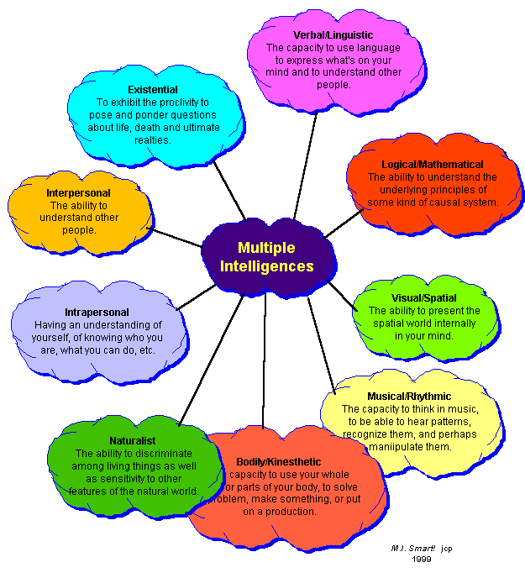

Slide 15
What is artificial intelligence?
There is no agreed definition of the term artificial intelligence. However, there are various definitions that have been proposed. Some will be considered below.

Slide 16

What is artificial intelligence?
American Association for Artificial Intelligence
The scientific understanding of the mechanisms underlying thought and intelligent behavior and their embodiment in machines.

Slide 17
What is artificial intelligence?
It is the science and engineering of making intelligent machines, especially intelligent computer programs.
It is related to the similar task of using computers to understand human intelligence, but AI does not have to confine itself to methods that are biologically observable. (John McCarthy )

Slide 18
What is artificial intelligence? (ctd.)
The use of computers to solve problems that previously could only be solved by applying human intelligence…. thus something can fit this definition today, but, once we see how the program works and understand the problem, we will not think of it as AI anymore (David Parnas)

Slide 19
What is artificial intelligence? (ctd.)
AI is a study in which computer systems are made that think like human beings. Haugeland, 1985 & Bellman, 1978.
AI is a study in which computer systems are made that act like people. AI is the art of creating computers that perform functions that require intelligence when performed by people. Kurzweil, 1990.
AI is the study of how to make computers do things which at the moment people are better at. Rich & Knight, 1991
AI is a study in which computers that rationally think are made. Charniac & McDermott, 1985.
AI is the study of computations that make it possible to perceive, reason and act. Winston, 1992.
AI is the study in which systems that rationally act are made. AI is considered to be a study that seeks to explain and emulate intelligent behaviour in terms of computational processes. Schalkeoff, 1990.
AI is considered to be a branch of computer science that is concerned with the automation of intelligent behavior. Luger & Stubblefield, 1993.

Slide 20
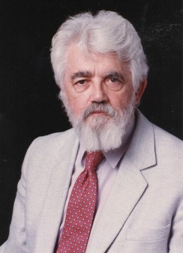
What is Artificial Intelligence?
(John McCarthy, Stanford University)
What is artificial intelligence?
It is the science and engineering of making intelligent machines, especially intelligent computer programs. It is related to the similar task of using computers to understand human intelligence, but AI does not have to confine itself to methods that are biologically observable.
Yes, but what is intelligence?
Intelligence is the computational part of the ability to achieve goals in the world. Varying kinds and degrees of intelligence occur in people, many animals and some machines.
Isn't there a solid definition of intelligence that doesn't depend on relating it to human intelligence?
Not yet. The problem is that we cannot yet characterize in general what kinds of computational procedures we want to call intelligent. We understand some of the mechanisms of intelligence and not others.
More in: http://www-formal.stanford.edu/jmc/whatisai/node1.html

Slide 21
What’s involved in Intelligence?
Ability to interact with the real world
  to perceive, understand, and act
  e.g., speech recognition and understanding and synthesis
  e.g., image understanding
  e.g., ability to take actions, have an effect
Reasoning and Planning
  modeling the external world, given input
  solving new problems, planning, and making decisions
  ability to deal with unexpected problems, uncertainties
Learning and Adaptation
  we are continuously learning and adapting
  our internal models are always being “updated”
    e.g., a baby learning to categorize and recognize animals
Notes:
Synthesis : mixture

Slide 22
Academic Disciplines relevant to AI
Philosophy Logic, methods of reasoning, mind as physical
system, foundations of learning, language,
rationality.
Mathematics Formal representation and proof, algorithms,
computation, (un)decidability, (in)tractability
Probability/Statistics modeling uncertainty, learning from data
Economics utility, decision theory, rational economic agents
Neuroscience neurons as information processing units.
Psychology/ how do people behave, perceive, process cognitive
Cognitive Science information, represent knowledge.
Computer building fast computers
engineering
Control theory design systems that maximize an objective
function over time
Linguistics knowledge representation, grammars

Slide 23
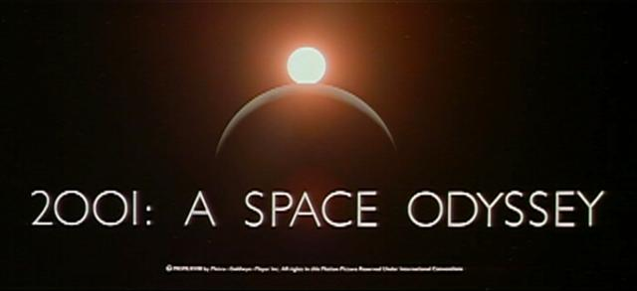
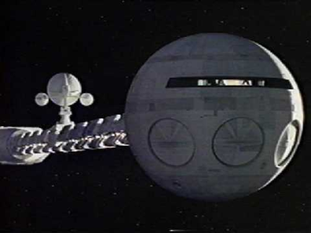
HAL: from the movie 2001
2001: A Space Odyssey
  classic science fiction movie from 1969
HAL
  part of the story centers around an intelligent computer called HAL
  HAL is the “brains” of an intelligent spaceship
  in the movie, HAL can
    speak easily with the crew
    see and understand the emotions of the crew
    navigate the ship automatically
    diagnose on-board problems
    make life-and-death decisions
    display emotions
In 1969 this was science fiction: is it still science fiction?

Slide 24
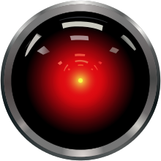
Hal and AI
HAL’s Legacy: 2001’s Computer as Dream and Reality
  MIT Press, 1997, David Stork (ed.)
  discusses
    HAL as an intelligent computer
    are the predictions for HAL realizable with AI today?
Materials online at
  http://mitpress.mit.edu/e-books/Hal/contents.html
The website contains
  full text and abstracts of chapters from the book
  links to related material and AI information
  sound and images from the film

Slide 25
Consider what might be involved in building a computer like Hal….
What are the components that might be useful?
  Fast hardware?
  Chess-playing at grandmaster level?
  Speech interaction?
    speech synthesis
    speech recognition
    speech understanding
  Image recognition and understanding ?
  Learning?
  Planning and decision-making?

Slide 26
Can we build hardware as complex as the brain?
How complicated is our brain?
  a neuron, or nerve cell, is the basic information processing unit
  estimated to be on the order of 10 ¹² neurons in a human brain
  many more synapses (10 ¹⁴) connecting these neurons
  cycle time: 10 ⁻³ seconds (1 millisecond)
How complex can we make computers?
  10⁸ or more transistors per CPU
  supercomputer: hundreds of CPUs, 10¹² bits of RAM
  cycle times: order of 10 ⁻ ⁹ seconds
Conclusion
  YES: in the near future we can have computers with as many basic processing elements as our brain, but with
    far fewer interconnections (wires or synapses) than the brain
    much faster updates than the brain
  but building hardware is very different from making a computer behave like a brain!

Slide 27
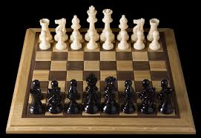
Can Computers beat Humans at Chess?
Chess Playing is a classic AI problem
  well-defined problem
  very complex: difficult for humans to play well
Conclusion:
  YES: today’s computers can beat even the best human
Deep Blue
Human World Champion
Deep Thought
Points Ratings

Slide 28

Can Computers Talk?
This is known as “speech synthesis”
  translate text to phonetic form
    e.g., “fictitious” -> fik-tish-es
  use pronunciation rules to map phonemes to actual sound
    e.g., “tish” -> sequence of basic audio sounds
Difficulties
  sounds made by this “lookup” approach sound unnatural
  sounds are not independent
    e.g., “act” and “action”
    modern systems (e.g., at AT&T) can handle this pretty well
  a harder problem is emphasis, emotion, etc
    humans understand what they are saying
    machines don’t: so they sound unnatural
Conclusion:
  NO, for complete sentences
  YES, for individual words

Slide 29
Can Computers Recognize Speech?
Speech Recognition:
  mapping sounds from a microphone into a list of words
  classic problem in AI, very difficult
    “Lets talk about how to wreck a nice beach”
    (I really said “________________________”)
Recognizing single words from a small vocabulary
    systems can do this with high accuracy (order of 99%)
    e.g., directory inquiries
      limited vocabulary (area codes, city names)
      computer tries to recognize you first, if unsuccessful hands you over to a human operator
      saves millions of dollars a year for the phone companies

Slide 30
Recognizing human speech (ctd.)
Recognizing normal speech is much more difficult
  speech is continuous: where are the boundaries between words?
    e.g., An English professor wrote the words: "A woman without her man is nothing" on the board and asked his students to punctuate it correctly.
    All of the males in the class wrote: "A woman, without her man, is nothing."
    All the females in the class wrote: "A woman: without her, man is nothing."
  large vocabularies
    can be many thousands of possible words
    we can use context to help figure out what someone said
      e.g., hypothesize and test
      try telling a waiter in a restaurant:
      “I would like some dream and sugar in my coffee”
  background noise, other speakers, accents, colds, etc
  on normal speech, modern systems are only about 60-70% accurate
  Conclusion:
  NO, normal speech is too complex to accurately recognize
  YES, for restricted problems (small vocabulary, single speaker)

Slide 31
Can Computers Understand speech?
Understanding is different to recognition:
  “Time flies like an arrow”
    assume the computer can recognize all the words
    how many different interpretations are there?

Slide 32
Can Computers Understand speech?
Understanding is different to recognition:
  “Time flies like an arrow”
    assume the computer can recognize all the words
    how many different interpretations are there?
      1. time passes quickly like an arrow?
      2. “time-flies” are fond of arrows
      …

Slide 33
Can Computers Understand speech?
Understanding is different to recognition:
  “Time flies like an arrow”
    assume the computer can recognize all the words
    how many different interpretations are there?
      1. time passes quickly like an arrow?
      2. command: time the flies the way an arrow times the flies
      3. command: only time those flies which are like an arrow
      4. “time-flies” are fond of arrows
    only 1. makes any sense,
      but how could a computer figure this out?
      clearly humans use a lot of implicit commonsense knowledge in communication
Conclusion: NO, much of what we say is beyond the capabilities of a computer to understand at present

Slide 34
Can Computers Learn and Adapt ?
Learning and Adaptation
  consider a computer learning to drive on the freeway
  we could teach it lots of rules about what to do
  or we could let it drive and steer it back on route when it heads for the edge
    systems like this are under development (e.g., Daimler Benz)
    e.g., RALPH at CMU
      in mid 90’s it drove 98% of the way from Pittsburgh to San Diego without any human assistance
  machine learning allows computers to learn to do things without explicit programming
  many successful applications:
    requires some “set-up”: does not mean your PC can learn to forecast the stock market or become a brain surgeon
Conclusion: YES, computers can learn and adapt, when presented with information in the appropriate way

Slide 35
Can Computers “see”?
Recognition v. Understanding (like Speech)
  Recognition and Understanding of Objects in a scene
    look around this room
    you can effortlessly recognize objects
    human brain can map 2d visual image to 3d “map”
Why is visual recognition a hard problem?
Conclusion:
  mostly NO: computers can only “see” certain types of objects under limited circumstances
  YES for certain constrained problems (e.g., face recognition)

Slide 36
Can computers plan and make optimal decisions?
Intelligence
  involves solving problems and making decisions and plans
  e.g., you want to take a holiday in Brazil
    you need to decide on flights
    you need to get to the airport, etc
    involves a sequence of decisions, plans, and actions
What makes planning hard?
  the world is not predictable:
    your flight is canceled or there’s a backup on the 405
  there are a potentially huge number of details
    do you consider all flights? all dates?
      no: commonsense constrains your solutions
  AI systems are only successful in constrained planning problems
Conclusion: NO, real-world planning and decision-making is still beyond the capabilities of modern computers
  exception: very well-defined, constrained problems

Slide 37
Summary of State of AI Systems in Practice
Speech synthesis, recognition and understanding
  very useful for limited vocabulary applications
  unconstrained speech understanding is still too hard
Computer vision
  works for constrained problems (hand-written zip-codes)
  understanding real-world, natural scenes is still too hard
Learning
  adaptive systems are used in many applications: have their limits
Planning and Reasoning
  only works for constrained problems: e.g., chess
  real-world is too complex for general systems
Overall:
  many components of intelligent systems are “doable”
  there are many interesting research problems remaining

Slide 38
Intelligent Systems in Your Everyday Life
Post Office
  automatic address recognition and sorting of mail
Banks
  automatic check readers, signature verification systems
  automated loan application classification
Customer Service
  automatic voice recognition
The Web
  Identifying your age, gender, location, from your Web surfing
  Automated fraud detection
Digital Cameras
  Automated face detection and focusing
Computer Games
  Intelligent characters/agents

Slide 39
AI Applications: Machine Translation
Language problems in international business
  e.g., at a meeting of Japanese, Korean, Vietnamese and Swedish investors, no common language
  or: you are shipping your software manuals to 127 countries
  solution; hire translators to translate
  would be much cheaper if a machine could do this
How hard is automated translation
  very difficult! e.g., English to Russian
      “The spirit is willing but the flesh is weak” (English)
      “the vodka is good but the meat is rotten” (Russian)
  not only must the words be translated, but their meaning also!
  is this problem “AI-complete”?
Nonetheless....
  commercial systems can do a lot of the work very well (e.g., restricted vocabularies in software documentation)
  algorithms which combine dictionaries, grammar models, etc.
  Recent progress using “black-box” machine learning techniques

Slide 40
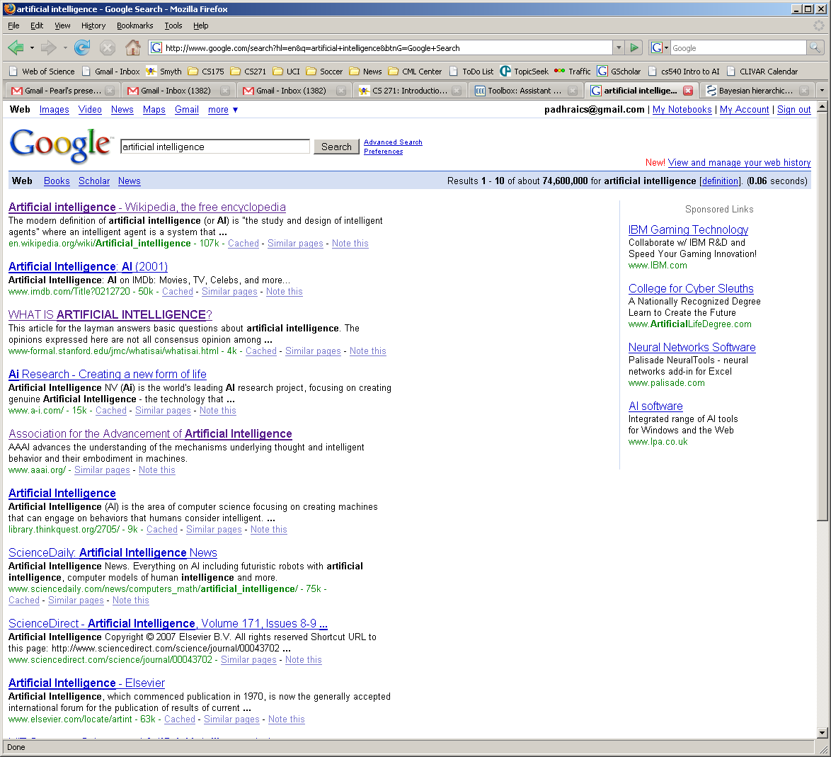
AI and Web Search

Slide 41
Summary of Today’s Lecture
Artificial Intelligence involves the study of:
  automated recognition and understanding of signals
  reasoning, planning, and decision-making
  learning and adaptation
AI has made substantial progress in
  recognition and learning
  some planning and reasoning problems
  …but many open research problems
AI Applications
  improvements in hardware and algorithms => AI applications in industry, finance, medicine, and science.
Reading: chapter 1 in text,

Slide 42
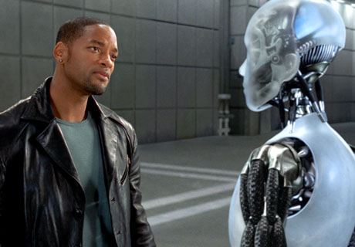
How much is a Machine Intelligent?

Slide 43
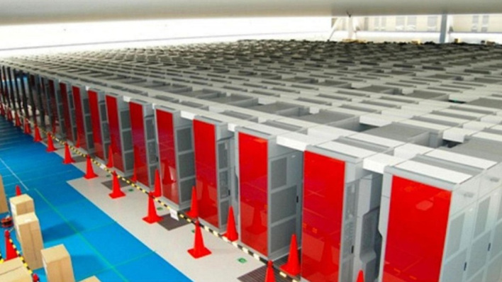
Simulating 1 second of real brain activity takes 40 minutes and 83K processors
Researchers have simulated 1 second of real brain activity, on a network equivalent to 1 percent of an actual brain’s neural network, using the world’s fourth-fastest supercomputer.
The results aren’t revolutionary just yet,
http://gigaom.com/2013/08/02/simulating-1-second-of-real-brain-activity-takes-40-minutes-83k-processors/

Slide 44
successes of AI today

Slide 45
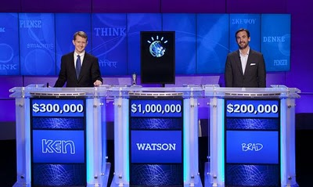
IBM Watson
http://www-03.ibm.com/innovation/us/watson/
NY Times article
Trivia demo
IBM Watson wins on Jeopardy (February 2011)

Slide 46
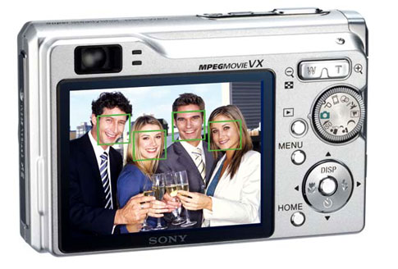
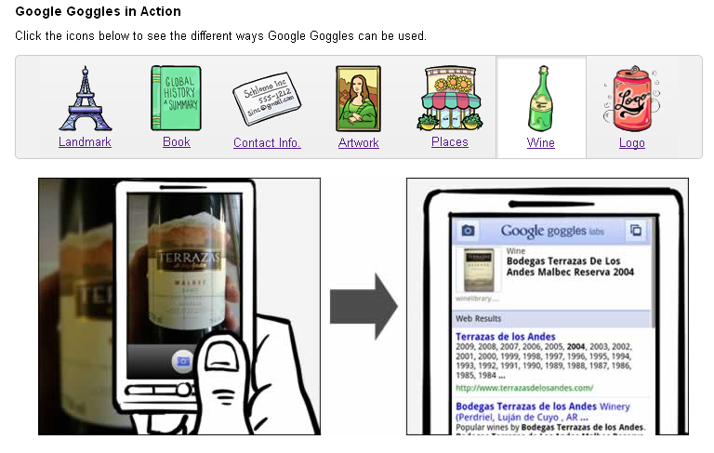
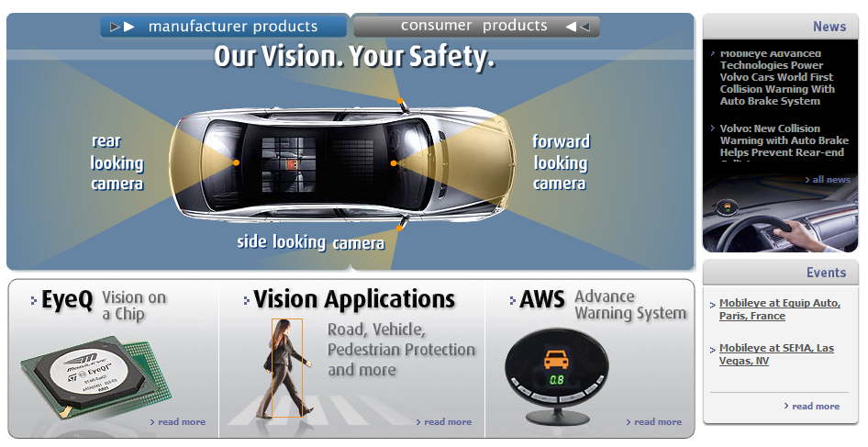

Vision
OCR, handwriting recognition
Face detection/recognition: many consumer cameras, Apple iPhoto
Visual search: Google Goggles
Vehicle safety systems: Mobileye

Slide 47
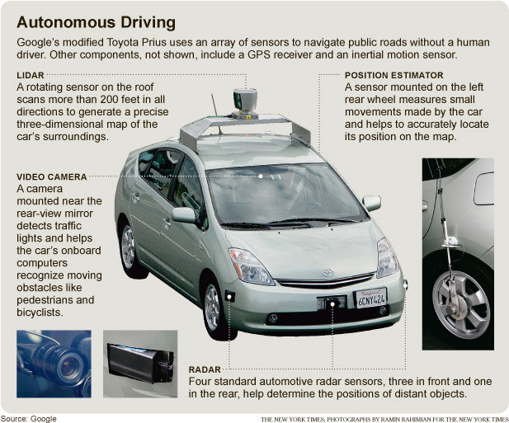
Google self-driving cars
Google’s self-driving car passes 300,000 miles ( 8/15/2012)

Slide 48
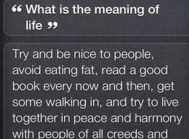
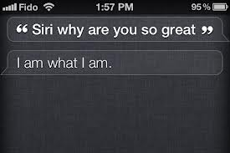
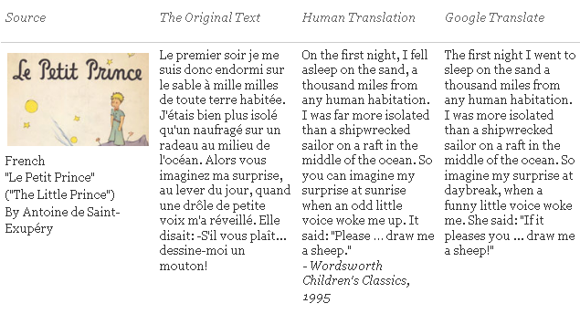
Natural Language
Speech technologies
  Google voice search
  Apple Siri
Machine translation
  translate.google.com
  Comparison of several translation systems

Slide 49
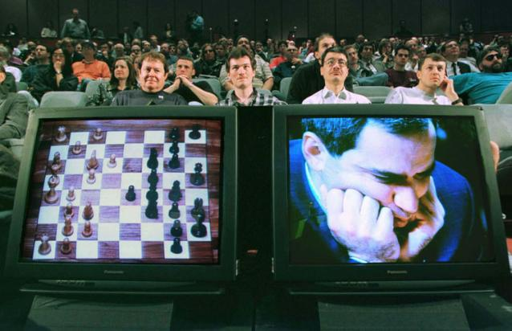
Math, games
In 1996, a computer program written by researchers at Argonne National Laboratory proved a mathematical supposition unsolved for decades
  NY Times story: “[The proof] would have been called creative if a human had thought of it”
IBM’s Deep Blue defeated the reigning world chess champion Garry Kasparov in 1997
  1996: Kasparov Beats Deep Blue
  “I could feel – I could smell – a new kind
  of intelligence across the table.”
  1997: Deep Blue Beats Kasparov
  “Deep Blue hasn't proven anything.”
In 2007, checkers was “solved”
  Science article

Slide 50
Logistics, scheduling, planning
During the 1991 Gulf War, US forces deployed an AI logistics planning and scheduling program that involved up to 50,000 vehicles, cargo, and people
NASA’s Remote Agent software operated the Deep Space 1 spacecraft during two experiments in May 1999
In 2004, NASA introduced the MAPGEN system to plan the daily operations for the Mars Exploration Rovers

Slide 51
Information agents
Search engines
Recommendation systems
Spam filtering
Automated helpdesks
Fraud detection
Automated trading
Medical diagnosis

Slide 52
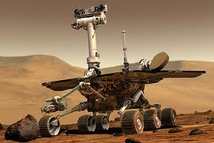
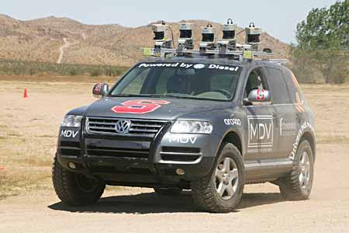

Robotics
Mars rovers
Autonomous vehicles
  DARPA Grand Challenge
  Google self-driving cars
Autonomous helicopters
Robot soccer
  RoboCup
Personal robotics
  Humanoid robots
  Robotic pets
  Personal assistants?

Slide 53
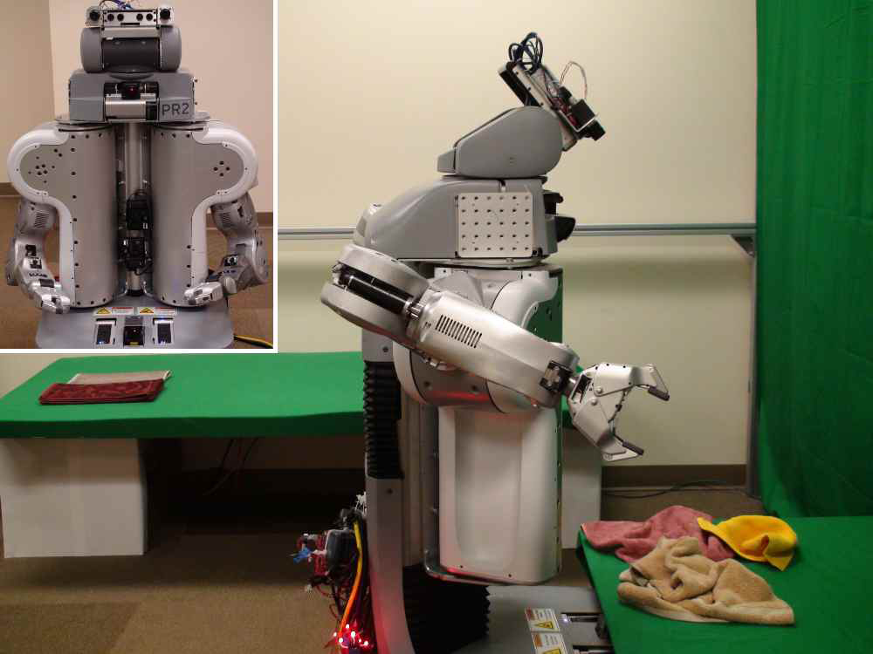
Towel-folding robot
YouTube Video
J. Maitin-Shepard, M. Cusumano-Towner, J. Lei and P. Abbeel, “Cloth Grasp Point Detection based on Multiple-View Geometric Cues with Application to Robotic Towel Folding,” ICRA 2010

Slide 54
Summary of Today’s Lecture
Artificial Intelligence involves the study of:
  automated recognition and understanding of signals
  reasoning, planning, and decision-making
  learning and adaptation
AI has made substantial progress in
  recognition and learning
  some planning and reasoning problems
  …but many open research problems
AI Applications
  improvements in hardware and algorithms => AI applications in industry, finance, medicine, and science.
Reading: chapter 1 in text,

Slide 55
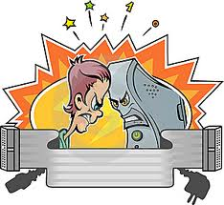
Human Intelligence VS Artificial Intelligence

Slide 56
Human Intelligence VS Artificial Intelligence
Pros
Human Intelligence
Artificial Intelligence
Intuition, Common sense, Judgement, Creativity, Beliefs etc
The ability to demonstrate their intelligence by communicating effectively
Reasoning and Critical thinking
Ability to simulate human behavior and cognitive processes
Capture and preserve human expertise
Fast Response. The ability to comprehend large amounts of data quickly.
Notes:
The important aspects of human intelligence seem to following the use of intuition, common sense, judgment, creativity, goal directedness, plausible reasoning, knowledge and beliefs.
Meaning of intelligence is not human brain’s information processing ability but the ability of humans to demonstrate their intelligence by communicating effectively.

Slide 57
Human Intelligence VS Artificial Intelligence
Cons
Human Intelligence
Artificial Intelligence
  Humans are fallible
  They have limited knowledge bases
  Information processing of serial nature proceed very slowly in the brain as compared to computers
Humans are unable to retain large amounts of data in memory.
No “common sense”
Cannot readily deal with “mixed” knowledge
May have high development costs
Raise legal and ethical concerns

Slide 58
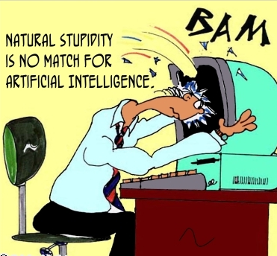
Human Intelligence VS Artificial Intelligence
We achieve more than we know.
We know more than we understand.
We understand more than we can explain
(Claude Bernard, 19th C French scientific philosopher)

Slide 59
Artificial Intelligence VS Conventional Computing
Artificial Intelligence
Conventional Computing
AI software uses the techniques of search and pattern matching
Programmers design AI software to give the computer only the problem, not the steps necessary to solve it
Conventional computer software follow a logical series of steps to reach a conclusion
Computer programmers originally designed software that accomplished tasks by completing algorithms

Slide 60
Artificial intelligence & Our society
Why we need AI??
To supplement natural intelligence for e.g
we are building intelligence in an object so that it can do what we want it to do,
as for example-- robots, thus reducing human labor and reducing human mistakes

Slide 61
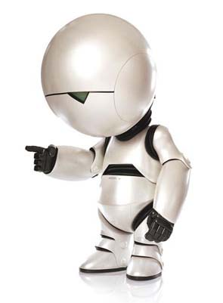
A Perspective
For Humans Intelligence is no more than TAKING a right decision at right time
And
For Machines Artificial Intelligence is no more than CHOOSING a right decision at right time
I think Artificial intelligence is the Second intelligence ever to exist

Slide 62
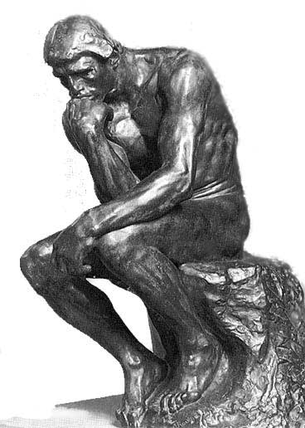
Is AI dangerous?
What is a Sentient AI?
Sentience = self-awareness
Human-level intelligence
Notes:
The Turing Test is a test devised by famed British computer scientist Alan Turing. The test involves a human judge having a conversation with one person and one machine, both of which are trying to appear human. For obvious reasons, the conversation would be text only, via written or typed messages. If the Judge cannot reliably identify the participants, then the machine is said to have passed the Turing Test. Imitation game -> how else to tell if something thinks? Can’t peek inside one’s head…
[sen-shuhns]
[sen-shuhnt]

Slide 63
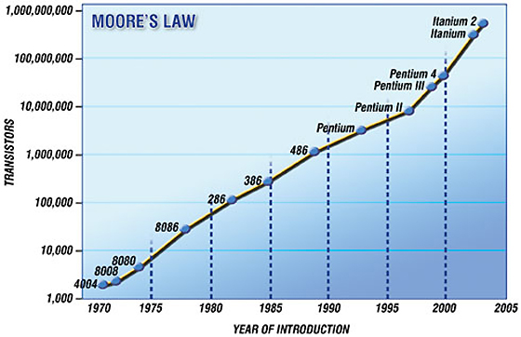
The Plausibility of Sentient AI
Moore’s Law: exponential growth!
Notes:
Moore's Law describes an important trend in the history of computer hardware: that the number of transistors that can be inexpensively placed on an integrated circuit is increasing exponentially, doubling approximately every two years.^{[1]} The observation was first made by Intel co-founder Gordon E. Moore in a 1965 paper.^{[2][3][4]} The trend has continued for more than half a century and is not expected to stop for another decade at least and perhaps much longer. Even if a wall is reached, it is likely that some other way will be found to increase computing power, such as using quantum computers or by replacing wires with laser beams/light.

Slide 64
The Plausibility of Sentient AI
The Blue Brain Project
  It could be possible to model a complete human brain within ten years – on a single machine, no less.
Ray Kurzweil:
  “… we will have both the hardware and the software to achieve human level artificial intelligence with the broad suppleness of human intelligence including our emotional intelligence by 2029”
Notes:
Blue Brain: research project conducted in Switzerland. Model of the brain built from the bottom-up, using a supercomputer to simulate individual neuron interactions. BIOLOGICALLY REALISTIC/ACCURATE
-Have accurately modeled a small slice of a rat’s brain
-Hope to model a complete rat brain within two years, download its brain into a robot rat body to test it – bump into walls = bad.
RAY KURZWEIL:
-Futurist and inventor
-Invented Kurzweil Reading Machine for the blind – scan text and read aloud.

Slide 65
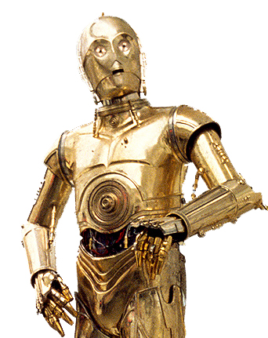
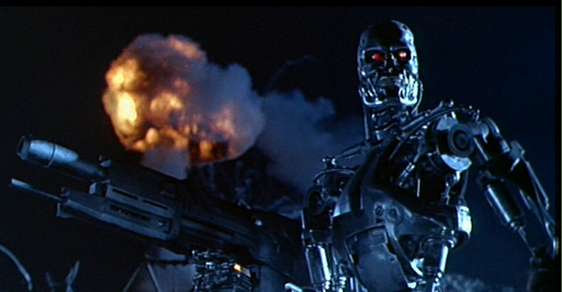
The Controversy
Should humans strive to build sentient AI?
  What are the risks? Benefits?
  Is it ethical or morally responsible?
  What rights should artificial beings have?
  Would there be any place for us?
?
Notes:
change

Slide 66
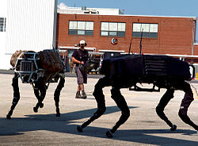
Sentient Artificial Intelligence could be dangerous
I, Robot
Thinking for one’s self
Turn skills against humans
Resent taking care of weaker race
Stephen Hawking:
  “in contrast with our intellect, computers double their performance every 18 months … the danger is real that they could develop intelligence and take over the world”
Natural selection and resources
Big Dog

Slide 67
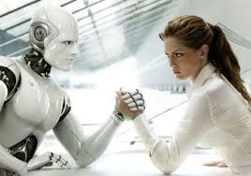
Sentient Artificial Intelligence would take jobs away from humans
Around the neighborhood
  “in the home, by the end of 2003, about 610,000 autonomous vacuum cleaners and lawn-mowers were in operation” (United Nations)
Medicine
  “computers [are] better able to distinguish signs of Alzheimer's than humans, and [prove] cheaper, faster and more accurate than current methods” (Richard Frackowiak, “PC beats doctor in scan tests”)
Car industry
Outsourcing is already a problem

Slide 68

Ethical Dilemma
Robot Rights
  If machines have the potential to exhibit complex behaviors such as altruism, language, and self-reproduction, “questions of ‘machine rights’ and ‘robot liberation’ will surely arise in the future” (Robert A. Freitas)
Society’s views on the rights of sentient AI
Is it right to create life?
  Is sentient Artificial intelligence life?
Notes:
Humans as advanced Machines:
Humans are basically very complex machines, programmed by Biology and experience. Soon, the gap between machine and man will narrow, therefore by creating sentient artificial intelligence we open a flood of moral issues.

Slide 69
Blown out of proportion
Movies such as I, Robot, Terminator, and The Matrix
    Take negative ideas and make them prominent.
    Give society a negative idea of sentience and AI.
    These movies are not an accurate idea of the potential uses of sentience.
Benefits of Sentient AI
    Benefits of AI be more important than the very small possibility of these movies becoming a reality.

Slide 70
Job loss isn’t a bad thing
Take those jobs away!
    Dangerous occupations
    Depths of space
      One-way Missions
    Biological limitations
    Purely repetitive tasks
    Waste disposal
Increase Efficiency

Slide 71
Creation- A bribe!
Still just a robot
Overall benefits to mankind
  Utilitarianism View
Exploration into the unknown

Slide 72
Sentient AI is beneficial
Artificial intelligence is already being used in society
  Social
    Video games – intelligent foes
  Industrial
    Smarter assembly lines
  Mathematical
    Consumer purchasing prediction models

Slide 73
Other benefits of Sentient AI
Nanotechnology
    Smart patches and medical innovations
      Acquire medical information without even going to a doctor
Commercial
    Sentient artificial intelligence won’t fear doing more risky jobs.
      More safe work environment
    Reach areas previously inaccessible by humans, and develop!

Slide 74
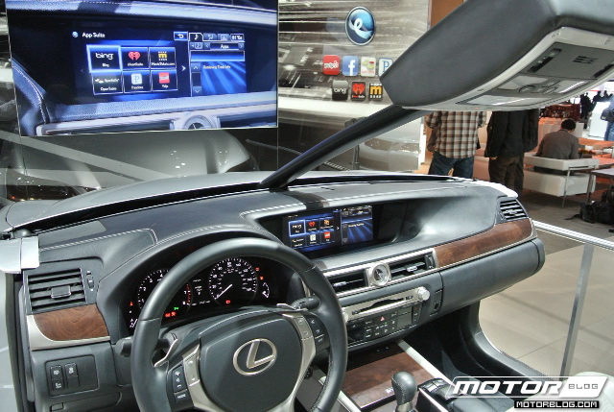
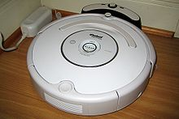
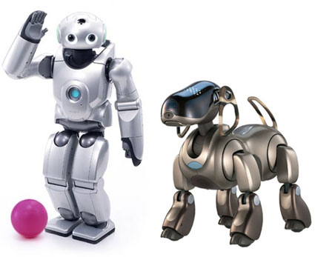
A Life of Luxury
Smart Cars – Lexus
    Park itself!
Roomba!
Think QRIO

Slide 75
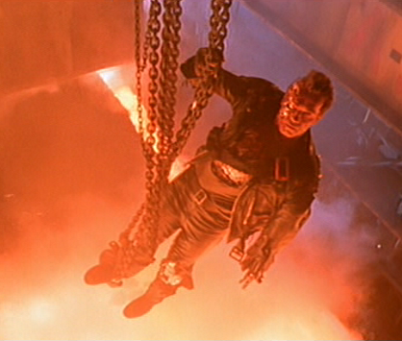
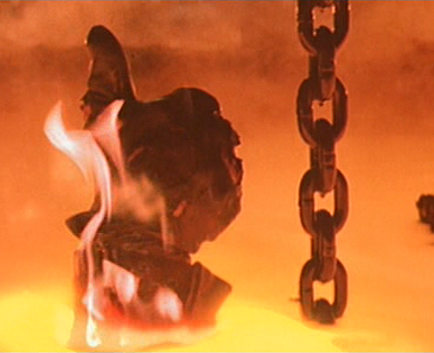
Conclusion / Compromise
Some level of artificial intelligence is capable of benefitting society
AI should be specialized in a specific task so as to not become more like humans
If these requirements are met, AI should be allowed to be developed more

Slide 76
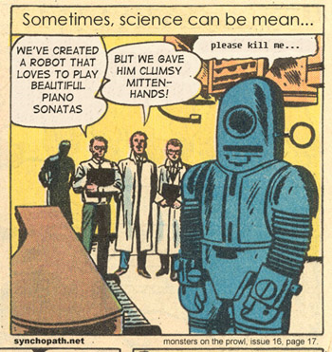
Robots have feelings too

Slide 77
Summary of Today’s Lecture
Artificial Intelligence involves the study of:
  automated recognition and understanding of signals
  reasoning, planning, and decision-making
  learning and adaptation
AI has made substantial progress in
  recognition and learning
  some planning and reasoning problems
  …but many open research problems
AI Applications
  improvements in hardware and algorithms => AI applications in industry, finance, medicine, and science.
Human Intelligence VS Artificial Intelligence
  Artificial Intelligence VS Conventional Computing
Is AI dangerous?
  Sentient AI
Reading: chapter 1 in text,

