Slide 1
Lecture
Interaction Design
Basics– Part II

Slide 2
Today’s Outline
Basic principles
Grouping, structure, order
Alignment
Use of white space

Slide 3
Introduction
In previous sessions we have seen to make system interactive but not about how we put them together.
  A single screen image often has to present information clearly and also act as the locus for interacting with the system.
  This is a complex area, involving some of the psychological understanding of interactivity as well as aspects of graphical design.

Slide 4
Basic principles of design
ask
  what is the user doing?
think
  what information, comparisons, order
design
  form follows function

Slide 5
Tools for layout
We have a number of visual tools available to help us suggest to the user appropriate ways to read and interact with a screen or device.

Slide 6
Available tools
grouping of items
order of items
decoration - fonts, boxes etc.
alignment of items
white space between items

Slide 7
Grouping and structure
If things logically belong together, then we should normally physically group them together. This may involve multiple levels of structure.
  For example, in the Figure in next slide we can see a potential design for an ordering screen. Notice how the details for billing and delivery are grouped together spatially; also note how they are separated from the list of items actually ordered by a line as well as spatially.

Slide 8
Grouping and structure
This reflects the following logical structure:
logically together ⇒ physically together
Billing details:
Name
Address: …
Credit card no
Delivery details:
Name
Address: …
Delivery time
Order details:
item quantity cost/item cost
size 10 screws (boxes) 7 3.71 25.97
…… … … …
Figure: Grouping of related items

Slide 9
Order of groups and items
think! - what is natural order
should match screen order!
  use boxes, space etc.
  set up tabbing right!
instructions
  beware the cake recipie syndrome!
  … mix milk and flour, add the fruit
  after beating them

Slide 10
Decoration
We can see how the design uses boxes and a separating line to make the grouping clear. Other decorative features like font style, and text or background colors can be used to emphasize groupings.

Slide 11
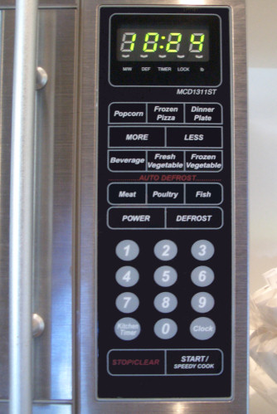
Example – A microwave control panel
Decoration of different buttons in single layout

Slide 12
Decoration
use boxes to group logical items
use fonts for emphasis, headings
but not too many!!
ABCDEFGHIJKLM
NOPQRSTUVWXYZ

Slide 13
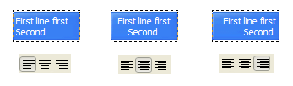
Alignment - text
you read from left to right (English and European)
⇒ align left hand side
boring but
readable!
Willy Wonka and the Chocolate Factory
Winston Churchill - A Biography
Wizard of Oz
Xena - Warrior Princess
Willy Wonka and the Chocolate Factory
Winston Churchill - A Biography
Wizard of Oz
Xena - Warrior Princess
fine for special effects but hard to scan

Slide 14
Alignment - names
Usually scanning for surnames ⇒ make it easy!
✗
✓
Alan Dix
Janet Finlay
Gregory Abowd
Russell Beale
Dix , Alan
Finlay, Janet
Abowd, Gregory
Beale, Russell
✓
Alan Dix
Janet Finlay
Gregory Abowd
Russell Beale

Slide 15
Alignment - numbers
think purpose!
which is biggest?
532.56
179.3
256.317
15
73.948
1035
3.142
497.6256

Slide 16
Alignment - numbers
visually:
long number = big number
align decimal points
or right align integers
627.865
1.005763
382.583
2502.56
432.935
2.0175
652.87
56.34

Slide 17
Multiple columns
scanning across gaps hard:
(often hard to avoid with large data base fields)
sherbert 75
toffee 120
chocolate 35
fruit gums 27
coconut dreams 85

Slide 18
Multiple columns - 2
use leaders
sherbert 75
toffee 120
chocolate 35
fruit gums 27
coconut dreams 85

Slide 19
Multiple columns - 3
or greying (vertical too)
sherbert 75
toffee 120
chocolate 35
fruit gums 27
coconut dreams 85

Slide 20
Multiple columns - 4
or even (with care!) ‘bad’ alignment
sherbert 75
toffee 120
chocolate 35
fruit gums 27
coconut dreams 85

Slide 21

White space - the counter
WHAT YOU SEE

Slide 22
White Space
In typography the space between the letters is called the counter.
In painting this is also important and artists may focus as much on the space between the foreground elements such as figures and buildings as on the elements themselves.

Slide 23
White space - the counter
WHAT YOU SEE
THE GAPS BETWEEN

Slide 24
White Space
Often the shape of the counter is the most important part of the composition of a painting and in calligraphy and typography the balance of a word is determined by giving an even weight to the counters.
  If one ignores the ‘content’ of a screen and instead concentrates on the counter – the space between the elements – one can get an overall feel for the layout.

Slide 25
White Space
If elements that are supposed to be related look separate when you focus on the counter, then something is wrong.
  Screwing up your eyes so that the screen becomes slightly blurred is another good technique for taking your attention away from the content and looking instead at the broad structure.

Slide 26
Space to separate

Slide 27
space to structure

Slide 28
Space to highlight

Slide 29

White Space Animation

Slide 30
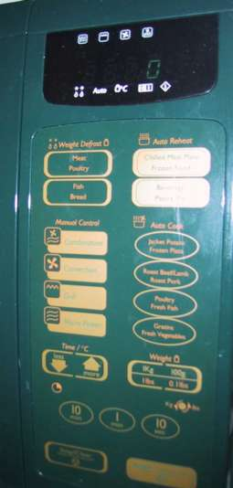
We covered so far: Physical controls
grouping of items
  defrost settings
  type of food
  time to cook
defrost settings
type of food
time to cook

Slide 31
Physical controls
grouping of items
order of items
1) type of heating
1
2) temperature
3) time to cook
2
4) start
3
4

Slide 32
Physical controls
grouping of items
order of items
decoration
different colours for different functions
lines around related
buttons (temp up/down)

Slide 33
Physical controls
grouping of items
order of items
decoration
alignment
  centered text in buttons
  easy to scan ?

Slide 34
physical controls
grouping of items
order of items
decoration
alignment
white space
  (gaps to aid grouping)

Slide 35
User action and control
entering information
knowing what to do
affordances

Slide 36
Entering Information
Some of the most complicated and difficult screen layouts are found in forms-based interfaces and dialog boxes is to design for entering information.
In each case the screen consists not only of information presented to the user, but also of places for the user to enter information or select options.

Slide 37
Entering information
Name:
Alan Dix
forms, dialogue boxes
  presentation + data input
  similar layout issues
  alignment - N.B. different label lengths
logical layout
  use task analysis
  groupings
  natural order for entering information
    top-bottom, left-right (depending on culture)
    set tab order for keyboard entry
Address:
Lancaster
✓
Name:
Alan Dix
Address:
Lancaster
?
Name:
Alan Dix
Address:
Lancaster

Slide 38
Knowing what to do
Some elements of a screen are passive, simply giving you information; others are active, expecting you to fill them in, or do something to them.
It is often not even clear which elements are active, let alone what the effect is likely to be when you interact with them!

Slide 39
Knowing what to do
what is active what is passive
  where do you click
  where do you type
consistent style helps
  e.g. web underlined links
labels and icons
  standards for common actions
  language – bold = current state or action

Slide 40
Affordances
These are especially difficult problems in multimedia applications where one may deliberately adopt a non-standard and avant-garde style.
  How are users supposed to know where to click?
The psychological idea of affordance says that things may suggest by their shape and other attributes what you can do to them.

Slide 41
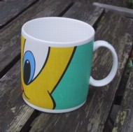
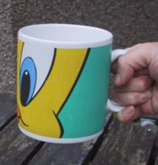
Affordances
psychological term
for physical objects
  shape and size suggest actions
    pick up, twist, throw
  also cultural – buttons ‘afford’ pushing
for screen objects
  button–like object ‘affords’ mouse click
  physical-like objects suggest use
culture of computer use
  icons ‘afford’ clicking
  or even double clicking … not like real buttons!
mug handle
‘affords’
grasping

Slide 42
Appropriate appearance
presenting information
aesthetics and utility
colour and 3D
localisation & internationalisation

Slide 43

Presenting information
purpose matters
  sort order (which column, numeric alphabetic)
  text vs. diagram
  scatter graph vs. histogram
use paper presentation principles!
but add interactivity
  softens design choices
    e.g. re-ordering columns
    ‘dancing histograms’ (chap 21)
name
name
size
size
size
chap1
chap10
chap11
chap12
chap13
chap14
…
chap10
chap5
chap1
chap14
chap20
chap8
…
17
12
51
262
83
22
…
12
16
17
22
27
32
…

Slide 44
Aesthetics and utility
aesthetically pleasing designs
  increase user satisfaction and improve productivity
beauty and utility may conflict
  mixed up visual styles ⇒ easy to distinguish
  clean design – little differentiation ⇒ confusing
  backgrounds behind text
  … good to look at, but hard to read
but can work together
  e.g. the design of the counter
  in consumer products – key differentiator (e.g. iMac)

Slide 45
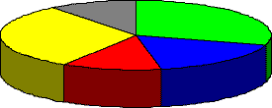
Colour and 3D
both often used very badly!
colour
  older monitors limited palette
  colour over used because ‘it is there’
  beware colour blind!
  use sparingly to reinforce other information
3D effects
  good for physical information and some graphs
  but if over used …
  e.g. text in perspective!! 3D pie charts

Slide 46
Bad use of colour
over use - without very good reason (e.g. kids’ site)
colour blindness
poor use of contrast
do adjust your set!
  adjust your monitor to greys only
  can you still read your screen?

Slide 47
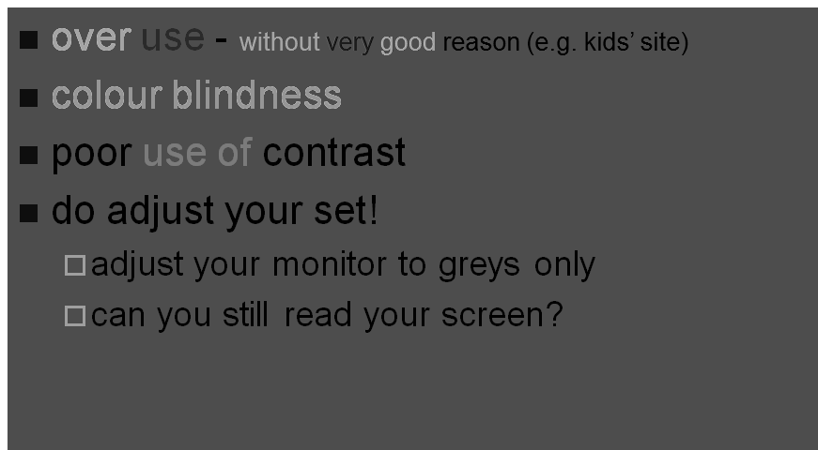
Grey

Slide 48

Cross countries and cultures
localisation & internationalisation
  changing interfaces for particular cultures/languages
globalisation
  try to choose symbols etc. that work everywhere
simply change language?
  use ‘resource’ database instead of literal text
  … but changes sizes, left-right order etc.
deeper issues
  cultural assumptions and values
  meanings of symbols
  e.g tick and cross … +ve and -ve in some cultures
  … but … mean the same thing (mark this) in others

Slide 49
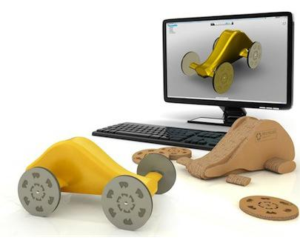
Prototyping
A prototype is an early sample, model, or release of a product built to test a concept or process or to act as a thing to be replicated or learned from. It is a term used in a variety of contexts, including semantics, design, electronics, and software programming. A prototype is designed to test and trial a new design to enhance precision by system analysts and users. Prototyping serves to provide specifications for a real, working system rather than a theoretical one. In some workflow models, creating a prototype (a process sometimes called materialization) is the step between the formalization and the evaluation of an idea.
Notes:
A prototype is an early sample, model, or release of a product built to test a concept or process or to act as a thing to be replicated or learned from. It is a term used in a variety of contexts, including semantics, design, electronics, and software programming. A prototype is designed to test and trial a new design to enhance precision by system analysts and users. Prototyping serves to provide specifications for a real, working system rather than a theoretical one.In some workflow models, creating a prototype (a process sometimes called materialization) is the step between the formalization and the evaluation of an idea.

Slide 50
Iteration and Prototyping
Because human situations are complex and designers are not infallible it is likely that our first design will not be perfect! For this reason, almost all interaction design includes some form of iteration of ideas.
  This often starts early on with paper designs and storyboards being demonstrated to colleagues and potential users.

Slide 51
Iteration and Prototyping
Later in the design process one might use mockups of physical devices or tools such as Shockwave or Visual Basic to create prototype versions of software.

Slide 52
Iteration and prototyping
getting better …
and starting well...

Slide 53
Prototyping
you never get it right first time
if at first you don’t succeed …
OK?
design
prototype
evaluate
done!
re-design

Slide 54
Formative Vs Summative
Any of these prototypes, whether paper-based or running software, can then be evaluated to see whether they are acceptable and where there is room for improvement.
  This sort of evaluation, intended to improve designs, is called formative evaluation.
  This is in contrast to summative evaluation, which is performed at the end to verify whether the product is good enough.

Slide 55


Pitfalls of prototyping
moving little by little … but to where
Malverns or the Matterhorn?
1. need a good start point
2. need to understand what is wrong

Slide 56
Design
A really good designer might guess a good initial design based on experience and judgment. However, the complexity of interaction design problems means that this insight is hard.
Another approach, very common in graphical design, is to have several initial design ideas and drop them one by one as they are developed further.

Slide 57
Summary
We have seen that design in HCI is not just about creating devices or software, but instead is about the whole interaction between people, software and their environment.
Because of this it is good to see the product of design not just as the obvious artifacts but as the whole intervention that changes the existing situation to a new one.

