Slide 1
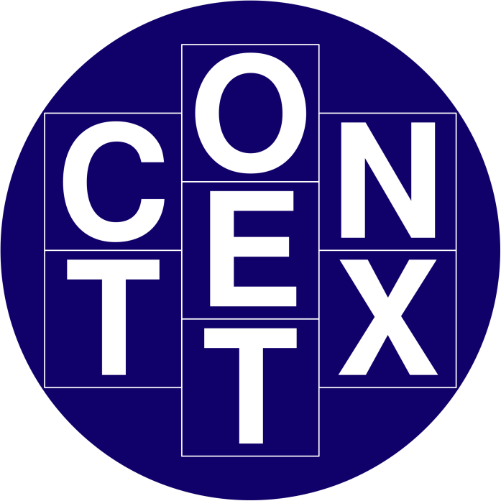
Lecture 6
Context

Slide 2
Today’s Outline
Context
  social,
  organizational,
  Motivational
How to design a good a and value able system
Impacts of context
Also we will cover few case studies

Slide 3
Context
Interaction between the system and the user is effected by the interface design.
  This interaction does not occur within a vacuum. We have already noted some of the physical factors in the environment that can directly affect the quality of the interaction.
  This is part of the context in which the interaction takes place.

Slide 4
Context
In reality, users work within a wider social and organizational context.
This provides the wider context for the interaction, and may influence the activity and motivation of the user.

Slide 5
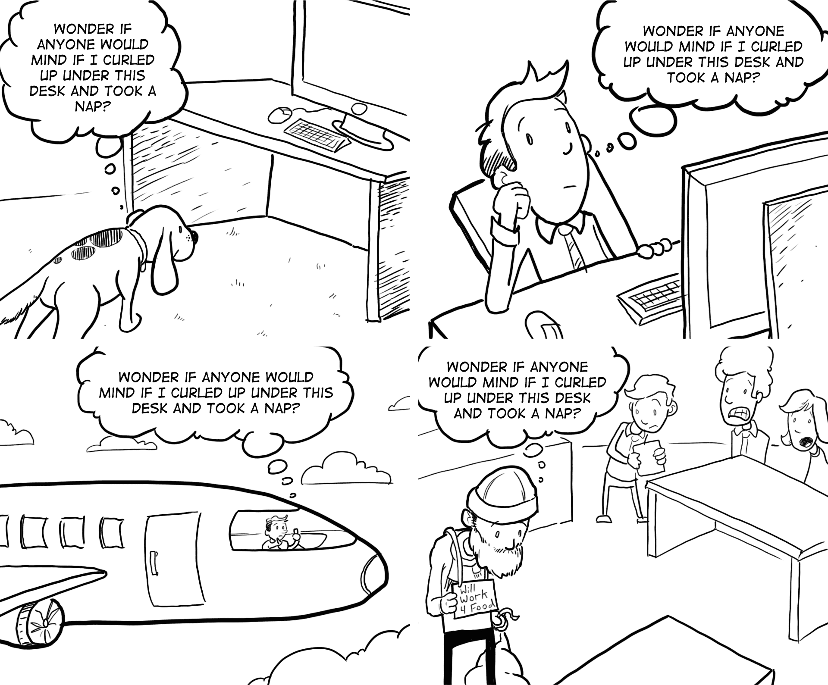
What is Context?

Slide 6
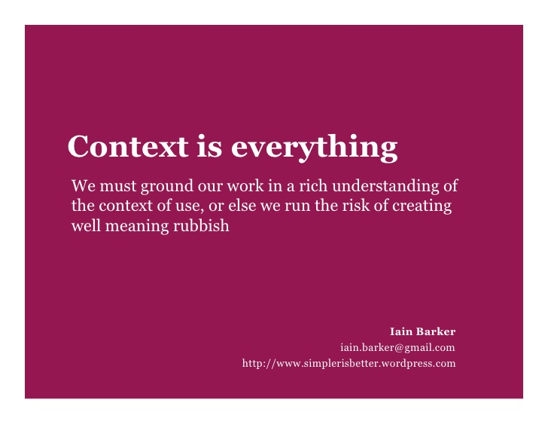
Context is everything

Slide 7
A Case Study
The safe in most banks is operated by at least two keys, held by different employees of the bank. This makes it difficult for a bank robber to obtain both keys, and also protects the bank against light-ﬁngered managers! ATMs contain a lot of cash and so need to be protected by similar measures. In one bank, which shall remain nameless, the ATM had an electronic locking device. The machine could not be opened to replenish or remove cash until a long key sequence had been entered. In order to preserve security, the bank gave half the sequence to one manager and half to another, so both managers had to be present in order to open the ATM. However, these were traditional bank managers who were not used to typing – that was a job for a secretary! So they each gave their part of the key sequence to a secretary to type in when they wanted to gain entry to the ATM. In fact, they both gave their respective parts of the key sequence to the same secretary. Happily the secretary was honest, but the moral is you cannot ignore social expectations and relationships when designing any sort of computer system, however simple it may be.

Slide 8
Unexpected System
The user may also lose motivation if a system is introduced that does not match the actual requirements of the job to be done.
  Often systems are chosen and introduced by managers rather than the users themselves.
In some cases the manager’s perception of the job may be based upon observation of results and not on actual activity.

Slide 9
Importance of Context
If this happens there may be three results: the system will be
  rejected,
  the users will be resentful and unmotivated, or
  the user will adapt the intended interaction to his own requirements.
This indicates the importance of involving actual users in the design process.

Slide 10
Case Study – design focus
When systems are not designed to match the way people actually work, then users end up having to do ‘work around’. Integrated student records systems are becoming popular in universities in the UK. They bring the benefits of integrating examination systems with enrolment and finance systems so all data can be maintained together and cross-checked. All very useful and time saving – in theory. However, one commonly used system only holds a single overall mark per module for each student, whereas many modules on UK courses have multiple elements of assessment. Knowing a student’s mark on each part of the assessment is often useful to academics making decisions in examination boards as it provides a more detailed picture of performance. In many cases staff are therefore supplementing the official records system with their own unofficial spreadsheets to provide this information – making additional work for staff and increased opportunity for error.

Slide 11
Technology to provide Context
The introduction of new technology may prove to be a motivation to users, particularly if it is well designed, integrated with the user’s current work, and challenging.
  Providing adequate feedback is an important source of motivation for users. If no feedback is given during a session, the user may become bored, unmotivated or, worse, unsure of whether the actions performed have been successful.

Slide 12
Context design for the user
In general, an action should have an obvious effect to prevent confusion.
if system delays occur, feedback can be used to prevent frustration on the part of the user
  the user is then aware of what is happening and is not left wondering if the system is still working.

Slide 13
Context in Overview
Interaction affected by social and organizational context
other people
  desire to impress, competition, fear of failure
motivation
  fear, allegiance/loyalty, ambition, self-satisfaction
inadequate systems
  cause frustration and lack of motivation

Slide 14
Context and Computation
Context: What students want to do with computation. An application domain.
  Biology: Invent new medicines.
  Engineering: See and test models before realizing them.
  Media: Manipulate sounds and images to express new thoughts in new ways.

Slide 15
Experience, engagement and fun
Understanding experience
designing experience
physical engagement
managing value

Slide 16
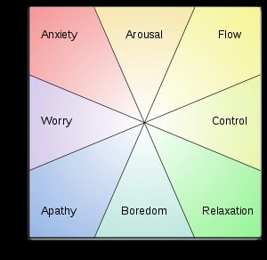
Experience?
home, entertainment, shopping
  not enough that people can use a system
  they must want to use it!
psychology of experience
  flow (Csikszentmihalyi)
  balance between anxiety and boredom
education
  zone of proximal development
  things you can just do with help and without help
wider ...
  literary analysis, film studies, drama
Mental state in terms of challenge level and skill level, according to Csikszentmihalyi's flow model.
Notes:
In his seminal work, Flow: The Psychology of Optimal Experience, Csíkszentmihályi outlines his theory that people are happiest when they are in a state of flow— a state of concentration or complete absorption with the activity at hand and the situation. It is a state in which people are so involved in an activity that nothing else seems to matter.

Slide 17
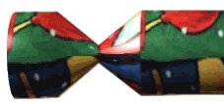

Designing experience
real Christmas crackers
  cheap and cheerful!
  bad joke, plastic toy, paper hat
  pull and bang

Slide 18
Designing experience
virtual crackers
  cheap and cheerful
  bad joke, web toy, cut-out mask
  click and bang

Slide 19


Designing experience
virtual crackers
  cheap and cheerful
  bad joke, web toy, cut-out mask
  click and bang

Slide 20





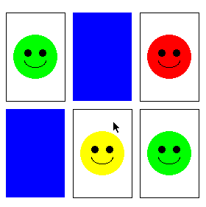
how crackers work
fill in web form
sender
To: wxv
From: ..
receive email
recipient
closed
cracker page
open
message
watches
progress
recipient clicks
cracker opens ...
very slowly
open
cracker page
joke
links
sender
mask
web toy

Slide 21
The crackers experience
real cracker virtual cracker
Surface elements
design cheap and cheerful simple page/graphics
play plastic toy and joke web toy and joke
dressing up paper hat mask to cut out
Experienced effects
shared offered to another sent by email message
co-experience pulled together sender can't see content until opened by recipient
excitement cultural connotations recruited expectation
hiddenness contents inside first page - no contents
suspense pulling cracker slow ... page change
surprise bang (when it works) WAV file (when it works)

Slide 22
Physical design
many constraints:
  ergonomic – minimum button size
  physical – high-voltage switches are big
  legal and safety – high cooker controls
  context and environment – easy to clean
  aesthetic – must look good
  economic – … and not cost too much!

Slide 23
Design trade-offs
constraints are contradictory … need trade-offs
within categories:
  e.g. safety – cooker controls
    front panel – safer for adult
    rear panel – safer for child
between categories
  e.g. ergonomics vs. physical – MiniDisc remote
    ergonomics – controls need to be bigger
    physical – no room!
    solution – multifunction controls & reduced functionality

Slide 24
Fluidity
do external physical aspects reflect logical effect?
  related to affordance (chap 5)
  logical state revealed in physical state?
      e.g. on/off buttons
  inverse actions inverse effects?
      e.g. arrow buttons, twist controls

Slide 25
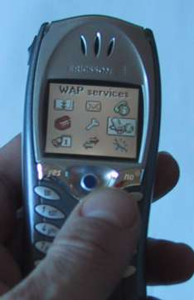
inverse actions
yes/no buttons
  well sort of
‘joystick’
also left side control

Slide 26
spring back controls
one-shot buttons
joystick
some sliders
good – large selection sets
bad – hidden state

Slide 27
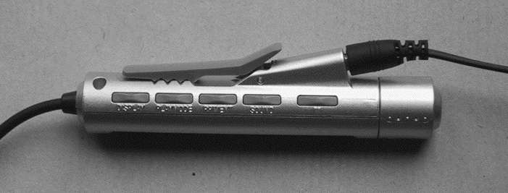
a minidisk controller
twist for track movement
pull and twist for volume
– spring back
– natural inverse for twist
series of spring-back controls
each cycle through some options
–natural inverse back/forward

Slide 28
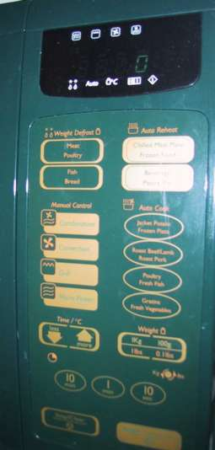
physical layout
controls:
logical relationship
~ spatial grouping

Slide 29
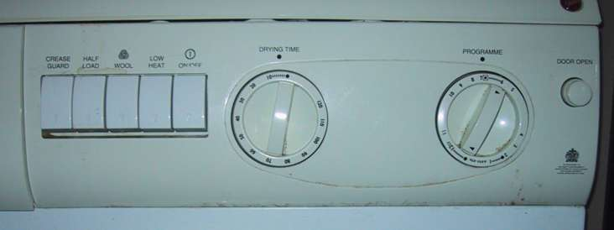
compliant interaction
state evident in
mechanical buttons
rotary knobs reveal internal state and can be controlled by both user and machine

Slide 30
Managing Values
If we want people to want to use a device or application we need to understand their personal values.
  Why should they want to use it?
  What value do they get from using it?
Now when we say value here we don’t mean monetary value, although that may be part of the story, but all the things that drive a person.

Slide 31
Managing Values
For some people this may include being nice to colleagues, being ecologically friendly, being successful in their career. Whatever their personal values are, if we ask someone to do something or use something they are only likely to do it if the value to them exceeds the cost.

Slide 32
Managing Values
In economics, businesses use a measure called ‘net present value’ to calculate what a future gain is worth today;
  money can be invested, £100 today is worth the same as perhaps £200 in five years’ time.
For human decision making, future gains are typically discounted very highly;
  many of us are bad at saving for tomorrow or even keeping the best bits of our dinner until last.

Slide 33
Managing Values
This means that not only must we understand people’s value systems, but we must be able to offer

Slide 34
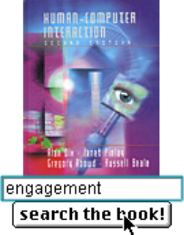
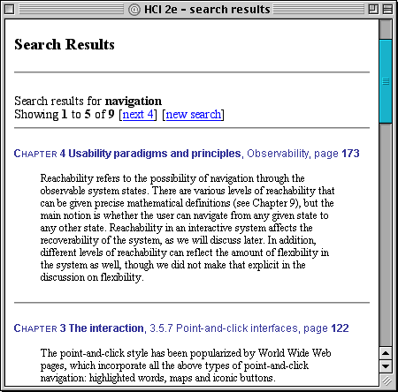
example – HCI book search
value for people who have the book
helps you to look up things
      chapter and page number
value for those who don’t …
sort of online mini-encyclopaedia
      full paragraph of context
… but also says “buy me”!!
… but also says “buy me”!!

Slide 35
Value and organisational design
coercion
    tell people what to do!
    value = keep your job
enculturation
    explain corporate values
    establish support (e.g share options)
emergence
    design process so that
    individuals value → organisational value

Slide 36
In Context Summary
if you want someone to do something …
make it easy for them!
understand their values

Slide 37
Summary of Interaction
We have learnt
  Interaction models
    translations between user and system
  ergonomics
    physical characteristics of interaction
  interaction styles
    the nature of user/system dialog
  context
    social, organizational, motivational

