Slide 1
Lecture 5
THE INTERACTION
Prof. Dr. Sajjad Mohsin

Slide 2
Today’s Outline
We will cover today,
  Interaction models
    translations between user and system
  ergonomics
    physical characteristics of interaction

Slide 3

What is interaction?
communication
user  system
but is that all … ?
Notes:
2 participants user and the system

Slide 4
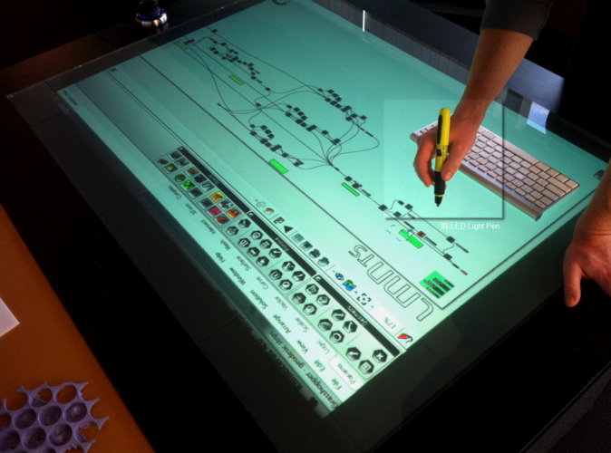
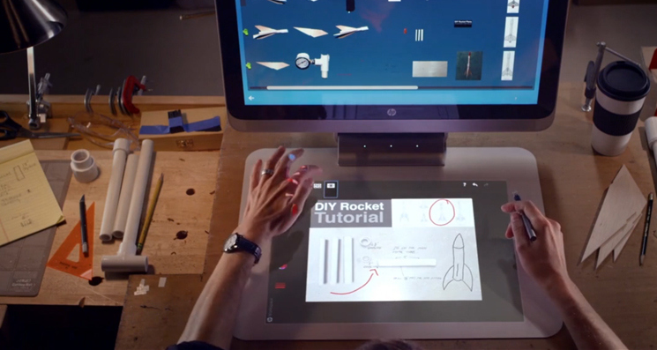
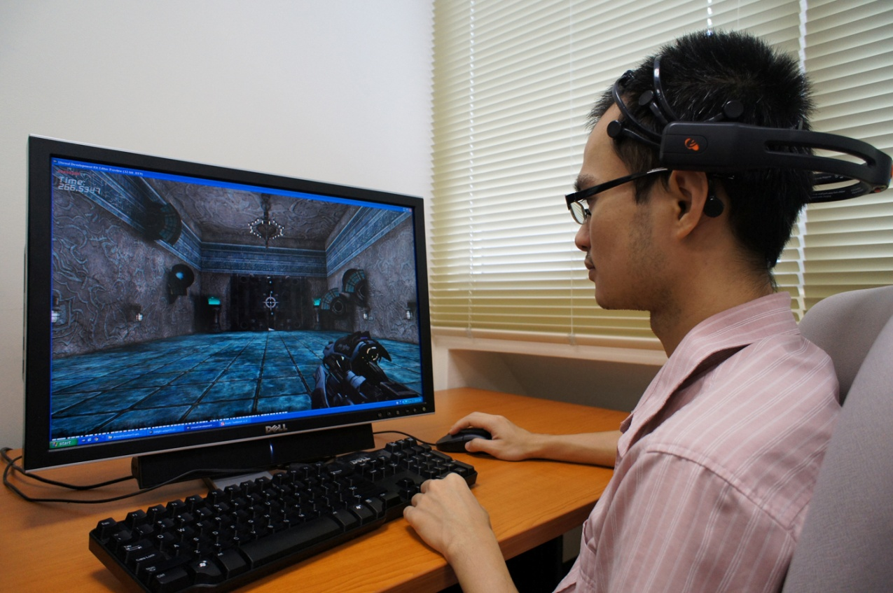
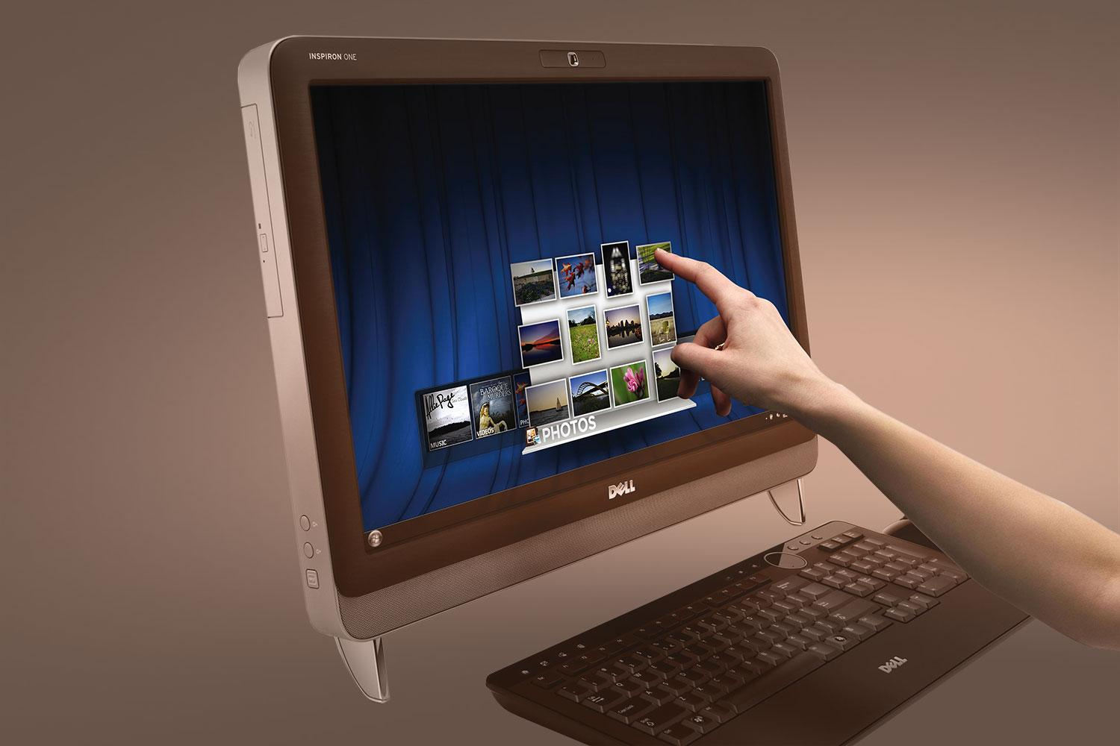
Different types of interaction

Slide 5
Models of interaction
Terms of interaction
Norman model
Interaction framework

Slide 6
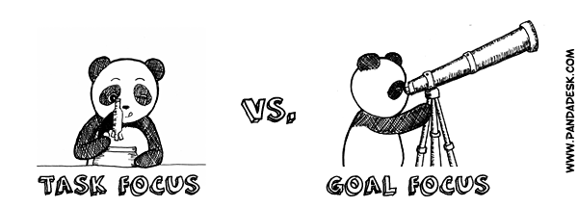
Terms of interaction
Traditionally, the purpose of an interactive system is to aid a user in accomplishing goals from some application domain.
Tasks are operations to manipulate the concept of domain.
Notes:
A domain
defines an area of expertise and knowledge in some real-world activity
Some examples of domains are graphic design, authoring and process control in a factory.

Slide 7
Some terms of interaction
Domain – the area of work under study
  e.g. graphic design
Goal – what you want to achieve
  e.g. create a solid red triangle
Task – how you go about doing it
– ultimately in terms of operations or actions
  e.g. … select fill tool, click over triangle
Note …
  traditional interaction …
  use of terms differs a lot especially task/goal !!!

Slide 8
Domain or Problem Domain
A problem domain is the area of expertise or application that needs to be examined to solve a problem.
A problem domain is simply looking at only the topics of an individual's interest, and excluding everything else.
  For example, when developing a system to measure good practice in medicine, carpet drawings at hospitals would not be included in the problem domain. In this example the domain refers to relevant topics solely within the delimited area of interest: medicine.

Slide 9
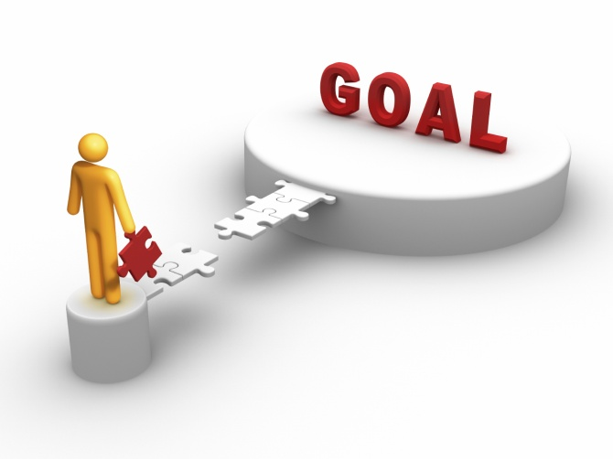
Goal
A goal is a desired result a person or a system envisions, plans and commits to achieve a personal or organizational desired end-point in some sort of assumed development.
Many people endeavor to reach goals within a finite time by setting
deadlines.

Slide 10
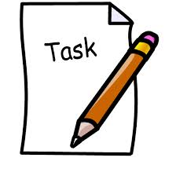
Task
A task is an activity that needs to be accomplished within a defined period of time or by a deadline to work towards work-related goals.
A task can be broken down into assignments which should also have a defined start and end date or a deadline for completion.

Slide 11
Donald Norman’s model
Seven stages
  user establishes the goal
  formulates intention
  specifies actions at interface
  executes action
  perceives system state
  interprets system state
  evaluates system state with respect to goal
Norman’s model concentrates on user’s view of the interface

Slide 12

execution/evaluation loop
    user establishes the goal
    formulates intention
    specifies actions at interface
    executes action
    perceives system state
    interprets system state
    evaluates system state with respect to goal
goal
execution
evaluation
system

Slide 13
execution/evaluation loop
    user establishes the goal
    formulates intention
    specifies actions at interface
    executes action
    perceives system state
    interprets system state
    evaluates system state with respect to goal
goal
execution
evaluation
system

Slide 14
execution/evaluation loop
    user establishes the goal
    formulates intention
    specifies actions at interface
    executes action
    perceives system state
    interprets system state
    evaluates system state with respect to goal
goal
execution
evaluation
system

Slide 15
execution/evaluation loop
    user establishes the goal
    formulates intention
    specifies actions at interface
    executes action
    perceives system state
    interprets system state
    evaluates system state with respect to goal
goal
execution
evaluation
system

Slide 16
Using Norman’s model
Some systems are harder to use than others
Gulf of Execution
  user’s formulation of actions
  ≠ actions allowed by the system
Gulf of Evaluation
  user’s expectation of changed system state
  ≠ actual presentation of this state
Notes:
"The basic idea is simple. To get something done, you have to start with some notion of what is wanted—the goal that is to be achieved. Then, you have to do something to the world, that is, take action to move yourself or manipulate someone or something. Finally, you check to see that your goal was made. So there are four different things to consider: the goal, what is done to the world, the world itself, and the check of the world. The action itself has two major aspects: doing something and checking. Call these execution and evaluation." [Norman, p. 46.]

Slide 17
Human error - slips and mistakes
slip
  understand system and goal
  correct formulation of action
  incorrect action
mistake
  may not even have right goal!
Fixing things?
slip – better interface design
mistake – better understanding of system

Slide 18
Abowd and Beale framework
extension of Norman…
their interaction framework has 4 parts
  user
  input
  system
  output
each has its own unique language
interaction ⇒ translation between languages
problems in interaction = problems in translation
O
output
S
core
U
task
I
input

Slide 19
Using Abowd & Beale’s model
user intentions
→ translated into actions at the interface
→ translated into alterations of system state
→ reflected in the output display
→ interpreted by the user
general framework for understanding interaction
  not restricted to electronic computer systems
  identifies all major components involved in interaction
  allows comparative assessment of systems
  an abstraction

Slide 20
Ergonomics
physical aspects of interfaces
industrial interfaces

Slide 21
What is Ergonomics?
“The scientific discipline concerned with understanding of interactions among humans and other elements of a system, and the profession that applies theory, principles, methods and data to design in order to optimize human well-being and overall system performance”.
Ergonomics means
“fitting the job to the worker”
From the Greek
Ergo = Work
Nomos = Laws
Source : International Ergonomics Association (IEA) in 2000

Slide 22
What are Work Related Musculo-Skeletal Disorders (WMSDs)?
WMSDs are also known as:
  Cumulative Trauma Disorders (CTDs)
  Repetitive Strain Injuries (RSIs)
  Overuse injuries
They are soft tissue injuries which occur gradually
Notes:
These injuries are called work-related musculoskeletal injuries, or WMSDs. You may have heard of these injuries by another name, such as MSD’s which are the same as WMSD’s, but they don’t happen as a result of work related issues, cumulative trauma disorder, or CTD; repetitive strain injury, or RSI; or overuse injuries. WMSDs affect the soft tissues of the body - the muscles, tendons that connect muscles to bones, ligaments that connect bone to bone, nerves, blood vessels, pretty much every part of your body that’s not a bone or internal organ.
These are the parts of your body that are prone to injury when demands on them go beyond what they can handle. Typically these injuries occur in your body’s joints, the moving parts of the body like your low back, wrist, shoulder, elbow and knee. These are the parts of your body that get used the most and that are placed under the most stress during the day.
Often these injuries start out small, as a little muscle pull or a slightly irritated tendon. However, if a small injury isn’t given a chance to heal, it can become aggravated, especially if you keep doing the activity that caused the injury in the first place. Over time, these small injuries can build until they become chronic, and at this point they become a WMSD.
Refer to the NIOSH definition of MSD and WMSD:
MSDs refer to the disorders of the muscles, nerves, tendons, ligaments, joints cartilage, or spinal disks. These disorders are not result of any instantaneous event such as slip or fall but reflect a more gradual or chronic development. These are disorders that diagnosed by a medical history, physical examination, or other medical tests and they can range in severity from mild and intermittent to debilitating and chronic. These are disorders with several distinct features (such as carpal tunnel syndrome) or disorders defined primarily by the location of the pain (such as low back pain).
b) WMSDs refer to MSDs to which the work environment and the performance of work contribute significantly or MSDs that are made worse of longer lasting by work conditions.

Slide 23
What are some of the symptoms of WMSDs?
Discomfort
Pain
Numbness
Tingling
Inflammation
Burning
Swelling
Change in color
Tightness, loss of flexibility
Notes:
WMSDs have many different symptoms, many of which you may have experienced at one time or another. These include discomfort, pain, numbness, tingling or burning sensations, swelling and inflammation, changes in skin color, and tight muscles or loss of flexibility in a joint. Having one or more of these symptoms doesn’t necessarily mean you have an injury, though.
Everyone has had muscle aches or stiffness after working or exercising hard, especially when you’re not used to it. Usually these symptoms go away as you rest or as you get used to the work. That’s different from symptoms of injury, which last longer or include things like numbness and tingling that mean something more serious might be going on. Sometimes these symptoms might make it difficult to do your job or things around the house, or they might wake you up at night and keep you from getting a good night’s sleep. The important thing is not to ignore what your body is trying to tell you. Often simple changes to the way you work are all that are necessary to prevent these symptoms from becoming a WMSD.

Slide 24
What causes WMSDs?
  Heavy, Frequent, or Awkward Lifting
  Pushing, Pulling or Carrying Loads
  Working in Awkward Postures
  Hand Intensive Work
  Vibration
  Contact Stress
Notes:
There are many things that everyone does on the job and at home that could contribute to a WMSD if they are done for long enough periods of time. These activities are called risk factors. Risk factors include heavy, frequent or awkward lifting, pushing, pulling or carrying, working in awkward postures, and hand intensive work that requires the use of high hand forces and repetitive motions. Also, vibration, both hand and whole body and contact stress (direct or continuous contact with hard or sharp objects or surfaces such as non-rounded desk edges or unpadded tool handles or other work objects that create pressure over an area of the body) can cause WMSD’s.

Slide 25
Risk Factors
Risk of injury depends upon:
  Duration of exposure
  Frequency of exposure
  Intensity of exposure
  Combinations of risk factors
(how
long)
often
(how
often)
often
MUCH)
(how
+++
Notes:
Just because your job has risk factors, doesn’t mean that you’re going to have a WMSD, though. In fact, a little bit of exposure to some risk factors can actually be good for you. Occasionally moving into awkward postures like reaching or bending will help to stretch and exercise your muscles.
Also, if you occasionally do some lifting, especially if you do it properly, it can help to strengthen your muscles. This is the whole point behind exercising.
Whether or not a risk factor will result in a WMSD depends on the duration, or how long you are exposed to it; the frequency, or how often you are exposed to it and how much rest you get in between; and the intensity, or how much of the risk factor there is (for example, how heavy is the object you lift, or how far over you have to bend to pick it up), and combinations of risk factors, where you are exposed to more than one risk factor at a time. The more risk factors you have at once, the more likely an injury will occur.
Next, we’ll take a look at each risk factor a little more closely.

Slide 26
Ergonomics – examples
arrangement of controls and displays
  e.g. controls grouped according to function or frequency of use, or sequentially
surrounding environment
  e.g. seating arrangements adaptable to cope with all sizes of user
health issues
  e.g. physical position, environmental conditions (temperature, humidity), lighting, noise,
use of colour
  e.g. use of red for warning, green for okay,
  awareness of colour-blindness etc.

Slide 27
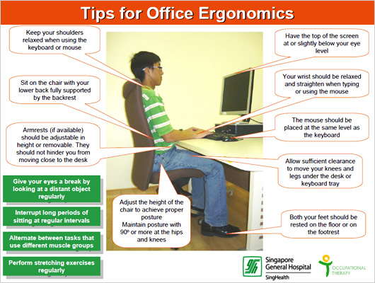

Slide 28

VIDEO on Ergonomics

Slide 29
Industrial interfaces
Office interface vs. industrial interface?
Context matters!
office industrial
type of data textual numeric
rate of change slow fast
environment clean dirty
… the oil soaked mouse!

Slide 30
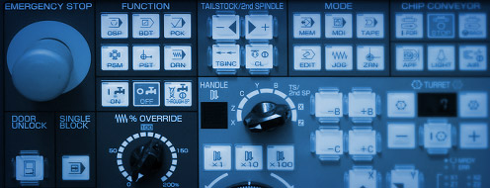
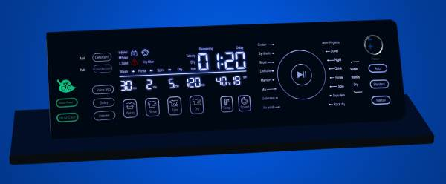
Glass interfaces ?
industrial interface:
  traditional … dials and knobs
  now … screens and keypads
glass interface
  cheaper, more flexible,
  multiple representations,
  precise values
  not physically located,
  loss of context,
  complex interfaces
may need both
Vessel B Temp
0
100
200
113
multiple representations
of same information

Slide 31
Indirect manipulation
office– direct manipulation
  user interacts
  with artificial world
system
industrial – indirect manipulation
  user interacts
  with real world
  through interface
issues ..
  feedback
  delays
interface
plant
immediate
feedback
instruments

Slide 32
Interaction styles
dialogue … computer and user
distinct styles of interaction

Slide 33
Common interaction styles
command line interface
menus
natural language
question/answer and query dialogue
form-fills and spreadsheets
WIMP
point and click
three–dimensional interfaces

Slide 34
Command line interface
Way of expressing instructions to the computer directly
  function keys, single characters, short abbreviations, whole words, or a combination
suitable for repetitive tasks
better for expert users than novices
offers direct access to system functionality
command names/abbreviations should be meaningful!
Typical example: the Unix system

Slide 35
Menus
Set of options displayed on the screen
Options visible
  less recall - easier to use
  rely on recognition so names should be meaningful
Selection by:
  numbers, letters, arrow keys, mouse
  combination (e.g. mouse plus accelerators)
Often options hierarchically grouped
  sensible grouping is needed
Restricted form of full WIMP system

Slide 36
Natural language
Familiar to user
speech recognition or typed natural language
Problems
  vague
  ambiguous
  hard to do well!
Solutions
  try to understand a subset
  pick on key words

Slide 37
Query interfaces
Question/answer interfaces
  user led through interaction via series of questions
  suitable for novice users but restricted functionality
  often used in information systems
Query languages (e.g. SQL)
  used to retrieve information from database
  requires understanding of database structure and language syntax, hence requires some expertise

Slide 38
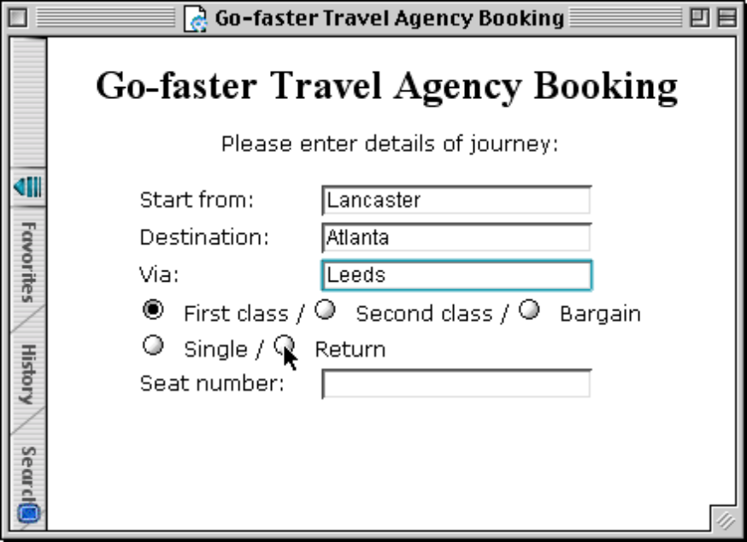
Form-fills
Primarily for data entry or data retrieval
Screen like paper form.
Data put in relevant place
Requires
  good design
  obvious correction
  facilities

Slide 39
Spreadsheets
first spreadsheet VISICALC, followed by Lotus 1-2-3
MS Excel most common today
sophisticated variation of form-filling.
  grid of cells contain a value or a formula
  formula can involve values of other cells
  e.g. sum of all cells in this column
  user can enter and alter data spreadsheet maintains consistency

Slide 40
WIMP Interface
Windows
Icons
Menus
Pointers
… or windows, icons, mice, and pull-down menus!
default style for majority of interactive computer systems, especially PCs and desktop machines

Slide 41
Point and click interfaces
used in ..
  multimedia
  web browsers
  hypertext
just click something!
  icons, text links or location on map
minimal typing

Slide 42
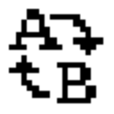

Three dimensional interfaces
virtual reality
‘ordinary’ window systems
  highlighting
  visual affordance
  indiscriminate use
  just confusing!
3D workspaces
  use for extra virtual space
  light and occlusion give depth
  distance effects
flat buttons …
click me!
… or sculptured

Slide 43
Elements of the wimp interface
windows, icons, menus, pointers
+++
buttons, toolbars,
palettes, dialog boxes

Slide 44
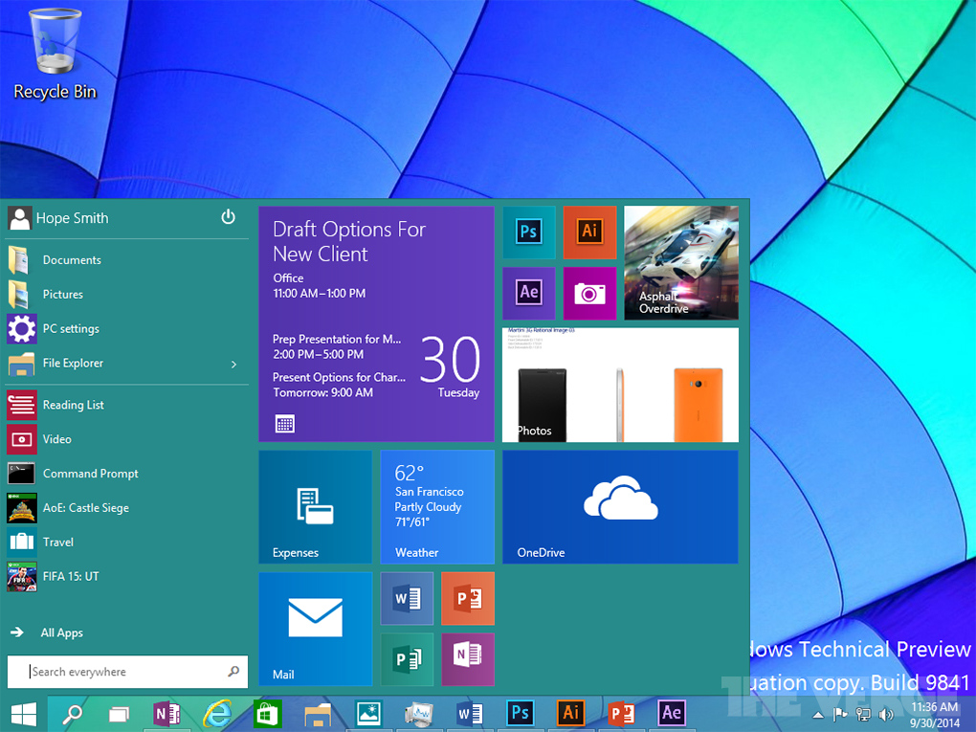
Windows
Areas of the screen that behave as if they were independent
  can contain text or graphics
  can be moved or resized
  can overlap and obscure each other, or can be laid out next to one another (tiled)

Slide 45
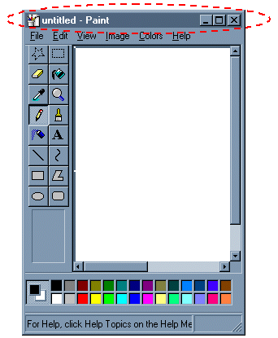
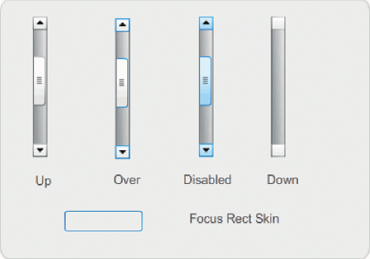
Windows
scrollbars
  allow the user to move the contents of the window up and down or from side to side
title bars
  describe the name of the window

Slide 46
Icons
small picture or image
represents some object in the interface
  often a window or action
windows can be closed down (iconised)
  small representation for many accessible windows
icons can be many and various
  highly stylized
  realistic representations.

Slide 47
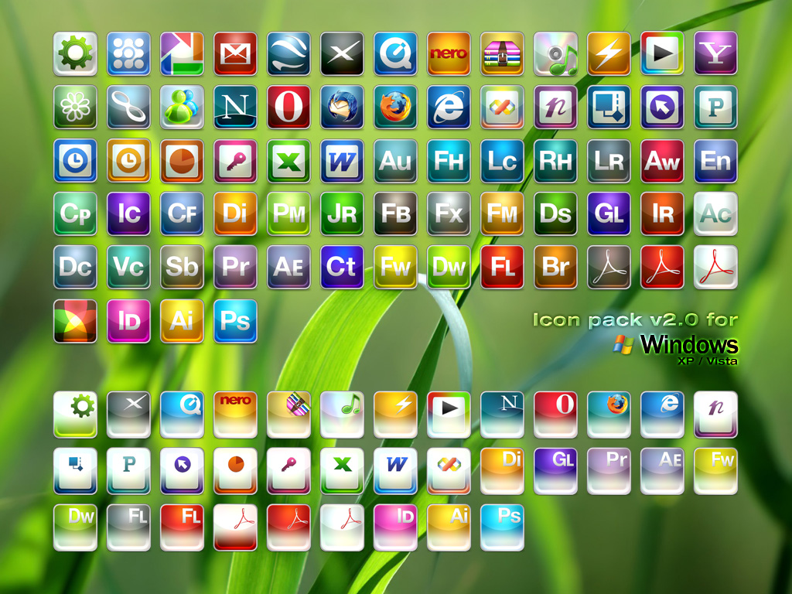
icons

Slide 48
Pointers
important component
  WIMP style relies on pointing and selecting things
uses mouse, trackpad, joystick, trackball, cursor keys or keyboard shortcuts
wide variety of graphical images

Slide 49
Menus
Choice of operations or services offered on the screen
Required option selected with pointer
problem – take a lot of screen space
solution – pop-up: menu appears when needed

Slide 50
Kinds of Menus
Menu Bar at top of screen (normally), menu drags down
  pull-down menu - mouse hold and drag down menu
  drop-down menu - mouse click reveals menu
  fall-down menus - mouse just moves over bar!
Contextual menu appears where you are
  pop-up menus - actions for selected object
  pie menus - arranged in a circle
    easier to select item (larger target area)
    quicker (same distance to any option)
    … but not widely used!

Slide 51
Menus extras
Cascading menus
  hierarchical menu structure
  menu selection opens new menu
  infinitum
Keyboard accelerators
  key combinations - same effect as menu item
  two kinds
    active when menu open – usually first letter
    active when menu closed – usually Ctrl + letter
  usually different !!!

Slide 52
Menus design issues
which kind to use
what to include in menus at all
words to use (action or description)
how to group items
choice of keyboard accelerators

Slide 53
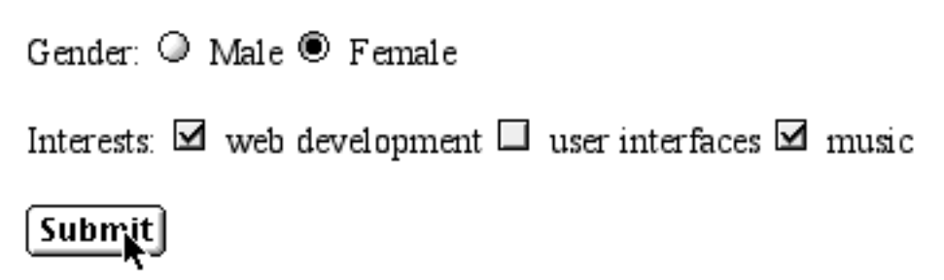
Buttons
individual and isolated regions within a display that can be selected to invoke an action
Special kinds
  radio buttons
  – set of mutually exclusive choices
  check boxes
  – set of non-exclusive choices

Slide 54
Toolbars
long lines of icons …
… but what do they do?
fast access to common actions
often customizable:
  choose which toolbars to see
  choose what options are on it

Slide 55
Palettes and tear-off menus
Problem
menu not there when you want it
Solution
palettes – little windows of actions
  shown/hidden via menu option
  e.g. available shapes in drawing package
tear-off and pin-up menus
  menu ‘tears off’ to become palette

Slide 56
Dialogue boxes
information windows that pop up to inform of an important event or request information.
  e.g: when saving a file, a dialogue box is displayed to allow the user to specify the filename and location. Once the file is saved, the box disappears.

Slide 57
Summary
Today we have learnt,
  Interaction models
    translations between user and system
  ergonomics
    physical characteristics of interaction

