Slide 1
Lecture 3
HUMAN COMPUTER INTERACTION

Slide 2
Summary
  MEMORY
  Information stored in memory
    sensory, short-term, long-term
  Information processed and applied
    reasoning, problem solving, skill, error
  Emotion influences human capabilities
  Each person is different

Slide 3
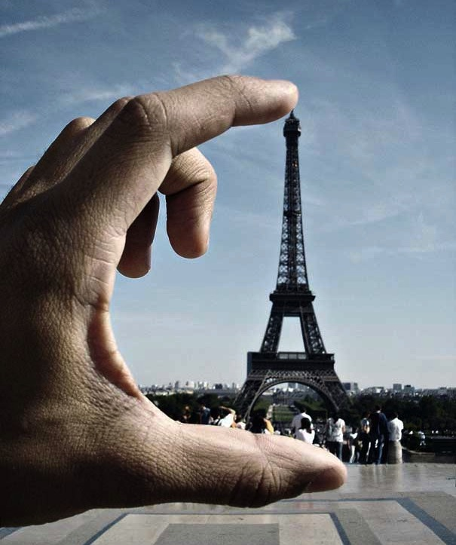
Perception

Slide 4
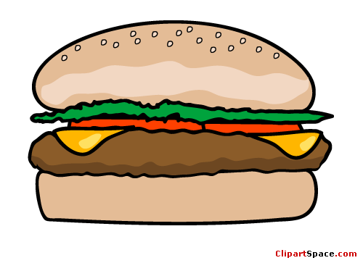





What is Perception?
Perception is our sensory experience of the world around us. It refers to the interpretation of what we take in through our senses.
It involves both the recognition of environmental stimuli and actions in response to these stimuli.
We gain information about properties and elements of the environment that are critical to our survival.

Slide 5

The Perceptual Process
The perceptual process is a sequence of steps that begins with the environment and leads to our perception of a stimulus and an action in response to the stimulus. This process is continual, but you do not spend a great deal of time thinking about the actual process that occurs when you perceive the many stimuli that surround you at any given moment.
Steps are:
    The Environmental Stimulus
    The Attended Stimulus
    The Image on the Retina
    Transduction
    Neural Processing
    Perception
    Recognition
    Action

Slide 6

1. The Environmental Stimulus
The world is full of stimuli that can attract our attention through various senses. The environmental stimulus is everything in our environment that has the potential to be perceived.
  This might include anything that can be seen, touched, tasted, smelled or heard.
For example, imagine that you are out on a morning jog at your local park. There are a wide variety of environmental stimuli that might capture your attention.
The swaying tree branches
A man is out on the grass
A car with music blaring
A duck in a nearby pond.
These things may serve as a starting point for the perceptual process.

Slide 7
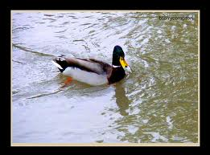
2. The Attended Stimulus
The attended stimulus is the specific object in the environment on which our attention is focused. In many cases, we might focus on stimuli that are familiar to us, such as the face of a friend in a crowd of strangers at the local coffee shop.
Let's imagine that during your morning jog you focus your attention on the duck floating in the nearby pond. The duck represents the attended stimulus.

Slide 8
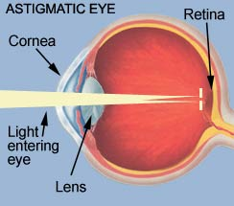

3. The Image on Retina
The attended stimulus is formed as an image on the retina.
The first part of this process involves the light actually passing through the cornea and pupil and onto the lens of the eye.
The cornea helps focus the light as it enters the eye, and the iris of the eye controls the size of the pupils in order to determine how much light to let in.
The cornea and lens act together to project an inverted image on the retina.

Slide 9
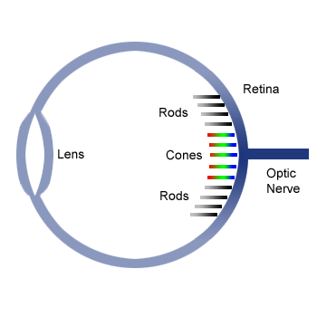
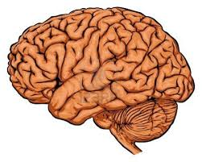
4. Transduction
The image on the retina is then transformed into electrical signals in a process known as transduction. This allows the visual messages to be transmitted to the brain to be interpreted.
The retina contains many photoreceptor cells. These cells contain proteins known as rods and cones.
Rods are primarily for seeing things in low light, while cones are associated with detecting color and shapes at normal light levels.
Rods & cones contain molecule “retinal”, which transduces light into visual signals that are transmitted via nerve impulses to brain.

Slide 10
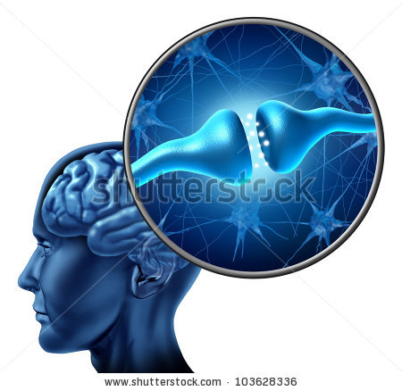
5. Neural Processing
The electrical signals then undergo neural processing. The path followed by a particular signal depends on what type of signal it is (i.e. an auditory signal or a visual signal).
Through the series of interconnect neurons located throughout the body, electrical signals are propagated from the receptors cells to the brain.
In our previous example, the image of duck floating in the pond is received as light on the retina, which is then transduced into an electrical signal and then processed through the neurons in the visual network.

Slide 11

6. Perception
Here, we actually perceive the stimulus object in the environment. It is at this point that we become consciously aware of the stimulus.
Let's consider our example, in which we imagined that you were out for a morning jog in the park. At the perception stage, you have become aware of that there is something out on the pond to perceive.

Slide 12
7. Recognition
Perception doesn't just involve becoming consciously aware of the stimuli. It is also necessary for our brain to categorize and interpret what it is we are sensing.
Our ability to interpret and give meaning to the object is the next step, known as recognition.
It is at the recognition stage of the perceptual process that you realize that there is a duck floating on the water.
It’s a duck!

Slide 13

8. Action
The final step of the perceptual process involves some sort of action in response to the environmental stimulus.
  This could involve a variety of actions, such as turning your head for a closer look or turning away to look at something else
We may wish to move towards the duck as an action

Slide 14
Factors Influencing Perception
Perceiver
Situation
Situation
Perception

Slide 15

Organization of Perceptions
The manner in which stimuli are arranged, that is, grouped, (in addition to their individual characteristics) also affects their perception.
Important stimulus characteristics that affect the organization of stimuli and their perception include the following:
  Similarity
  Nearness
  Closure
  Continuity
  Common fate

Slide 16
1. Similarity
The principle of similarity states that things which share visual characteristics such as shape, size, color, texture, value or orientation will be seen as belonging together. Similarity means there is a tendency to see groups which have the same characteristics.
For-example:
There are three groups of red squares and three groups of yellow squares arranged in lines.
Due to similarity, all are making a group and making a square.

Slide 17

2. Nearness
Stimuli that are near one another tend to be grouped together.
For-example:
Stars near one another are sometimes seen as a pattern or constellation, which is not the case for stars that are far apart.

Slide 18

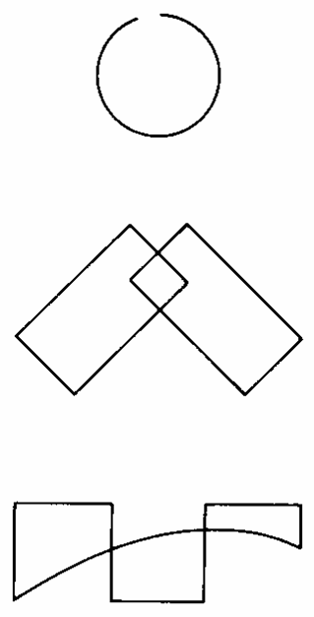
3. Closure
There is a tendency to close simple figures, if there lays some missing information. This results in an effect of filling in missing information or organizing information which is present to make a whole.
For-example:
In these images, the circle is incomplete but the viewer will consider it a circle as by filling in the missing portion in mind.

Slide 19
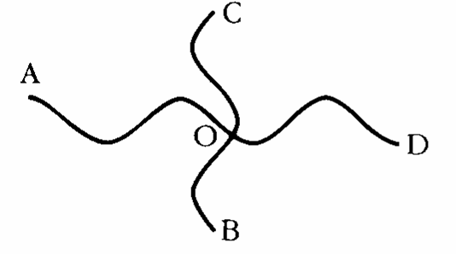
4. Continuity
Continuity means that we do look at objects that are closer together as having smooth movements. Continuation occurs when the eye is compelled to move through one object and continue to another object.
For-example:
Looking at the picture, A to O and O to D are two lines. Similarly, C to O and O to B are two lines. The principle of continuity predicts the preference for continuous figures. We perceive the figure as two crossed lines instead of four lines meeting at the center.

Slide 20

5. Common fate
Elements with the same moving direction are perceived as a collective or unit. They have common fate as they seem to be moving in same direction. The brain will mentally group items all pointing in the same direction.
For-example:
In this image, we perceive that both the lines are moving in same direction (downward or upward).

Slide 21

6. Grouping:
In order to make sense of our world our brains try to see patterns or shapes that are recognizable. This principle is called “grouping”.
The mind forms shapes that don't exist

Slide 22

Watch an example keeping in mind the organizing elements of perception
Video: TEDxSummit intro- The power of x

Slide 23
Types of Perceptions
The manner in which stimuli are arranged, that is, grouped, (in addition to their individual characteristics) also affects their perception.
Important stimulus characteristics that affect the organization of stimuli and their perception include the following:
  Self Perception
  Depth Perception
  Movement Perception
  Person perception
  Object perception

Slide 24
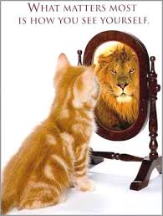
1. Self Perception
Self perception is a process by which people develop a view of themselves.
It is developed from social interaction within different groups.
Self-perception has three parts:
Self-concept
Self-esteem
Self-presentation

Slide 25
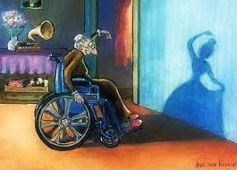
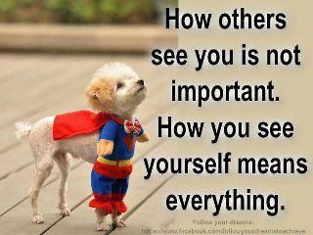
a. Self-concept
  It refers to how someone thinks about or perceives themselves
  You see yourself as a LOVEABLE and WORTHWHILE person
  You feel uncertain and uncomfortable about yourself-you fear possible rejection
  self-identity is the mental and conceptual awareness of strengths and weaknesses

Slide 26
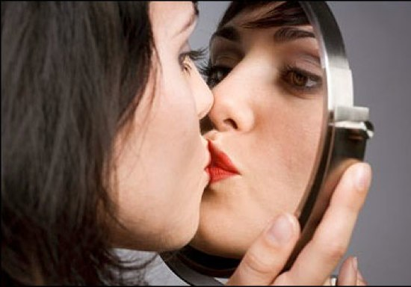
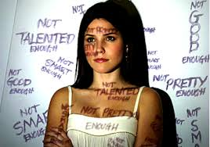
b. Self-esteem
  Emotional dimension of self-perception
  Positive and negative judgments people have of themselves
  People with low self-esteem tend to be unsuccessful; do not adapt well to stressful events
  Those with high self-esteem have the opposite experiences

Slide 27


c. Self-presentation
  Behavioral strategies people use to affect how others see them
  Goals of self-presentation
    Affect other people's impressions to win their approval
    Increase the person's influence in a situation
    Ensure that others have an accurate impression of the person

Slide 28

Self Perception sometimes depends on what others say and believe about ourselves.
Watch example
Video: In Your Head (Self Perception)

Slide 29
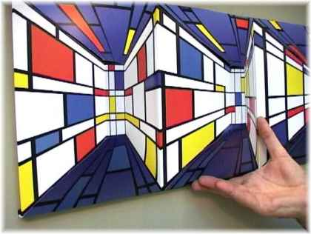
2. Depth Perception
Depth perception is the visual ability to perceive the world in three dimensions (3D) and the distance of an object. Depth perception arises from a variety of depth cues. Monocular cues include size, lines, color, visual angles and object placement.
The best example of this phenomenon is the painting on canvas

Slide 30

2. Depth Perception (continued…)
Focusing foreground
Depth through size
Focusing background
Depth through perspective
Depth through overlapping objects
Depth through distance

Slide 31


3. Movement Perception
Movement is the path that the viewer’s eye follows in the drawing or a painting. Such movement can be directed along lines edges, shape and color within the artwork.
The eye moves in response to the unconscious process of measurement through the axis.
The eye will move in the form of a spiral.
The eye will move either from left to right or right to left as the curve line is followed.

Slide 32
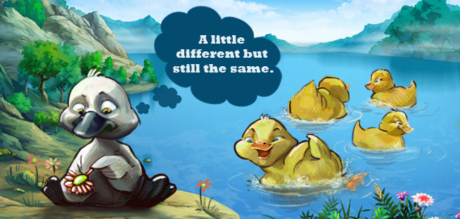
4. Person perception
The term person perception refers to the mental process that we use to form impressions of other people. This includes not just how we form these impressions, but the different conclusions we make about other people based upon our impressions.
For-example
Consider how often you make these kind of judgments everyday. When you meet with a new co-worker, you immediately begin to develop an initial impression of this person.

Slide 33
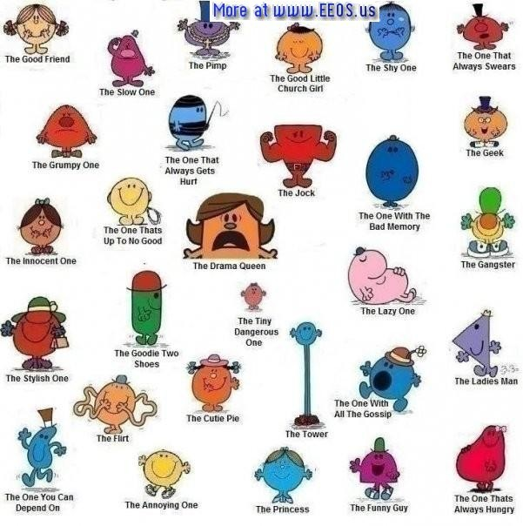
4. Person perception (continued…)
Social categorization
One of the mental shortcuts that we use in person perception is known as social categorization. In the social categorization process, we mentally categorize people into different groups based on common characteristics. Sometimes this process occurs consciously, but for the most part social categorizations happens automatically and unconsciously.
  Some of the most common grouping people use include age, gender, occupation and race.

Slide 34

Watch description of person perception
Video: Why is perception important-

Slide 35
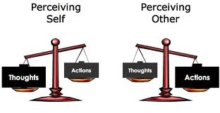
Difference between self perception and person perception

Slide 36
5. Object Perception
Object perception is a process by which people develop a view of objects they see.
Reversible Figure: Figure and ground that can be reversed

Slide 37
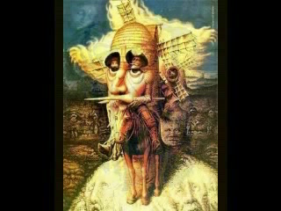
Perception may cause optical illusions of objects that we see
Watch some examples
Video: The Best Optical Illusions Ever(xvid)(wmv)

Slide 38
THANK YOU

