Slide 1
Lecture 2
HUMAN COMPUTER INTERACTION

Slide 2
Summary
In previous lecture we learnt about,
  Basics of Human Computer Interaction
    Alarm Clock Example
    Dos time versus software application
    Don Norman’s Door Example
  The human
    Information i/o …
      visual,
      auditory,
      haptic,
      movement

Slide 3
TODAY’S OUTLINE
The MEMORY
Information stored in memory
  sensory, short-term, long-term
Information processed and applied
  reasoning, problem solving, skill, error
Emotion influences human capabilities
Each person is different

Slide 4
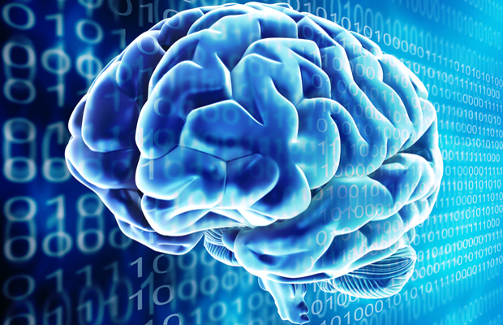
Memory

Slide 5
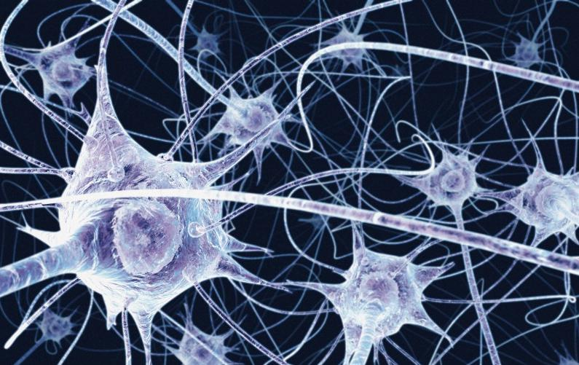
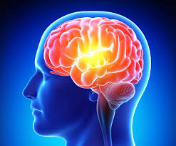
Memory
Without the capacity to remember and to learn, it is difficult to imagine what life would be like, whether it could be called living at all. Without memory, we would be servants of the moment, with nothing but our innate reflexes to help us deal with the world. There could be no language, no art, no science, no culture.’ (Blakemore, 1988)

Slide 6
Memory
There are three types of memory function:
Sensory memories
Short-term memory or working memory
Long-term memory
Selection of stimuli governed by level of arousal.
Attention
Rehearsal

Slide 7

sensory memory
Buffers for stimuli received through senses
  iconic memory: visual stimuli
  echoic memory: aural stimuli
  haptic memory: tactile stimuli
Examples
  “sparkler” trail
  stereo sound
Continuously overwritten

Slide 8
Short-term memory (STM)
Scratch-pad for temporary recall
  rapid access ~ 70ms
  rapid decay ~ 200ms
  limited capacity - 7± 2 chunks

Slide 9
Examples
212348278493202
0121 414 2626
HEC ATR ANU PTH ETR EET
(The Cat Ran Up The Tree)

Slide 10
Long-term memory (LTM)
Repository for all our knowledge
  slow access ~ 1/10 second
  slow decay, if any
  huge or unlimited capacity
Two types
  episodic – serial memory of events
  semantic – structured memory of facts,concepts, skills
  semantic LTM derived from episodic LTM

Slide 11
Long-term memory (cont.)
Semantic memory structure
  provides access to information
  represents relationships between bits of information
  supports inference
Model: semantic network
  inheritance – child nodes inherit properties of parent nodes
  relationships between bits of information explicit
  supports inference through inheritance

Slide 12
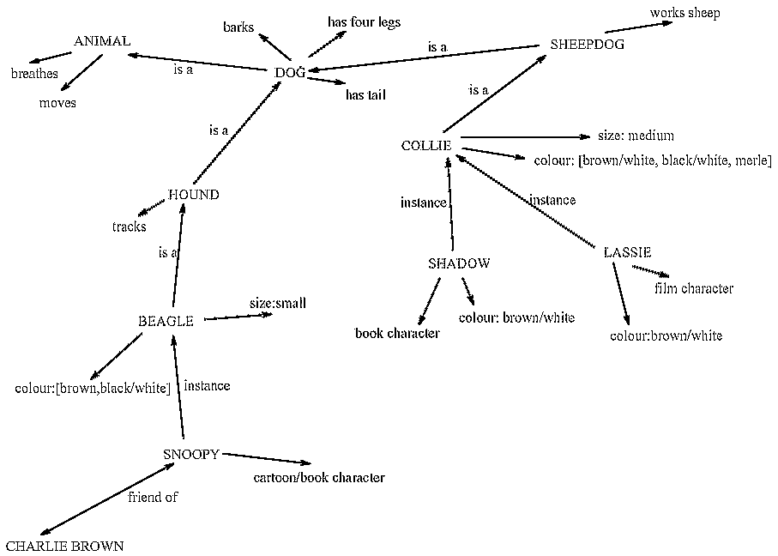
LTM - semantic network

Slide 13
Models of LTM - Frames
Information organized in data structures
Slots in structure instantiated with values for instance of data
Type–subtype relationships
DOG
Fixed
legs: 4
Default
diet: carniverous
sound: bark
Variable
size:
colour
COLLIE
Fixed
breed of: DOG
type: sheepdog
Default
size: 65 cm
Variable
colour

Slide 14
Models of LTM - Scripts
Model of stereotypical information required to interpret situation
Script has elements that can be instantiated with values for context
Script for a visit to the vet
Entry conditions: dog ill
vet open
owner has money
Result: dog better
owner poorer
vet richer
Props: examination table
medicine
instruments
Roles: vet examines
diagnoses
treats
owner brings dog in
pays
takes dog out
Scenes: arriving at reception
waiting in room
examination
paying
Tracks: dog needs medicine
dog needs operation

Slide 15
Models of LTM - Production rules
Representation of procedural knowledge.
Condition/action rules
  if condition is matched
  then use rule to determine action.
IF dog is wagging tail
THEN pat dog
IF dog is growling
THEN run away

Slide 16
LTM - Storage of information
rehearsal
  information moves from STM to LTM
total time hypothesis
  amount retained proportional to rehearsal time
distribution of practice effect
  optimized by spreading learning over time
structure, meaning and familiarity
  information easier to remember

Slide 17
LTM - Forgetting
decay
  information is lost gradually but very slowly
interference
  new information replaces old: retroactive interference
  old may interfere with new: proactive inhibition
so may not forget at all memory is selective …
… affected by emotion – can subconsciously `choose' to forget

Slide 18
LTM - retrieval
recall
  information reproduced from memory can be assisted by cues, e.g. categories, imagery
recognition
  information gives knowledge that it has been seen before
  less complex than recall - information is cue

Slide 19
Thinking
Reasoning
deduction, induction, abduction
Problem solving

Slide 20
Deductive Reasoning
Deduction:
  derive logically necessary conclusion from given premises.
  e.g. If it is Friday then he will go to work
  It is Friday
  Therefore he will go to work.
Logical conclusion not necessarily true:
  e.g. If it is raining then the ground is dry
  It is raining
  Therefore the ground is dry

Slide 21
Deduction (cont.)
When truth and logical validity clash …
  e.g. Some people are babies
  Some babies cry
  Inference - Some people cry
Correct?
People bring world knowledge to bear

Slide 22
Inductive Reasoning
Induction:
  generalize from cases seen to cases unseen
  e.g. all elephants we have seen have trunks
  therefore all elephants have trunks.
Unreliable:
  can only prove false not true
… but useful!
Humans not good at using negative evidence
  e.g. Wason's cards.

Slide 23
Wason's cards
7 E 4 K
If a card has a vowel on one side it has an even number on the other
Is this true?
How many cards do you need to turn over to find out?
…. and which cards?

Slide 24
Abductive reasoning
reasoning from event to cause
  e.g. Sam drives fast when drunk.
  If I see Sam driving fast, assume drunk.
Unreliable:
  can lead to false explanations

Slide 25
Problem solving
Process of finding solution to unfamiliar task using knowledge.
Several theories.
Gestalt
  problem solving both productive and reproductive
  productive draws on insight and restructuring of problem
  attractive but not enough evidence to explain `insight' etc.
  move away from behaviourism and led towards information processing theories

Slide 26
Problem solving (cont.)
Problem space theory
  problem space comprises problem states
  problem solving involves generating states using legal operators
  heuristics may be employed to select operators
  e.g. means-ends analysis
  operates within human information processing system
  e.g. STM limits etc.
  largely applied to problem solving in well-defined areas
  e.g. puzzles rather than knowledge intensive areas

Slide 27
Problem solving (cont.)
Analogy
  analogical mapping:
    novel problems in new domain?
    use knowledge of similar problem from similar domain
  analogical mapping difficult if domains are semantically different
Skill acquisition
  skilled activity characterized by chunking
    lot of information is chunked to optimize STM
  conceptual rather than superficial grouping of problems
  information is structured more effectively

Slide 28
Errors and mental models
Types of error
slips
  right intention, but failed to do it right
  causes: poor physical skill,inattention etc.
  change to aspect of skilled behaviour can cause slip
mistakes
  wrong intention
  cause: incorrect understanding
    humans create mental models to explain behaviour.
    if wrong (different from actual system) errors can occur

Slide 29
Emotion
Various theories of how emotion works
  James-Lange: emotion is our interpretation of a physiological response to a stimuli
  Cannon: emotion is a psychological response to a stimuli
  Schacter-Singer: emotion is the result of our evaluation of our physiological responses, in the light of the whole situation we are in
Emotion clearly involves both cognitive and physical responses to stimuli

Slide 30
Emotion (cont.)
The biological response to physical stimuli is called affect
Affect influences how we respond to situations
  positive → creative problem solving
  negative → narrow thinking
  “Negative affect can make it harder to do even easy tasks; positive affect can make it easier to do difficult tasks”
        (Donald Norman)

Slide 31
Emotion (cont.)
Implications for interface design
  stress will increase the difficulty of problem solving
  relaxed users will be more forgiving of shortcomings in design
  aesthetically pleasing and rewarding interfaces will increase positive affect

Slide 32
Individual differences
long term
– gender, physical and intellectual abilities
short term
– effect of stress or fatigue
changing
– age
Ask yourself:
will design decision exclude section of user population?

Slide 33
Psychology and the Design of Interactive System
Some direct applications
  e.g. blue acuity is poor
  ⇒ blue should not be used for important detail
However, correct application generally requires understanding of context in psychology, and an understanding of particular experimental conditions

Slide 34
SUMMARY
Today we learnt about,
  MEMORY
  Information stored in memory
    sensory, short-term, long-term
  Information processed and applied
    reasoning, problem solving, skill, error
  Emotion influences human capabilities
  Each person is different

