Slide 1
HUMAN COMPUTER INTERACTION
LECTURE 1
Professor Dr. Sajjad Mohsin

Slide 2
Faculty Profile
Ph.D.
  Division of Production, Information and Systems Engineering, Muroran Institute of Technology (MIT), Hokkaido. JAPAN
M.E.
  Dept. of Computer Science and Systems Engineering, MIT. JAPAN
M.Sc. Computer Science
  Department of Computer Science, Quaid-i-Azam University Islamabad, Pakistan
Notes:
m

Slide 3
Experience
Professor & Dean FIST, COMSATS Institute of Information Technology Islamabad Pakistan, April 2011 to date
Dean FIST & Chairman CS (Associate Professor)COMSATS Institute of Information Technology Islamabad Pakistan, Nov 2010 to August 2011
Chairman & Head (Associate Professor) Department of Computer Science, COMSATS Institute of Information Technology Islamabad Pakistan, July 2009 to Nov 2010.

Slide 4
Experience
Head (Associate Professor), Department of Computer Science, COMSATS Institute of Information Technology Islamabad Pakistan, January 2008 to July 2009
Associate Professor, COMSATS Institute of Information Technology Abbottabad Campus, Pakistan, April 2005-January 2008
Research Assistant with Prof. Yukinori Suzuki, MIT Japan, 2004 to 2005
  Research Project: A study on Telecommunication Network Modeling.

Slide 5
Experience
Research Assistant with Prof. Yukinori Suzuki, MIT Japan. Research, 2003-2004
  Project: A study on Congestion Control of Telecommunication Network.
Teaching Assistant with Dr. Yasushi Honda, MIT Japan. Oct 2002, to Feb 2003
  Subject: Information Engineering Basic Practice B.
Researcher with Prof. Yukinori Suzuki at the MIT Japan, Oct 1998 to March 2000.

Slide 6
Experience
Systems Analyst, Central Telecom Research Laboratories (CTRL),PakistanTelecommunication Corporation Ltd. (PTCL), Islamabad. Pakistan, July 1992 – Sep. 2003
Systems Analyst, National Institute of Electronics (NIE), Islamabad. Pakistan, Jun. 1987 – Jul. 1992

Slide 7
Grants
2007 – Present
  Higher Education Commission, Pakistan approved & funded research project "High Performance Image Processing using Genetic Algorithms on Auto-Load Balancing Symmetric Multi-Processing Platform" worth more than (Pakistan Rs.) 0.6 million
2011 – 2013
  National ICT R&D Fund approved and funded the research project titled “3D Graphical Imagery Therapy for Healing Brain Tumors in Children” worth more than 11 million PKR.
  2012 – 2016
  Grand Challenges Canada approve the project titled “Improving mental health care for young adults in Badakhshan Province of Afghanistan using eHealth” worth Canadian $1 Million as Co-PI in collaboration with University of Calgary, Canada.

Slide 8
HONORS
Distinguish Professor of IT
Member Editorial Board of the “IEEE Transaction of The Fuzzy Systems” Journal
Member Editorial Board of the World Information Technology Journal
Member Editorial Board of the Information Technology Journal
Approved PhD Supervisor of Higher Education Commission for Pakistan
Member Australian Computer Society

Slide 9
Honors
Awarded Japanese Government, Ministry of Education Scholarship for Ph.D. April 2002- March 2005
Awarded Japanese Government, Ministry of Education Scholarship for M.E. April 2000 –March 2002
Awarded Japanese Government, Ministry of Education Scholarship as Research Student. Oct 1998- March 2000.
Awarded Merit Scholarship by the Quaid-i-Azam University Islamabad for M.Sc. Jan. 1985 – Dec. 1986

Slide 10
Course Learning Outcomes
Upon completion of the course, students will be able to:
Explain human factors of HCI including human body physical abilities, ergonomics, accessibility, health issues, cognitive load and psychology.
Explain hardware factors of HCI including different input and output devices e.g. keyboard, mouse, and touchscreen.
Understand different key elements from which user interfaces are constructed.
Implement user-centered approach in software development process and apply suitable techniques for collecting user requirement and analyzing task.
Evaluate and compare user interfaces using different techniques such as laboratory experiments and expert reviews.

Slide 11
Recommended Resources
Text book
  Human Computer Interaction, A. Dix et al., 3rd edition, Pearson Education,
Other
  Designing Interactive Systems: A comprehensive guide to HCI, UX and interaction design, D. Benyon, 3rd edition, Pearson Education, 2013.
  Designing the User Interface: Strategies for Effective Human-Computer Interaction, B. Shneiderman et al., 5th edition, Pearson Education, 2009.
  The essence of human computer interaction, C. Faulkner, 1st Ed.
  The design of everyday things, D. Norman, 2nd Ed.
  http://hcibib.org/

Slide 12
Outline
Introduction to HCI
  Alarm Clock Example
  Dos time versus software application
  Don Norman’s Door Example
The human
  Information i/o …
    visual,
    auditory,
    haptic,
    movement

Slide 13
Goals of HCI
Useful
  Accomplish what is required
  Play music, cook dinner, format a document
Usable
  Do it easily and naturally
  Without danger of error
Used
  Make people want to use it
  Be attractive, engaging, fun

Slide 14

Alarm Clock

Slide 15
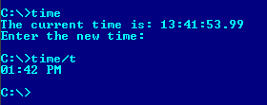
DOS TIME

Slide 16
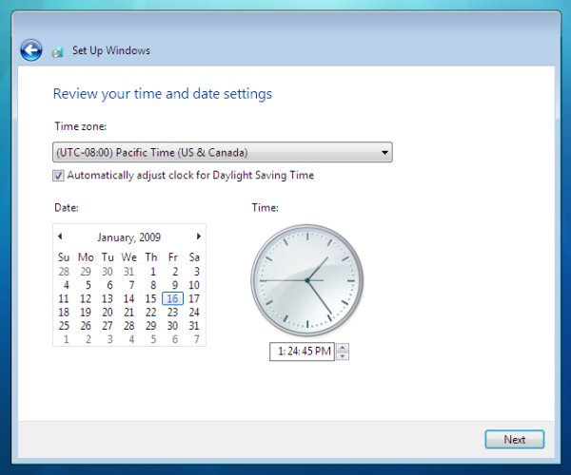
Why Study HCI – Software Perspective

Slide 17
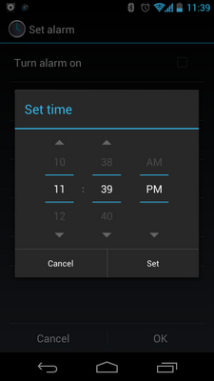
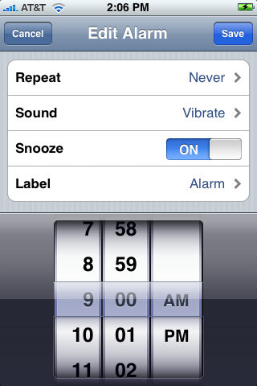
Smart Phone Clock

Slide 18

Don Norman’s Door Example
A classic book. Read it!
I will share its pdf soon
Main Point: no one reads manuals, so things should be designed so that manuals are not needed
BTW what is wrong with the kettle on the book cover?

Slide 19
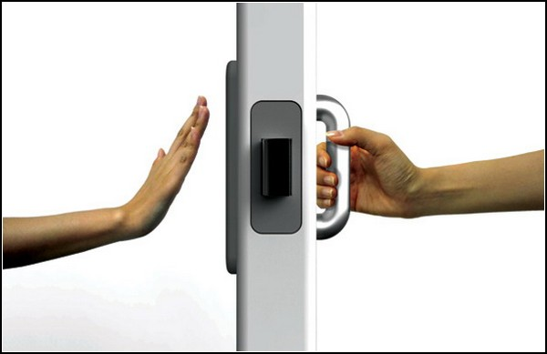
Don Norman’s Door Example
A plate naturally says “ push me” and a handle naturally says “pull me “

Slide 20
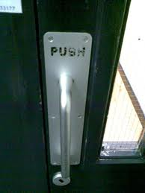
Don Norman’s Door Example
When Don Norman’s advice is not followed

Slide 21

Vision
Two stages in vision
• physical reception of stimulus
• processing and interpretation of stimulus

Slide 22
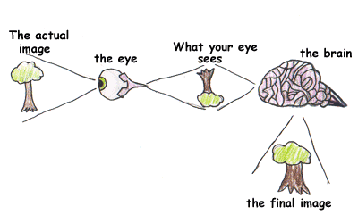
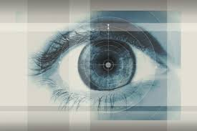
The Eye - physical reception
mechanism for receiving light and transforming it into electrical energy
light reflects from objects
images are focused upside-down on retina
retina contains rods for low light vision and cones for colour vision
ganglion cells (brain!) detect pattern and movement

Slide 23
Interpreting the signal
Size and depth
  visual angle indicates how much of view object occupies
  (relates to size and distance from eye)
  visual acuity is ability to perceive detail (limited)
  familiar objects perceived as constant size
  (in spite of changes in visual angle when far away)
  cues like overlapping help perception of size and depth

Slide 24
Interpreting the signal (cont)
Brightness
  subjective reaction to levels of light
  affected by luminance of object
  measured by just noticeable difference
  visual acuity increases with luminance as does flicker
Colour
  made up of hue, intensity, saturation
  cones sensitive to colour wavelengths
  blue acuity is lowest
  8% males and 1% females colour blind

Slide 25
Interpreting the signal (cont)
The visual system compensates for:
  movement
  changes in luminance.
Context is used to resolve ambiguity
Optical illusions sometimes occur due to over compensation

Slide 26
Optical Illusions
the Ponzo illusion
the Muller Lyer illusion

Slide 27

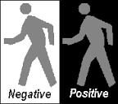
Reading
Several stages:
  visual pattern perceived
  decoded using internal representation of language
  interpreted using knowledge of syntax, semantics, pragmatics
Reading involves saccades and fixations
Perception occurs during fixations
Word shape is important to recognition
Negative contrast improves reading from computer screen

Slide 28
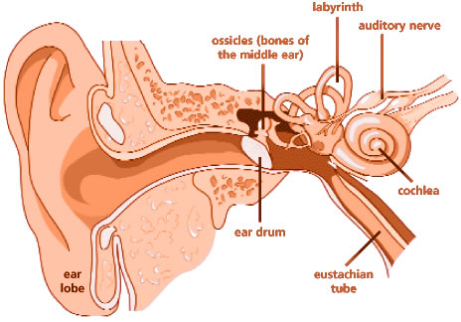
Hearing
Provides information about environment:
distances, directions, objects etc.
Physical apparatus:
  outer ear – protects inner and amplifies sound
  middle ear – transmits sound waves as
  vibrations to inner ear
  inner ear – chemical transmitters are released
  and cause impulses in auditory nerve
Sound
  pitch – sound frequency
  loudness – amplitude
  timbre – type or quality

Slide 29
Hearing (cont)
Humans can hear frequencies from 20Hz to 15kHz
  less accurate distinguishing high frequencies than low.
Auditory system filters sounds
  can attend to sounds over background noise.
  for example, the party phenomenon.

Slide 30
Touch/Haptic
Provides important feedback about environment.
May be key sense for someone who is visually impaired.
Stimulus received via receptors in the skin:
  Thermo-receptors – heat and cold
  nociceptors – pain
  mechanoreceptors – pressure
  (some instant, some continuous)
Some areas more sensitive than others e.g. fingers.
Kinesthesis - awareness of body position
  affects comfort and performance.

Slide 31
Movement
Time taken to respond to stimulus:
reaction time + movement time
Movement time dependent on age, fitness etc.
Reaction time - dependent on stimulus type:
  visual ~ 200ms
  auditory ~ 150 ms
  pain ~ 700ms
Increasing reaction time decreases accuracy in the unskilled operator but not in the skilled operator.

Slide 32
Movement (cont)
Fitts' Law describes the time taken to hit a screen target:
Mt = a + b log₂(D/S + 1)
  where: a and b are empirically determined constants
  Mt is movement time
  D is Distance
  S is Size of target
targets as large as possible
distances as small as possible

Slide 33
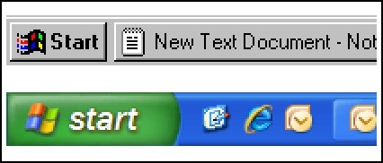
Fitts law
Fitts law is useful for web designers when deciding where to place the next button
    Call to Action Buttons , links and other buttons can be strategically placed on websites/apps to increase the chance of clicking. Not only do you want to direct traffic to the right places, but users need to a have a simple and easy experience. Notice how the windows start button almost doubled in size?

Slide 34
Summary
Today we learnt about,
  Basics of Human Computer Interaction
    Alarm Clock Example
    Dos time versus software application
    Don Norman’s Door Example
  The human
    Information i/o …
      visual,
      auditory,
      haptic,
      movement

