Slide 1

Lecture 8
COMSATS Islamabad
Enterprise
Systems
Development
( CSC447)
Muhammad Usman, Assistant Professor

Slide 2
Use Case Modeling

Slide 3
What is a Use Case?
Narrative descriptions of domain processes in a structured prose format
They are stories or scenarios of how people use the system

Slide 4
A Short Example to Start With
Dice game
  A software simulates a player rolling two dice. If the total is seven, they win; otherwise, they lose.

Slide 5
A Short Example to Start With
Use case: Play a game
Actors: Player
Description: Player requests to roll the dice. System presents results: If the dice face value totals seven, player wins; otherwise, player loses.

Slide 6
Case Study – The NextGen POS System
Computerized application used to record sales and handle payments
Used in retail store
It includes hardware and software
  It also interfaces to other applications, such as a third-party tax calculator and inventory control
Multiple and varied clients-side terminals and interfaces
Commercial POS

Slide 7
Use Case, Actor, and Scenario
Actors
  Something with behavior such as person, computer system, or organization
Scenario
  It is a specific sequence of actions and interactions between actors and the system. It is also called use case instance
  It is one particular story of using a system
    E.g. scenario of successfully purchasing items with cash or scenario of failing to purchase items because of credit payment denial
  Use case then is a collection of success and failure scenarios
Use cases are requirements, primarily functional.

Slide 8
Use Case, Actor, and Scenario
A UC is a dialogue between an Actor and a system that accomplishes a task.
The dialogue is presented as a sequence of steps
A complete sequence of steps is a use case scenario
  A scenario (UC instance) forms a complete path thru the UC.

Slide 9
Use Case, Actor, and Scenario
UC can contain multiple scenarios (i.e., >1 path thru UC)
Can range from simple (brief summary) to elaborate (detailed steps using adopted document template)
UCs are NOT object-oriented artifacts! They feed into other OO models

Slide 10
Use Cases
Kinds of Actors
  Primary actor
    has user goals fulfilled through using services of the SuD
    Why identify? To find user goals, which drive the use cases.
  Supporting actor
    provides a service (for example, information) to the SuD
    Why identify? To clarify external interfaces and protocols.
  Offstage actor
    has an interest in the behavior of the use case
    Why identify? To ensure that all necessary interests are identified and satisfied.

Slide 11
Use Cases
Guidelines
  How to find use cases
    Choose the system boundary
    Find primary actors
    Identify goals for each primary actor
    Define Use cases that satisfy user goals

Slide 12
1. System Boundary

Slide 13
2 and 3. Primary actors and Goals
Brainstorm the primary actors first.
Questions to help identify Actors and Goals
  Who starts and stops the system?
  Who does user and security management?
  Who does system administration?
  Is “Time” an actor because the system does something in response to a time event?
  Are there any external software system that call upon the services of the system?
Organize the actors and goals in an Actor Goal List

Slide 14
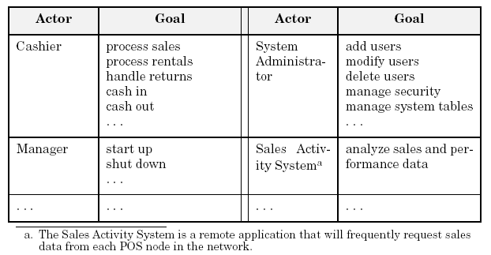

Slide 15
4. Define Use cases for user goals

Slide 17
Alternate Actor Notation

Slide 18
Writing Use Cases
Use cases are text documents, not diagrams and use case modeling is primarily an act of writing text, not drawing diagrams.
Use Case Style
  Black Box Use cases
    Focus on what not how
Use Case Formats
  Brief
  Casual
  Fully dressed

Slide 19
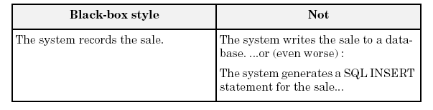
Black Box Use cases

Slide 20
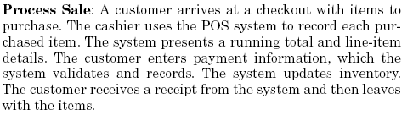
Use Case Formats
Brief

Slide 21
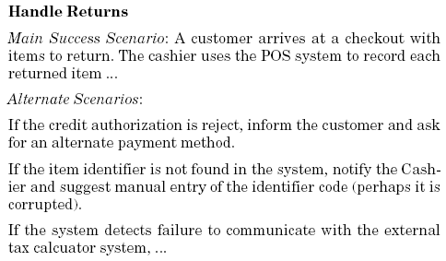
Use Case Formats
Causal

Slide 22
Fully dressed
Use case Section | Comment
Use case name | Start with a verb
Scope | The system under design
Level | “user goal” or “sub function”
Primary Actor | Calls on system to deliver its services
Stakeholders and interests | who cares about the system and what do they want
Preconditions | what must be true on start
Success Guarantee | What must be true on successful completion
Main Success Scenario | Unconditional happy path scenario of success
Extensions | Alternate scenario of success or failure
Special Requirements | Related NFRs
Technology and Data variation list | Varying I/O methods
Frequency of occurrence | Influences investigation, testing
Miscellaneous | Open issues

Slide 23
Process Sale Use Case
UC: Process Sale
User selects new sale option
System requests item identifier
User enters item identifier
System records sale of item, and
System displays item description, price, current total
Steps 2-5 repeated until user finished
User selects sale finished option
System displays total and taxes due
User selects payment option
System requests payment information
User enters payment information
System handles payment
System logs completed sale and sends sale information to Accounting System and Inventory System
System generates receipt

Slide 24
Alternate Flow or Extensions
3a. Invalid identifier:
1 . System signals error and rejects entry.
3-6a: Customer asks Cashier to remove an item from the purchase:
1. Cashier enters item identifier for removal from sale.
2. System displays updated running total.
3-6b. Customer tells Cashier to cancel sale:
1. Cashier cancels sale on System.
4a. The system generated item price is not wanted (e.g., Customer complained about something and is offered a lower price):
1. Cashier enters override price. .
2. System presents new price.
…..
Link to Full Use Case PDF

Slide 25
Common UC Issues
What Tests Can Help Find Useful Use Cases?
    The Boss Test
    The EBP Test: A task performed by 1 user in 1 place at 1 time in response to a business event, that adds measurable value to the business and leaves data in a consistent state.
    The Size Test
Writing Style
  Essential (keep the UI out)
  Concrete (UI decisions embedded in the UC text)
Write ‘black box’ UCs
  Defer implementation details
  Avoid reference to specific technologies

Slide 26
Library Use Case Diagram
A computerized library system for a university keeps track of all books and periodicals in the library and their check-out status.
Checkout and return are automated through a bar code reader (an external device).
The library system also interfaces with an external relational database which stores information about the library users (students, faculty, and staff), including whether they have any library items checked out.
Library users can access the catalog and recall books and periodicals.
Library employees have the same access as well as additional capabilities (e.g., listing the status of an item).
Note: the library catalog is part of the library computer system so it is not shown as an actor.
EmployeeLogin
CheckIn
LibEmployee
CheckOut
BarCodeReader
LibUser
CheckAvailability
UsersDB
Recall

Slide 27
Use Case for Employee Login
Employee initiates use case by entering user name
System prompts for password
If password is valid, employee is logged on and now has access to employee commands
Starting and Ending Conditions?
Exceptions? e.g., cannot find the employee login
EmployeeLogin
CheckIn
LibEmployee
CheckOut
BarCodeReader
LibUser
CheckAvailability
UsersDB
Recall

Slide 28
Use Case for Check Book Availability
User/Employee initiates use case by selecting the check book availability option
System prompts for choice of search by title, author, or call number
User makes selection and enters title, author or call number
System performs search through the library catalog database
If a match is found, system displays item status (not checked out, checked out and due date, overdue)
Starting and Ending Conditions?
Exceptions?
EmployeeLogin
CheckIn
LibEmployee
CheckOut
BarCodeReader
LibUser
CheckAvailability
UsersDB
Recall

Slide 29
Terminology: Concrete, Abstract, Base, and Addition Use Cases
Concrete use case
  is initiated by an actor
  is an EBP use case
  e.g., Process Sale
Abstract use case
  is never instantiated by itself
  is a sub-function use case (part of another use case)
  e.g., Handle Credit Payment
Base use case
  that includes another use case, or that is extended or specialized by another use case
  e.g., Process Sale with respect to the included Handle Credit Payment
Addition use case
  that is an inclusion, extension, or specialization
  Handle Credit Payment in the include relationship to Process Sale
Addition use cases are usually abstract
Base use cases are usually concrete

Slide 30
Use Case Associations
Use case association = relationship between use cases
Important types:
  Include
    A use case uses another use case (functional decomposition and reuse of existing functionality)
  Extends
    A use case extends another use case
  Generalization
    A use case has different specializations

Slide 31
≪Include≫: Functional Decomposition
Problem:
  A function in the original problem statement is too complex to be solvable immediately
Solution:
  Describe the function as the aggregation of a set of simpler functions. The associated use case is decomposed into smaller use cases
CreateDocument
≪include≫
≪include≫
≪include≫
Scan
OCR
Check

Slide 32
≪Include≫: Reuse of Existing Functionality
Problem:
  There are already existing functions. How can we reuse them?
Solution:
  The include association from Use Case A to Use Case B indicates that an instance of A performs all the behavior described in B (“A delegates to B”)
Example:
  The use case “ViewMap” describes behavior that can be used by the use case “OpenIncident” (“ViewMap” is factored out)
Note: The base use case cannot exist alone. It is always called with the supplier use case
≪include≫
OpenIncident
Base Use
Case
ViewMap
≪include≫
Supplier
Use Case
AllocateResources

Slide 33
Example: Include Relationship
UC1: Process Sale
…
Main Success Scenario:
  1. Customer arrives at a POS checkout with goods and/or services to purchase
  .…
  Customer pays and System handles payment.
  …
Extensions:
  7b. Paying by credit: Include Handle Credit Payment.
  7c. Paying by check: Include Handle Check Payment.
  …

Slide 34
Example: Include Relationship cont…
UC12: Handle Credit Payment
…
Level: Sub-function
Main Success Scenario:
  Customer enters their credit account information.
  System sends payment authorization request to an external Payment Authorization Service System, and requests payment approval.
  System receives payment approval and signals approval to Cashier.
  …
Extensions:
  2a. System detects failure to collaborate with external system:
    System signals error to Cashier.
    Cashier asks Customer for alternate payment.
…

Slide 35
When to Use Include Relationship?
Use include when you are repeating yourself in two or more separate use cases and you want to avoid repetition.
A use case is very complex and long, and separating it into subunits aids comprehension.

Slide 36
≪Extend≫ Association for Use Cases
Problem:
  The functionality in the original problem statement needs to be extended.
Solution:
  An extend association from Use Case B to Use Case A indicates that B is an extension of A.
Example:
  The use case “ReportEmergency” is complete by itself , but can be extended by the use case “Help” for a specific scenario in which the user requires help
Note: In an extend association, the base use case can be executed without the use case extension
Base Use
Case
B
Help
FieldOfficer
A
≪extend≫
ReportEmergency

Slide 37
≪Extend≫ Association for Use Cases
The idea is to create an extending or addition use case, and within it, describe where and under what condition it extends the behavior of some base use case.

Slide 38
Example: Extend Relationship
____Process Sale___
Extension Points:
Payment
VIP Customer
UML Notation:
The extending use
case points to the
base use case.
2. The condition and the
extension point can be
shown on the line.
≪Extend≫
Payment, if customer presents a gift certificate
Handle gift certificate
payment

Slide 39
Example: Extend Relationship
UC1: Process Sale (the base use case)
…
Extension Points: VIP Customer, step 1. Payment, step 7.
Main Success Scenario:
  1. Customer arrives at a POS checkout with goods and/or services to purchase
  .…
  7. Customer pays and System handles payment
  .…

Slide 40
Example: Extend Relationship cont…
UC15: Handle Gift Certificate Payment (the extending use case)
…
Trigger: Customer wants to pay with gift certificate.
Extension Points: Payment in Process Sale.
Level: Sub-function
Main Success Scenario:
  Customer gives gift certificate to Cashier.
  Cashier enters gift certificate ID.
…

Slide 41
Generalization Association in Use Cases
Problem
  You have common behavior among use cases and want to factor this out.
Solution
  The generalization association among use cases factors out common behavior. The child use cases inherit the behavior and meaning of the parent use case and add or override some behavior.
Example
  Consider the use case “ValidateUser”, responsible for verifying the identity of the user. The customer might require two realizations: “CheckPassword” and “CheckFingerprint”
CheckPassword
Parent
Case
ValidateUser
Child
Use Case
CheckFingerprint

Slide 42
References
Craig Larman, Applying UML and Patterns, 3rd Edition

