Slide 1

Lecture 7
COMSATS Islamabad
Enterprise
Systems
Development
( CSC447)
Muhammad Usman, Assistant Professor

Slide 2
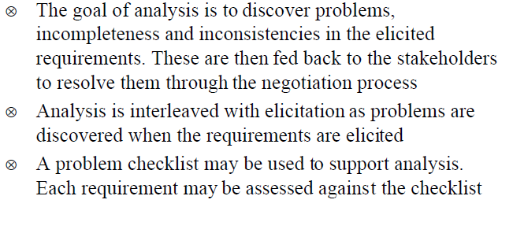
Requirements Analysis

Slide 3
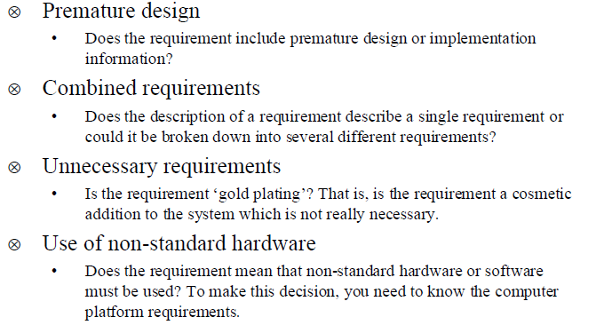
Analysis Checklists

Slide 4
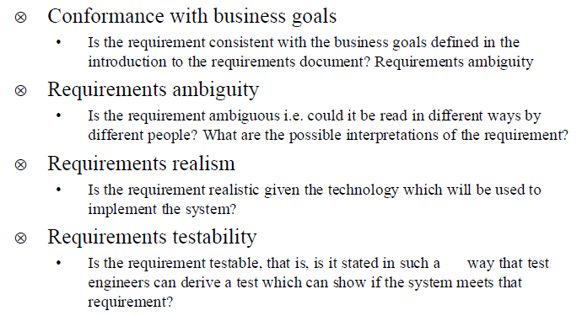
Analysis Checklists

Slide 5
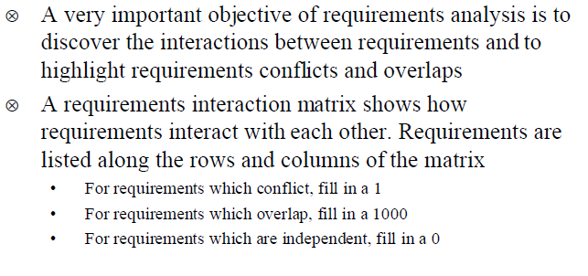
Requirements Interactions

Slide 6
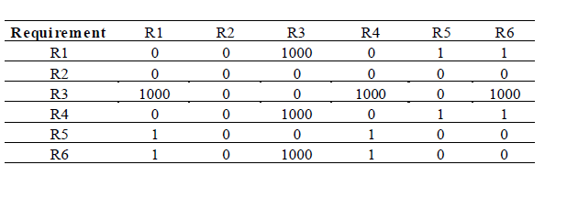
Interaction Metrices

Slide 7
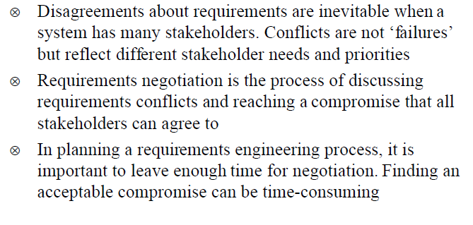
Requirements Negotiation

Slide 8
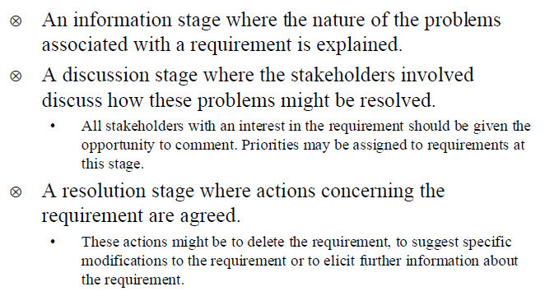
Negotiation Meetings

Slide 9
Requirements Documentation/Specification

Slide 10
Characteristics of Requirements
Correct
Consistent
Unambiguous
Complete
Feasible
Relevant
Testable
Traceable

Slide 11
Examples of Poorly Written Requirements
ATM machine will confiscate the card if user enters wrong PIN multiple times.
The product should have a good human interface.
The output of the program shall usually be given within 10 secs.
The System shall allow student to add six courses in one semester if he/she has good GPA.

Slide 12
Requirements specification
(1) The System Requirements Definition Document
  A statement in a natural language of what user services the system is expected to provide.
  sometimes known as the user requirements document (or concept of operations) records the system requirements.
  defines the high-level system requirements from the domain perspective.
  Must list the system requirements along with background information about overall objectives for the system, its target environment and a statement of the constraints, assumptions and non-functional requirements.
  May include conceptual models designed to illustrate the system context, usage scenarios, the principal domain entities, and data, information and work-flows.

Slide 13
Requirements specification
(2) Requirements specification (intermediate level)
A structured document which sets out the system services in more detail.
It should be written such that understandable by technical staff from both clients and developers.
Samples/Template

Slide 14
Sample Table of Contents
Preamble Requirement Shell Requirement Numbering Definitions Used in this Template PROJECT DRIVERS: 1. The Purpose of the Product 2. Client, Customer, Stakeholders 3. Users of the Product PROJECT CONSTRAINTS: 4. Mandated Constraints 5. Naming Conventions and Definitions 6. Relevant Facts and Assumptions | FUNCTIONAL REQUIREMENTS: 7. The Scope of the Work 8. The Scope of the Product 9. Functional and Data Requirements NON-FUNCTIONAL REQUIREMENTS: 10. Look and Feel 11. Usability 12. Performance 13. Operational 14. Maintainability 15. Portability 16. Security 17. Cultural and Political 18. Legal | PROJECT ISSUES: 18. Open Issues 19. Off-the-shelf Solutions 20. New Problems 21. Tasks 22. Cutover 23. Risks 24. Costs 25. User Documentation 26 Ideas for Solutions
Notes:
Mandate

Slide 15
A Common Approach (RS)
3.A. Functional Requirements
3.A.i. Student Services
R-001 Students can add, drop, and change course.
R-002 Students can check which sections of a certain course are available.
R-003 Students can check the tuition fee.
3.A.ii. Teacher Services
R-009 The professors can set the limit of number of students in his or her class.
R-010 Any user can view any courses offered in the year.
R-011 The professors can let a student register a course but no overloading.
3.A.iii. System-Related Requirements
R-013 The system shall provide access through the web.
R-014 The system shall work with internet protocol.
3.B. Performance Requirements
R-020 The system shall allow 1000 users to connect simultaneously.
R-021 The system shall response the request in 15 seconds.
R-022 The system shall log out the user after 20 minutes of connection.

Slide 16
Non Functional Requirements
Property
Metric
Speed
Process transaction/second, user/event response time
must be testable, so should be expressed quantitatively, using an accepted metric or especially design-one.
Size
Kilobytes, code, RAM chip
Ease of Use
Training time, of held frames
Reliability
Mean time to failure, probability of unavailability, Role of failure occurrence, Availability.
Robustness
Time to restart after failure,
%age of events causing failure, Probability of data corruption on failure
Portability
%age of target dependent statements, No. of target systems

Slide 17
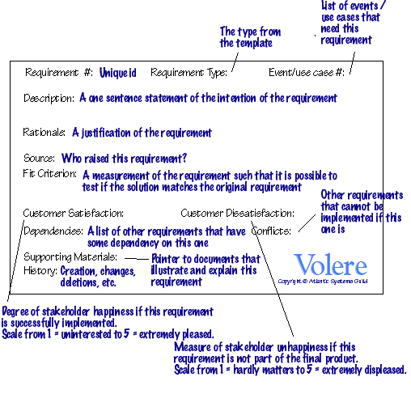
Requirement Shell/template
As a guide for writing each requirement.

Slide 18
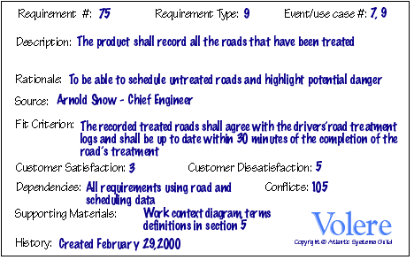
Example

Slide 19
(3) Software Requirements Specification (SRS)
Also called (Design Specification)
An abstract description of the S/W, which is basis for its design and implementation. There should be a clear and direct relationship between this document and the requirement specification, but the reader of this are S/W designers.
Such a specification is included mostly as part of system contract and is the basis for designing system acceptance tests.
Inputs, Process, Output, pre-conditions, post-conditions are the minimum required.

Slide 20
SRS
Structured Language Specification
Natural Language is required because of understandability.
Many notations have been developed which rely on natural language in a controlled way using standard form and also use graphical highlighting.
The form structure will vary depending on the requirement structuring technique (functional, data, object e.t.c).
Functional oriented Specifications are most common.
Notes:
and may use control constructs, (derived from program languages)

Slide 21
SRS
Form based approach fits well with formal mathematical specification. A formal specification can be defined and paraphrased in a set of forms or a formal specification can be defined from the structured forms and used to refine the requirement specification.
Other approaches (e.g. formal mathematical) tackle some problems of specifications ambiguity but at the cost of perhaps, readability.

Slide 22
SRS
ATM example of structured requirement specification (functional approach)
Function: Check-Card-Validity
Description: Must ensure the card input by the user, is in date, contains account information e.t.c.
Inputs: Bank-identifiers, account No. , Expiry date
Source: Input read from card magnetic strip
Output: Card-Status (OK, invalid)
Destination: AutoTeller (Status passed to other parts of S/W)
Requires: Bank list, account format, today’ date.
Pre-condition: Card has been input and strip data read.
Post-Condition: Bank-identifier is in bank list and account number matches Account format, expiry-date, today-date and card-status = OK
Side effects: None
Exercise: Design a format for object oriented specification technique
A form based approach could obviously be automated.
Pre and post conditions are used to specify the actions of the function.
It is not an operational specification of what the function must do.
The names used (in the form) must be defined elsewhere or if possible in data dictionary.

Slide 23
Document Structure and Standards
Several recommended guides and standards exist to help define the structure of requirements documentation. These include IEEE P1233/D3 guide, IEEE Std. 1233 guide, IEEE Std. 830-1998, ISO/IEC 12119-1994. IEEE Std 1362-1998 concept of operations (ConOPs).

Slide 24
Importance of SRS
It serves as a basis of communication among all parties
Formally or informally, it represents an agreement among the various parties
It serves as the software manager's reference standard.
It serves as input to the design and implementation groups.
It serves as input to the software testing and QA (quality assurance) groups.
It controls the evolution of the system throughout the development phase of the project; as new features are added or modified in the Vision document, they are elaborated within the package.

Slide 25
Characteristics of a good SRS
An SRS should be
  Correct
  Unambiguous
  Complete
  Consistent
  Ranked for importance and/or stability
  Verifiable
  Modifiable
  Traceable

Slide 26
Examples of Bad SRS Documents
Unstructured Specifications:
  Narrative essay --- one of the worst types of specification document:
    Difficult to change
    Difficult to be precise
    Difficult to be unambiguous
    Scope for contradictions etc.
Noise:
  Presence of text containing information irrelevant to the problem.
Silence:
  Aspects important to proper solution of the problem are omitted.

Slide 27
Examples of Bad SRS Documents
Over specification:
  Addressing “how to” aspects
    For example, “Library member names should be stored in a sorted descending order”
    Over specification restricts the solution space for the designer.
Contradictions:
  Contradictions might arise if the same thing described at several places in different ways.

Slide 28
Examples of Bad SRS Documents
Ambiguity:
  Literary expressions Unquantifiable aspects, e.g. “good user interface”
Forward References:
  References to aspects of problem defined only later on in the text.
Wishful Thinking:
  Descriptions of aspects for which realistic solutions will be hard to find.

Slide 29
Requirements Documentation
IEEE Standard for SRS
Introduction to the Document
  1.1 Purpose of the Product
  1.2 Scope of the Product
  1.3 Acronyms, Abbreviations, Definitions
  1.4 References
  1.5 Outline of the rest of the SRS
General Description of Product
  2.1 Context of Product
  2.2 Product Functions
  2.3 User Characteristics
  2.4 Constraints
  2.5 Assumptions and Dependencies
Specific Requirements
  3.1 External Interface Requirements
    3.1.1 User Interfaces
    3.1.2 Hardware Interfaces
    3.1.3 Software Interfaces
    3.1.4 Communications Interfaces
  3.2 Functional Requirements
    3.2.1 Class 1
    3.2.2 Class 2
    …
  3.3 Performance Requirements
  3.4 Design Constraints
  3.5 Quality Requirements
  3.6 Other Requirements
Appendices

Slide 30
RUP SRS Template
Overview
Revision History
Table of Contents
Introduction
  Purpose
  Scope
  References
  Assumptions and Dependencies
Use-Case Model Survey
  The use case name, brief description, list of actors
Actor Survey
  The actor’s name, brief description of actor
  Requirements
  Functional Requirements
  Nonfunctional Requirements

Slide 31
RUP SRS Template
Online User Documentation and Help System Requirements
Design Constraints
Purchased Components
Interfaces
  User Interfaces
  Hardware Interfaces
  Software Interfaces
  Communications Interfaces
Licensing Requirements
Legal, Copyright, and Other Notices
Applicable Standards
Index
Glossary

Slide 32
Appendix: Use-Case Specifications
  Use-Case Revision History
  Table of Contents
  Use-Case Name
    Brief Description
    Flow of Events
  Basic Flow
  Alternative Flows
    First Alternative Flow
    Second Alternative Flow
    Special Requirements
First Special Requirement
Second Special Requirement
  Preconditions
  Precondition 1
  Postconditions
  Postcondition 1
Extension Points
Name of extension point
Other Use-Case Material

Slide 33
Requirements Modeling
Functional Requirements
  Use Case Modeling
  Domain Modeling
  Activity Diagrams
Non- Functional Requirements
  Quality Attribute Scenarios

Slide 34
Activity Diagrams
To model the dynamic aspects of a system
It is essentially a flowchart
  Showing flow of control from activity to activity
Purpose
  Model business workflows
  Model operations
Notes:
14

Slide 35
Activity Diagrams
Activity diagrams commonly contain
  Activity states and action states
  Transitions
  Objects

Slide 36
Action States and Activity States
Action states are atomic and cannot be decomposed
  Work of the action state is not interrupted
Activity states can be further decomposed
  Their activity being represented by other activity diagrams
  They may be interrupted

Slide 37
Transitions
When the action or activity of a state completes, flow of control passes immediately to the next action or activity state
A flow of control has to start and end someplace
  initial state -- a solid ball
  stop state -- a solid ball inside a circle

Slide 38
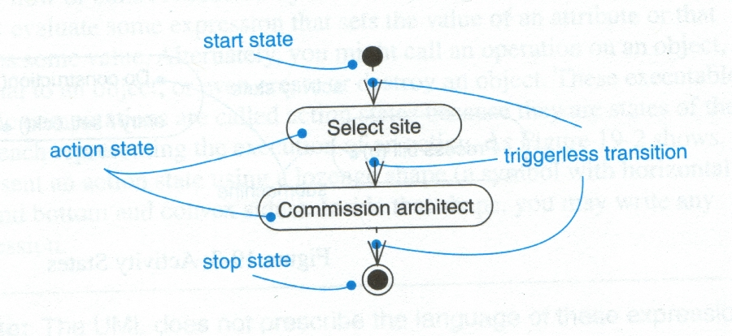
Transitions

Slide 39
Branching
A branch specifies alternate paths taken based on some Boolean expression
A branch may have one incoming transition and two or more outgoing ones

Slide 40
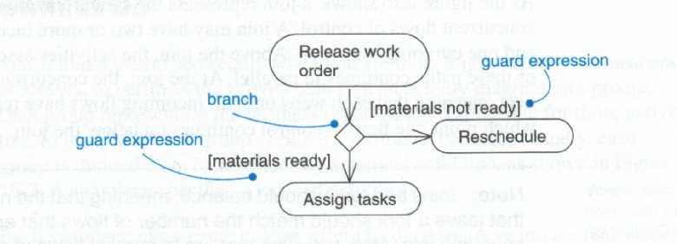
Branching

Slide 41
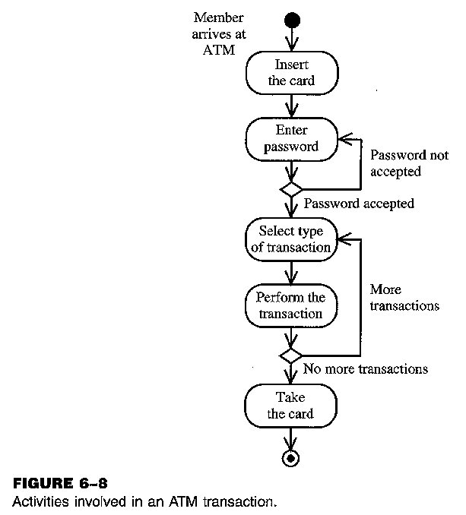
Example of Activity Diagram

Slide 42
Forking and Joining
Use a synchronization bar to specify the forking and joining of parallel flows of control
A synchronization bar is rendered as a thick horizontal or vertical line

Slide 43
Fork
A fork may have one incoming transitions and two or more outgoing transitions
  each transition represents an independent flow of control
  conceptually, the activities of each of outgoing transitions are concurrent
    either truly concurrent (multiple nodes)
    or sequential yet interleaved (one node)

Slide 44
Join
A join may have two or more incoming transitions and one outgoing transition
  above the join, the activities associated with each of these paths continues in parallel
  at the join, the concurrent flows synchronize
    each waits until all incoming flows have reached the join, at which point one flow of control continues on below the join

Slide 45
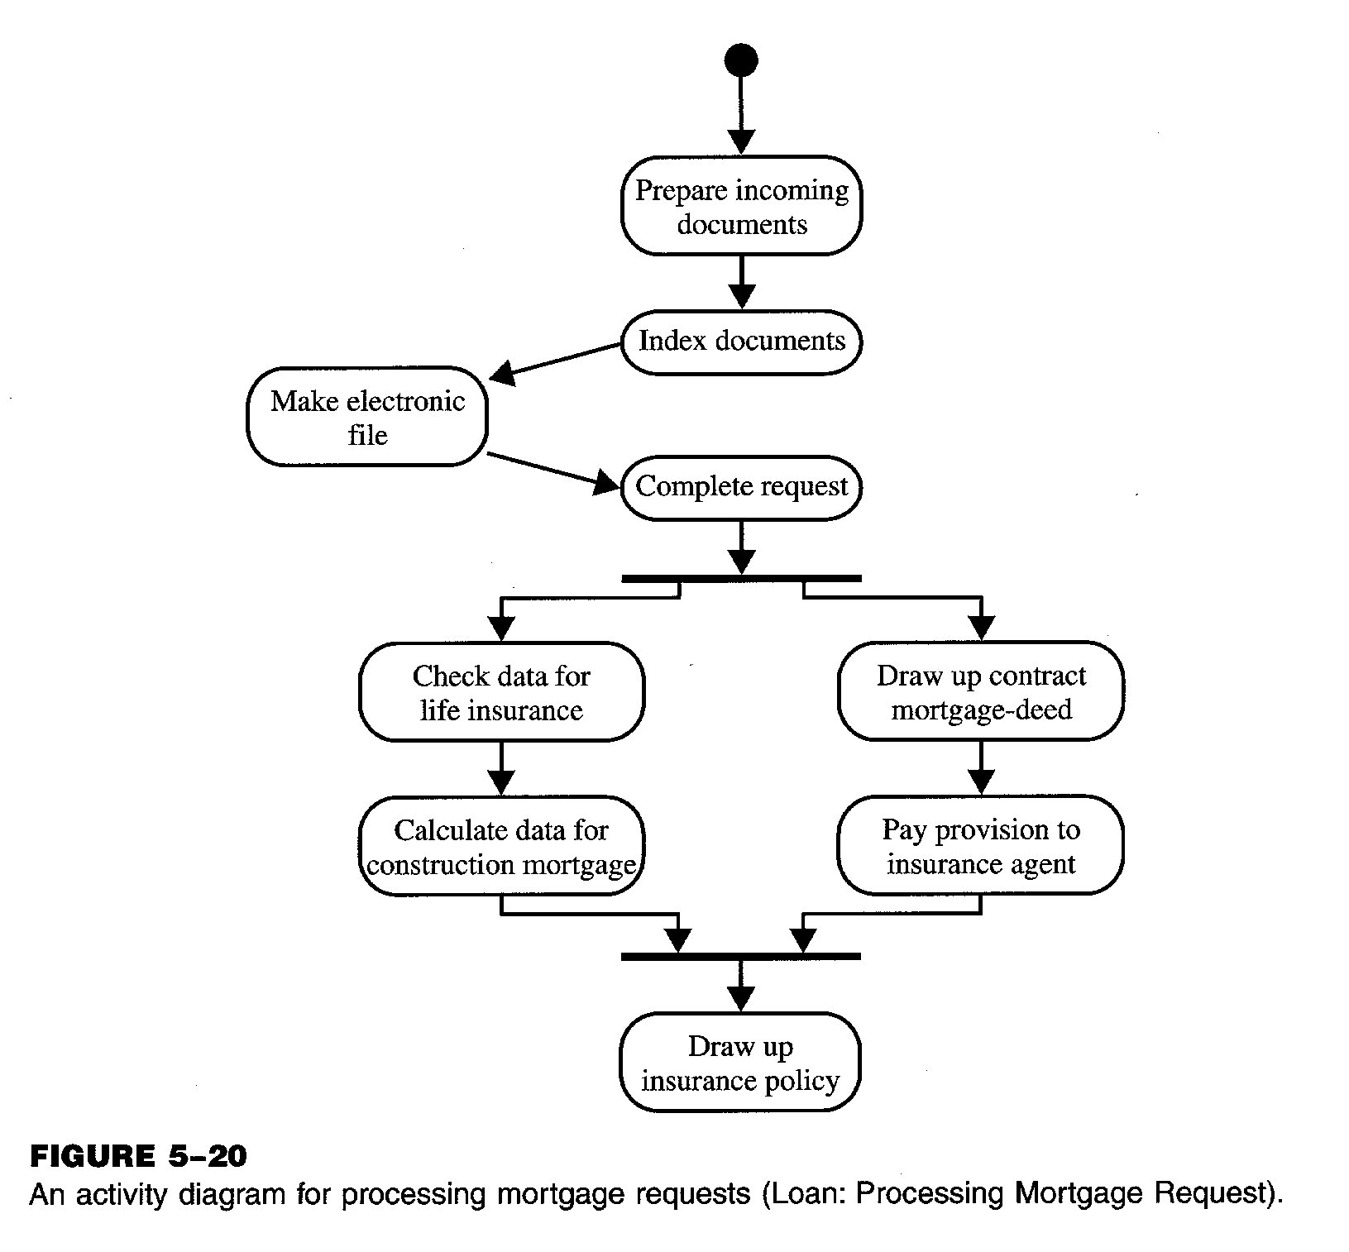
Example of Activity Diagram

Slide 46
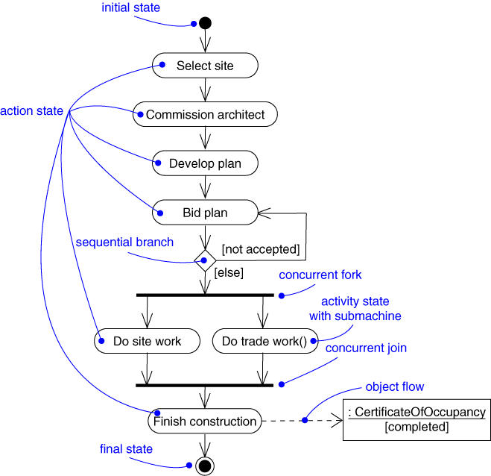
Example of an Activity Diagram

Slide 47
Swimlanes
A swimlane specifies a locus of activities
To partition the activity states on an activity diagram into groups
  each group representing the business organization responsible for those activities
  each group is called a swimlane
Each swimlane is divided from its neighbor by a vertical solid line

Slide 48
Swimlanes
Each swimlane has a name unique within its diagram
Each swimlane may represent some real-world entity
Each swimlane may be implemented by one or more classes
Every activity belongs to exactly one swimlane, but transitions may cross lanes

Slide 49
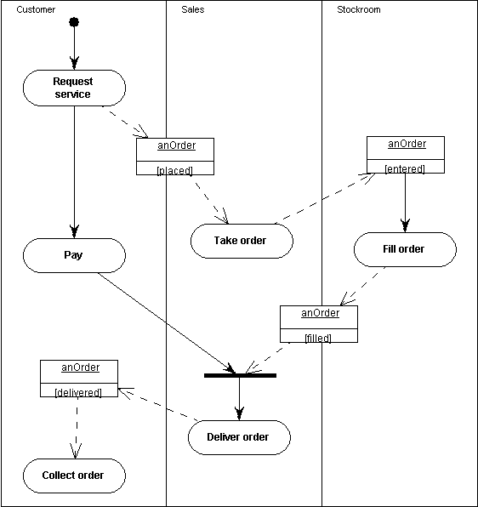
Example of Activity Diagram

Slide 50
Example: Shopping
Member
Till staff
Warehouse staff
Fill in form
Process order
[Order cancelled]
[order ok]
Process
payment
Items picked
Collection
slip printed
Sent for collection
Collect
items

Slide 51
Example: Shopping
Process order
Item entered
into computer
[not in
stock]
Remove item
[in stock]
[more items]
[all items processsed]

Slide 52
Reference
Gerald Kotonya and Ian Sommerville, REQUIREMENTS Engineering PROCESSES AND TECHNIQUES by Wiley Publishers
Activity Diagrams by Keng Siau, University of Nebraska-Lincoln

