Slide 1

Lecture 22
COMSATS Islamabad
Enterprise
Systems
Development
( CSC447)
Muhammad Usman, Assistant Professor

Slide 2
Reusable components
The development cost of reusable components may be higher than the cost of specific equivalents. This extra reusability enhancement cost should be an organization rather than a project cost.
Generic components may be less space-efficient and may have longer execution times than their specific equivalents.

Slide 3
Component management
Component management involves deciding how to classify the component so that it can be discovered, making the component available either in a repository or as a service, maintaining information about the use of the component and keeping track of different component versions.
A company with a reuse program may carry out some form of component certification before the component is made available for reuse.
  Certification means that someone apart from the developer checks the quality of the component.

Slide 4
CBSE with reuse
CBSE with reuse process has to find and integrate reusable components.
When reusing components, it is essential to make trade-offs between ideal requirements and the services actually provided by available components.
This involves:
  Developing outline requirements;
  Searching for components then modifying requirements according to available functionality.
  Searching again to find if there are better components that meet the revised requirements.
  Composing components to create the system.

Slide 5
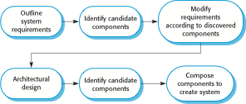
CBSE with reuse

Slide 6

The component identification process

Slide 7
Component identification issues
Trust. You need to be able to trust the supplier of a component. At best, an untrusted component may not operate as advertised; at worst, it can breach your security.
Requirements. Different groups of components will satisfy different requirements.
Validation.
  The component specification may not be detailed enough to allow comprehensive tests to be developed.
  Components may have unwanted functionality. How can you test this will not interfere with your application?

Slide 8
Component validation
Component validation involves developing a set of test cases for a component (or, possibly, extending test cases supplied with that component) and developing a test harness to run component tests.
  The major problem with component validation is that the component specification may not be sufficiently detailed to allow you to develop a complete set of component tests.
As well as testing that a component for reuse does what you require, you may also have to check that the component does not include any malicious code or functionality that you don’t need.

Slide 9
Ariane launcher failure – validation failure?
In 1996, the 1st test flight of the Ariane 5 rocket ended in disaster when the launcher went out of control 37 seconds after take off.
The problem was due to a reused component from a previous version of the launcher (the Inertial Navigation System) that failed because assumptions made when that component was developed did not hold for Ariane 5.
The functionality that failed in this component was not required in Ariane 5.

Slide 10
Component composition
The process of assembling components to create a system.
Composition involves integrating components with each other and with the component infrastructure.
Normally you have to write ‘glue code’ to integrate components.

Slide 11
Types of composition
Sequential composition where the composed components are executed in sequence. This involves composing the provides interfaces of each component.
Hierarchical composition where one component calls on the services of another. The provides interface of one component is composed with the requires interface of another.
Additive composition where the interfaces of two components are put together to create a new component. Provides and requires interfaces of integrated component is a combination of interfaces of constituent components.

Slide 12
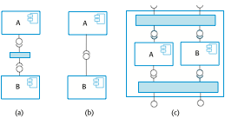
Types of component composition

Slide 13
Interface incompatibility
Parameter incompatibility where operations have the same name but are of different types.
Operation incompatibility where the names of operations in the composed interfaces are different.
Operation incompleteness where the provides interface of one component is a subset of the requires interface of another.

Slide 14
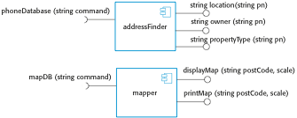
Components with incompatible interfaces

Slide 15
Adaptor components
Address the problem of component incompatibility by reconciling the interfaces of the components that are composed.
Different types of adaptor are required depending on the type of composition.
An addressFinder and a mapper component may be composed through an adaptor that strips the postal code from an address and passes this to the mapper component.

Slide 16
Composition through an adaptor
The component postCodeStripper is the adaptor that facilitates the sequential composition of addressFinder and mapper components.

Slide 17

An adaptor linking a data collector and a sensor

Slide 18

Photo library composition

Slide 19
Interface semantics
You have to rely on component documentation to decide if interfaces that are syntactically compatible are actually compatible.
Consider an interface for a PhotoLibrary component:

Slide 20
Photo Library documentation
“This method adds a photograph to the library and associates the photograph identifier and catalogue descriptor with the photograph.”
“what happens if the photograph identifier is already associated with a photograph in the library?”
“is the photograph descriptor associated with the catalogue entry as well as the photograph i.e. if I delete the photograph, do I also delete the catalogue information?”

Slide 21
The Object Constraint Language
The Object Constraint Language (OCL) has been designed to define constraints that are associated with UML models.
It is based around the notion of pre and post condition specification – common to many formal methods.

Slide 22
The OCL description of the Photo Library interface
-- The context keyword names the component to which the conditions apply
context addItem
-- The preconditions specify what must be true before execution of addItem
pre: PhotoLibrary.libSize() > 0
PhotoLibrary.retrieve(pid) = null
-- The postconditions specify what is true after execution
post:libSize () = libSize()@pre + 1
PhotoLibrary.retrieve(pid) = p
PhotoLibrary.catEntry(pid) = photodesc
context delete
pre: PhotoLibrary.retrieve(pid) <> null ;
post: PhotoLibrary.retrieve(pid) = null
PhotoLibrary.catEntry(pid) = PhotoLibrary.catEntry(pid)@pre
PhotoLibrary.libSize() = libSize()@pre—1

Slide 23
Photo library conditions
As specified, the OCL associated with the Photo Library component states that:
  There must not be a photograph in the library with the same identifier as the photograph to be entered;
  The library must exist - assume that creating a library adds a single item to it;
  Each new entry increases the size of the library by 1;
  If you retrieve using the same identifier then you get back the photo that you added;
  If you look up the catalogue using that identifier, then you get back the catalogue entry that you made.

Slide 24
Composition trade-offs
When composing components, you may find conflicts between functional and non-functional requirements, and conflicts between the need for rapid delivery and system evolution.
You need to make decisions such as:
  What composition of components is effective for delivering the functional requirements?
  What composition of components allows for future change?
  What will be the emergent properties of the composed system?

Slide 25
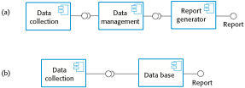
Data collection and report generation components

Slide 26
Interfaces
Components

Slide 27
Abstract Classes
When we define a class to be “final”, it cannot be extended. In certain situation, we want to properties of classes to be always extended and used. Such classes are called Abstract Classes.
An Abstract class is a conceptual class.
An Abstract class cannot be instantiated – objects cannot be created.
Abstract classes provides a common root for a group of classes, nicely tied together in a package:

Slide 28
Abstract Class Syntax
abstract class ClassName
{
    ...
    …
    abstract Type MethodName1();
    …
    …
    Type Method2()
    {
    // method body
    }
}
When a class contains one or more abstract methods, it should be declared as abstract class.
The abstract methods of an abstract class must be defined in its subclass.
We cannot declare abstract constructors or abstract static methods.

Slide 29
Abstract Class -Example
Shape is an abstract class.
Shape
Circle
Rectangle

Slide 30
The Shape Abstract Class
public abstract class Shape {
public abstract double area();
public void move() { // non-abstract method
// implementation
}
}
Is the following statement valid?
  Shape s = new Shape();
No. It is illegal because the Shape class is an abstract class, which cannot be instantiated to create its objects.

Slide 31
Abstract Classes
public Circle extends Shape {
protected double r;
protected static final double PI =3.1415926535;
public Circle() { r = 1.0; )
public double area() { return PI * r * r; }
…
}
public Rectangle extends Shape {
protected double w, h;
public Rectangle() { w = 0.0; h=0.0; }
public double area() { return w * h; }
}

Slide 32
Abstract Classes Properties
A class with one or more abstract methods is automatically abstract and it cannot be instantiated.
A class declared abstract, even with no abstract methods can not be instantiated.
A subclass of an abstract class can be instantiated if it overrides all abstract methods by implementation them.
A subclass that does not implement all of the superclass abstract methods is itself abstract; and it cannot be instantiated.

Slide 33
Abstract Classes
If you do not want (properties of) your class to be extended or inherited by other classes, define it as a final class.
  Java supports this is through the keyword “final”.
  This is applied to classes.
You can also apply the final to only methods if you do not want anyone to override them.
If you want your class (properties/methods) to be extended by all those who want to use, then define it as an abstract class or define one or more of its methods as abstract methods.
  Java supports this is through the keyword “abstract”.
  This is applied to methods only.
  Subclasses should implement abstract methods; otherwise, they cannot be instantiated.

Slide 34
Interfaces
Design Abstraction and a way for loosing realizing Multiple Inheritance

Slide 35
Interfaces
Interface is a conceptual entity similar to a Abstract class.
Can contain only constants (final variables) and abstract method (no implementation) - Different from Abstract classes.
Use when a number of classes share a common interface.
Each class should implement the interface.

Slide 36
Interfaces: An informal way of realizing multiple inheritance
An interface is basically a kind of class—it contains methods and variables, but they have to be only abstract classes and final fields/variables.
Therefore, it is the responsibility of the class that implements an interface to supply the code for methods.
A class can implement any number of interfaces, but cannot extend more than one class at a time.
Therefore, interfaces are considered as an informal way of realising multiple inheritance in Java.

Slide 37
Interface - Example
<<Interface>>
Speaker
speak()
Politician
Priest
Lecturer
speak()
speak()
speak()

Slide 38
Interfaces Definition
Syntax (appears like abstract class):
Example:
interface InterfaceName {
// Constant/Final Variable Declaration
// Methods Declaration – only method body
}
interface Speaker {
public void speak( );
}

Slide 39
Implementing Interfaces
Interfaces are used like super-classes who properties are inherited by classes. This is achieved by creating a class that implements the given interface as follows:
class ClassName implements InterfaceName [, InterfaceName2, …]
{
// Body of Class
}

Slide 40
Implementing Interfaces Example
class Politician implements Speaker {
public void speak(){
System.out.println(“Talk politics”);
}
}
class Priest implements Speaker {
public void speak(){
System.out.println(“Religious Talks”);
}
}
class Lecturer implements Speaker {
public void speak(){
System.out.println(“Talks Object Oriented Design and Programming!”);
}
}

Slide 41
Extending Interfaces
Like classes, interfaces can also be extended. The new sub-interface will inherit all the members of the superinterface in the manner similar to classes. This is achieved by using the keyword extends as follows:
interface InterfaceName2 extends InterfaceName1 {
// Body of InterfaceName2
}

Slide 42
Inheritance and Interface Implementation
A general form of interface implementation:
This shows a class can extended another class while implementing one or more interfaces. It appears like a multiple inheritance (if we consider interfaces as special kind of classes with certain restrictions or special features).
class ClassName extends SuperClass implements InterfaceName [, InterfaceName2, …]
{
// Body of Class
}

Slide 43
Student Assessment Example
Consider a university where students who participate in the national games or Olympics are given some grace marks. Therefore, the final marks awarded = Exam_Marks + Sports_Grace_Marks. A class diagram representing this scenario is as follow:
Student
Sports
extends
Exam
implements
extends
Results

Slide 44
Software Implementation
class Student
{
// student no and access methods
}
interface Sport
{
// sports grace marks (say 5 marks) and abstract methods
}
class Exam extends Student
{
// example marks (test1 and test 2 marks) and access methods
}
class Results extends Exam implements Sport
{
// implementation of abstract methods of Sport interface
// other methods to compute total marks = test1+test2+sports_grace_marks;
// other display or final results access methods
}

Slide 45
Interfaces and Software Engineering
Interfaces, like abstract classes and methods, provide templates of behaviour that other classes are expected to implement.
Separates out a design hierarchy from implementation hierarchy. This allows software designers to enforce/pass common/standard syntax for programmers implementing different classes.
Pass method descriptions, not implementation
Java allows for inheritance from only a single superclass. Interfaces allow for class mixing.
Classes implement interfaces.

Slide 46
Components

Slide 47
IC analogy
Software components should be like integrated circuits (ICs)
  Or plumbing components?
Why? What are our desires for software components?
Bertrand Meyer, in Object Oriented Software Construction:
modular (IC chips, disk drivers, are self-contained: packaged code)
a) compatible (chips or boards that plug in easily, simple interfaces)
b) reusable (same processor IC can serve various purposes)
c) extendible (IC technology can be improved: inheritance)
reliable (an IC works most of the time!)
a) correct (it does what it's supposed to, according to specification)
b) robust (it functions in abnormal conditions)
efficient (ICs are getting faster and faster!)
inexpensive (ICs prices are falling
portable (ease of transferring to different platforms)
timely (released when or before users want it)
What do you think: will any software paradigm answer all our wishes?

Slide 48
Definition of Software Components
“A software component is a unit of composition with contractually specified interfaces and explicit context dependencies only. A software component can be deployed independently and is subject to composition by third parties.”
Unit of composition – combine components to build systems
Binary units – black boxes, not source code
Contractually specified interfaces – mechanism for interface definition, such as Interface Definition Language
Independent production – separation of concerns
Deployed and composed by third parties – reusable units assembled like parts supplied by manufacturers

Slide 49
Why a component based approach?
Consider two ends of a spectrum:
  Comm. off the shelf < --- > Custom-made
  What advantages of COTS software could components offer to custom-made?
Advantages:
  Cost efficiency & flexibility
  Reuse, productivity
  Scalability
  Application of engineering techniques

Slide 50
Costs of components
It takes significant effort to create a software component that is effectively reusable. How so?
The component needs:
  to be fully documented;
  more thorough testing;
  robust input validity checking;
  to pass back useful error messages as appropriate;
  to be built with an awareness that it will be put to unforeseen uses
  a mechanism for compensating developers who invest the (substantial) effort implied above.

Slide 51
Distributed Component Technologies
The goal:
Integration of services for applications on various platforms
Interoperability: let disparate systems communicate
and share data seamlessly
Approaches:
- Microsoft: DDE, COM, OLE, OCX, DCOM and ActiveX
- Sun: JavaBeans, Enterprise JavaBeans, J2EE
- CORBA (Common Object Request Broker Architecture)
- SOAP (using XML)

Slide 52
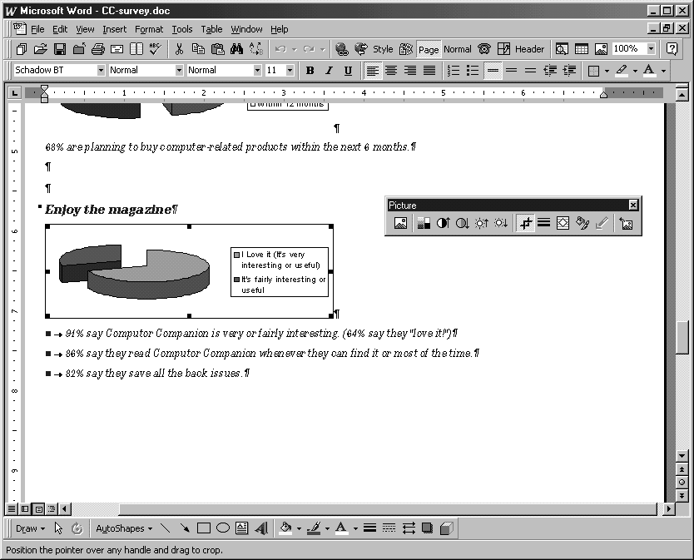
Example from Microsoft environment (80’s)
Excel-generated pie chart embedded in a Word document displayed in a PowerPoint presentation
Different applications need to share data or procedures

Slide 53
DDE (Dynamic Data Exchange)
A little history: starting with evolution of Microsoft approach:
  Windows gave PCs a more accessible computing environment
  Problem: lack of consistency between different programs
  What if spreadsheet and word processor need to share data?
Early solution was integrating suites into large programs:
  e.g., Microsoft Works – Pros and cons of suite approach?
Microsoft comes out with Dynamic Data Exchange (DDE), circa 1989
  Lets different Windows programs share data through links
  Suppose some spreadsheet data were linked into word processor
  When you changed data in spreadsheet, the new data would appear in word processor
  Limitation: you couldn’t update the data in the word processor; you had to invoke the spreadsheet to update the date there
  Worse, links were fragile and would break if you moved data files around in file system

Slide 54

OLE (circa 1991)
Object Linking and Embedding
  Linking is essentially DDE, using reference semantics
  Embedding lets users copy a snapshot of data into word processor and save it there
  Linking is cheaper when data files are large
  Embedding supports compound documents (“document-centric” computing)
A way for Windows to create documents containing objects from other programs.
  E.g. place a chart from Excel and a slide from PowerPoint into
  a Word document
  Components containers can be re-used by many applications
  But components do not make data independent of application programs, and OLE is a platform-specific solution.

Slide 55
OLE Technology (circa 1993)
A set of APIs to create and display a (compound) document
  Now possible to share code as well as data
Component Object Model (COM)
  COM protocols let components connect to origination program:
  E.g. word processor can tell spreadsheet, “the user just clicked on the spreadsheet, so start yourself up, look for data here, and let me know when you’re done.”
COM now includes OLE as part of a larger concept
  OLE becomes a set of standard COM interfaces
Embedded documents retain all their original properties
  If the user decides to edit the embedded data, Windows activates the originating application and loads the embedded document

Slide 56
OLE Extensions (OCX)
With Windows 95 came a new standard:
  OCX (OLE Custom eXtension component)
  A piece of code, smaller than application program, but with its own user interface
  Let users bundle OCX controls to form customized applications
  E.g., combine spell checker and synonym provider component to make a new program
  Is this beginning to sound like object-oriented programming?

Slide 57
ActiveX (circa 1996)
Microsoft retools OLE and COM as ActiveX
  ActiveX applies to a whole set of COM-based technologies
ActiveX control is Microsoft 's answer to the Java technology from
  An ActiveX control is roughly equivalent to a applet, but is known as an ActiveX control
Writing a program to run in the ActiveX environment creates a self-sufficient program that can run anywhere in ActiveX network
This component is known as an ActiveX control, and is often used to attach a program to a web page

Slide 58
ActiveX - implementation
An ActiveX control can be created using one of several languages
or development tools, including C++ and Visual Basic,
or with scripting tools such as VBScript.
Network OLE for rudimentary support of distributed applications
ActiveX controls originally were Windows only
  Other vendors later provided Mac and Unix/Linux support for ActiveX
Security issues: ActiveX controls have full file access (no sandbox)
  Can be signed for authentication
  Are signed controls secure enough?

