Slide 1

Lecture 21
COMSATS Islamabad
Enterprise
Systems
Development
( CSC447)
Muhammad Usman, Assistant Professor

Slide 2
Common Process Problems
Settling for Less
Do these statements sound familiar? If they do, your organization may be settling for less than it is capable of and may be a good candidate for process improvement.
“I'd rather have it wrong than have it late. We can always fix it later.”
“The bottom line is schedule. My promotions and raises
are based on meeting schedule first and foremost.”

Slide 3
Process Improvement Basics
The Process Management Premise
The quality of a system is highly influenced by the quality of the process used to acquire, develop, and maintain it.
This premise implies a focus on processes as well as on products.
• This is a long-established premise in manufacturing (and is based on TQM principles as taught by Shewhart,
Juran, Deming, and Humphrey).
• Belief in this premise is visible worldwide in quality movements in manufacturing and service industries
(e.g., ISO standards).

Slide 4
Process Improvement Basics (Cont.)
The Role of Process
Everyone realizes the importance of having a motivated, quality work force and the latest technology, but even the finest people can’t perform at their best when the process is not understood or operating at its best.
PEOPLE
PROCESS
TECHNOLOGY

Slide 5
Process Improvement Basics (Cont.)
Common Misconceptions
I don’t need process, I have
• really good people
• advanced technology
• an experienced manager
Process
• interferes with creativity
• equals bureaucracy + regimentation
• isn’t needed when building prototypes
• is only useful on large projects
• hinders agility in fast-moving markets
• costs too much

Slide 6
Capability Maturity Model® Integration (CMMI®)
Capability Maturity Modeling, CMM, and CMMI are registered in the U.S. Patent and
Trademark Office by Carnegie Mellon University.

Slide 7
What Is a CMM?
A Capability Maturity Model (CMM) is a reference model of mature practices in a specified discipline, used to improve
and appraise a group’s capability to perform that discipline.
CMMs differ by
• discipline (e.g., software engineering, systems engineering)
• structure (e.g., staged, continuous)
• definition of maturity (i.e., process improvement path)

Slide 8
Multiple Process Models
Software CMM
Systems Security Engr CMM
Systems Engr CMM
People CMM
IPD CMM
Software Acq CMM
EEIIAA 773311
ISO 15504

Slide 9
Understanding CMMI Representations
There are two types of representations in the CMMI
models:
• staged
• continuous
A representation allows an organization to pursue different
improvement paths.
The organization and presentation of the data are different in each representation. However, the content is the same.

Slide 10
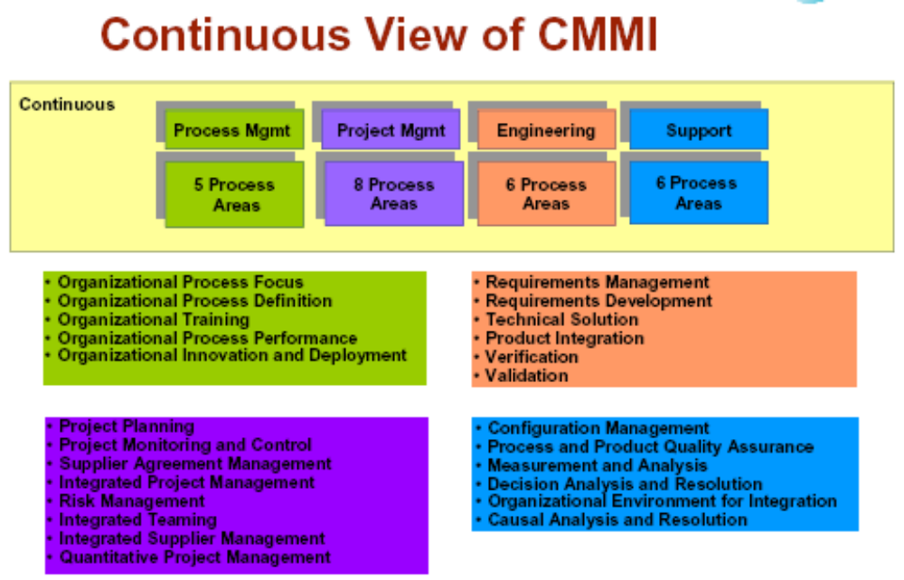

Slide 11
Capability Levels
A capability level is a well-defined evolutionary plateau describing the organization’s capability relative to a particular process area.
There are six capability levels.
Each level is a layer in the foundation for continuous process improvement.
Thus, capability levels are cumulative (i.e., a higher capability level includes the attributes of the lower levels).

Slide 12
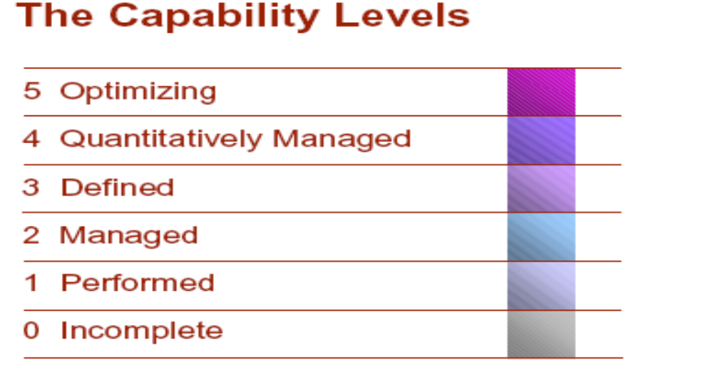

Slide 13
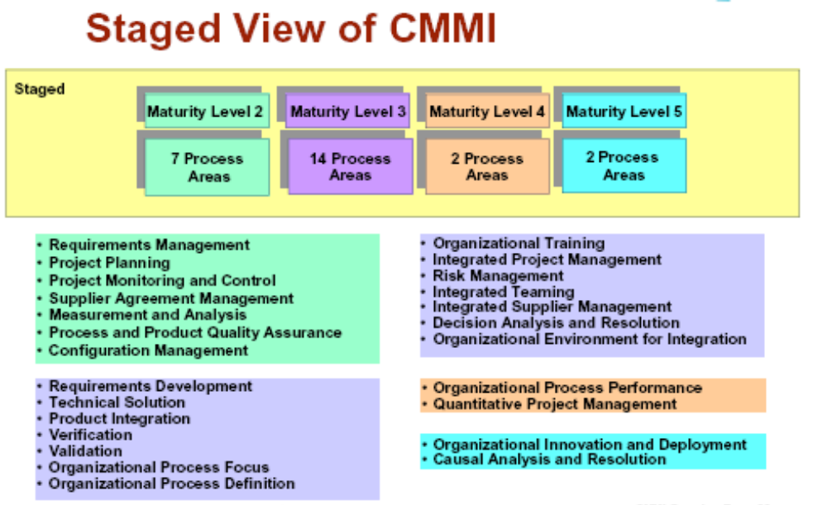

Slide 14
  The CMM Maturity Levels
High
5
Process Performance
Process Capability
4
Process Maturity
3
Low
2
1

Slide 15
The Five Levels of Software Process Maturity
Continuously Improving Process
5.Optimizing
Focus on process improvement
4. Managed
Predictable Process
Managing Change
Process measured and controlled
Standard, Consistent Process
3. Defined
Product and Process Quality
Process characterized, fairly well understood
Disciplined Process
2. Repeatable
Integrated Engineering Process
Can repeat previously mastered tasks
1. Initial
Project Management
Unpredictable and poorly controlled

Slide 16
A Foundation, Not a Destination
The optimizing level (Level 5) is not the destination of process management.
The destination is better products for a better price: economic survival
The optimizing level is a foundation for building an ever-improving capability.

Slide 17
Component-based software engineering

Slide 18
Component-based development
Component-based software engineering (CBSE) is an approach to software development that relies on the reuse of entities called ‘software components’.
It emerged from the failure of object-oriented development to support effective reuse. Single object classes are too detailed and specific.
Components are more abstract than object classes and can be considered to be stand-alone service providers. They can exist as stand-alone entities.

Slide 19
CBSE essentials
Independent components specified by their interfaces.
Component standards to facilitate component integration.
Middleware that provides support for component inter-operability.
A development process that is geared to reuse.

Slide 20
CBSE and design principles
Apart from the benefits of reuse, CBSE is based on sound software engineering design principles:
  Components are independent so do not interfere with each other;
  Component implementations are hidden;
  Communication is through well-defined interfaces;
  Component platforms are shared and reduce development costs.

Slide 21
Component standards
Standards need to be established so that components can communicate with each other and inter-operate.
Unfortunately, several competing component standards were established:
  Sun’s Enterprise Java Beans
  Microsoft’s COM and .NET
  CORBA’s CCM
In practice, these multiple standards have hindered the uptake of CBSE. It is impossible for components developed using different approaches to work together.

Slide 22
CBSE problems
Component trustworthiness - how can a component with no available source code be trusted?
Component certification - who will certify the quality of components?
Emergent property prediction - how can the emergent properties of component compositions be predicted?
Requirements trade-offs - how do we do trade-off analysis between the features of one component and another?

Slide 23
Components
Components provide a service without regard to where the component is executing or its programming language
  A component is an independent executable entity that can be made up of one or more executable objects
  The component interface is published and all interactions are through the published interface;

Slide 24
Component definitions
Councill and Heinmann:
  A software component is a software element that conforms to a component model and can be independently deployed and composed without modification according to a composition standard.
Szyperski:
  A software component is a unit of composition with contractually specified interfaces and explicit context dependencies only. A software component can be deployed independently and is subject to composition by third-parties.

Slide 25
Component characteristics
Component characteristic | Description
Standardized | Component standardization means that a component used in a CBSE process has to conform to a standard component model. This model may define component interfaces, component metadata, documentation, composition, and deployment.
Independent | A component should be independent—it should be possible to compose and deploy it without having to use other specific components. In situations where the component needs externally provided services, these should be explicitly set out in a ‘requires’ interface specification.
Composable | For a component to be composable, all external interactions must take place through publicly defined interfaces. In addition, it must provide external access to information about itself, such as its methods and attributes.

Slide 26
Component characteristics
Component characteristic | Description
Deployable | To be deployable, a component has to be self-contained. It must be able to operate as a stand-alone entity on a component platform that provides an implementation of the component model. This usually means that the component is binary and does not have to be compiled before it is deployed. If a component is implemented as a service, it does not have to be deployed by a user of a component. Rather, it is deployed by the service provider.
Documented | Components have to be fully documented so that potential users can decide whether or not the components meet their needs. The syntax and, ideally, the semantics of all component interfaces should be specified.

Slide 27
Component as a service provider
The component is an independent, executable entity. It does not have to be compiled before it is used with other components.
The services offered by a component are made available through an interface and all component interactions take place through that interface.
The component interface is expressed in terms of parameterized operations and its internal state is never exposed.

Slide 28
Component interfaces
Provides interface
  Defines the services that are provided by the component to other components.
  This interface, essentially, is the component API. It defines the methods that can be called by a user of the component.
Requires interface
  Defines the services that specifies what services must be made available for the component to execute as specified.
  This does not compromise the independence or deployability of a component because the ‘requires’ interface does not define how these services should be provided.

Slide 29

Component interfaces
Note UML notation. Ball and sockets can fit together.

Slide 30
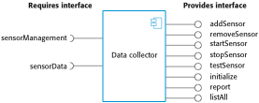
A model of a data collector component

Slide 31
Component models
A component model is a definition of standards for component implementation, documentation and deployment.
Examples of component models
  EJB model (Enterprise Java Beans)
  COM+ model (.NET model)
  Corba Component Model
The component model specifies how interfaces should be defined and the elements that should be included in an interface definition.

Slide 32
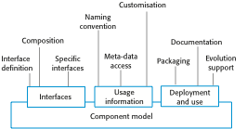
Basic elements of a component model

Slide 33
Elements of a component model
Interfaces
  Components are defined by specifying their interfaces. The component model specifies how the interfaces should be defined and the elements, such as operation names, parameters and exceptions, which should be included in the interface definition.
Usage
  In order for components to be distributed and accessed remotely, they need to have a unique name or handle associated with them. This has to be globally unique.
Deployment
  The component model includes a specification of how components should be packaged for deployment as independent, executable entities.

Slide 34
Middleware support
Component models are the basis for middleware that provides support for executing components.
Component model implementations provide:
  Platform services that allow components written according to the model to communicate;
  Support services that are application-independent services used by different components.
To use services provided by a model, components are deployed in a container. This is a set of interfaces used to access the service implementations.

Slide 35
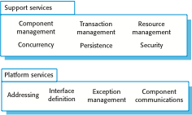
Middleware services defined in a component model

Slide 36
CBSE processes
CBSE processes are software processes that support component-based software engineering.
  They take into account the possibilities of reuse and the different process activities involved in developing and using reusable components.
Development for reuse
  This process is concerned with developing components or services that will be reused in other applications. It usually involves generalizing existing components.
Development with reuse
  This process is the process of developing new applications using existing components and services.

Slide 37
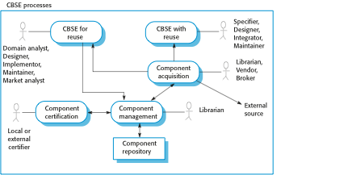
CBSE processes

Slide 38
Supporting processes
Component acquisition is the process of acquiring components for reuse or development into a reusable component.
  It may involve accessing locally- developed components or services or finding these components from an external source.
Component management is concerned with managing a company’s reusable components, ensuring that they are properly catalogued, stored and made available for reuse.
Component certification is the process of checking a component and certifying that it meets its specification.

Slide 39
CBSE for reuse
CBSE for reuse focuses on component development.
Components developed for a specific application usually have to be generalised to make them reusable.
A component is most likely to be reusable if it associated with a stable domain abstraction (business object).
For example, in a hospital stable domain abstractions are associated with the fundamental purpose - nurses, patients, treatments, etc.

Slide 40
Component development for reuse
Components for reuse may be specially constructed by generalising existing components.
Component reusability
  Should reflect stable domain abstractions;
  Should hide state representation;
  Should be as independent as possible;
  Should publish exceptions through the component interface.
There is a trade-off between reusability and usability
  The more general the interface, the greater the reusability but it is then more complex and hence less usable.

Slide 41
Changes for reusability
Remove application-specific methods.
Change names to make them general.
Add methods to broaden coverage.
Make exception handling consistent.
Add a configuration interface for component adaptation.
Integrate required components to reduce dependencies.

Slide 42
Exception handling
Components should not handle exceptions themselves, because each application will have its own requirements for exception handling.
  Rather, the component should define what exceptions can arise and should publish these as part of the interface.
In practice, however, there are two problems with this:
  Publishing all exceptions leads to bloated interfaces that are harder to understand. This may put off potential users of the component.
  The operation of the component may depend on local exception handling, and changing this may have serious implications for the functionality of the component.

Slide 43
Legacy system components
Existing legacy systems that fulfil a useful business function can be re-packaged as components for reuse.
This involves writing a wrapper component that implements provides and requires interfaces then accesses the legacy system.
Although costly, this can be much less expensive than rewriting the legacy system.

Slide 44
Reusable components
The development cost of reusable components may be higher than the cost of specific equivalents. This extra reusability enhancement cost should be an organization rather than a project cost.
Generic components may be less space-efficient and may have longer execution times than their specific equivalents.

Slide 45
Reference
CMMi–Overview -- presentation on Carnegie Mellon Software Engineering Institute site
Kim Caputo’s book on CMM Implementation Guide
Ian Sommerville, Software Engineering

