Slide 1

Lecture 20
COMSATS Islamabad
Enterprise
Systems
Development
( CSC447)
Muhammad Usman, Assistant Professor

Slide 2
Difference in (QA) , (QC) & (Testing) ?
- Prevention process & detective process
QA –those activities which develop / modify processes to prevent introduction of defects
QC –those activities which find & correct the flaws
QA Focus ---- Process-oriented,
Randomly Evaluate the product to confirm if process works,
Ensures if process is defined & right, preventing defect from occurring
e.g. Development of methodologies & standards: Review if requirement being
defined at proper level of detail?
QC Focus ---- Products-oriented ,
Continuous activity & observe if defective,
Focus on finding, detecting & correcting the defects in specific deliverables
e.g. Are defined requirements the right requirements?
Testing ----- The process of executing a system with the intent of finding defects
Note: Process of executing a system includes test planning prior to the execution of the test cases
-Testing is one example of a QC activity, but there are others such as reviews, inspections etc..

Slide 3
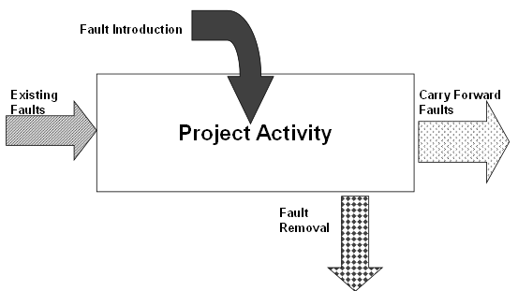
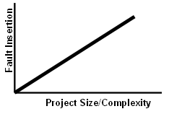
How Faults Happen? Failures Cost?
Saving the Cost…..
Inserting faults is the norm
High reliance on human
communication, Lack of Training
High complexity, Missing Docs
Ignorance of standard, missing reviews, insufficient testing etc. ,
*As the amount of effort increases, the number of faults will increase

Slide 4
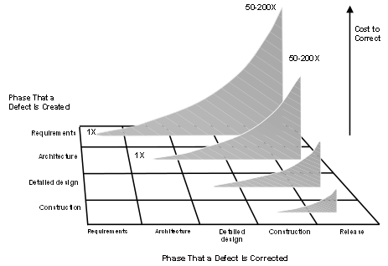
Quality Philosophy, Cost
Quality improvement
cost increases as
we progress in the
software lifecycle ( < = 1 x)
Cost for Fixing of Defects
increases as we progress
in the software
lifecycle (= > [1 x – 200 x])
Difference of ratio? Or by x factor?
That mistakes will be made throughout the project:
Project success depends on positioning the project team to detect mistakes early so that they can correct them quickly and easily (Quality Control)
2. That the way things are built greatly impacts how well they can be built:
Project success depends also on using effective and efficient methods by the
project team (Quality Assurance)

Slide 5
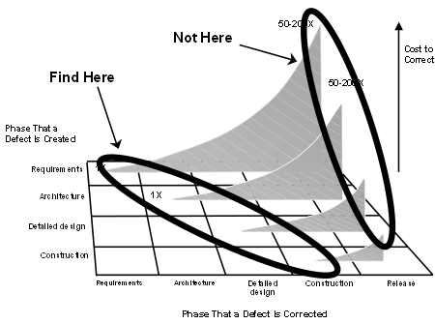
Prevention , Detection & Failures & Cost ?
Prevention
- Quality planning
- Formal process audits
- Training
Detection
- In-process and inter- process review
- Test equipment
Equipment calibration and
maintenance
- Reviews, Testing, etc….
Failure Costs
- Rework
- Repair
- Scrap
- Failure mode analysis
Complaint
resolution
Product return
and replacement
- Help line support Quality Improvement Cost is [ < = 1 x ]
- Warranty work Cost of fixing defect in later phases is [ = > 50 x – 200 ]

Slide 6
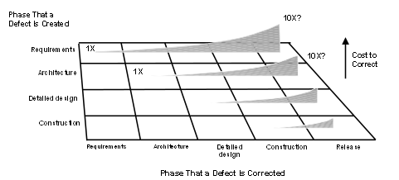
Prevention , Detection & Failures, Cost?
Prevention
- Culture
- Professional development
- Practice toolbox selection
- Checklists & Templates
- Audits
- Quality gates
- Team structure
- Continuous process improvement
Detection
- To get to acceptable defect removal rates requires a combination of techniques
Unit testing, component testing, and system testing cannot remove full defects
Neither effective or efficient!
- Skipping reviews and/or inspections will result in high tail-end costs !

Slide 7
Cost Categorization
Prevention
- Correct Customer Requirements
Adequate Education
Process Designing
- Right Selection of People & Skill
Detection
Reviews
Testing
Incoming Inspection, Failure Analysis
Non-conformance
Rework
Additional Inventory
Additional Support calls COST of correction increases exponentially as time
Contractual Penalties between occurrence of error & detection error increases
Overtime Cost
Lost Business

Slide 8

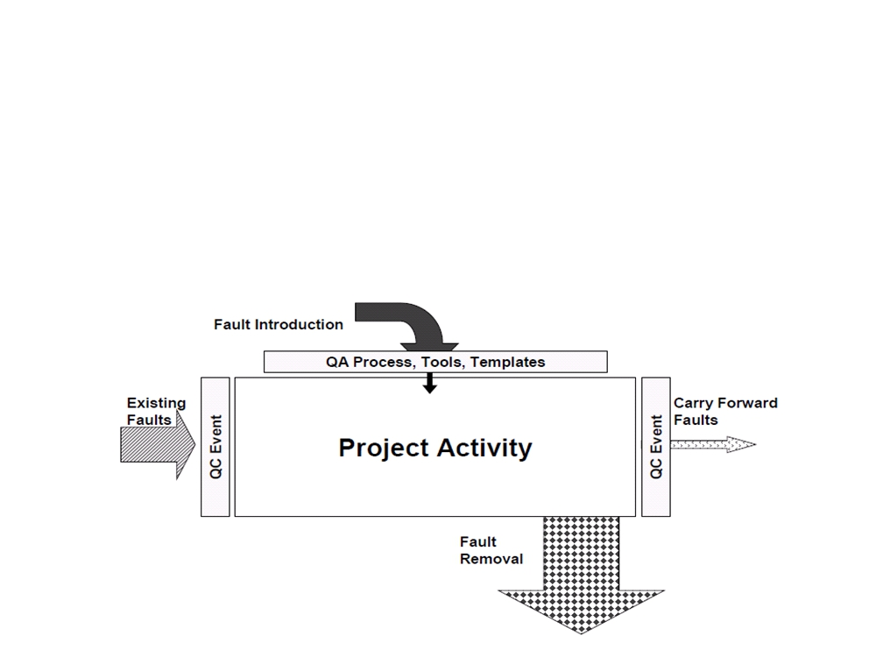
Quality Practices in the Software Lifecycle
SQE Approach: An iterative Process, Pre-QA? QA, Post-QA?
Prevention - Quality Assurance (QA)
  fault prevention through process design and auditing
Detection - Quality Control (QC)
  fault detection through review & testing of artifacts & program

Slide 9
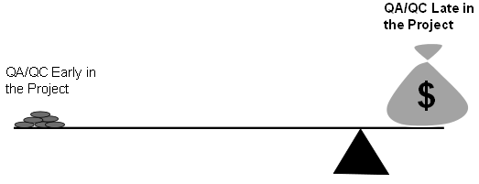
Quality Practices in the Software Lifecycle
Quality Plan?
Quality Assessment?
QA practices
QC practices

Slide 10
Quality Practices in the Software Lifecycle
Recalling the Quality Views
Quality is several attributes (portability, reliability, efficiency, usability,
testability, understandability, modifiability) ...……………. Glass
- Quality is conformance to requirements ………………… Crosby
- Quality is fitness for use …………………………………... Deming
- Quality is value to some person ………………..…...……. Weinberg
- Quality is whatever the customer decides………….……. Ginac
Quality is an attitude or state of mind ……………...…….. Juran
Other Views …….. Garvin
Manufacturing View….Conformance to specification
Value-based View..How much customer is willing to pay
Quality Goals?

Slide 11
Software Quality Engineering Approach
Three Elements of SQE
-Pre-QA activities, in-QA activities, and post-QA activities:
Pre-QA activities: Quality planning.
Software Quality Engineering Process is driven by the Software Quality Plan
These are the activities that should be carried out before carrying out the regular QA activities. two
major types
(a) Set specific quality goals.
(b) Form an overall QA strategy, which includes two sub-activities:
i. Select appropriate QA activities to perform.
ii. Choose appropriate quality measurements and models to provide feedback,
quality assessment and improvement.
2. In-QA activities: Executing planned QA activities and handling discovered defects.
3. Post-QA activities: Quality measurement, assessment and improvement
Primary purpose: is to provide quality assessment and feedback so that various management
decisions can be made and possible quality improvement initiatives can be carried out.

Slide 12
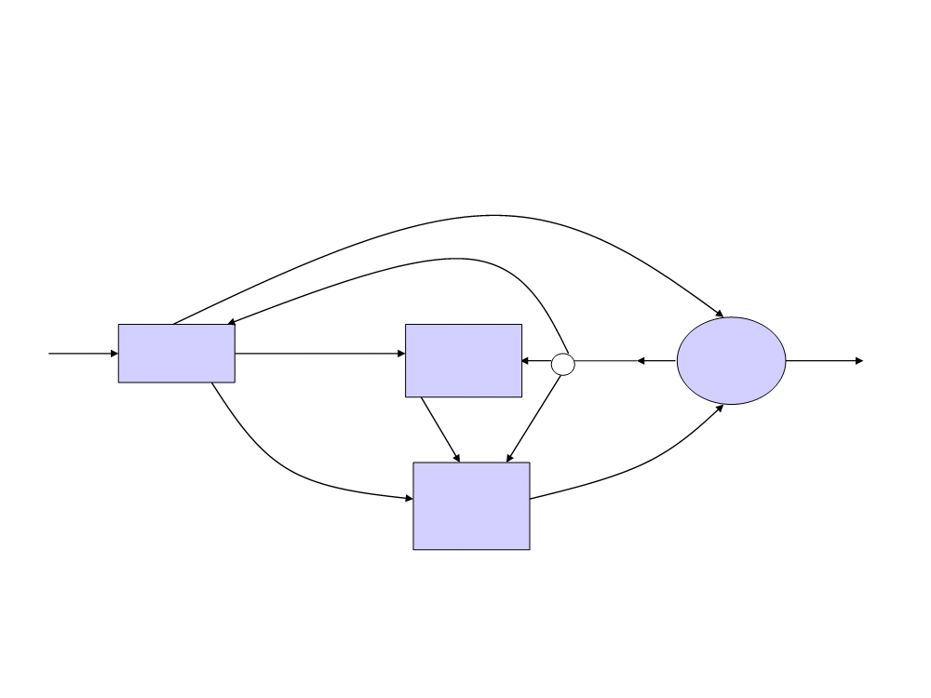
Software Quality Engineering
-Iterative process which combines quality planning, quality assurance,
and control activities.
Set quality goals
Entry
Quality
No
Quality
goals
Exit
Quality
Assurance
Activities
Planning
Selected QA
activities
Yes
satisfied?
Feedback &
adjustments
Measurements
Selected measurements
& models
Quality
Control
Activities
Analysis/
Modeling
results
-Main goal: defect prevention, defect reduction, and defect containment

Slide 13
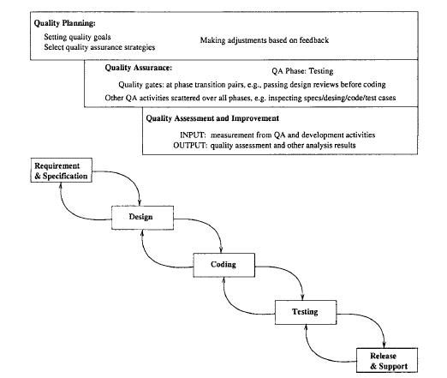
Software Quality Engineering

Slide 14
Software Quality Engineering
-Long-Term Feedback of SQE comes from two process
Comes from quality planning
e.g. if current goals are unachievable them we have to made adjustments
2. Feedback to quality assessment and improvement activities:
e.g. modeling results may be highly unstable, which may well be an indication of the
model inappropriateness. In this case, new or modified models need to be used
Quality improvement process QIP (another model similar to SQE)
van Solingen and Berghout, (1999)
quality improvement was achieved through measurement, analysis, feedback,
and organizational support.
- QIP includes three interconnected steps:
1) understanding (the baseline, all future processes are measured with this baseline)
2) assessing (assessing impact and change)
3) packaging (packing the baseline data and update the process)

Slide 15
McCall's software quality factors model
ISO 9126
Process ISO 9000-4 & Product ISO 9126
Customized Framework

Slide 16
McCall's software quality factors model

Slide 17
Evaluation of Software Quality
Framework
Quality requirements that the software product must meet
Quality factors – Management-oriented attributes of software that contribute to its quality
Quality sub-factors – Decompositions of a quality factor to its technical components
Metrics – quantitative measures of the degree to which given attributes (factors) are present
“Factors” McCall’s & “Characteristics” ISO 9126
- What are Quality requirements? Fertile Research Area…

Slide 18
Example

Slide 19
Example
Quality requirement – “The product will be easy to use”
Quality factor(s) – Usability (An attribute that bear on the effort needed for use and on the assessment of such use by users)
Quality sub-factors – Understandability, ease of learning, operability, communicativeness

Slide 20
Example - Subfactors
Understandability – The amount of effort required to understand software
Ease of learning – The degree to which user effort required to learn how to use the software is minimized
Operability – The degree to which the effort required to perform an operation is minimized
Communicativeness – The degree to which software is designed in accordance with the psychological characteristics of users

Slide 21
Example - Metrics
Understanding
  Learning time: Time for new user to gain basic understanding of features of the software
Ease of learning
  Learning time: Time for new user to learn how to perform basic functions of the software
Operability
  Operation time: Time required for a user to perform operation(s) of the software
Communicativeness
  Human factors: Number of negative comments from new users regarding ergonomics, human factors, etc.

Slide 22
Criteria for the evaluation of Software Quality
McCall's software quality
factors mode
Software quality factors
Product operation factors
Product revision factors
Product transition factors

Slide 23
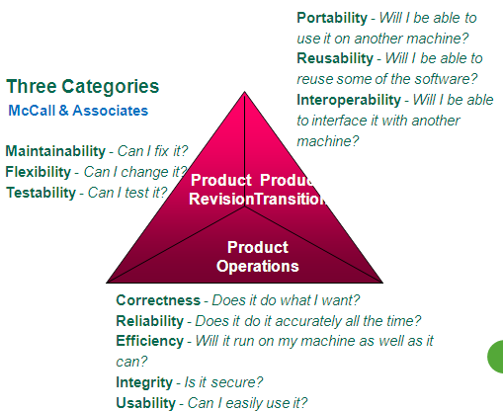
Criteria for the evaluation of Software Quality

Slide 24
Product operation factors
Correctness: extent to which a program fulfills its specification.
Reliability: ability not to fail.
Efficiency: use of resources execution and storage.
Integrity: protection of the program from unauthorized access.
Usability: ease of use of the software.

Slide 25
Product revision factors
Maintainability: effort required to locate and fix a fault in a program.
Flexibility: ease of making changes required by changes in operating environment.
Testability: ease of testing the program to ensure that it is error-free and meets its specification.

Slide 26
Product transition factors
Portability: Effort required to transfer a program from one environment to another system.
Reusability: ease of re-using software in a different context.
Interoperability: effort required to couple a system to another system.

Slide 27
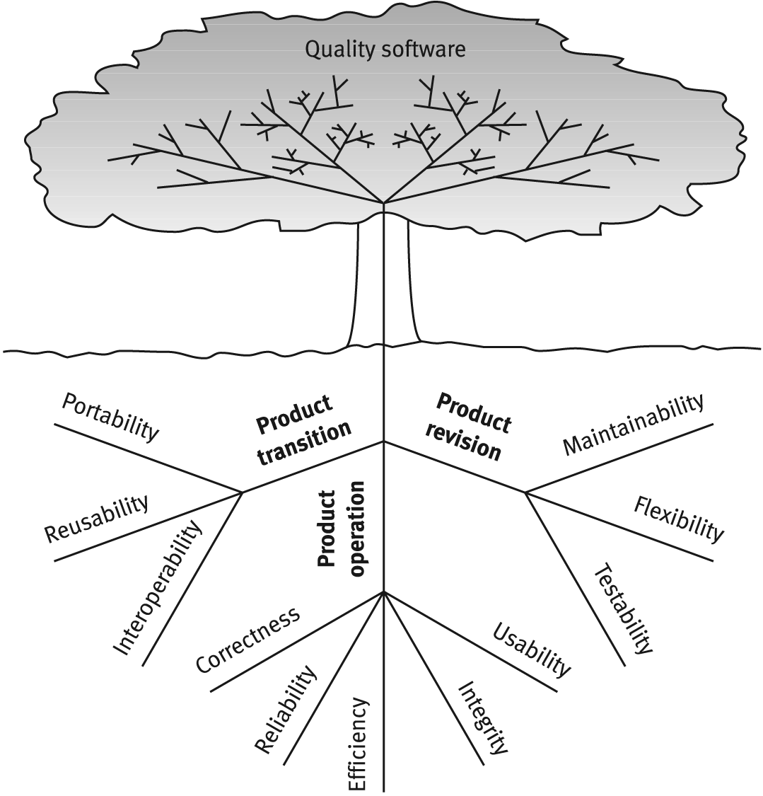
McCall’s Software Quality Model

Slide 28
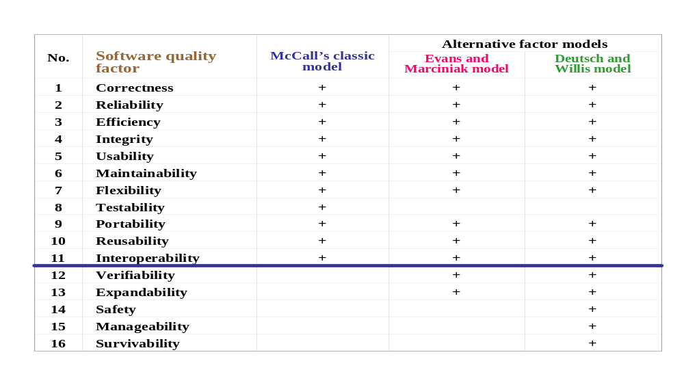
McCall’s Model and Alternative Models

Slide 29
Criteria for evaluation of software quality at NASA
At NASA, the criteria for evaluation of software quality are taken from McCall's software quality factors model.
Selection of criteria is application dependent.
At NASA, Selection of criteria is mission dependent, and environment dependent

Slide 30
Criteria for evaluation of software quality at NASA
Examples:
Flight software that flies on a single mission satellite will not be concerned with portability but may be very concerned with reliability.
A software system that remains on the ground may be concerned with portability and not very concerned by reliability.

Slide 31
Other Software Quality Factors Models
IBM monitors CUPRIMDSO–Capability (Functionality), Usability, Performance, Reliability, Installability, Maintainability, Documentation, Service, & Overall.
HP monitors FURPS–Functionality, Usability, Reliability, Performance & Service.

Slide 32
McCall’s Quality Criteria Subfactors

Slide 33
McCall’s Quality Criteria - Sub factors
A quality criterion is an attribute of quality factor that is related to software development.
McCall and his colleagues have introduced 23 criteria: Modularity, Error Tolerance, Storage efficiency, Simplicity, Machine independence, Data communality, Training, Conciseness, …

Slide 34
Quality criteria
Access audit: Ease with which software and data can be checked for compliance with standards or other requirements.
Access control: Provisions for control and protection of the software and data.
Accuracy: Precision of computations and output.
Communication commonality: Degree to which standard protocols and interfaces are used.
Completeness: Degree to which a full implementation of the required functionalities has been achieved.
Communicativeness: Ease with which inputs and outputs can be assimilated

Slide 35
Quality criteria
Conciseness: Compactness of the source code, in terms of lines of code.
Consistency: Use of uniform design and implementation techniques and notation throughout a project.
Data commonality: Use of standard data representations.
Error tolerance: Degree to which continuity of operation is ensured under adverse conditions.
Execution efficiency: Run time efficiency of the software.
Expandability: Degree to which storage requirements or software functions can be expanded.
Generality: Breadth of the potential application of software components.

Slide 36
Quality criteria
Hardware independence: Degree to which the software is dependent on the underlying hardware.
Instrumentation: Degree to which the software provides for measurement of its use or identification of errors.
Modularity: Provision of highly independent modules.
Operability: Ease of operation of the software.
Self-documentation: Provision of in-line documentation that explains implementation of components.
Simplicity: Ease with which the software can be understood.
Software system independence: Degree to which the software is independent of its software environment—nonstandard language constructs, operating system, libraries, database management system, etc.

Slide 37
Quality criteria
Software efficiency: Run time storage requirements of the software.
Traceability: Ability to link software components to requirements.
Training: Ease with which new users can use the system.

Slide 38
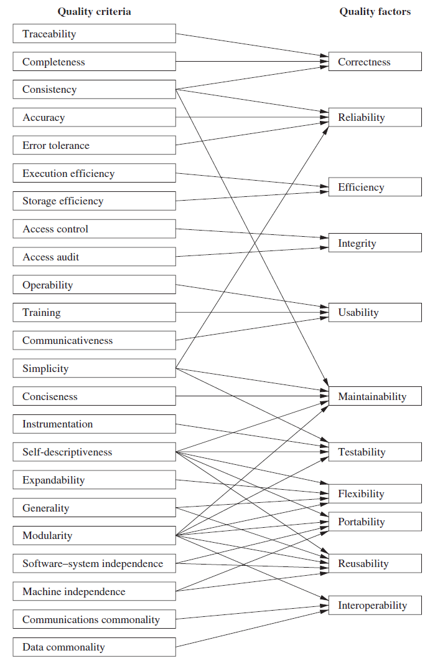
Quality factors and quality criteria

Slide 39
ISO 9126 Model
Other Quality factors models

Slide 40
ISO 9126 Quality Characteristics
“Quality Factors”

Slide 41
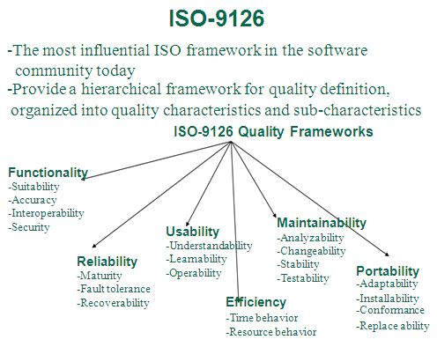
Relation between ISO 9126 characteristics and sub characteristics

Slide 42
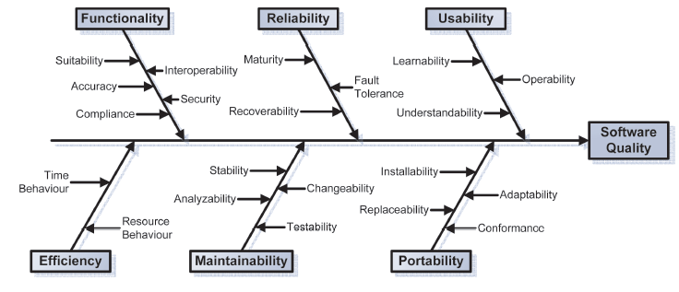
Relation between ISO 9126 characteristics and sub-characteristics

Slide 43
ISO 9126 Quality Characteristics
“Quality Factors”
Functionality: A set of attributes that bear on the existence of a set of functions and their specified properties. The functions are those that satisfy stated or implied needs.
Reliability: A set of attributes that bear on the capability of software to maintain its performance level under stated conditions for a stated period of time.
Usability: A set of attributes that bear on the effort needed for use and on the individual assessment of such use by a stated or implied set of users.

Slide 44
ISO 9126 Quality Characteristics “Quality Factors”
Efficiency: A set of attributes that bear on the relationship between the software’s performance and the amount of resource used under stated conditions.
Maintainability: A set of attributes that bear on the effort needed to make specified modifications
Portability: A set of attributes that bear on the ability of software to be transferred from one environment to another

Slide 45
ISO 9126 Quality Sub-characteristics (“Quality Sub-factors” by McCalls)

Slide 46
ISO 9126 Quality Subcharacteristics “Quality Subfactors”
Functionality
Suitability: The capability of the software to provide an adequate set of functions for specified tasks and user objectives.
Accuracy: The capability of the software to provide the right or agreed-upon results or effects.
Interoperability: The capability of the software to interact with one or more specified systems.
Security: The capability of the software to prevent unintended access and resist deliberate attacks intended to gain unauthorized access to confidential information.

Slide 47
ISO 9126 Quality Subcharacteristics “Quality Subfactors”
Reliability
Maturity: The capability of the software to avoid failure as a result of faults in the software.
Fault Tolerance: The capability of the software to maintain a specified level of performance in case of software faults or of infringement of its specified interface.
Recoverability: The capability of the software to reestablish its level of performance and recover the data directly affected in the case of a failure.

Slide 48
ISO 9126 Quality Subcharacteristics “Quality Subfactors”
Usability
Understandability: The capability of the software product to enable the user to understand whether the software is suitable, and how it can be used for particular tasks and conditions of use.
Learnability: The capability of the software product to enable the user to learn its applications.
Operability: The capability of the software product to enable the user to operate and control it.
Attractiveness: The capability of the software product to be liked by the user.

Slide 49
ISO 9126 Quality Subcharacteristics “Quality Subfactors”
Efficiency
Time Behavior: The capability of the software to provide appropriate response and processing times and throughput rates when performing its function under stated conditions.
Resource Behavior: The capability of the software to use appropriate resources in an appropriate time when the software performs its function under stated condition.

Slide 50
ISO 9126 Quality Subcharacteristics “Quality Subfactors”
Maintainability
Analyzability: The capability of the software product to be diagnosed for deficiencies or causes of failures in the software or for the parts to be modified to be identified.
Changeability: The capability of the software product to enable a specified modification to be implemented.
Stability: The capability of the software to minimize unexpected effects from modifications of the software.
Testability: The capability of the software product to enable modified software to be validated.

Slide 51
ISO 9126 Quality Subcharacteristics “Quality Subfactors”
Portability
Adaptability: The capability of the software to be modified for different specified environments without applying actions or means other than those provided for this purpose for the software considered.
Installability: The capability of the software to be installed in a specified environment.
Coexistence: The capability of the software to coexist with other independent software in a common environment sharing common resources.
Replaceability: The capability of the software to be used in place of other specified software in the environment of that software.

Slide 52
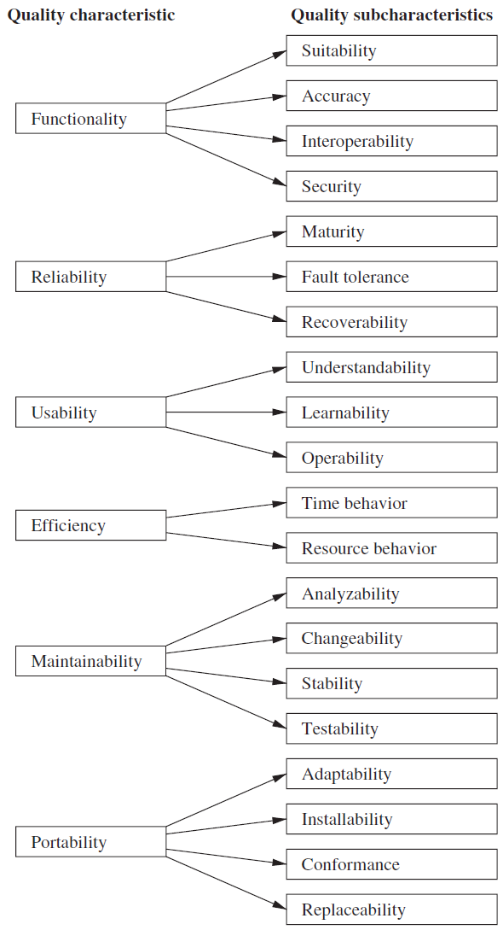
Relation between ISO 9126 characteristics and sub characteristics
Strict Hierarchy

Slide 53
Quality factors and quality criteria
Flexible Hierarchy

Slide 54
Other Characteristics
Different Models (provides categorization) of quality factors Garvins, McCall’s, ISO 9126, Deutsch
Notes:
54

Slide 55
Software Quality Attributes
Eight Dimensions Software Quality Attributes
Garvins David
Performance Quality: Does software delivers all contents, functions, & features that are specified
Feature Quality: Does software provides features that surprise & delight first-time end users?
Reliability: If deliver without failure? If available when needed?
Conformance: Does conform to design & coding conventions? e.g. accepted design rules for menu selection

Slide 56
Software Quality Attributes
Eight Dimensions Software Quality Attributes
Garvins David
Durability: Can software be maintained (changed) & corrected (debugged) without side effects?
Serviceability: Can debugged in acceptability short time period? If support staff acquire all info to make change
Aesthetics: Artistic, Aesthetics entity has certain elegance, cannot quantify
Perceptions: if a vender has an excellent reputation, you may perceive quality even it doesn’t really exists, vice versa, or some past experience is more bitter

Slide 57
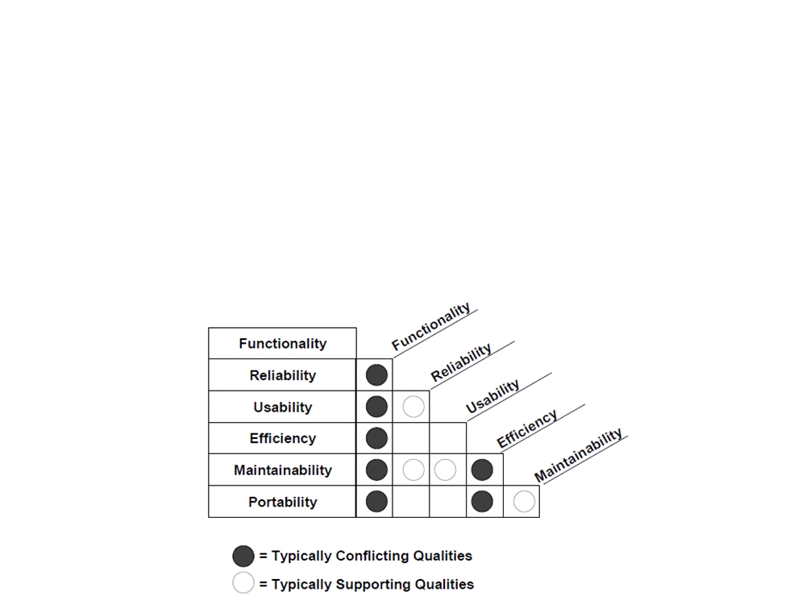
Quality Attributes: Practical Usage
Quality attributes are identified early to express quality
requirements and to drive the development and evaluation
of quality products.
- Quality attributes for a given system may be:
conflicting; for instance, achieving security may be at the expense of
efficiency or interoperability. So trade-off must be made when
addressing such kinds of quality attributes
- supportive; for instance usability can improve maintainability.

Slide 58
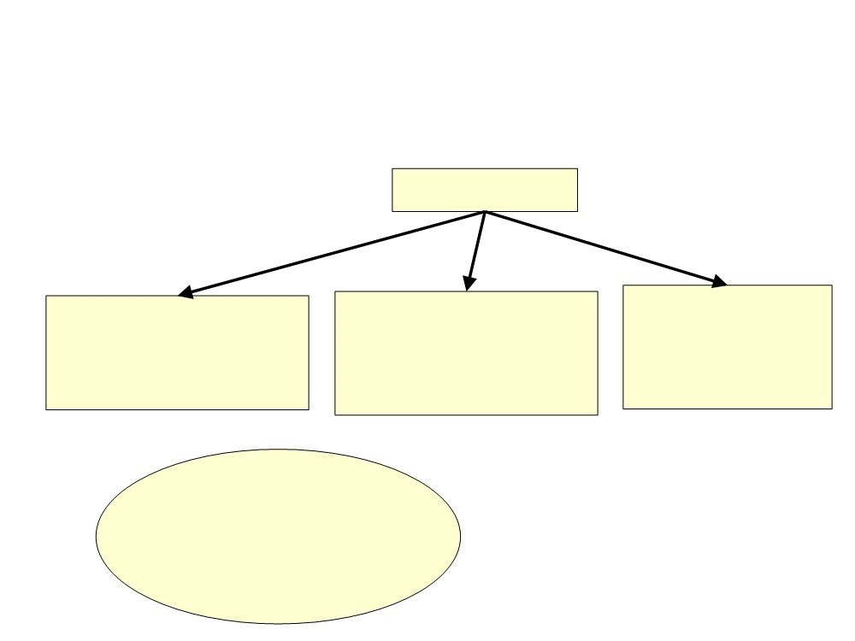
ISO 9000 Quality Standard
What is assessment? Comparison of your organization with some standards
Where you stand? Where improvement? STEPS: obtain data, find strengths &
weakness, identify area to improve, use guidelines and implement standards i.e. ISO
ISO 9000 is a set of international standards that can be used in the development
of a quality management system
in all industries.
ISO 9000
ISO 9001
ISO 9002
ISO 9003
Quality System Model for
Quality Assurance in design,
development, production,
installation and service
Quality System Model for
Quality Assurance in
Quality System Model
for Quality Assurance
in final inspection and
test (more guideline)
servicing, production,
Installation
ISO 9000-3
Guidelines for the
application of ISO 9001 to
the design, development
and maintenance of
software

Slide 59
ISO 9000 Quality Standard (ctd.)
-ISO 9001 is a generic model of a quality process that describes
which standards and procedures should exist within an
organization.
•As it is not industry-specific, this description is high-level.
Within any specific organization, a set of appropriate quality
processes should be defined and documented in an
organizational quality manual.
•Certification bodies exist that check regularly conformance
with ISO 9001 of the quality process as expressed in the
quality plan.
- ISO 9004 – more comprehensive

Slide 60
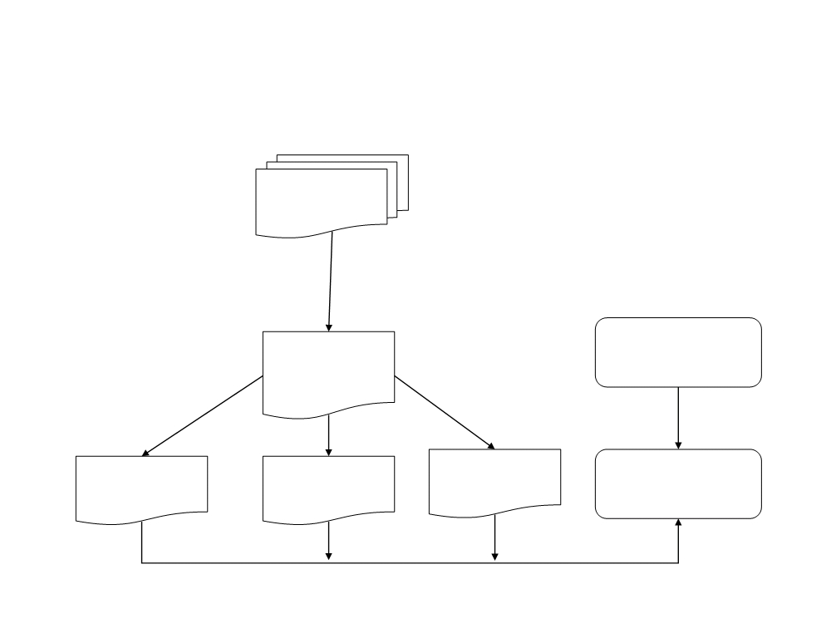
ISO 9000 Quality Standard (ctd.)
Quality management based on ISO 9000
ISO9000
quality models
is instantiated as
Organization
Organization
Quality manuals
quality process
Is used to develop
Project 1 Project 2
Project 3
Quality plan Quality plan
Quality plan
Project quality
management
supports

Slide 61
Some of the requirements in ISO 9000-3
include:
•Develop and document software test plans.
•Develop methods to test whether the software meets the
customer's requirements.
•Perform software validation and acceptance tests.
•Maintain records of the test results.
•Control how software bugs are investigated and resolved.
•Prove that the product is ready before it is released.
•Develop procedures to control the software's release process.
•Identify and define what quality information should be collected.
•Use statistical techniques to analyze the software development
process.
•Use statistical techniques to evaluate product quality.

Slide 62
CUPRIMDSO & FURPS
Other Customized Software Quality factors models

Slide 63
Other Customized Software Quality Factors Models
IBM monitors CUPRIMDSO–Capability (Functionality), Usability, Performance, Reliability, Installability, Maintainability, Documentation, Service, & Overall.
HP monitors FURPS–Functionality, Usability, Reliability, Performance & Service.

