Slide 1

Lecture 19
COMSATS Islamabad
Enterprise
Systems
Development
( CSC447)
Muhammad Usman, Assistant Professor

Slide 2
Approaches to quality
Quality of the product versus quality of the process
Check whether (product or process) conforms to certain norms
Improve quality by improving the product or process

Slide 3
Approaches to quality
Conformance
Improvement
Product
ISO 9126
‘best practices’
CMM
SPICE
Bootstap
ISO 9001
SQA
Process

Slide 4
Major Software Failures of 2011
Deficiencies in software quality often results
  in costly emergency fixes
  damage to a brand’s reputation, software company defaulters – large repayments
Software defects are extremely costly in term of
  money
  reputation
  loss of life
Major Failures
Cash machine bug benefits customers by giving them extra money
An Australian bank began giving out large sums of money from 40 Cash Machines cross one city. Officials at the company said they were operating in
stand-by mode, so could not identify the account balances of customers.

Slide 5
Major Software Failures of 2011
Major Failures
-22 people wrongly arrested in Australia due to failures in new NZ $54.5 million courts computer system
A new NZ $54.5 million ($42.7 million or £26.8 million) computer system linking New South Wales courts and allowing documents to be lodged electronically led to damages claims for unlawful arrest and malicious prosecution, after 3600 defects in the electric transfers of data from the courts to
the police’s database led to the wrongful arrest of 22 individuals.
-Computer system bugs cause Asian banking facilities’ downtime
Computer system problems at one of Japan’s largest banks resulted in a nationwide ATM network of more than 5,600 machines going offline for 24 hours, internet banking services being shut down for three days, delays in salary payments worth $1.5 billion (£939 million) into the accounts of 620,000 people and a backlog of more than 1 million unprocessed
payments worth around $ 9 billion (£5.64 billion).

Slide 6
Some Failure Statistics
IT projects have a terrible track record
  A 1995 Standish Group study (CHAOS) found that only 16.2% of IT projects were successful and over 31% were canceled before completion, costing over $81 B in the U.S. alone
  2009 – only 32 % project become successful
    24 % Failed – never completed
    44 % Challenged – cost & time over run
The need for IT projects keeps increasing
  In 2000, there were 300,000 new IT projects
  In 2001, over 500,000 new IT projects were started

Slide 7
Causes of Software Errors
Faulty requirements definition
Client developer communication failures
Intentional deviations from software requirements
Logical design errors
Coding errors
Noncompliance with documentation and coding instructions
Shortcomings of the testing process
User interface and procedure errors
Documentation errors
etc

Slide 8
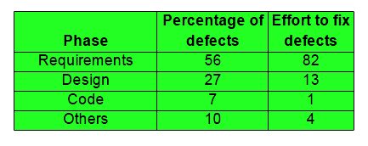
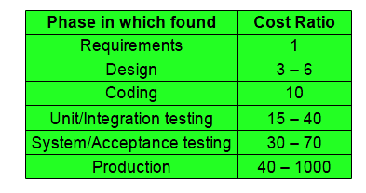
Development process relation to defects
Majority of defects are
Introduced in earlier phases
Relative cost of fixing defects

Slide 9
Importance of software quality
Software is a major component of computer systems
(about 80% of the cost – used for )
  communication (e.g. phone system, email system), health monitoring,
  entertainment, transportation (e.g. automobile, aeronautics),
  economic exchanges (e.g. ecommerce), etc.
Software defects are extremely costly in term of money
  reputation , loss of life
  How to avoid Failure ?
    through an effective quality management strategy
    identifying resolving potential glitches before they appear.

Slide 10
Importance of Software Quality
The term ‘defect’ generally refer to the some problem with software either with
its external or internal characteristics
Failure: The inability of a system or component to perform its required
functions within specified performance requirements
Fault: An incorrect step, process, or data definition in a computer program
Error: A human action that produces an incorrect result.
Error, fault and failure collectively refer to as defects
Notes:
10
The term failure refers to a behavioral deviation from the user requirement or the product specification;
fault refers to an underlying (primary, original) condition within a software that causes certain failure(s) to occur;
Fault can also be defined as, A requirements, design, or implementation flaw or deviation from a desired or intended state.
Fault Tolerance is the ability of a functional unit to continue to perform a required function in the presence of faults or errors.
while error refers to a missing or incorrect human action resulting in certain fault(s) being injected into a software.
Example, Implementation of a wrong mathematical formula

Slide 11
Importance of Software Quality
errors → faults → failures
Errors may cause faults to be injected into the software, and faults may cause failures when the software is executed
A single error may cause many faults, such as in the case that a wrong algorithm is applied in multiple modules and causes multiple faults, and a single fault may cause many failures in repeated executions
Notes:
11
the same failure may be caused by several faults, such as an interface or interaction failure involving multiple modules, and the same fault may be
there due to different errors.

Slide 12
Importance of Software Quality
faults which do not cause a failure under the given scenarios are typically called dormant or latent faults, which may still cause problems under a different set of scenarios or circumstances
software can be seen as a series of imperfect translation processes. Each of these translations produces a work product or deliverable.
software errors are introduced when there is a failure to completely and accurately translate one representation to another, or to fully match the solution to the problem.
Notes:
12
Dormant → Sleeping, inactive, latent

Slide 13
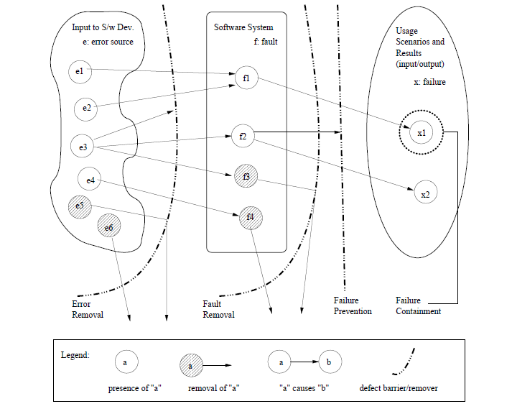
Importance of software quality

Slide 14
Definition of Software Quality
• Quality
Quality is conformance to requirements and prevention of defects.
The degree to which a system, component, or process meets specified
requirements.
-The degree to which a system, component, or process meets customer or user needs or expectations.

Slide 15
Different Views of Software Quality
Perceived in different domains differently
Five major views according to (Kitchenham and Pfleeger1996, Pfleeger et al., 2002, software quality: The elusive target) are:
User’s | fitness for purpose
Manufacturing | conformance to specification
Product | inherent characteristics of the product
Value based | the amount a customer is willing to pay
Transcendent | (“I really like this program”)
Notes:
15
Quality Perspective from the book Wiley-InterScience - Software Quality Engineering - Testing, Quality Assurance and Quantifiable Improvement
Transcendental → Surpassing all others; Superior; Beyond common thought or experience; mystical or supernatural.
Elusive → vague, intangible, indefinable

Slide 16
Different Views of Software Quality
User View
  The basic building block on which fitness for use is built is the Quality Characteristic.
  Any feature (property, attribute, etc.) of the products, materials, or processes
  which is needed to achieve fitness for use is a Quality Characteristic.
Manufacturing View
  The degree to which a system, component, or process meets
    Specified requirements, customer/user needs or expectations
    Conformance to process standards
Notes:
16
Quality Characteristic Example:

Slide 17
Different Views of Software Quality
Product View
  In the product view, the focus is on inherent characteristics in the product itself in the hope that controlling these internal quality indicators will result in improved external product behavior (quality in use)
Value Based View
  In the value-based view, quality is the customers’ willingness to pay for a software.
Notes:
17
Transcendental View: we can think of software quality as something towards which we strive as an ideal but may never implement completely.
Surpassing all others; Superior; Beyond common thought or experience; mystical or supernatural.

Slide 18
Achieving Quality
-Achieving a high level of product or service quality is the objective
of most organizations.
-It is no longer acceptable to deliver poor quality products, and fix
deficiencies after they have been shipped to the customer.
-However, software quality is a complex notion that cannot be
defined in a simple way, unlike for other manufactured products
such as cars, televisions, or computers
.
- Quality product is expected to comply with customer requirements;
unfortunately such requirements are often incomplete for software.
- We do not know how to precisely specify and check certain quality
requirements (e.g., usability, maintainability, reusability etc.)
3
Notes:
18
Transcendental View: we can think of software quality as something towards which we strive as an ideal but may never implement completely.
Surpassing all others; Superior; Beyond common thought or experience; mystical or supernatural.

Slide 19
Software Quality Attributes
-The expected quality features and characteristics of a software product
are commonly referred to as Quality Attributes.
- Quality attributes are used early in the development process to identify
user quality requirements. Each system has specific and unique quality
needs, which are a function of the purpose of the application.
5

Slide 20
Software Quality Attributes
Quality is not just meeting requirements - it has many dimensions
Software Quality Attributes
External (rely on execution) Internal (don’t rely on s/w execution)
correctness maintainability
reliability flexibility
usability portability
efficiency reusability
integrity readability
adaptability testability
robustness understandability
Notes:
20
Internal Metrics: Internal metrics are those which do not rely on software execution (static measures)
External Metrics: External metrics are applicable to running software.
Reliability: the capability of the system to maintain its service provision under defined conditions for defined periods of time.
Integrity is a concept of consistency of actions, values, methods, measures, principles, expectations and outcomes.
Adaptability is the ability of a system (e.g., a computer system) to adapt itself efficiently and fast to changed circumstances. An adaptive system is therefore an open system that is able to fit its behavior according to changes in its environment or in parts of the system itself.
Robustness is the quality of being able to withstand stresses, pressures, or changes in procedure or circumstance. A system, organism or design may be said to be "robust" if it is capable of coping well with variations (sometimes unpredictable variations) in its operating environment with minimal damage, alteration or loss of functionality.

Slide 21
Software Quality Attributes
Portability - Will I be able to use it on another machine?
Reusability - Will I be able to reuse some of the software?
Interoperability - Will I be able to interface it with another machine?
Maintainability - Can I fix it?
Flexibility - Can I change it?
Testability - Can I test it?
Product
Revision
Product
Transition
Product
Operations
Correctness - Does it do what I want?
Reliability - Does it do it accurately all the time?
Efficiency - Will it run on my machine as well as it can?
Integrity - Is it secure?
Usability - Can I easily use it?

Slide 22
Software Quality and Quality Software
Software Quality
  Software quality measures how well software is designed (quality of design), and how well the
  software conforms to that design (quality of conformance).
  Quality of conformance is concerned with implementation,
  Quality of design measures how valid the design and requirements are in creating a
  worthwhile product ( Pressman )
Quality Software
  Software that exhibit all the functional capabilities and non-functional attributes that
  ensure that it can be put to all its intended uses with the least effort, inconvenience and
  resource cost to the user.
Notes:
22
Stifle → suffocate, Suppress

Slide 23
Software Quality and Quality Software
Quality Software…
  Software should function correctly with respect to a specification that has been predefined by the client who has commissioned the development of the software.
  Software must possess attributes other than correctness with respect to a specification before it can be classified as quality software.
Notes:
23
Commissioned: Custom Built, Specially Made

Slide 24
Software Quality
-In large organizations or projects, how to ensure that the required level
of product quality is achieved
Whose Responsibility?
- the responsibility of the so-called quality managers, quality team / group
- quality group: director, manager, coordinator, members of different
department i.e. HR, PM, Finance
How Quality process will be carried out?
If it is carried out through established _____________ Engineering?

Slide 25
Apply Engineering?
• Engineering is concerned with applying science/ scientific principles
and techniques to develop products for use by society
- Objective: within the constraints of Project Scope, Time, Resources & Budget:
Civil?
- Science?
  Steel Structures
Software?
- Science?
  Data Structure, Algorithm, Analysis, Brainstorming techniques, OOAD, White Box Testing ..
Quality?
- Science?
  Inspection, Assessments Techniques, Measurement Tools, Feedback & Improvements

Slide 26
Overall Quality Approach
Apply Ad-hoc Software Practice…conventional
Analysis
Design & Code
Test & Deploy
Apply Software Engineering Practice…..modern, thus improvement
Apply Quality Engineering Practice ….. thus improvement
New Testing Techniques
New Models, Standards
RE
Data Structure
Pre-SQA
SQA
Post SQA
Quality Management System

Slide 27
Apply Quality in Organization
Upper Management
Finance Dept.
Payroll
Budget
HR Dept.
Training
SQA, SQC,
SQE, TQM
SQA, SQC, SQE, TQM
SQA, SQC,
SQE,
TQM
System, IT & Software Dept.
IT Projects
Web App.
Quality Management System
Testing T
Overall Quality in Portfolio i.e. Process, Service & Product

Slide 28
Another View
SQA, SQC, SQE, TQM
Requirement
SQA, SQC, SQE, TQM
SQA, SQC, SQE, TQM
Test & Deploy
Design & Code
SQA, SQC, SQE, TQM
Payroll Dept.
Quality Management System

Slide 29
Overall Improvement
System
Services
Processes
People, Department, etc.
Products
Quality Management System

Slide 30
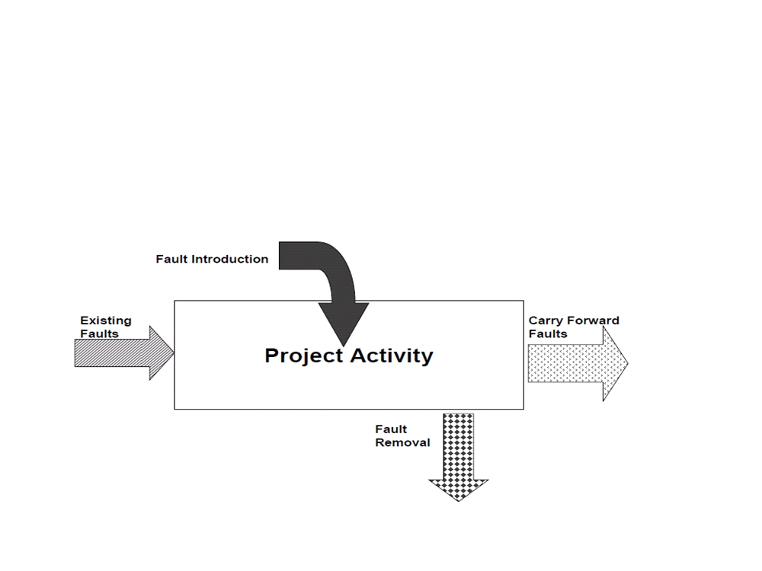
Software Quality Engineering?
Software Quality Foundation
Software Lifecycle
- Defects are introduced in software by human activities through Software
Life Cycle

Slide 31
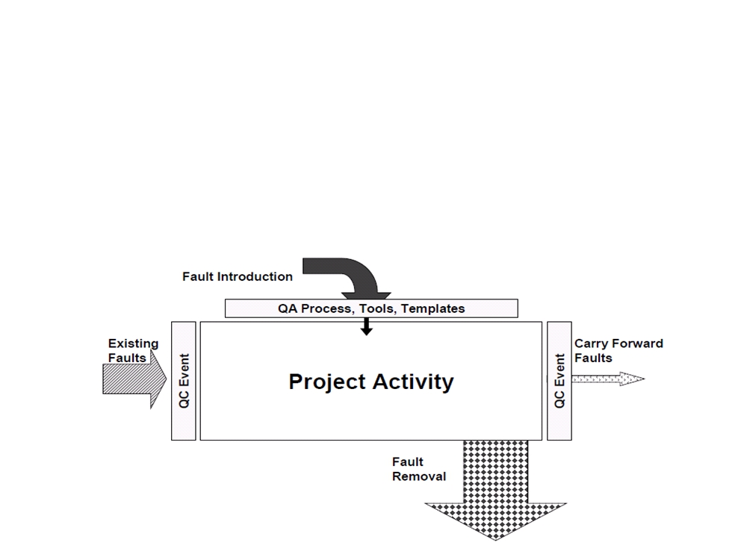
Software Quality Engineering?
- Quality Assurance (QA) is fault prevention through process
design and auditing
- Creating processes, procedures, tools, jigs, etc. to prevent faults from occurring
- Examples: Templates, checklists, guides
- Main goal: prevent as much as possible defect injection

Slide 32
Software Quality Engineering?
- Quality Control (QC) is fault/failure detection through static
and/or dynamic testing of artifacts
- Examining the artifact against pre-determined criteria to measure conformance

Slide 33
Difference in (QA) & (QC) ?
Quality Assurance (QA)
Things done before developing software & related produces
Recruit Good People
Develop Good Processes
Provide Good Tools
Train People to use Processes & Tools
Provide Adequate Supervision
Appreciate Good work
- Plan for QC
Quality Control (QC)
Things done after developing software & related products
In spite our best efforts, some mistakes will occur
Detect mistakes & ensures that quality standards / procedures are followed

Slide 34
Difference in (QA) , (QC) & (Testing) ?
- Prevention process & detective process
QA –those activities which develop / modify processes to prevent introduction of defects
QC –those activities which find & correct the flaws
QA Focus ---- Process-oriented,
Randomly Evaluate the product to confirm if process works,
Ensures if process is defined & right, preventing defect from occurring
e.g. Development of methodologies & standards: Review if requirement being
defined at proper level of detail?
QC Focus ---- Products-oriented ,
Continuous activity & observe if defective,
Focus on finding, detecting & correcting the defects in specific deliverables
e.g. Are defined requirements the right requirements?
Testing ----- The process of executing a system with the intent of finding defects
Note: Process of executing a system includes test planning prior to the execution of the test cases
-Testing is one example of a QC activity, but there are others such as reviews, inspections etc..

