Slide 1

Lecture 18
COMSATS Islamabad
Enterprise
Systems
Development
( CSC447)
Muhammad Usman, Assistant Professor

Slide 2
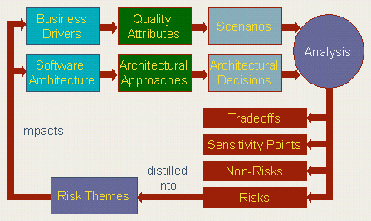
Architecture Trade-off Analysis Method
An architecture evaluation doesn’t tell you “yes” or “no” or “6,75 out of 10”. It tells you where the risks are.

Slide 3
Architecture Trade-off Analysis Method
The ATAM is based upon a set of attribute-specific measures of the system
  Analytic (performance & availability)
  Qualitative (modifiability, safety, security)
The ATAM workshops typically takes three days and the involvement of 10-20 people
  Evaluators
  Architects
  and other system stakeholders
Benefits:
  clarified quality attribute requirements
  improved architecture documentation
  documented basis for architectural decisions
  identified risks early in the life-cycle
  increased communication among stakeholders

Slide 4
Risks, Non-risks, Sensitivity Points and
Trade-off Points
Risks are potentially problematic architectural decisions.
The rules for writing business logic modules in the second tier of your three-tier client-server style are not clearly articulated. This could result in replication of functionality, thereby compromising modifiability of the third tier (a quality attribute response and its consequences)
Nonrisks are good decisions that rely on assumptions that are frequently implicit in the architecture.
Assuming message arrival rates of once per second, a processing time of less than 30 milliseconds, and the existence of one higher priority process, then a one-second soft deadline seems reasonable.
A sensitivity point is a property of one or more components (and/or component relationships) that is critical for achieving a particular quality attribute response.
The latency for processing an important message might be sensitive to the priority of the lowest priority process involved in handling the message.
The average number of person-days of effort it takes to maintain a system might be sensitive to the degree of encapsulation of its communication protocols and file formats.
A trade-off point is a property that affects more than one attribute and is a sensitivity point for more than one attribute.
If the processing of a confidential message has a hard real-time latency requirement then the level of encryption could be a trade-off point.

Slide 5
Architecture Trade-off Analysis Method
Preparation
  Business track
    Interview project leader
    Interview business representatives
    Prepare quality attribute tree
    Prepare scenario brainstorm
  Architecture track
    Interview architect
    Interview lead developers
    Prepare example architecture documentation
    Identify approaches
  Analysis

Slide 6
What Result Does an Evaluation Produce?
Answers to two kind of questions:
  Is the architecture suitable for the system for which is was designed?
  Which of two or more competing architectures is the most suitable one for the system at hand?
It meets its quality goals
Predictable behaviour
Performance
Modifiable
Security
suitable
The system can be built
Staff
Budget
Legacy
Time
If the sponsor of a system cannot tell you what any of the quality goals are for the system, then the architecture will do.

Slide 7
Summary of the ATAM Steps
Presentation
  Present the method
    Evaluation leader
  Present business drivers
    12 slides; 45 min; guidelines for content; project manager
  Present architecture
    20 slides; 60 min; guidelines for content + checklist with questions; architect
Investigation and Analysis
  Identify the architectural approaches
    architect
  Generate the quality attribute utility tree
    Workshop, templates for utility tree and scenarios
  Analyse the architectural approaches
    workshop, templates for risks, nonrisks, sensitivity points and trade-off points
Testing
  Brainstorm and prioritise scenarios
    Voting workshop
  Analyse the architectural scenario’s
    See step 6
Reporting
  Present the results
    Document template; evaluation team

Slide 8
Step 1: Present ATAM
Evaluation Team presents an overview of the ATAM
• ATAM steps in brief
• Techniques
- utility tree generation
- architecture elicitation and analysis
- scenario brainstorming/mapping
• Outputs
- architectural approaches
- utility tree
- scenarios
- risks and “non-risks”
- sensitivity points and tradeoffs

Slide 9
Step 2: Present Business Drivers
ATAM customer representative describes the system’s business drivers including:
  Business context for the system
  High-level functional requirements
  High-level quality attribute requirements
  Architectural drivers: quality attributes that “shape” the architecture
  Critical requirements: quality attributes most central to the system’s success

Slide 10
Step 3: Present the Architecture
Architect presents an overview of the architecture including (for example):
  Technical constraints such as an OS, hardware, or middle-ware prescribed for use
  Other systems with which the system must interact
  Architectural approaches/styles used to address quality attribute requirements
Evaluation team begins probing for and capturing risks.

Slide 11
Step 4: Identify Architectural Approaches
Start to identify places in the architecture that are key for realizing quality attribute goals.
Identify any predominant architectural approaches – for example:
  client-server
  3-tier
  proxy
  publish-subscribe
  redundant hardware

Slide 12
Step 5: Generate Utility Tree
Identify, prioritize, and refine the most important quality attribute goals by building a utility tree.
  A utility tree is a top-down vehicle for characterizing the “driving” attribute-specific requirements
  Select the most important quality goals to be the high-level nodes (typically performance, modifiability, security, and availability)
  Scenarios are the leaves of the utility tree
    Output: a characterization and a prioritization of specific quality attribute requirements.

Slide 13
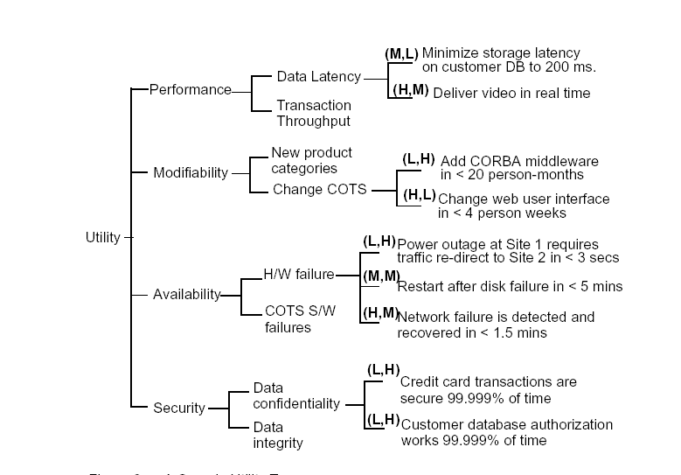
Step 5: Utility Tree /cont.

Slide 14
Step 5- Scenarios
Scenarios are used to
  Represent stakeholders’ interests
  Understand quality attribute requirements
Scenarios should cover a range of
  Anticipated uses of (use case scenarios),
  Anticipated changes to (growth scenarios), or
  Unanticipated stresses (exploratory scenarios) to the system.
A good scenario makes clear what the stimulus is that causes it and what responses are of interest.

Slide 15
Step 5 – Scenario examples
Use case scenario
  Remote user requests a database report via the Web during peak period and receives it within 5 seconds.
Growth scenario
  Add a new data server to reduce latency in scenario 1 to 2.5 seconds within 1 person-week.
Exploratory scenario
  Half of the servers go down during normal operation without affecting overall system availability.
Scenarios should be as specific as possible.

Slide 16
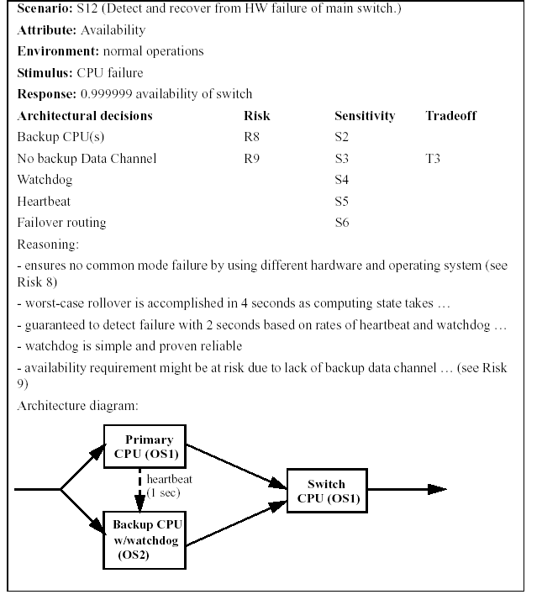
Step 6: Analyze Architectural Approaches
Scenarios
Vs.
Architecture

Slide 17
Step 6: Analysis /cont.
Evaluation Team probes architectural approaches from the point of view of specific quality attributes to identify risks.
  Identify the approaches that pertain to the highest priority quality attribute requirements
  Generate quality-attribute specific questions for highest priority quality attribute requirement
  Ask quality-attribute specific questions
  Identify and record risks and non-risks, sensitivity points and tradeoffs

Slide 18
Step 6: Analysis /cont.
Quality attribute questions probe styles to elicit architectural decisions which bear on quality attribute requirements.
Examples
  Performance
    How are priorities assigned to processes?
    What are the message arrival rates?
    What are transaction processing times?
  Modifiability
    Are there any places where layers/facades are circumvented ?
    What components rely on detailed knowledge of message formats?
    What components are connected asynchronously?

Slide 19
Step 6: Sensitivity & Tradeoffs
Sensitivity – A property of a component that is critical to success of system.
  The number of simultaneous database clients will affect the number of transaction a database can process per second. This assignment is a sensitivity point for the performance
  Keeping a backup database affects reliability
  Power of encryption (Security) sensitive to number of bits of the key
Tradeoff point- A property that affects more than one attribute or sensitivity point.
  In order to achieve the required level of performance in the discrete event generation component, assembly language had to be used thereby reducing the portability of this component.
  Keeping the backup database affects performance also so it’s a trade-off between reliability and performance

Slide 20
Steps 6: Risks & Non-Risks
Risk
  The decision to keep backup is a risk if the performance cost is excessive
  Rules for writing business logic modules in the second tier of your 3-tier style are not clearly articulated. This could result in replication of functionality thereby compromising modifiability of the third tier.
Non Risk
  The decision to keep backup is a non-risk if the performance cost is not excessive
  Assuming message arrival rates of once per second, a processing time of less than 30 ms, and the existence of one higher priority process, a 1 second soft deadline seems reasonable Performance.

Slide 21
Step 7: Brainstorm & Prioritize Scenarios
Stakeholders generate scenarios using a facilitated brainstorming process.
  Scenarios at the leaves of the utility tree serve as examples to facilitate the step.
  The new scenarios are added to the utility tree
Each stakeholder is allocated a number of votes roughly equal to 0.3 x #scenarios.

Slide 22
Step 8: Analyze Architectural Approaches
Identify the architectural approaches impacted by the scenarios generated in the previous step.
This step continues the analysis started in step 6 using the new scenarios.
Continue identifying risks and non-risks.
Continue annotating architectural information.

Slide 23
Step 9: Present ATAM results
Architectural approaches
Utility tree
Scenarios
Risks and “non-risks”
Sensitivity points and tradeoffs

Slide 24
Software Quality

Slide 25
Why Are Software Difficult?
• According to Fred Brooks* software projects are difficult
because of
accidental - methods, tools & techniques
essential - inherent, inborn nature of software:
complexity, conformity, changeability, invisibility
• Additional reasons software projects are difficult are:
intellect-intensive - team-oriented nature of the work
externally imposed constraints - engineering, platform, domain,
process, scientific, technology, domain knowledge ..

Slide 26
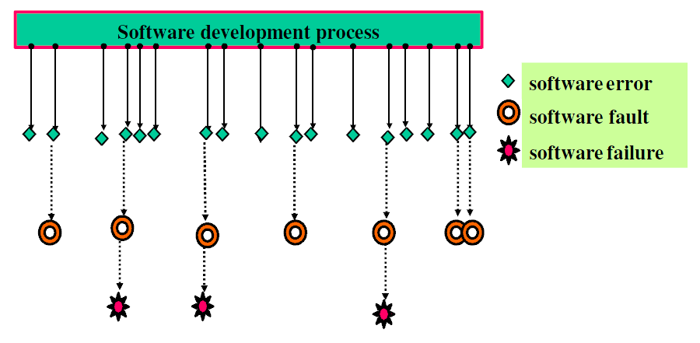
Software Errors, Faults, & Software Failures
Software errors are introduced when there is a failure to completely and accurately translate one representation to another, or to fully match the solution to the problem.
Bug / defect / fault
consequence of a human error
results in non-conformance
to requirements
obvious as failure in
running software
Notes:
Computer Program: a series of instructions/statements in a form acceptable to computer and designed to cause the computer to execute an operation(s).
Computer data: a representation of facts, concepts, or instructions in a structured form suitable for acceptance, interpretation, or processing by computer.
Computer Program Documentation: technical data, including program listings & printouts in human readable form which document the requirement, design, implementation, and other details of the computer program. Also instructions for using and maintaining the computer program.

Slide 27
Approaches to quality
Quality of the product versus quality of the process
Check whether (product or process) conforms to certain norms
Improve quality by improving the product or process

