Slide 1
LESSON 09

Slide 2
Overview
of
Previous Lesson(s)

Slide 3
Over View
Microsoft Visual Studio is an integrated development environment (IDE) from Microsoft Corporation, which is used to develop console and GUI based applications.
.NET Framework is a software framework developed by Microsoft that runs primarily on Microsoft Windows.
It includes a large library and provides language interoperability across several programming languages

Slide 4
Over View..
Programs written for the .NET Framework execute in a software environment, known as the Common Language Runtime, an application virtual machine that provides services such as security, memory management, and exception handling.

Slide 5
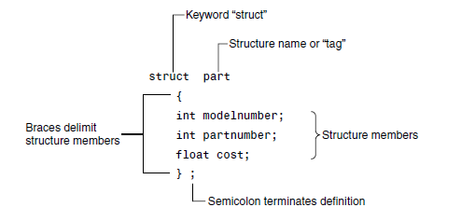
Over View…
Structures
  A structure is a collection of simple variables.
  The data items in a structure are called the members of the structure.

Slide 6
Over View…
A function groups a number of program statements into a unit and gives it a name.
This unit can then be invoked from other parts of the program.
The function’s code is stored in only one place in memory, even though the function is executed many times in the course of the program.

Slide 7
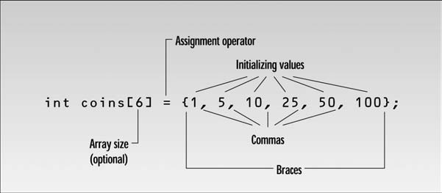
Over View…
Arrays are like structures in that they both group a number of items into a larger unit.
Structure usually groups items of different types, an array groups items of the same type.
Items in a structure are accessed by name, while those in an array are accessed by an index number.

Slide 8
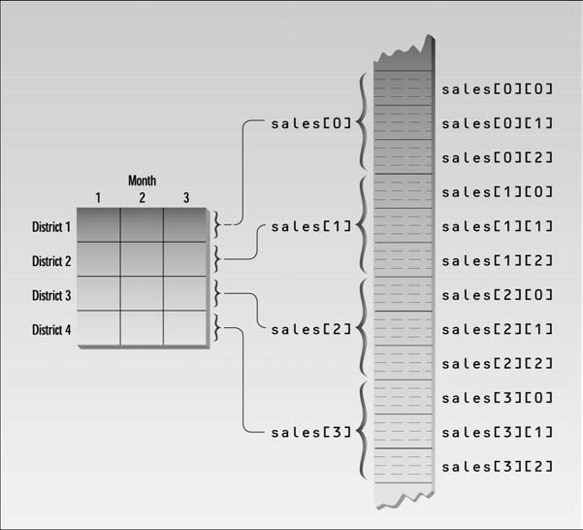
Over View…
Multidimensional Array

Slide 9
TODAY’S LESSON

Slide 10
Contents
Pointers
Memory Addresses
Indirection Operator
Pointers to Char
Array of Pointers
The sizeof Operator
Classes
Objects
C++/CLI Programming

Slide 11
Pointers
Each memory location that you use to store a data value has an address.
A pointer is a variable that stores the address of another variable of a particular type.
A pointer has a variable name just like any other variable and also has a type that designates what kind of variables its contents refer to.
The type of a pointer variable includes the fact that it ’ s a pointer.

Slide 12
Declaring Pointers
The declaration for a pointer is similar to that of an ordinary variable, except that the pointer name has an asterisk in front of it to indicating that it’s a variable, that is a pointer.
For example, to declare a pointer pnum of type long:
long* pnum;
It can also be written as, Compiler will not mind ;)
long *pnum; //convention in C++
Declarations of ordinary variables and pointers can be mixed in the similar statement.
long* pnumber, number (99);

Slide 13
Address of Operator
How do we get the address of an operator ???
So for getting the address of operator, & is used.
  This is a unary operator that obtains the address of a variable.
  It ’ s also called the reference operator.
The assignment statement can be written as:
long number = 200;
long* pnumber;
pnumber = &number;

Slide 14
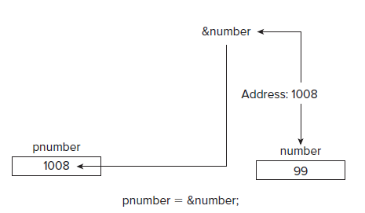
Address of Operator..
Operator & can be used to obtain the address of any variable, but you need a pointer of the appropriate type to store it.

Slide 15
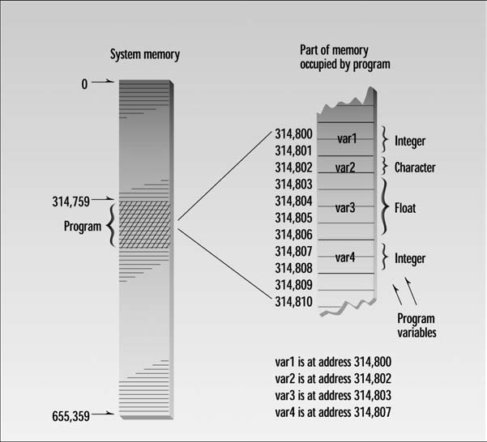
Memory Address

Slide 16
The Indirection Operator
Taking the address of a variable and storing it in a pointer is all very well, but the really interesting aspect is how you can use it.
Fundamental to using a pointer is accessing the data value in the variable to which a pointer points.
This is done using the indirection operator * .
The name ‘ indirection operator ’ stems from the fact that the data is accessed indirectly.

Slide 17
* Operator
One aspect of this operator that can seem confusing is the fact that it has several different uses:
  It is the multiply operator.
  It serves as the indirection operator.
  It is used in the declaration of a pointer.
Each time you use * , the compiler is able to distinguish its meaning by the context.

Slide 18
Initializing Pointer
Using pointers that aren’t initialized is extremely hazardous.
Random areas of memory can easily be overwritten through an uninitialized pointer.
int number(0); // Initialized integer variable
int* pnumber( & number); // Initialized pointer
In case, you don’t want to initialize with the address of a specific variable, it can be initialized with the pointer equivalent of zero.
For this, Visual C++ provides the literal nullptr, a pointer literal that does not point to anything.
int* pnumber(nullptr); // Pointer not pointing to anything

Slide 19
Using Pointer
#include <iostream>
using namespace std;
int main()
{
int var1 = 11; //two integer variables
int var2 = 22;
cout << &var1 << endl //print addresses of variables
<< &var2 << endl << endl;
int* ptr; //pointer to integers
ptr = &var1; //pointer points to var1
cout << ptr << endl; //print pointer value
ptr = &var2; //pointer points to var2
cout << ptr << endl; //print pointer value
return 0;
}

Slide 20
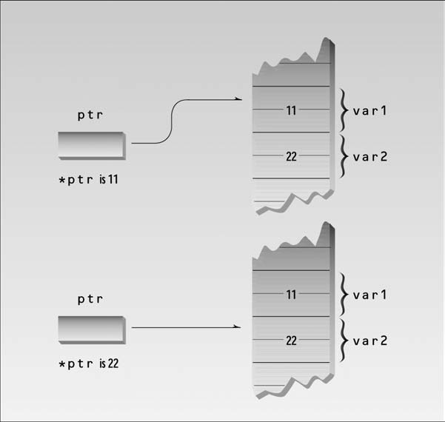
Using Pointer..

Slide 21
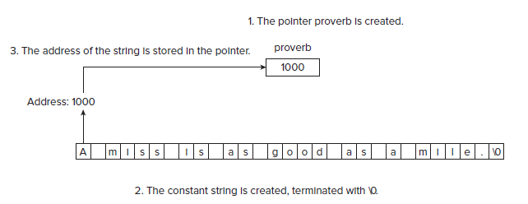
Char Pointer
A pointer of type char* has the interesting property that it can be initialized with a string literal.
  char* proverb ("A miss is as good as a mile.");

Slide 22
Char Pointer..
// Initializing pointers with strings
#include < iostream >
Using namespace std;
int main()
{ char* pstr1(“Quaid-e-Azam");
char* pstr2(“Allama Iqbal");
char* pstr3(“Sir Syed Ahmed Khan");
char* pstr4(“M M ALAM");
char* pstr5 (“Imran Khan");
char* pstr6(“Ashfaq Ahmad");
char* pstr("Your lucky star is ");
int dice(0);
cout < < “Pick a lucky star!” < < “Enter a number between 1 and 6: ”;
cin > > dice; cout < < endl;

Slide 23
Char Pointer..
switch(dice)
{
case 1: cout < < pstr < < pstr1; break;
case 2: cout < < pstr < < pstr2; break;
case 3: cout < < pstr < < pstr3; break;
case 4: cout < < pstr < < pstr4; break;
case 5: cout < < pstr < < pstr5; break;
case 6: cout < < pstr < < pstr6; break;
default: cout < < "Sorry, you haven't got a lucky star.";
}
return 0;
}

Slide 24
Array of Pointers
int main()
{
char* pstr[] = { " Quaid-e-Azam ", // Initializing a pointer array
" Allama Iqbal ",
" Sir Syed Ahmed Khan ",
" M M ALAM ",
" Imran Khan ",
" Ashfaq Ahmad "
};
char* pstart("Your lucky star is ");
int dice(0);

Slide 25
Array of Pointers..
cout <<“ Pick a lucky star”<<"Enter a number between 1 and 6: ";
cin >> dice; cout << endl;
if(dice > = 1 & & dice < = 6) // Check input validity
cout << pstart << pstr[dice - 1]; // Output star name
else
cout << "Sorry, you haven't got a lucky star."; // Invalid input
cout << endl;
return 0;
}

Slide 26
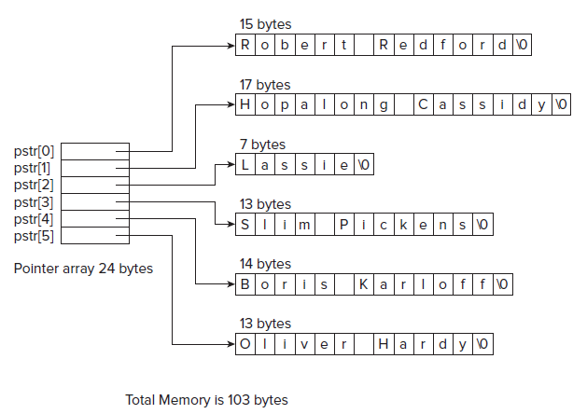
Array of Pointers..
Space saving
Fast execution

Slide 27
sizeof Operator
The sizeof operator produces an integer value of type size_t that gives the number of bytes occupied by its operand, where size_t is a type defined by the standard library.
Int dice; cout << sizeof dice; 4
The value of the expression sizeof dice is 4 because dice was declared as type int and therefore occupies 4 bytes.
The sizeof operator can be applied to an element in an array or to the whole array. When the operator is applied to an array name by itself, it produces the number of bytes occupied by the whole array, whereas when it is applied to a single element with the appropriate index value, it results in the number of bytes occupied by that element.

Slide 28
Class
A class is a specification of a data type that you define.
It can contain data elements that can either be variables of the basic types in C++, or of other user - defined types.
The data elements of a class may be single data elements, arrays, pointers, arrays of pointers, or objects of other classes.
A class also can contain functions that operate on objects of the class by accessing the data elements that they include.

Slide 29
Class..
A class combines both the definition of the elementary data that makes up an object and the means of manipulating the data that belongs to individual objects of the class (functions).
The data and functions within a class are called members of the class.

Slide 30
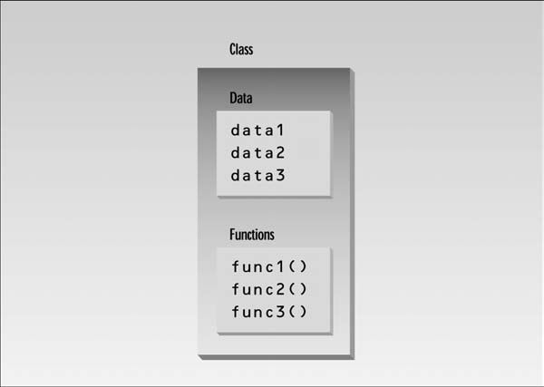
Class...

Slide 31
Defining a Class
CBox data type using the keyword class is defined as follows:
class CBox
{
public:
double m_Length; // Length of a box in inches
double m_Width; // Width of a box in inches
double m_Height; // Height of a box in inches
};

Slide 32
Access Specifier
The public keyword determines the access attributes of the members of the class that follow it.
Specifying the data members as public means that these members of an object of the class can be accessed anywhere within the scope of the class object to which they belong.
You can also specify the members of a class as private or protected.
Default attribute is private .
  Only difference between a class and a struct,
  Default access specifier for a struct is public.

Slide 33
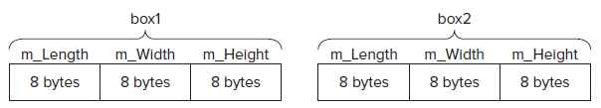
Object / Instance
CBox box1; // Declare box1 of type CBox
CBox box2; // Declare box2 of type Cbox

Slide 34
Data Members
A data member of a class can be referred using the direct member selection operator that is used to access members of a struct.
// Setting the value of a data member
box2.m_Height = 18.0;
double boxVolume(0.0); // Stores the volume of a box
box1.m_Height = 18.0; // Define the values
box1.m_Length = 78.0; // of the members of
box1.m_Width = 24.0; // the object box1
box2.m_Height = box1.m_Height - 10; // Define box2
box2.m_Length = box1.m_Length/2.0; // members in
box2.m_Width = 0.25*box1.m_Length; // terms of box1

Slide 35
Class Ex
// Calculate volume of box1
boxVolume = box1.m_Height*box1.m_Length*box1.m_Width;
cout << endl << "Volume of box1 = " < < boxVolume;
cout << endl << "box2 has sides which total “ << box2.m_Height+ box2.m_Length+ box2.m_Width << " inches.";
cout << endl << "A CBox object occupies “ << sizeof box1
<< " bytes.";
cout < < endl;
return 0;

Slide 36
Member Function
class CBox // Class definition at global scope
{
public:
double m_Length; // Length of a box in inches
double m_Width; // Width of a box in inches
double m_Height; // Height of a box in inches
// Function to calculate the volume of a box
double Volume()
{ return m_Length*m_Width*m_Height; }
};

Slide 37
Member Function..
boxVolume = box1.Volume(); // Calculate volume of box1
cout << endl << “Volume of box1 = “ << boxVolume;
cout << endl << “Volume of box2 = “ << box2.Volume();

Slide 38
Positioning a Member Function Definition
A member function definition need not be placed inside the class definition.
Put the prototype for the function inside the class.
class CBox // Class definition at global scope
{
public:
double m_Length; // Length of a box in inches
double m_Width; // Width of a box in inches
double m_Height; // Height of a box in inches
double Volume(void); // Member function prototype
};

Slide 39
Positioning a Member Function Definition..
As function definition suppose to appears outside the definition of the class, there has to be some way of telling the compiler that the function belongs to the class CBox .
This is done by prefixing the function name following scope resolution operator :: and with the name of the class.
// Function to calculate the volume of a box
double CBox::Volume()
{ return m_Length*m_Width*m_Height; }

Slide 40
C++ / CLI Programming
We wrote native C++ programs in the version of C++ defined by the ISO/IEC (International Standards Organization / International Electrotechnical Commision) language standard.
Now we will write applications to run under the control of the CLR in an extended version of C++ called C++/CLI.
The Common Language Runtime (CLR) is the Microsoft implementation of the Common Language Infrastructure (CLI) standard.
These programs will be referred as CLR programs or C++/CLI programs.

Slide 41
CLI Programming
The CLI is a specification for a virtual machine environment that enables applications written in diverse high - level programming languages to be executed in different system environments without the original source code ’ s being changed or replicated.
The CLI specifies a standard intermediate language for the virtual machine to which the high - level language source code is compiled.

Slide 42
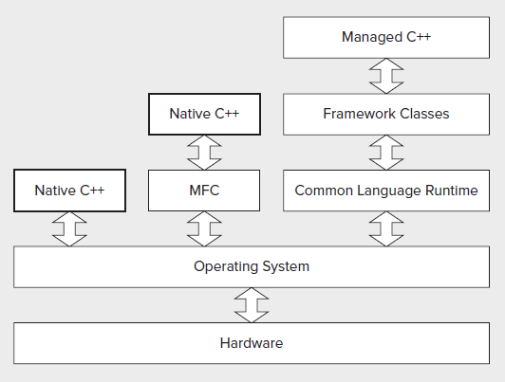
C++ Applications

Slide 43
Thank You

