Slide 1
LESSON 07

Slide 2
Overview
of
Previous Lesson(s)

Slide 3
Over View
C++
  Keywords Reserved words
  Identifiers Programmers defined variables
  Variables A named storage location in the computer’s memory for holding a piece of data.
  Data Types
Looping structures Decision structures
  For loop If
  While If / else
  Do While Switch

Slide 4
Over View..
Operator Precedence
  Operator precedence orders the operators in a priority sequence.
In an expression with more than one operator, evaluate in this order:
  - (unary negation), in order, left to right
  * / %, in order, left to right
  + -, in order, left to right
Example expression 2 + 2 * 2 – 2
evaluate
third
evaluate
second
evaluate
first

Slide 5
Over View…
Type Conversion and Casting
  Implicit type conversion:
    When an expression involving variables of different types then for each operation to be performed, the compiler has to arrange to convert the type of one of the operands to match that of the other.
  Explicit Type Conversion:
    A forced conversion from one type to another is referred as explicit type conversion.
Auto keyword is used as the type of a variable in a definition statement and have its type deduced from the initial value.
auto n = 16; // Type is int
auto pi = 3.14159; // Type is double

Slide 6
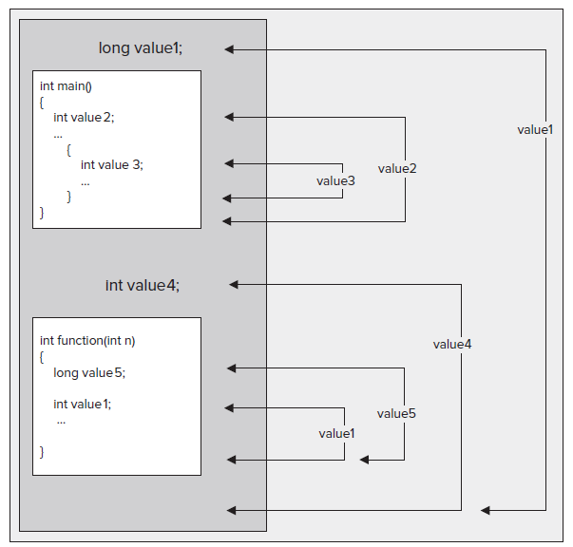
Over View…
Scope

Slide 7
Over View…
Namespaces provide a way to separate the names used in one part of a program from those used in another.
namespace keyword is used to declare a namespace
    namespace myStuff
    {
    // Code that I want to have in the namespace myStuff...
    }
This defines a namespace with the name myStuff .

Slide 8
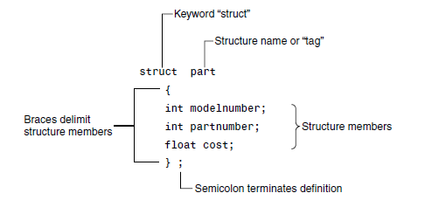
Over View…
Structures
  A structure is a collection of simple variables.
  The data items in a structure are called the members of the structure.

Slide 9
Over View…
Enumeration:
  To cope the need for variables that have a limited set of possible values.
  An enum declaration defines the set of all names that will be permissible values of the type, are called enumerators.
Ex, It can be usefully referred to by labels the days of the week or months of the year.
  enum Week{Mon, Tues, Wed, Thurs, Fri, Sat, Sun} thisWeek;

Slide 10
Over View…
A function groups a number of program statements into a unit and gives it a name.
This unit can then be invoked from other parts of the program.
The function’s code is stored in only one place in memory, even though the function is executed many times in the course of the program.

Slide 11
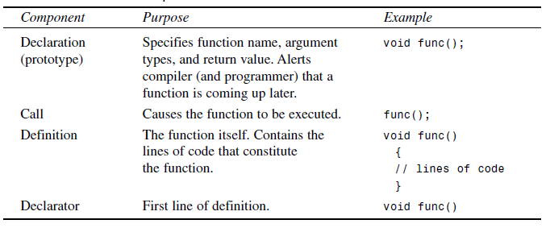
Over View…
Function Components

Slide 12
Over View…
Function with no arguments
      // starline()
      // function definition
      void starline() //function declarator
      {
      for(int j=0; j<45; j++) //function body
      cout << ‘*’;
      cout << endl;
      }

Slide 13
TODAY’S LESSON

Slide 14
Contents
Passing Arguments to Functions
Returning Values from Functions
Reference Arguments
Const Function Arguments
Function Overloading
Recursion
Inline Functions
Default Arguments

Slide 15
Passing Arguments to Function
An argument is a piece of data passed from a program to the function.
Arguments allow a function to operate with different values, or even to do different things, depending on the requirements of the program calling it.
Passing Constants:
  Lets discuss the starline function.

Slide 16
Passing Constant
// tablearguments.cpp
// demonstrates function arguments
#include <iostream>
using namespace std;
void repchar(char, int); //function declaration

Slide 17
Passing Constant..
int main()
{
repchar(‘-’, 43); //call to function
cout << “Students Result” << endl;
repchar(‘=’, 23); //call to function
cout << “Student A got 85 Marks” << endl;
cout << “Student B got 73 Marks” << endl;
cout << “Student C got 68 Marks” << endl;
repchar(‘-’, 43); //call to function
return 0;
}

Slide 18
Passing Constant…
// repchar()
// function definition
void repchar(char ch, int n) //function declarator
{
for(int j=0; j<n; j++) //function body
cout << ch;
cout << endl;
}

Slide 19
Program Output
-------------------------------------------------------------
Students Result
===================
Student A got 85 Marks
Student A got 73 Marks
Student A got 69 Marks
-------------------------------------------------------------

Slide 20
Passing Variables
// variablearguments.cpp
// demonstrates variable arguments
#include <iostream>
using namespace std;
void repchar(char, int); // function declaration

Slide 21
Passing Variables..
int main()
{
char char_in;
int number_in;
cout << “Enter a character: “;
cin >> char_in;
cout << “Enter number of times to repeat it: “;
cin >> number_in;
repchar(char_in, number_in);
return 0;
}

Slide 22
Passing Variables…
// repchar()
// function definition
void repchar(char ch, int n) //function declarator
{
for(int j=0; j<n; j++) //function body
cout << ch;
cout << endl;
}

Slide 23
Passing Variables…
Here’s some sample interaction with VARARG:
Enter a character: +
Enter number of times to repeat it: 20
++++++++++++++++++++
The data types of variables used as arguments must match those specified in the function declaration and definition, just as they must for constants.
That is, char_in must be a char, and number_in must be an int.

Slide 24
Passing by Value
In previous example the particular values possessed by char_in and number_in will be passed to the function after function call is executed in main function body.
When these constants were passed to it, the function creates new variables to hold the values of these variable arguments.
The function gives these new variables the names and data types of the parameters specified in the declarator: ch of type char and n of type int.
  It initializes these parameters to the values passed.
They are then accessed like other variables by statements in the function body.

Slide 25
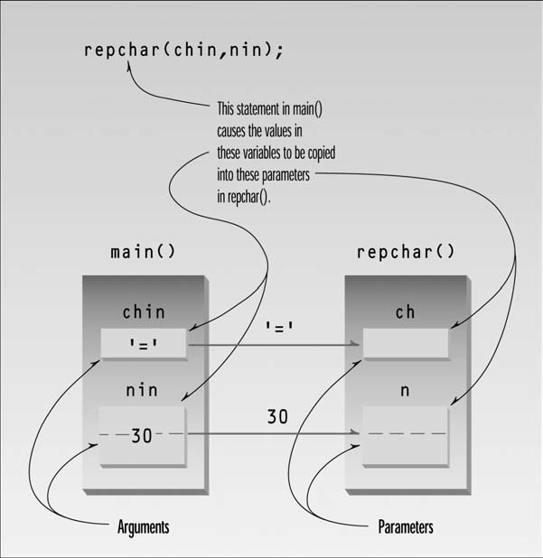
Passing by Value..
Passing arguments in a way, where the function creates copies of the arguments passed to it, is called passing by value.

Slide 26
Structure as Argument
Entire structures can be passed as arguments to functions.
We’ll try to understand the passing of a structure as an argument to a function with the help of a example.
A structure called circle represents a circular shape.
Circles are positioned at a certain place on the console screen, and have a certain radius.
They also have a color and a fill pattern.
In this example the Console Graphics Lite functions library is also used.

Slide 27
Circle Structure
// circstrc.cpp // circles as graphics objects
#include “msoftcon.h” // for graphics functions
struct circle //graphical circle
{
int xCo, yCo; //coordinates of center
int radius;
color fillcolor; //color
fstyle fillstyle; //fill pattern
};
void circ_draw(circle c)
{
set_color(c.fillcolor); //set color
set_fill_style(c.fillstyle); //set fill pattern
draw_circle(c.xCo, c.yCo, c.radius); //draw solid circle
}

Slide 28
Circle Program
int main()
{
init_graphics(); //initialize graphics system
//create circles
circle c1 = { 15, 7, 5, cBLUE, X_FILL };
circle c2 = { 41, 12, 7, cRED, O_FILL };
circle c3 = { 65, 18, 4, cGREEN, MEDIUM_FILL };
circ_draw(c1); //draw circles
circ_draw(c2);
circ_draw(c3);
set_cursor_pos(1, 25); //cursor to lower left corner
return 0;
}

Slide 29
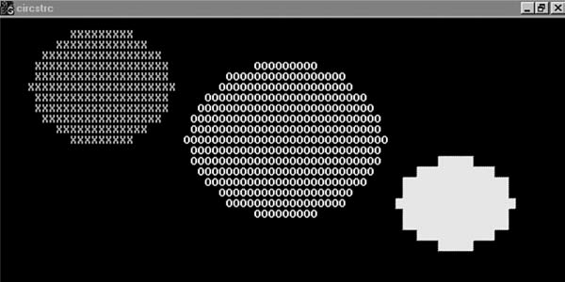
Output

Slide 30
Returning Values from Function
A function can return a single value to the calling program after its execution.
Usually this return value consists of an answer to the problem the function has solved.
Lets see a function whose job is to convert the pounds into kilograms and return the weight in kg.
  // convert.cpp
  // demonstrates return values, converts pounds to kg
  #include <iostream>
  using namespace std;
  float lbstokg(float); //declaration

Slide 31
Main Body & Function
int main()
{ float lbs, kgs;
cout << “\nEnter your weight in pounds: “;
cin >> lbs;
kgs = lbstokg(lbs);
cout << “Your weight in kilograms is “ << kgs << endl;
return 0; }
// lbstokg()
// converts pounds to kilograms
float lbstokg(float pounds)
{ float kilograms = 0.453592 * pounds;
return kilograms;
}

Slide 32
Returning Values..
Here’s some interaction with this program:
  Enter your weight in pounds: 182
  Your weight in kilograms is 82.553741
When a function returns a value, the data type of this value must be specified by the function.
In this function declaration does this by placing the data type, float before the function name in the declaration and the definition.
If we want more than one values in return ?????
  * Structures

Slide 33
Reference Arguments
A reference provides an alias a different name for a variable.
Passing arguments by reference uses a mechanism that Instead of a value being passed to the function, a reference to the original variable, in the calling program, is passed.
// ref.cpp
// demonstrates passing by reference
#include <iostream>
using namespace std;

Slide 34
Reference Arguments..
int main()
{
void intfrac(float, float&, float&); //declaration
float number, intpart, fracpart; //float variables
do {
cout << “\nEnter a real number: “; //number from user
cin >> number;
Intfrac(number, intpart, fracpart); //find int and frac
cout << “Integer part is “ << intpart //print them
<< “, fraction part is “ << fracpart << endl;
} while( number != 0.0 ); //exit loop on 0.0
return 0;
}

Slide 35
Reference Arguments..
// intfrac() finds integer and fractional parts of real number
void intfrac(float n, float& intp, float& fracp)
{
long temp = static_cast<long>(n); //convert to long,
intp = static_cast<float>(temp); //back to float
fracp = n - intp; //subtract integer part
}
Reference arguments are indicated by the ampersand (&) following the data type float& intp
The & indicates that intp is an alias, another name, for whatever variable is passed as an argument.

Slide 36
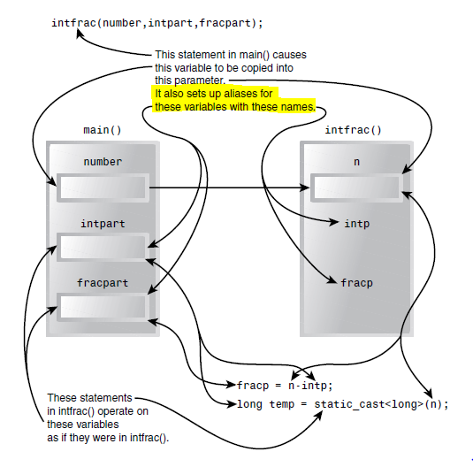
Reference Arguments…

Slide 37
Const Function Arguments
Arguments passing by reference can be used to allow a function to modify a variable in the calling program.
Main reason why passing by reference used is efficiency, but you don’t want the function to modify it.
Here const modifier is used with the variable in the function declaration, to guarantee such thing.
void aFunc(int& a, const int& b); //declaration
{
a = 107; // its OK
b = 111; //error: can’t modify constant argument
}

Slide 38
Function Overloading
Function overloading allows to use the same function name for defining several functions as long as they each have different parameter lists.
When the function is called, the compiler chooses the correct version for the job based on the list of arguments you supply.
The compiler must always be able to decide unequivocally which function should be selected in any particular instance of a function call, so the parameter list for each function in a set of overloaded functions must be unique.

Slide 39
Function Overloading..
// overload.cpp demonstrates function overloading
#include <iostream>
using namespace std;
void repchar(); //declarations
void repchar(char);
void repchar(char, int);
int main() {
repchar(); // Call with no arguments
repchar(‘=’); // Call with a single argument
repchar(‘+’, 30); // Call with 2 Arguments
return 0; }

Slide 40
Function Overloading…
// repchar() // displays 45 asterisks
void repchar()
{ for(int j=0; j<45; j++) // always loops 45 times
cout << ‘*’; // always prints asterisk
cout << endl; }
// displays 45 copies of specified character
void repchar(char ch)
{ for(int j=0; j<45; j++) // always loops 45 times
cout << ch; // prints specified character
cout << endl ; }

Slide 41
Function Overloading…
// displays specified number of copies of specified character
void repchar(char ch, int n)
}
for(int j=0; j<n; j++) // loops n times
cout << ch; // prints specified character
cout << endl;
}
This program prints out three lines of characters. Here’s the output:
  *********************************************
=============================================
++++++++++++++++++++++++++++++
The first two lines are 45 characters long, and the third is 30.

Slide 42
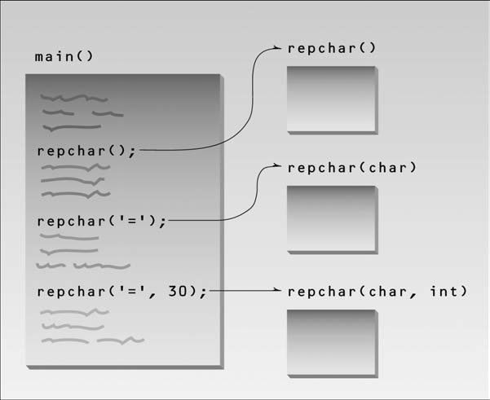
Function Overloading…

Slide 43
Recursion
Recursion involves a function calling itself.
This phenomena is much easier to understand with an example without going into the verbose..
Now we will calculate a Factorial using recursion.
#include <iostream>
using namespace std;
unsigned long factfunc(unsigned long); //declaration

Slide 44
Recursion..
int main()
{
int n; //number entered by user
unsigned long fact; //factorial
cout << “Enter an integer: “;
cin >> n;
fact = factfunc(n);
cout << “Factorial of “ << n << “ is “ << fact << endl;
return 0;
}

Slide 45
Recursion...
// factfunc() calls itself to calculate factorials
unsigned long factfunc(unsigned long n)
{
if(n > 1)
return n * factfunc(n-1); //self call
else
return 1;
}

Slide 46
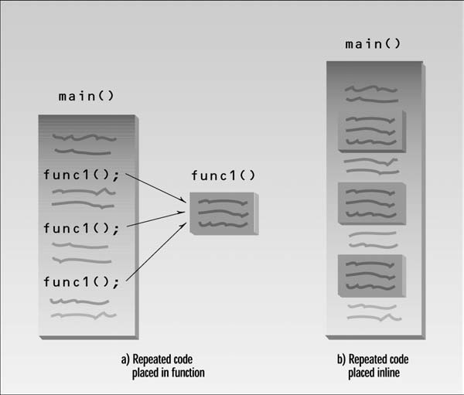
Inline Functions

Slide 47
Inline Functions..
Functions that are very short, say one or two statements, are candidates to be inlined.
#include <iostream>
using namespace std;
// lbstokg() converts pounds to kilograms
inline float lbstokg(float pounds) {
return 0.453592 * pounds; }
int main() {
float lbs;
cout << “\nEnter your weight in pounds: “;
cin >> lbs;
cout << “Your weight in kilograms is “ << lbstokg(lbs) ;
return 0; }

Slide 48
Default Arguments
Surprisingly, a function can be called without specifying all its arguments.
This won’t work on just any function, The function declaration must provide default values for those arguments that are not specified.
#include <iostream>
using namespace std;
void repchar(char=’*’, int=45); //declaration with default arguments
int main() {
repchar(); //prints 45 asterisks
repchar(‘=’); //prints 45 equal signs
repchar(‘+’, 30); //prints 30 plus signs
return 0; }

Slide 49
Default Arguments..
// repchar()
// displays line of characters
void repchar(char ch, int n) //defaults supplied if necessary
{
for(int j=0; j<n; j++) //loops n times
cout << ch; //prints ch
cout << endl;
}

Slide 50
Thank You

